Slide 1
Malaria
You know you want it!

Slide 2
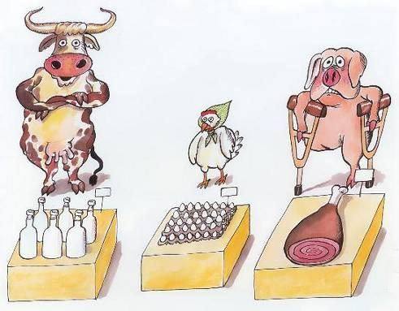
Natural Resources

Slide 3
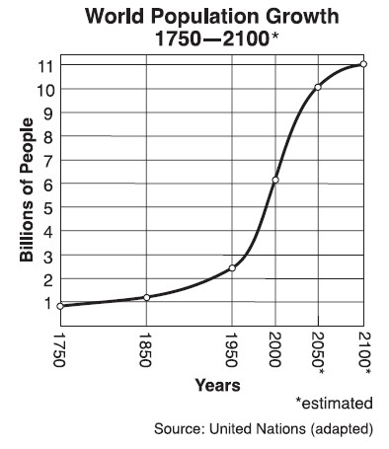
Market and Growth

Slide 4
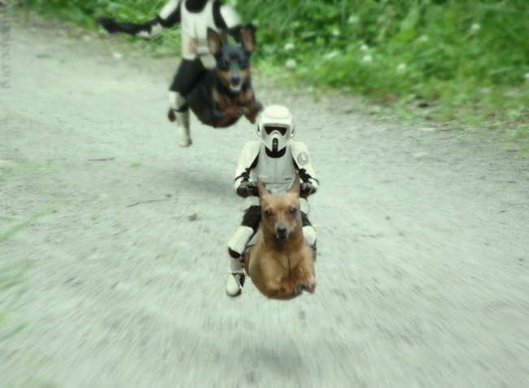
Affordable

Slide 5
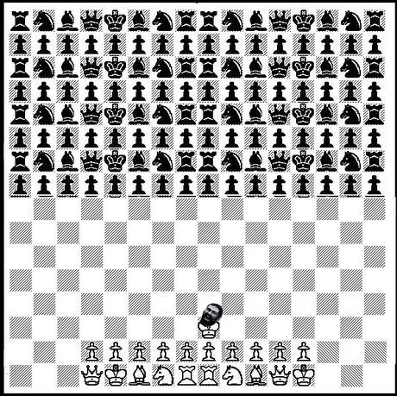
Committed User Base
This is SPARTA !!!

Slide 6
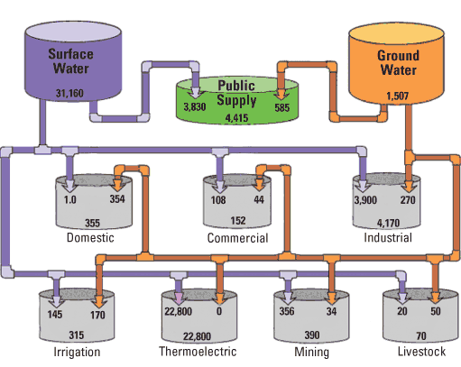
Viral Distribution

Slide 7
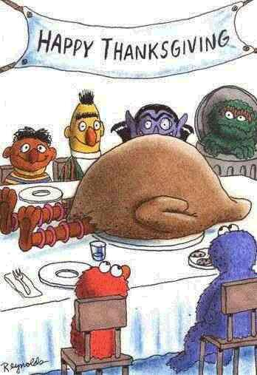
Success Track Record

Slide 8
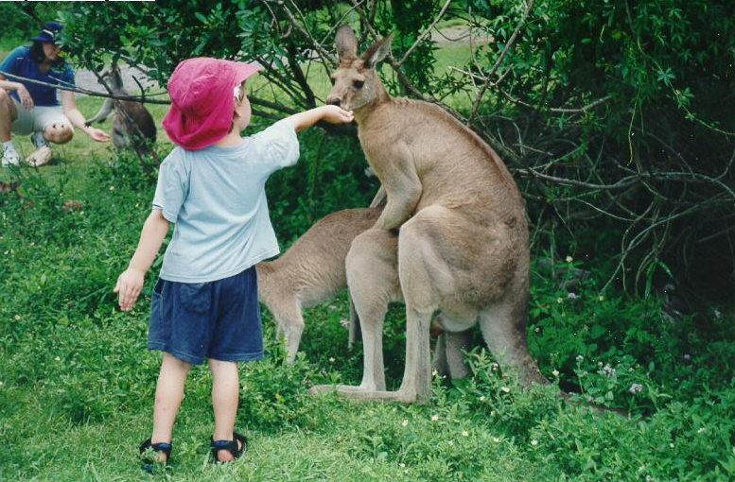
Worldwide Interest

Slide 9
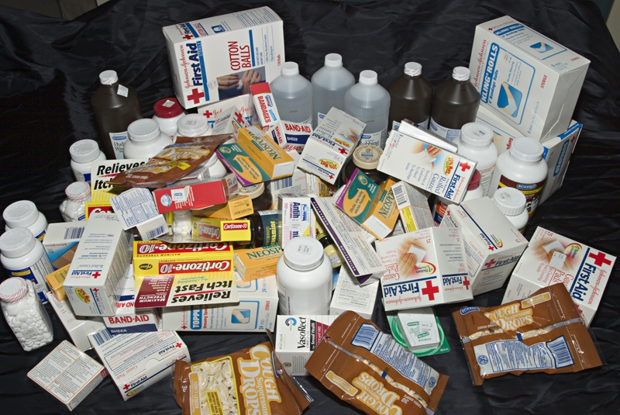
Merchandizing

Slide 10
Business Model
once you have the users,
someone will find a
way to monetize them (Yossi Vardi)

Slide 11
Malaria
Get it TODAY!
Created by nimrod@lehavi.com

