Slide 1
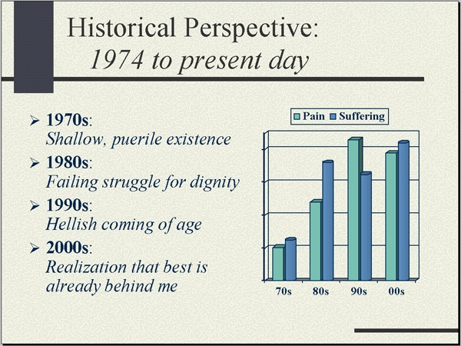
Graphic: TheOnion.com

Slide 2
Implementation Plan

Slide 3
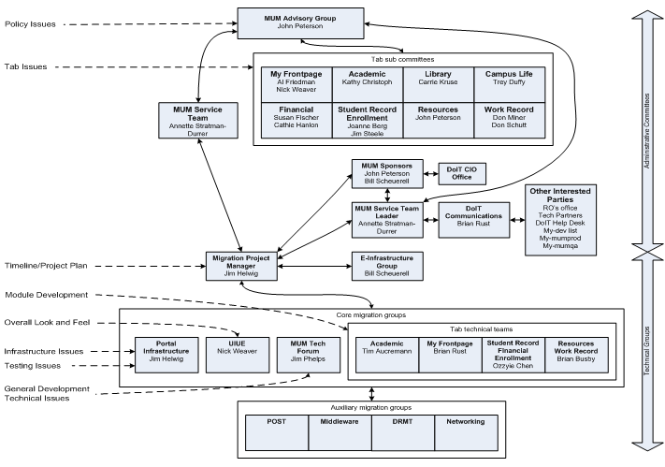

Slide 4
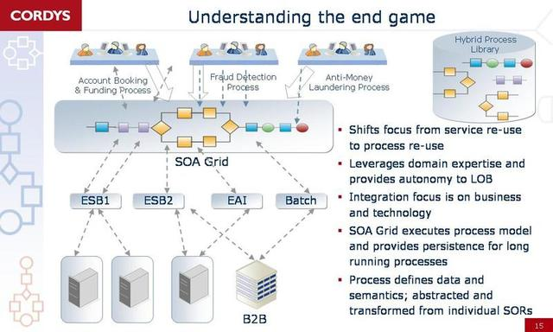
Source: blogs.fd.nl

Slide 5
Synergy Architecture
Source: www.cs.ucsb.edu/~rich

Slide 6
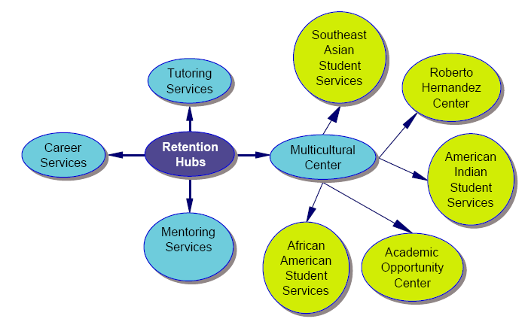
Access to Success: Hubs
Source: www.wisconsin.edu

Slide 7
Drivers of Synergy
INITIAL FACTORS INTERNAL FACTORS
Method of Payment
Operations
Strategic Relatedness
System Integration
Control and Culture
Contested vs. Uncontested
Acquisition Premium
SYNERGY
Strategy
Relative Size
Managerial Risk Taking
Time
Source: nb.vse.cz/~pichanic

