Slide 1
Quite Possibly The World’s Worst PowerPoint Presentation Ever
A Demonstration of What NOT to do When Creating and Using PowerPoint Slide Shows

Slide 2
Chilean Exports
Fresh fruit leads Chile's export mix - Chile emerges as major supplier of fresh fruit to world market due to ample natural resources, consumer demand for fresh fruit during winter season in U.S. and Europe, and incentives in agricultural policies of Chilean government, encouraging trend toward diversification of exports and development of nontraditional crops - U.S. Dept. of Agriculture, Economic Research Service Report
Chile is among the developing economies taking advantage of these trends, pursuing a free market economy. This has allowed for diversification through the expansion of fruit production for export, especially to the U.S. and Western Europe. Chile has successfully diversified its agricultural sector to the extent that it is now a major fruit exporting nation. Many countries view Chile's diversification of agriculture as a model to be followed.
Meanwhile, the U.S. remains the largest single market for Chile's fruit exports. However, increasing demand from the EC and Central and East European countries combined may eventually surpass exports to the U.S., spurring further growth in Chile's exports.
If you’ve read this far, your eyes probably hurt and you’ve been reading this tedious long-winded text instead of listening to me. I’m insulted- can’t you see I’m doing a presentation up here? Look at me! Congratulations, however, on having such good eyesight.

Slide 3
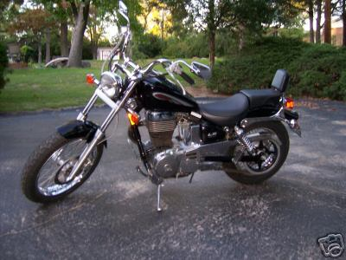
Beginner Motorcycles
My personal favorite: the Suzuki Savage
Light weight (~380lbs)
Adequate power (650cc engine)
Low seat height fits most riders

Slide 4




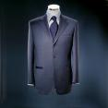

Buying a New Suit

Slide 5
Racquetball Fundamentals
2, 3, or 4 players.
1 player serves, other “returns.”
Only serving player can score.
Served ball must land past serving line and cannot hit back wall.
Ball can only bounce once before striking front wall…but ball does not have to bounce.

Slide 6
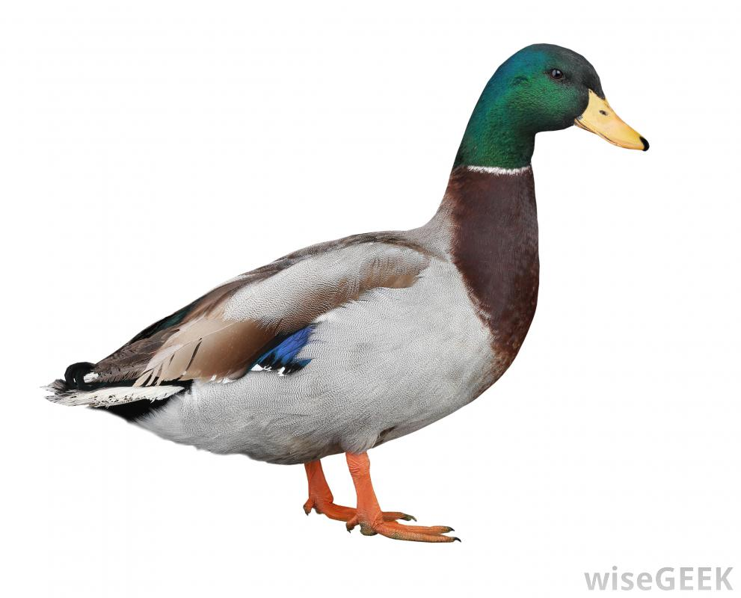
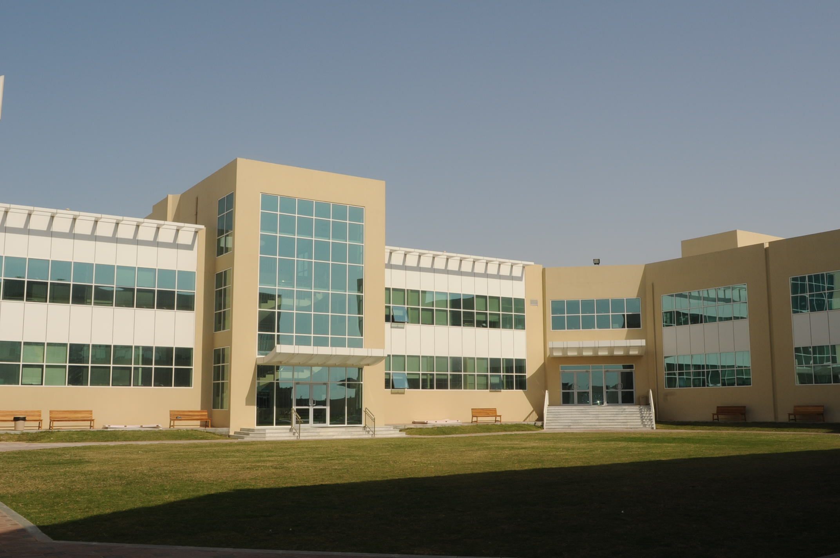
our school
our school is made up of one building there is a pond with ducks on and some fish at our school we teach maths science english art technology and pe we have lots of teachers who are really nice

