Slide 1
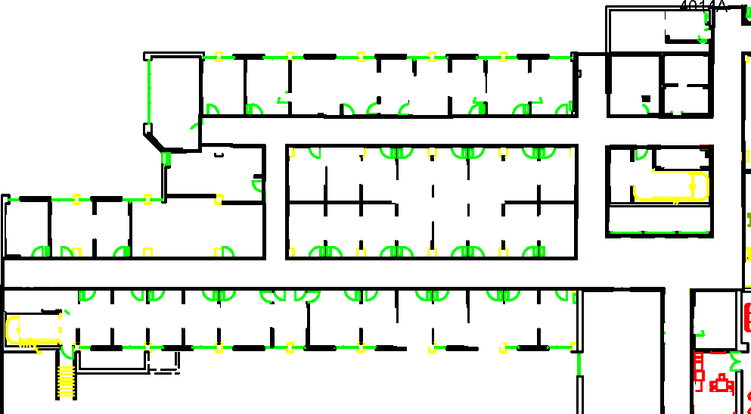
Start
Goal

Slide 2
12
7
8
9
10
11
1
2
3
4
5
6
Start
Goal

Slide 3
Sparse Obstacles
Start
Goal
Dense Obstacles

Slide 4
12
= Sparse Obstacles
7
8
9
10
11
= Dense Obstacles
1
2
3
4
5
6
Start
Goal

Slide 5

Semi-
Private
Start
Rooms
Private Offices
Goal

Slide 6
12
Not Intrusive
(Penalty = 0)
7
8
9
10
11
Somewhat Intrusive
(Penalty = 1)
Very Intrusive
(Penalty = 3)
1
2
3
4
5
6
Start
Goal

Slide 7
Sparse Obstacles
Semi-
Private
Start
Rooms
Private Offices
Goal
Dense Obstacles
Notes:
For paper uses

Slide 8
Sparse Obstacles
Start
Semi-
Private
Private Offices
Goal
Rooms
Dense Obstacles
Notes:
For paper uses

Slide 10
12
7
8
9
10
11
1
2
3
4
5
6
Start
Goal

Slide 12
12
7
8
9
10
11
1
2
3
4
5
6
Start
Goal

