Slide 1
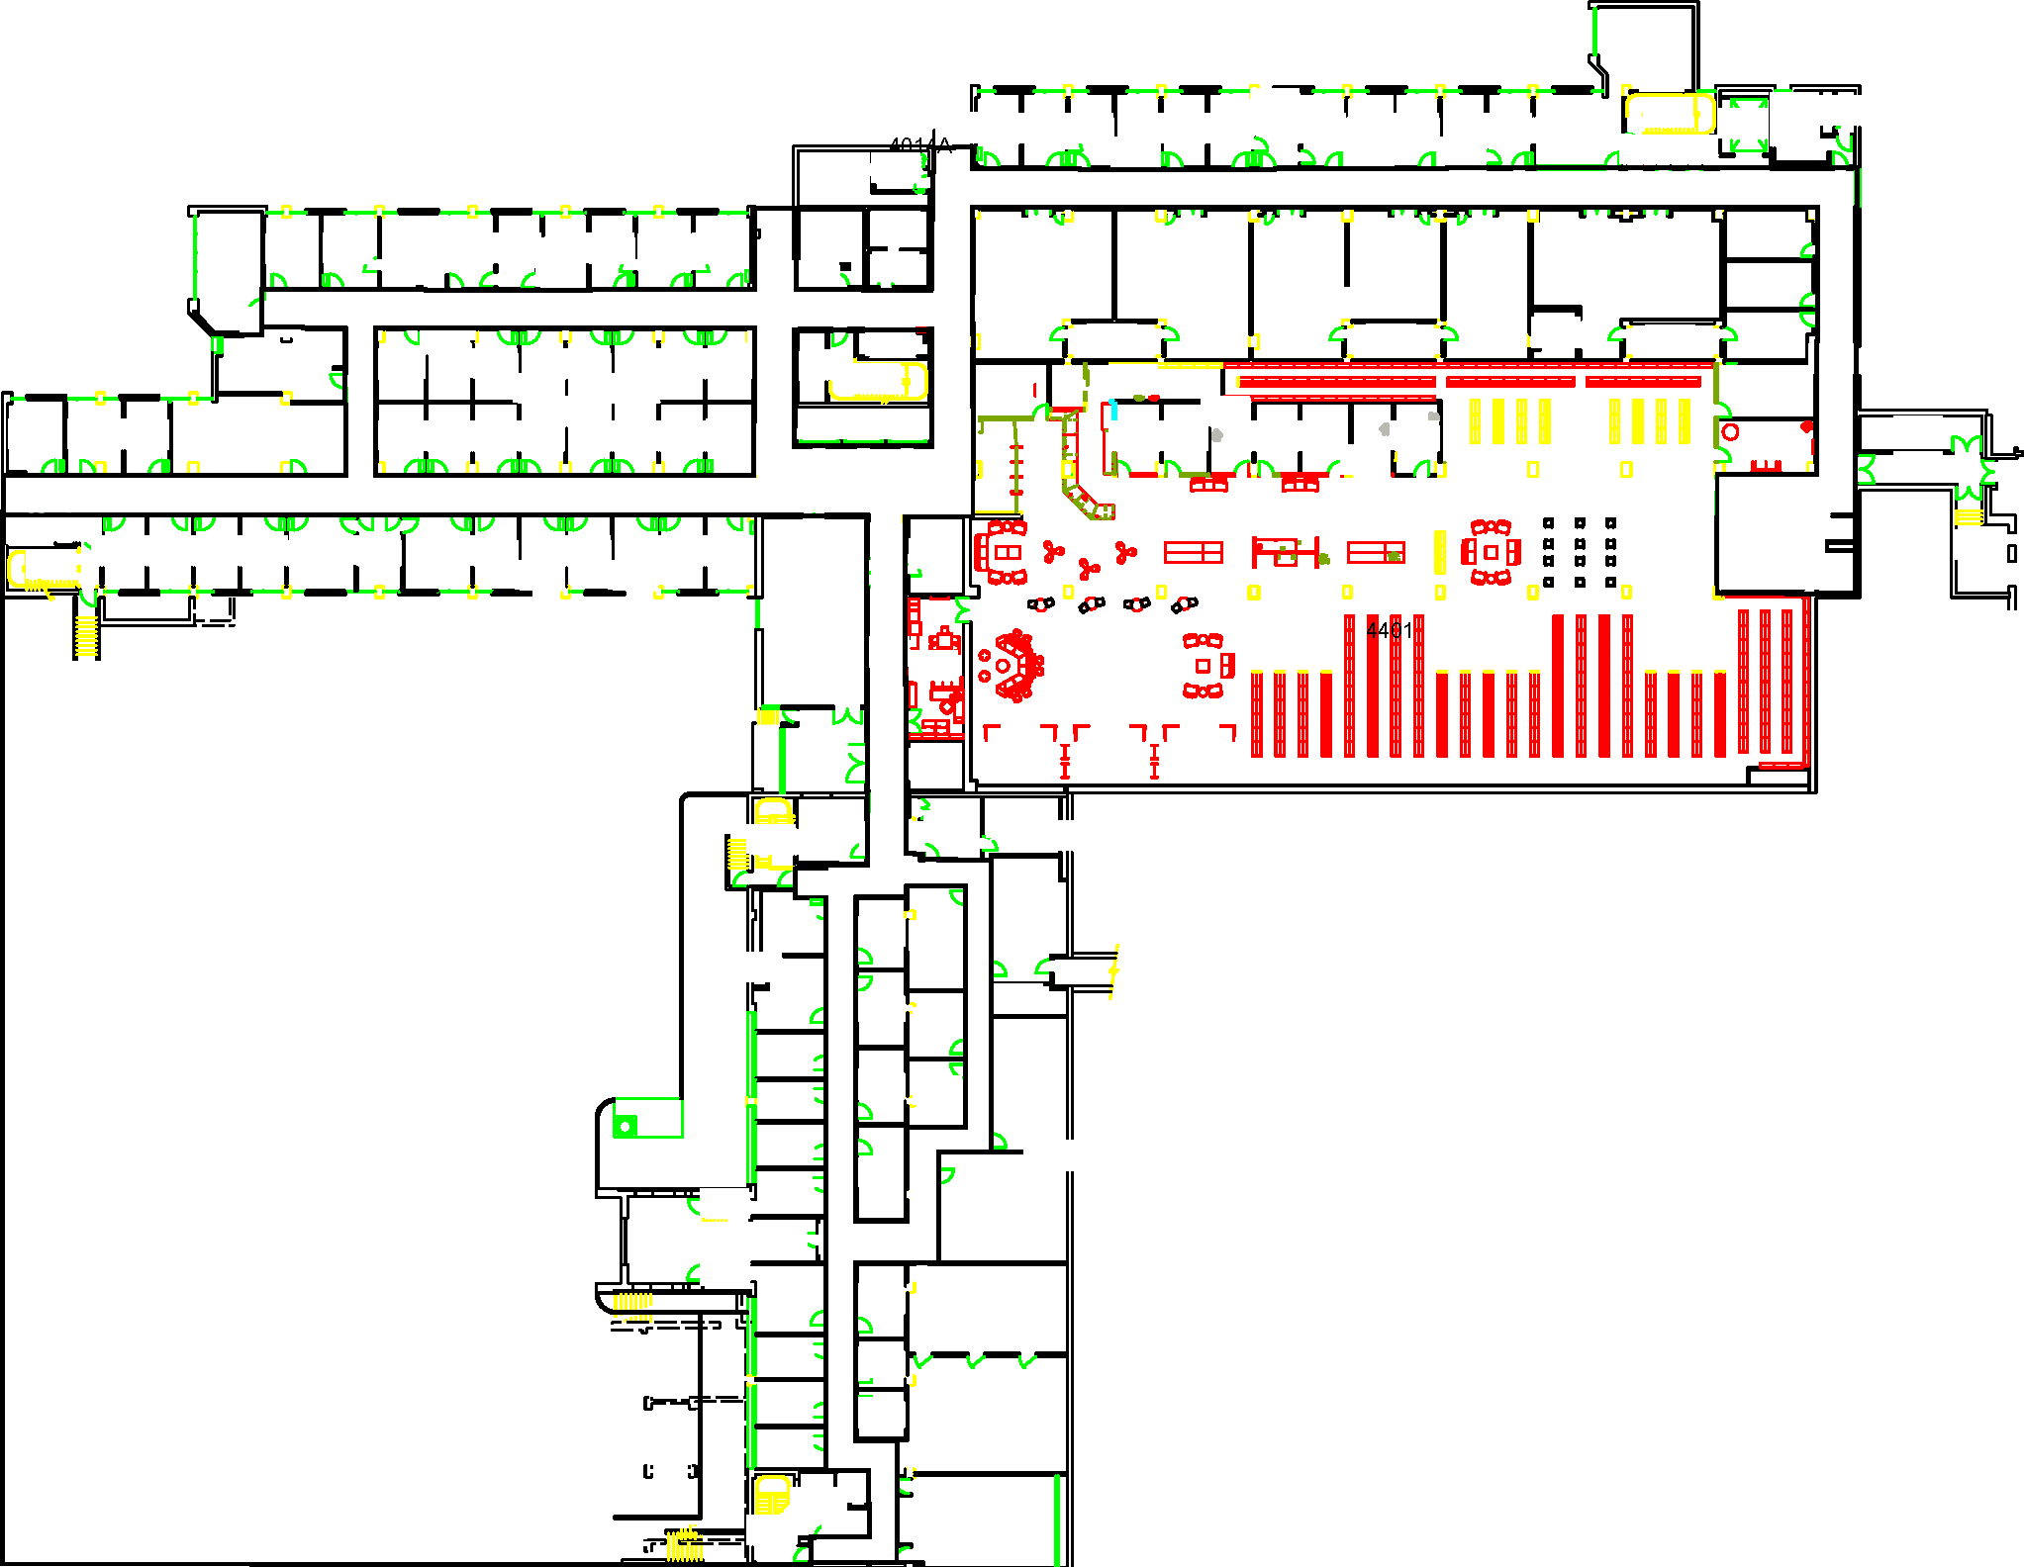

Slide 3
12
7
8
9
10
11
1
2
3
4
5
6

Slide 4
12
7
8
9
10
11
1
2
3
4
5
6

Slide 5
Map & Waypoints

Slide 6
Start
Goal
Notes:
Goal: “Reddish purple”; RGB = (204, 121, 167); Hex = #cc79a7

Slide 7
12
7
8
9
10
11
1
2
3
4
5
6
Start
Goal

Slide 8
Collision

Slide 9
Sparse Obstacles
Start
Goal
Dense Obstacles

Slide 10
12
= Sparse Obstacles
7
8
9
10
11
= Dense Obstacles
1
2
3
4
5
6
Start
Goal
Notes:
“darkgoldenrod3”; rgb(205, 149, 12)
“darkgoldenrod4”; rgb(139, 101, 8)

Slide 11
 | Full Speed (0.7 meters/second) | Half Speed (0.35 meters/second)
No Obstacle
Sparse Obstacles
Dense Obstacles
No collision
(Expected collision = 0.0)
No collision
(Expected collision = 0.0)
0.7 m/s
0.35 m/s
Probability of collision = 20%
(Expected collision = 0.2)
No collision at low speed
(Expected collision = 0.0)
0.7 m/s
0.35 m/s
Probability of collision = 40%
(Expected collision = 0.4)
No collision at low speed
(Expected collision = 0.0)
0.7 m/s
0.35 m/s
Notes:
Full speed -> ”Blue”; RGB = (0, 0, 255); Hex = #0000ff
Half speed -> “Sky blue”; RBG = (135, 206, 235); Hex = #87ceeb

Slide 12
Intrusiveness

Slide 13

Semi-
Private
Start
Rooms
Private Offices
Goal

Slide 14
12
Not Intrusive
(Penalty = 0)
7
8
9
10
11
Somewhat Intrusive
(Penalty = 1)
Very Intrusive
(Penalty = 3)
1
2
3
4
5
6
Start
Goal
Notes:
”Green”; rgb=(0,255,0); hex=#00FF00
“Yellow”; rgb=(255,255,0); hex=#FFFF00
“Red”; rgb=(255,0,0); hex=#FF0000

Slide 15
Sparse Obstacles
Semi-
Private
Start
Rooms
Private Offices
Goal
Dense Obstacles
Notes:
For paper uses

Slide 16
Sparse Obstacles
Start
Semi-
Private
Private Offices
Goal
Rooms
Dense Obstacles
Notes:
For paper uses

Slide 17
Navigation Plans

Slide 19
12
7
8
9
10
11
1
2
3
4
5
6
Start
Goal

Slide 21
12
7
8
9
10
11
1
2
3
4
5
6
Start
Goal

