Slide 1
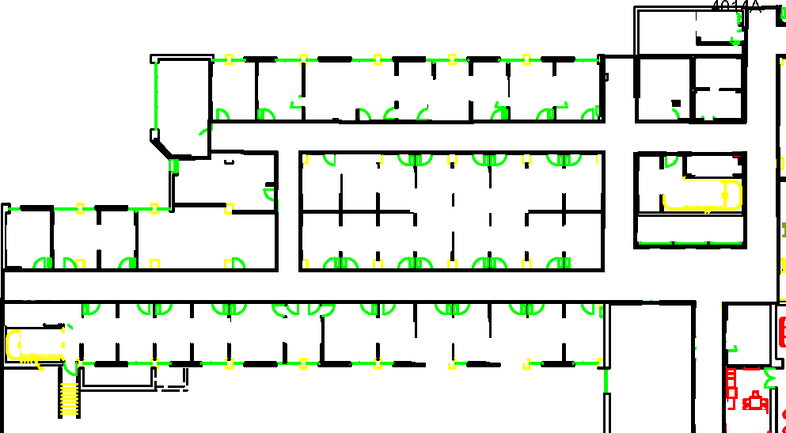
Goal
Start

Slide 2
11
6
7
8
9
10
1
2
3
4
5
Start
Goal

Slide 3
Sparse Obstacle
Goal
Start
Dense Obstacle

Slide 4
11
SO
SO = Sparse Obstacle
6
7
8
9
10
DO
DO = Dense Obstacle
1
2
3
4
5

Slide 5
Semi-Private Zone
Public Zone
Public Zone
Goal
Start
Private Zone

Slide 6
11
Not Intrusive
(Penalty = 0)
6
7
8
9
10
Somewhat Intrusive
(Penalty = 1)
Very Intrusive
(Penalty = 3)
1
2
3
4
5

Slide 7
Goal
Start

Slide 8
11
SO
6
7
8
9
10
DO
1
2
3
4
5
Start
Goal

Slide 9
Goal
Start

Slide 10
11
SO
6
7
8
9
10
DO
1
2
3
4
5
Start
Goal

Slide 11
Goal
Start

Slide 12
11
SO
6
7
8
9
10
DO
1
2
3
4
5
Start
Goal

