Slide 1
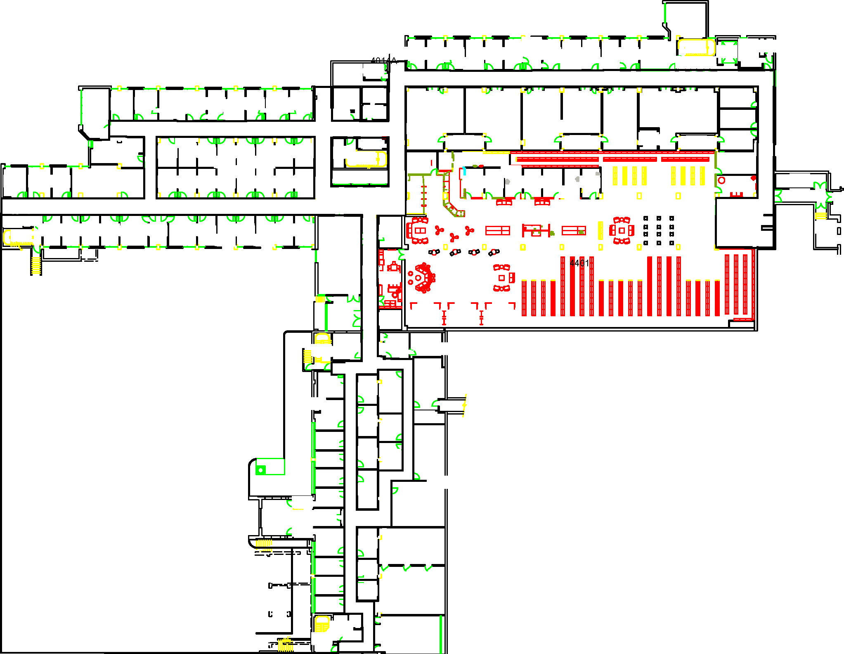

Slide 2
11
6
7
8
9
10
1
2
3
4
5

Slide 3
Map & Waypoints

Slide 4
Goal
Start

Slide 5
11
6
7
8
9
10
1
2
3
4
5
Start
Goal

Slide 6
Collision

Slide 7
Sparse Obstacle
Goal
Start
Dense Obstacle

Slide 8
11
SO
SO = Sparse Obstacle
6
7
8
9
10
DO
DO = Dense Obstacle
1
2
3
4
5

Slide 9
 | Full Speed (0.7 meters/second) | Half Speed (0.35 meters/second)
No Obstacle
Sparse Obstacle
Dense Obstacle
No collision
(Expected collision = 0.0)
No collision
(Expected collision = 0.0)
0.7 m/s
0.35 m/s
Probability of collision = 20%
(Expected collision = 0.2)
No collision at low speed
(Expected collision = 0.0)
0.7 m/s
0.35 m/s
Probability of collision = 40%
(Expected collision = 0.4)
No collision at low speed
(Expected collision = 0.0)
0.7 m/s
0.35 m/s

Slide 10
Intrusiveness

Slide 11
Semi-Private Zone
Public Zone
Public Zone
Goal
Start
Private Zone

Slide 12
11
Not Intrusive
(Penalty = 0)
6
7
8
9
10
Somewhat Intrusive
(Penalty = 1)
Very Intrusive
(Penalty = 3)
1
2
3
4
5

Slide 13
Navigation Problem

Slide 14
Goal
Start

Slide 15
11
SO
6
7
8
9
10
DO
1
2
3
4
5
Start
Goal

Slide 16
Navigation Plans

Slide 17
Goal
Start

Slide 18
11
SO
6
7
8
9
10
DO
1
2
3
4
5
Start
Goal

Slide 19
Goal
Start

Slide 20
11
SO
6
7
8
9
10
DO
1
2
3
4
5
Start
Goal

