Slide 1
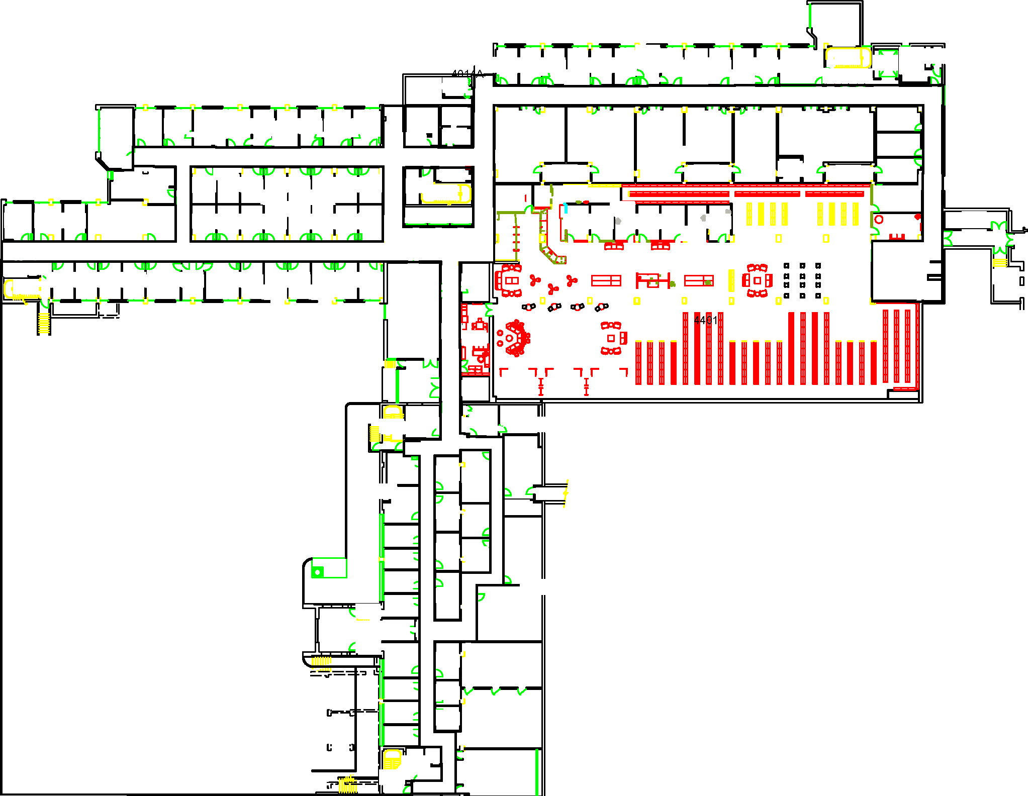

Slide 3
12
7
8
9
10
11
1
2
3
4
5
6

Slide 4
12
7
8
9
10
11
1
2
3
4
5
6

Slide 5
Map & Waypoints

Slide 6
Start
Goal
Notes:
Goal: “Reddish purple”; RGB = (204, 121, 167); Hex = #cc79a7

Slide 7
12
7
8
9
10
11
1
2
3
4
5
6
Start
Goal

Slide 8
Collision

Slide 9
Sparse Obstacle
Start
Goal
Dense Obstacle

Slide 10
12
SO
SO = Sparse Obstacle
7
8
9
10
11
DO
DO = Dense Obstacle
1
2
3
4
5
6
Start
Goal

Slide 11
 | Full Speed (0.7 meters/second) | Half Speed (0.35 meters/second)
No Obstacle
Sparse Obstacle
Dense Obstacle
No collision
(Expected collision = 0.0)
No collision
(Expected collision = 0.0)
0.7 m/s
0.35 m/s
SO
SO
Probability of collision = 20%
(Expected collision = 0.2)
No collision at low speed
(Expected collision = 0.0)
0.7 m/s
0.35 m/s
DO
DO
Probability of collision = 40%
(Expected collision = 0.4)
No collision at low speed
(Expected collision = 0.0)
0.7 m/s
0.35 m/s
Notes:
Color-blind friendly palette: http://mkweb.bcgsc.ca/colorblind/img/colorblindness.palettes.trivial.png
Full speed -> ”Blue”; RGB = (0, 114, 178); Hex = #0072b2
Half speed -> “Sky blue”; RBG = (86, 180, 233); Hex = #56b4e9

Slide 12
Intrusiveness

Slide 13

Semi-
Private
Start
Rooms
Private Offices
Goal
Notes:
Private area: “Vermillion”; RGB = (213, 94, 0); Hex = #d55e00
Semi-private area: “Yellow”; RGB = (240, 228, 66); Hex = #f0e442
Public area: “Bluish green”; RGB = (0, 158, 115); Hex = #009e73

Slide 14
12
Not Intrusive
(Penalty = 0)
SO
7
8
9
10
11
Somewhat Intrusive
(Penalty = 1)
DO
Very Intrusive
(Penalty = 3)
1
2
3
4
5
6
Start
Goal
Notes:
Private area: “Vermillion”; RGB = (213, 94, 0); Hex = #d55e00
Semi-private area: “Yellow”; RGB = (240, 228, 66); Hex = #f0e442
Public area: “Bluish green”; RGB = (0, 158, 115); Hex = #009e73

Slide 15
Navigation Plans

Slide 16
Notes:
Full speed -> ”Blue”; RGB = (0, 114, 178); Hex = #0072b2
Half speed -> “Sky blue”; RBG = (86, 180, 233); Hex = #56b4e9

Slide 17
12
SO
7
8
9
10
11
DO
1
2
3
4
5
6
Start
Goal
Notes:
Full speed -> ”Blue”; RGB = (0, 114, 178); Hex = #0072b2
Half speed -> “Sky blue”; RBG = (86, 180, 233); Hex = #56b4e9
Private area: “Vermillion”; RGB = (213, 94, 0); Hex = #d55e00
Semi-private area: “Yellow”; RGB = (240, 228, 66); Hex = #f0e442
Public area: “Bluish green”; RGB = (0, 158, 115); Hex = #009e73

Slide 19
12
SO
7
8
9
10
11
DO
1
2
3
4
5
6
Start
Goal
Notes:
Full speed -> ”Blue”; RGB = (0, 114, 178); Hex = #0072b2
Half speed -> “Sky blue”; RBG = (86, 180, 233); Hex = #56b4e9
Private area: “Vermillion”; RGB = (213, 94, 0); Hex = #d55e00
Semi-private area: “Yellow”; RGB = (240, 228, 66); Hex = #f0e442
Public area: “Bluish green”; RGB = (0, 158, 115); Hex = #009e73

