Slide 1
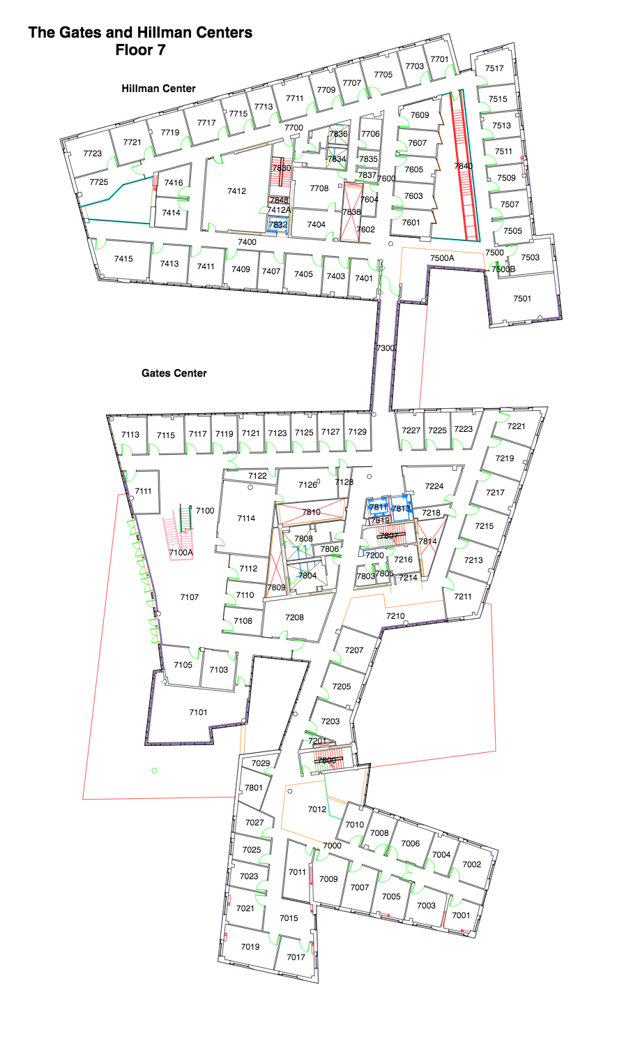
Image

Slide 2
4
5
Image + map topology (original)
3
1
2
10
9
6
7
8
11
12
13
14
15
16
17
18
22
19
21
20
26
25
23
24
27
28
29
31
32
30

Slide 3
4
5
Image + map topology (augmented)
3
1
2
10
9
6
7
8
11
12
X1
X2
13
X3
14
15
16
17
18
22
19
21
20
26
25
23
24
27
28
X5
X4
29
31
32
30

Slide 4
Image on grid

Slide 5
Grid -- grouped

Slide 6
Grid -- ungrouped

Slide 7
Horizontal -- ungrouped

Slide 8
Vertical -- ungrouped

