Slide 1
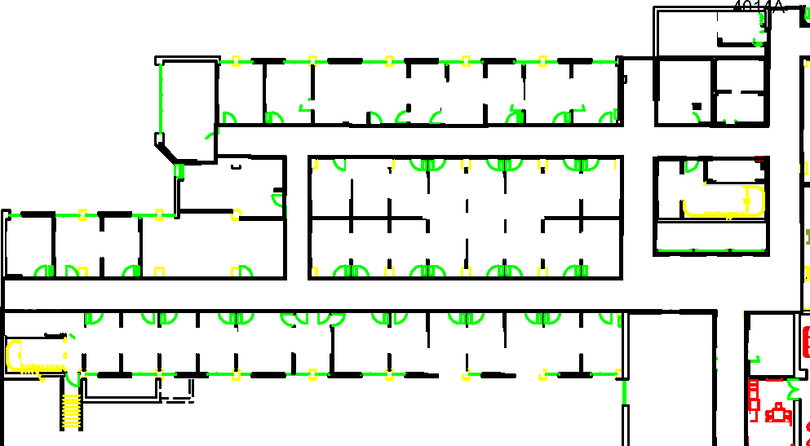
Start
Goal

Slide 2
12
7
8
9
10
11
1
2
3
4
5
6
Start
Goal

Slide 3
Sparse Obstacle
Start
Goal
Dense Obstacle

Slide 4
12
SO
SO = Sparse Obstacle
7
8
9
10
11
DO
DO = Dense Obstacle
1
2
3
4
5
6
Start
Goal

Slide 5

Semi-
Private
Start
Rooms
Private Offices
Goal

Slide 6
12
Not Intrusive
(Penalty = 0)
SO
7
8
9
10
11
Somewhat Intrusive
(Penalty = 1)
Very Intrusive
(Penalty = 3)
DO
1
2
3
4
5
6
Start
Goal

Slide 8
12
SO
7
8
9
10
11
DO
1
2
3
4
5
6
Start
Goal

Slide 10
12
SO
7
8
9
10
11
DO
1
2
3
4
5
6
Start
Goal

