Slide 1
Transformers
With slides from LP Morency and Paul Liang

Slide 2
Contextualized
Sequence Representations

Slide 3




















Sequence Encoding - Contextualization
Option 1: Bi-directional LSTM:
(e.g., ELMO)
$$h_{1}$$
$$h_{2}$$
$$h_{3}$$
$$h_{4}$$
$$h_{5}$$
$$h_{1}$$
$$h_{2}$$
$$h_{3}$$
$$h_{4}$$
$$h_{5}$$
Contextualized
Sequence Encoding
$$x_{1}$$
$$x_{2}$$
$$x_{3}$$
$$x_{4}$$
$$x_{5}$$
$$x_{1}$$
$$x_{2}$$
$$x_{3}$$
$$x_{4}$$
$$x_{5}$$
I
do
not
like
it
I
do
not
like
it
How to encode this sequence while modeling the interaction between elements (e.g., words)?
Sequential Computation
But harder to parallelize…
Notes:
Recall contextualized representations. How do we get these? One way: LSTMs
Xs: already word vector representations, for now. You could get them from scratch. But for understanding, we’ll start with w2v and enrich with context.

Slide 4




















Sequence Encoding - Contextualization
Option 2: Convolutions
$$h_{1}$$
$$h_{2}$$
$$h_{3}$$
$$h_{4}$$
$$h_{5}$$
$$h_{1}$$
$$h_{2}$$
$$h_{3}$$
$$h_{4}$$
$$h_{5}$$
Contextualized
Sequence Encoding
Sequential Computation
$$x_{1}$$
$$x_{2}$$
$$x_{3}$$
$$x_{4}$$
$$x_{5}$$
$$x_{1}$$
$$x_{2}$$
$$x_{3}$$
$$x_{4}$$
$$x_{5}$$
I
do
not
like
it
I
do
not
like
it
Can be parallelized!
But modeling long-range dependencies requires multiple layers.
And convolutional kernels are static.
Notes:
Convolutions get rid of the temporal bottleneck.

Slide 5
Sequence Encoding - Contextualization
Option 3: Self-attention
$$h_{1}$$
$$h_{2}$$
$$h_{3}$$
$$h_{4}$$
$$h_{5}$$
$$h_{1}$$
$$h_{2}$$
$$h_{3}$$
$$h_{4}$$
$$h_{5}$$
Contextualized
Sequence Encoding
Self-Attention
Sequential Computation
$$x_{1}$$
$$x_{2}$$
$$x_{3}$$
$$x_{4}$$
$$x_{5}$$
$$x_{1}$$
$$x_{2}$$
$$x_{3}$$
$$x_{4}$$
$$x_{5}$$
I
do
not
like
it
I
do
not
like
it
Can be parallelized!
Long-range dependencies
Dynamic attention weights
Notes:
Self attention – kind of a dynamic fusion. Like gates, weights depend on the inputs.

Slide 6
Self-Attention

Slide 7




















Self-Attention
$$h_{1}$$
$$h_{2}$$
$$h_{3}$$
$$h_{4}$$
$$h_{5}$$
Σ
$$α_{1,1}$$
$${x′}_{1}$$
$$α_{1,2}$$
$${x′}_{2}$$
$$α_{1,3}$$
$${x′}_{3}$$
$$α_{1,4}$$
$${x′}_{4}$$
$$α_{1,5}$$
$${x′}_{5}$$
Self-attention Module
$$x_{1}$$
$$x_{2}$$
$$x_{3}$$
$$x_{4}$$
$$x_{5}$$
I
do
not
like
it
Notes:
Two modes this could be used in: total transformation, or residuals. Residuals work better. We’ll see the details later.
Parallel computation for each word. Attention value: how much should each other word affect this.
This is effectively a bag-of-words representation, at each position. We’ll see later how this causes issues.

Slide 8





Self-Attention
$$h_{1}$$
$$h_{2}$$
$$h_{3}$$
$$h_{4}$$
$$h_{5}$$
Σ
$$α_{2,1}$$
$$α_{2,2}$$
$$α_{2,3}$$
$$α_{2,4}$$
$$α_{2,5}$$
$$α_{1,1}$$
$${x′}_{1}$$
$$α_{1,2}$$
$${x′}_{2}$$
$$α_{1,3}$$
$${x′}_{3}$$
$$α_{1,4}$$
$${x′}_{4}$$
$$α_{1,5}$$
$${x′}_{5}$$
Self-attention Module
$$x_{1}$$
$$x_{2}$$
$$x_{3}$$
$$x_{4}$$
$$x_{5}$$
I
do
not
like
it
Notes:
Two modes this could be used in: total transformation, or residuals. Residuals work better. We’ll see the details later.
Parallel computation for each word. Attention value: how much should each other word affect this.
This is effectively a bag-of-words representation, at each position. We’ll see later how this causes issues.

Slide 9













































Transformer Self-Attention
$$h_{1}$$
$$h_{2}$$
$$h_{3}$$
$$h_{4}$$
$$h_{5}$$
Σ
Σ
Σ
Σ
Σ
…
…
…
…
…
$$α_{2,1}$$
$$α_{1,1}$$
$$α_{2,2}$$
$$α_{1,2}$$
$$α_{2,3}$$
$$α_{1,3}$$
$$α_{2,4}$$
$$α_{1,4}$$
$$α_{2,5}$$
$$α_{1,5}$$
$${x′}_{1}$$
$${x′}_{2}$$
$${x′}_{3}$$
$${x′}_{4}$$
$${x′}_{5}$$
Value
Key
$$q_{1}$$
$$k_{1}$$
$$q_{2}$$
$$k_{2}$$
$$q_{3}$$
$$k_{3}$$
$$q_{4}$$
$$k_{4}$$
$$q_{5}$$
$$k_{5}$$
Query
$$W_{q}$$
$$W_{k}$$
$$W_{v}$$
$$W_{q}$$
$$W_{k}$$
$$W_{v}$$
$$W_{q}$$
$$W_{k}$$
$$W_{v}$$
$$W_{q}$$
$$W_{k}$$
$$W_{v}$$
$$W_{q}$$
$$W_{k}$$
$$W_{v}$$
$$x_{1}$$
$$x_{2}$$
$$x_{3}$$
$$x_{4}$$
$$x_{5}$$
I
do
not
like
it
Notes:
X’ is a transformed version of X, pick out a subspace. Imagine this as being a subspace where we can combine meanings via summation. More flexible than just summing attended reps x.
Keys & queries: content-based addressing. If my query attends to the key at this position, transfer some of the value at this position over.
Parameters tied across positions.

Slide 10





Transformer Self-Attention
$$h_{1}$$
$$h_{2}$$
$$h_{3}$$
$$h_{4}$$
$$h_{5}$$
Scale dot-product attention weights
Σ
Σ
Σ
Σ
Σ
…
…
…
…
…
$$α_{2,1}$$
$$α_{1,1}$$
$$α_{2,2}$$
$$α_{1,2}$$
$$α_{2,3}$$
$$α_{1,3}$$
$$α_{2,4}$$
$$α_{1,4}$$
$$α_{2,5}$$
$$α_{1,5}$$
$${x′}_{1}$$
$${x′}_{2}$$
$${x′}_{3}$$
$${x′}_{4}$$
$${x′}_{5}$$
Value
Key
$$q_{1}$$
$$k_{1}$$
$$q_{2}$$
$$k_{2}$$
$$q_{3}$$
$$k_{3}$$
$$q_{4}$$
$$k_{4}$$
$$q_{5}$$
$$k_{5}$$
Query
$$W_{q}$$
$$W_{k}$$
$$W_{v}$$
$$W_{q}$$
$$W_{k}$$
$$W_{v}$$
$$W_{q}$$
$$W_{k}$$
$$W_{v}$$
$$W_{q}$$
$$W_{k}$$
$$W_{v}$$
$$W_{q}$$
$$W_{k}$$
$$W_{v}$$
$$x_{1}$$
$$x_{2}$$
$$x_{3}$$
$$x_{4}$$
$$x_{5}$$
I
do
not
like
it
Notes:
X’ is a transformed version of X, pick out a subspace. Imagine this as being a subspace where we can combine meanings via summation. More flexible than just summing attended reps x.
Keys & queries: content-based addressing. If my query attends to the key at this position, transfer some of the value at this position over.
Parameters tied across positions.

Slide 11










Transformer Self-Attention
$$h_{1}$$
$$h_{2}$$
$$h_{3}$$
$$h_{4}$$
$$h_{5}$$
Scale dot-product attention weights
Σ
Σ
Σ
Σ
Σ
…
…
…
…
…
$$α_{2,1}$$
$$α_{1,1}$$
$$α_{2,2}$$
$$α_{1,2}$$
$$α_{2,3}$$
$$α_{1,3}$$
$$α_{2,4}$$
$$α_{1,4}$$
$$α_{2,5}$$
$$α_{1,5}$$
$${x′}_{1}$$
$${x′}_{2}$$
$${x′}_{3}$$
$${x′}_{4}$$
$${x′}_{5}$$
Value
Key
$$q_{1}$$
$$k_{1}$$
$$q_{2}$$
$$k_{2}$$
$$q_{3}$$
$$k_{3}$$
$$q_{4}$$
$$k_{4}$$
$$q_{5}$$
$$k_{5}$$
Query
$$W_{q}$$
$$W_{k}$$
$$W_{k}$$
$$W_{q}$$
$$W_{k}$$
$$W_{k}$$
$$W_{q}$$
$$W_{k}$$
$$W_{k}$$
$$W_{q}$$
$$W_{k}$$
$$W_{k}$$
$$W_{q}$$
$$W_{k}$$
$$W_{k}$$
$$x_{1}$$
$$x_{2}$$
$$x_{3}$$
$$x_{4}$$
$$x_{5}$$
I
do
not
like
it
Notes:
X’ is a transformed version of X, pick out a subspace. Imagine this as being a subspace where we can combine meanings via summation. More flexible than just summing attended reps x.
Keys & queries: content-based addressing. If my query attends to the key at this position, transfer some of the value at this position over.
Parameters tied across positions.

Slide 12




















Transformer Self-Attention
$$h_{1}$$
$$h_{2}$$
$$h_{3}$$
$$h_{4}$$
$$h_{5}$$
Scale dot-product attention weights
Σ
Σ
Σ
Σ
Σ
…
…
…
…
…
$$α_{2,1}$$
$$α_{1,1}$$
$$α_{2,2}$$
$$α_{1,2}$$
$$α_{2,3}$$
$$α_{1,3}$$
$$α_{2,4}$$
$$α_{1,4}$$
$$α_{2,5}$$
$$α_{1,5}$$
$$v_{1}$$
$$v_{2}$$
$$v_{3}$$
$$v_{4}$$
$$v_{5}$$
Value
Key
$$q_{1}$$
$$k_{1}$$
$$q_{2}$$
$$k_{2}$$
$$q_{3}$$
$$k_{3}$$
$$q_{4}$$
$$k_{4}$$
$$q_{5}$$
$$k_{5}$$
Query
$$W_{q}$$
$$W_{k}$$
$$W_{v}$$
$$W_{q}$$
$$W_{k}$$
$$W_{v}$$
$$W_{q}$$
$$W_{k}$$
$$W_{v}$$
$$W_{q}$$
$$W_{k}$$
$$W_{v}$$
$$W_{q}$$
$$W_{k}$$
$$W_{v}$$
$$x_{1}$$
$$x_{2}$$
$$x_{3}$$
$$x_{4}$$
$$x_{5}$$
I
do
not
like
it
Notes:
X’ is a transformed version of X, pick out a subspace. Imagine this as being a subspace where we can combine meanings via summation. More flexible than just summing attended reps x.
Keys & queries: content-based addressing. If my query attends to the key at this position, transfer some of the value at this position over.
Parameters tied across positions.

Slide 13








Transformer Self-Attention
What if we want to attend simultaneously to multiple subspaces of $x$?
$$h_{1}$$
$$h_{2}$$
$$h_{3}$$
$$h_{4}$$
$$h_{5}$$
Transformer’s Self-Attention Layer
$$W_{q}$$
$$W_{k}$$
$$W_{v}$$
$$x_{1}$$
$$x_{2}$$
$$x_{3}$$
$$x_{4}$$
$$x_{5}$$
I
do
not
like
it
Notes:
Different types of meaning in different subspaces.

Slide 14























Transformer Multi-Head Self-Attention
$$h_{1}$$
$$h_{2}$$
$$h_{3}$$
$$h_{4}$$
$$h_{5}$$
Linear projection
$$h_{1}^{2}$$
$$h_{1}^{3}$$
$$h_{2}^{2}$$
$$h_{2}^{3}$$
$$h_{3}^{2}$$
$$h_{3}^{3}$$
$$h_{4}^{2}$$
$$h_{4}^{3}$$
$$h_{5}^{2}$$
$$h_{5}^{3}$$
$$h_{1}^{1}$$
$$h_{2}^{1}$$
$$h_{3}^{1}$$
$$h_{4}^{1}$$
$$h_{5}^{1}$$
Transformer’s Self-Attention Layer
Transformer’s Self-Attention Layer
Transformer’s Self-Attention Layer
$$W_{q}^{1}$$
$$W_{k}^{1}$$
$$W_{v}^{1}$$
$$x_{1}$$
$$x_{2}$$
$$x_{3}$$
$$x_{4}$$
$$x_{5}$$
I
do
not
like
it
Notes:
Different types of meaning in different subspaces.

Slide 15














Transformer Multi-Head Self-Attention
$$h_{1}$$
$$h_{2}$$
$$h_{3}$$
$$h_{4}$$
$$h_{5}$$
Transformer’s Multi-Head
Self-Attention Layer
$$W_{q}^{3}$$
$$W_{k}^{3}$$
$$W_{v}^{3}$$
$$W_{q}^{2}$$
$$W_{k}^{2}$$
$$W_{v}^{2}$$
$$W_{q}^{1}$$
$$W_{k}^{1}$$
$$W_{v}^{1}$$
$$x_{1}$$
$$x_{2}$$
$$x_{3}$$
$$x_{4}$$
$$x_{5}$$
I
do
not
like
it

Slide 16







Transformer Multi-Head Self-Attention
$$h_{1}$$
$$h_{2}$$
$$h_{3}$$
$$h_{4}$$
$$h_{5}$$
Transformer’s Multi-Head
Self-Attention Layer
$$W_{q}^{3}$$
$$W_{k}^{3}$$
$$W_{v}^{3}$$
$$W_{q}^{2}$$
$$W_{k}^{2}$$
$$W_{v}^{2}$$
$$W_{q}^{1}$$
$$W_{k}^{1}$$
$$W_{v}^{1}$$
$$x_{1}$$
$$x_{2}$$
$$x_{3}$$
$$x_{4}$$
$$x_{5}$$
not
like
I
it
do
What happens if the words are shuffled?

Slide 17









Position embeddings
Position information is not encoded in a self-attention module
How can we encode position information?
Simple approach: one-hot encoding
0
0
1
0
0
0
0
0
1
0
1
0
0
0
0
0
0
0
0
1
0
1
0
0
0
$$x_{1}$$
$$p_{1}$$
$$x_{2}$$
$$p_{2}$$
$$x_{3}$$
$$p_{3}$$
$$x_{4}$$
$$p_{4}$$
$$x_{5}$$
$$p_{5}$$
not
like
I
it
do

Slide 18






Position embeddings
Position information is not encoded in a self-attention module
How can we encode position information?
Sum
Simple approach: one-hot encoding + linear embeddings
+
- or -
concat
$$W_{x}$$
$$W_{p}$$
$$x_{1}$$
$$p_{1}$$
$$x_{2}$$
$$p_{2}$$
$$x_{3}$$
$$p_{3}$$
$$x_{4}$$
$$p_{4}$$
$$x_{5}$$
$$p_{5}$$
not
like
I
it
do

Slide 19
High-dimensional geometry
“To deal with a 14-dimensional space, visualize a 3-D space and say “fourteen” to yourself very loudly. Everyone does it.” – Geoffrey Hinton
When your vector space is high-dimensional enough, adding vectors from two different spaces usually keeps the vectors separable
Don’t assume vectors are compatible with each other!
But a network can often disentangle them, if the training task demands it
For this reason, summing and concatenating vectors often have similar performance

Slide 20
High-dimensional geometry
“To deal with a 14-dimensional space, visualize a 3-D space and say “fourteen” to yourself very loudly. Everyone does it.” – Geoffrey Hinton
Bag of words representations can sometimes be enough
Deep Averaging Network: https://people.cs.umass.edu/~miyyer/pubs/2015_acl_dan.pdf
Order Word Matters Pre-Training for Little, https://arxiv.org/abs/2104.06644
Shuffled Models Know Word Order , https://aclanthology.org/2022.acl-long.476/

Slide 21










Transformer – Layers
…
Multi-head attention is basically linear
MHA Layer
…
=> need MLPs, and many layers (12 in BERT, 96 in GPT-3)
$$h_{1}^{(1)}$$
$$h_{T}^{(1)}$$
$$+$$
…
$$+$$
MLP
MLP
Residual connections allow each layer to update only a small subspace of the hidden space
$$+$$
…
$$+$$
MHA Layer
=> more than just contextualized word vectors
$$p_{1}$$
…
$$p_{T}$$
$$x_{1}$$
$$x_{T}$$

Slide 22







Transformer Multi-Head Self-Attention
$$h_{1}$$
$$h_{2}$$
$$h_{3}$$
$$h_{4}$$
$$h_{5}$$
Transformer’s Multi-Head
Self-Attention Layer
$$W_{q}^{3}$$
$$W_{k}^{3}$$
$$W_{v}^{3}$$
$$W_{q}^{2}$$
$$W_{k}^{2}$$
$$W_{v}^{2}$$
$$W_{q}^{1}$$
$$W_{k}^{1}$$
$$W_{v}^{1}$$
$$x_{1}$$
$$p_{1}$$
$$x_{2}$$
$$p_{2}$$
$$x_{3}$$
$$p_{3}$$
$$x_{4}$$
$$p_{4}$$
$$x_{5}$$
$$p_{5}$$
not
like
I
it
do

Slide 23












Transformer Multi-Head Self-Attention
In vector format…
$$h$$
Transformer’s Multi-Head
Self-Attention Layer
$$W_{q}^{3}$$
$$W_{k}^{3}$$
$$W_{v}^{3}$$
$$W_{q}^{2}$$
$$W_{k}^{2}$$
$$W_{v}^{2}$$
$$W_{q}^{1}$$
$$W_{k}^{1}$$
$$W_{v}^{1}$$
$$p$$
$$x$$

Slide 24



Transformer Multi-Head Self-Attention
$$h$$
Transformer’s Multi-Head
Attention Layer
$$W_{q}^{3}$$
$$W_{k}^{3}$$
$$W_{v}^{3}$$
$$W_{q}^{2}$$
$$W_{k}^{2}$$
$$W_{v}^{2}$$
$$W_{q}^{1}$$
$$W_{k}^{1}$$
$$W_{v}^{1}$$
Query
Key
Value
$$x$$
$$p$$

Slide 25
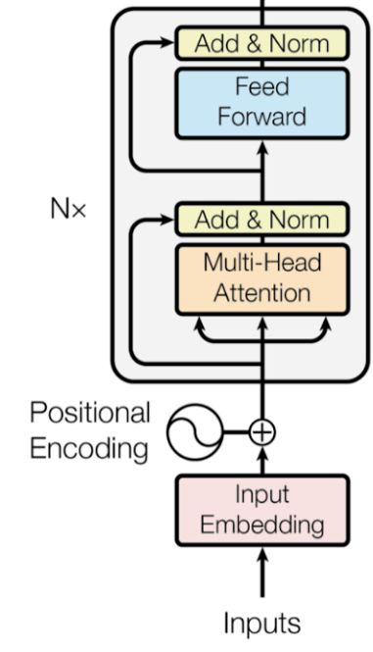


Transformer – Residual Connection
$$+$$
$$h$$
Transformer’s Multi-Head
Attention Layer
$$W_{q}^{3}$$
$$W_{k}^{3}$$
$$W_{v}^{3}$$
$$W_{q}^{2}$$
$$W_{k}^{2}$$
$$W_{v}^{2}$$
$$W_{q}^{1}$$
$$W_{k}^{1}$$
$$W_{v}^{1}$$
Query
Key
Value
$$p$$
$$x$$

Slide 26
Transformer Key Ideas
Learn to route information, then apply local computation to compose it.
Attention is input-dependent similarity
Compose multiple simple learned operations
Highly parallelizable; allows data to trump inductive biases
For more intuition: https://transformer-circuits.pub/2021/framework/index.html

Slide 27
Language Pre-training

Slide 28
















Token-level and Sentence-level Embeddings
Token-level embeddings
Sentence-level embedding
$$h_{1}$$
$$h_{2}$$
$$h_{3}$$
$$h_{4}$$
$$h_{5}$$
$$h_{s}$$
$$x_{1}$$
$$x_{2}$$
$$x_{3}$$
$$x_{4}$$
$$x_{5}$$
$$x_{1}$$
$$x_{2}$$
$$x_{3}$$
$$x_{4}$$
$$x_{5}$$
I
do
not
like
it
I
do
not
like
it

Slide 29














Pre-Training and Fine-Tuning
$$y_{1}$$
$$y_{2}$$
$$y_{3}$$
$$y_{4}$$
$$y_{5}$$
$$h_{1}$$
$$h_{2}$$
$$h_{3}$$
$$h_{4}$$
$$h_{5}$$
$$h_{1}$$
$$h_{2}$$
$$h_{3}$$
$$h_{4}$$
$$h_{5}$$
Initialize
parameters
$$x_{1}$$
$$x_{2}$$
$$x_{3}$$
$$x_{4}$$
$$x_{5}$$
$$x_{1}$$
$$x_{2}$$
$$x_{3}$$
$$x_{4}$$
$$x_{5}$$
I
do
not
like
it
I
do
not
like
it
Pre-training
Fine-Tuning
(e.g., language model)
Notes:
Inherited from CV. Find a pre-training task that’s well aligned with learning the reps you want for your fine-tuning task. Think about object classification vs denoising auto-encoders

Slide 30










BERT: Bidirectional Encoder Representations from Transformers
Advantages:
1
Jointly learn representation for token-level and sentence level
2
Same network architecture for pre-training and fine-tuning
$$h_{s}$$
$$h_{1}$$
$$h_{2}$$
$$h_{3}$$
$$h_{4}$$
$$h_{5}$$
$$x_{1}$$
$$x_{2}$$
$$x_{3}$$
$$x_{4}$$
$$x_{5}$$
I
do
not
like
it

Slide 31





















BERT: Bidirectional Encoder Representations from Transformers
Advantages:
1
Jointly learn representation for token-level and sentence level
2
Same network architecture for pre-training and fine-tuning
3
Can be used to learn relationship between sentences
4
Models bidirectional and long-range interactions between tokens
$$h_{s}$$
$$h_{1}$$
$$h_{2}$$
$$h_{3}$$
$$h_{4}$$
$$h_{5}$$
$$h_{sep}$$
$${h′}_{1}$$
$${h′}_{2}$$
$${h′}_{3}$$
$${h′}_{4}$$
$${h′}_{5}$$
How can we do all this?
CLS
$$x_{1}$$
$$x_{2}$$
$$x_{3}$$
$$x_{4}$$
$$x_{5}$$
SEP
$${x′}_{1}$$
$${x′}_{2}$$
$${x′}_{3}$$
$${x′}_{4}$$
$${x′}_{5}$$
I
do
not
like
it
I
enjoy
my
time
here

Slide 32

















BERT: Bidirectional Encoder Representations from Transformers
Advantages:
1
Jointly learn representation for token-level and sentence level
2
Same network architecture for pre-training and fine-tuning
3
Can be used to learn relationship between sentences
4
Models bidirectional interactions between tokens
$$h_{s}$$
$$h_{1}$$
$$h_{2}$$
$$h_{3}$$
$$h_{4}$$
$$h_{5}$$
$$h_{sep}$$
$${h′}_{1}$$
$${h′}_{2}$$
$${h′}_{3}$$
$${h′}_{4}$$
$${h′}_{5}$$
Transformer Self-Attention
Special sentence-level token
But how to train self-supervised?
CLS
$$x_{1}$$
$$x_{2}$$
$$x_{3}$$
$$x_{4}$$
$$x_{5}$$
SEP
$${x′}_{1}$$
$${x′}_{2}$$
$${x′}_{3}$$
$${x′}_{4}$$
$${x′}_{5}$$
I
do
not
like
it
I
enjoy
my
time
here

Slide 33
Pre-training BERT Model
1
Masked Language Model
Randomly mask input tokens
and then try to predict them
What is the loss function?
like
enjoy
$$h_{s}$$
$$h_{1}$$
$$h_{2}$$
$$h_{3}$$
$$h_{4}$$
$$h_{5}$$
$$h_{sep}$$
$${h′}_{1}$$
$${h′}_{2}$$
$${h′}_{3}$$
$${h′}_{4}$$
$${h′}_{5}$$
Transformer Self-Attention
CLS
$$x_{1}$$
$$x_{2}$$
$$x_{3}$$
mask
$$x_{5}$$
SEP
$${x′}_{1}$$
mask
$${x′}_{3}$$
$${x′}_{4}$$
$${x′}_{5}$$
I
do
not
it
I
my
time
here
Notes:
This is a denoising auto-encoder

Slide 34
Pre-training BERT Model
2
Next Sentence Prediction
Given two sentences, predict if this is the next one or not
What is the loss function?
IsNext
Where can we find training data?
- or -
NotNext
How can BERT know the difference between both sentences?
$$h_{s}$$
$$h_{1}$$
$$h_{2}$$
$$h_{3}$$
$$h_{4}$$
$$h_{5}$$
$$h_{sep}$$
$${h′}_{1}$$
$${h′}_{2}$$
$${h′}_{3}$$
$${h′}_{4}$$
$${h′}_{5}$$
Transformer Self-Attention
CLS
$$x_{1}$$
$$x_{2}$$
$$x_{3}$$
$$x_{4}$$
$$x_{5}$$
SEP
$${x′}_{1}$$
$${x′}_{2}$$
$${x′}_{3}$$
$${x′}_{4}$$
$${x′}_{5}$$
I
do
not
like
it
I
enjoy
my
time
here
For text-only domains, this NSP loss actually isn’t necessary! See RoBERTa.
Notes:
This is kind of like a contrastive objective, but forces everything to be in a single model.

Slide 35
Three Embeddings: Token + Position + Sentence
Notes:
Segment embeddings: take some of the pressure off of the position embeddings.

Slide 36
Fine-Tuning BERT
1
Sentence-level classification for only one sentence
Examples: sentiment analysis, document classification
How?
$$h_{s}$$
$$h_{1}$$
$$h_{2}$$
$$h_{3}$$
$$h_{4}$$
$$h_{5}$$
$$h_{sep}$$
$${h′}_{1}$$
$${h′}_{2}$$
$${h′}_{3}$$
$${h′}_{4}$$
$${h′}_{5}$$
Transformer Self-Attention
cls
$$x_{1}$$
$$x_{2}$$
$$x_{3}$$
$$x_{4}$$
$$x_{5}$$
sep
$${x′}_{1}$$
$${x′}_{2}$$
$${x′}_{3}$$
$${x′}_{4}$$
$${x′}_{5}$$
I
do
not
like
it
I
enjoy
my
time
here

Slide 37

Fine-Tuning BERT
1
Sentence-level classification for only one sentence
Examples: sentiment analysis, document classification
$${\hat{y}}_{s}$$
And if we have a label for each token?
softmax
$$h_{s}$$
$$h_{1}$$
$$h_{2}$$
$$h_{3}$$
$$h_{4}$$
$$h_{5}$$
Transformer Self-Attention
cls
$$x_{1}$$
$$x_{2}$$
$$x_{3}$$
$$x_{4}$$
$$x_{5}$$
I
do
not
like
it

Slide 38





Fine-Tuning BERT
2
Token-level classification for only one sentence
Examples: part-of-speech tagging, slot filling
$${\hat{y}}_{1}$$
$${\hat{y}}_{2}$$
$${\hat{y}}_{3}$$
$${\hat{y}}_{4}$$
$${\hat{y}}_{5}$$
How to compare two sentences?
$$h_{s}$$
$$h_{1}$$
$$h_{2}$$
$$h_{3}$$
$$h_{4}$$
$$h_{5}$$
Transformer Self-Attention
cls
$$x_{1}$$
$$x_{2}$$
$$x_{3}$$
$$x_{4}$$
$$x_{5}$$
I
do
not
like
it

Slide 39
Fine-Tuning BERT
3
Sentence-level classification for two sentences
Examples: natural language inference
$${\hat{y}}_{s}$$
softmax
$$h_{s}$$
$$h_{1}$$
$$h_{2}$$
$$h_{3}$$
$$h_{4}$$
$$h_{5}$$
$$h_{sep}$$
$${h′}_{1}$$
$${h′}_{2}$$
$${h′}_{3}$$
$${h′}_{4}$$
$${h′}_{5}$$
Transformer Self-Attention
cls
$$x_{1}$$
$$x_{2}$$
$$x_{3}$$
$$x_{4}$$
$$x_{5}$$
sep
$${x′}_{1}$$
$${x′}_{2}$$
$${x′}_{3}$$
$${x′}_{4}$$
$${x′}_{5}$$
I
do
not
like
it
I
enjoy
my
time
here

Slide 40
Fine-Tuning BERT
4
Question-answering: find start/end of the answer in the document
$$h_{s}$$
$$h_{1}$$
$$h_{2}$$
$$h_{3}$$
$$h_{4}$$
$$h_{5}$$
$$h_{sep}$$
$${h′}_{1}$$
$${h′}_{2}$$
$${h′}_{3}$$
$${h′}_{4}$$
$${h′}_{5}$$
Transformer Self-Attention
How?
cls
$$x_{1}$$
$$x_{2}$$
$$x_{3}$$
$$x_{4}$$
$$x_{5}$$
sep
$${x′}_{1}$$
$${x′}_{2}$$
$${x′}_{3}$$
$${x′}_{4}$$
$${x′}_{5}$$
How
old
is
the
man
He
is
25
years
old

Slide 41





Fine-Tuning BERT
4
Question-answering: find start/end of the answer in the document
Same architecture for the end time
Maximum value gives start time
softmax
Learned during fine-tuning
$$S$$
$$S$$
$$S$$
$$S$$
$$S$$
$$h_{s}$$
$$h_{1}$$
$$h_{2}$$
$$h_{3}$$
$$h_{4}$$
$$h_{5}$$
$$h_{sep}$$
$${h′}_{1}$$
$${h′}_{2}$$
$${h′}_{3}$$
$${h′}_{4}$$
$${h′}_{5}$$
Transformer Self-Attention
cls
$$x_{1}$$
$$x_{2}$$
$$x_{3}$$
$$x_{4}$$
$$x_{5}$$
sep
$${x′}_{1}$$
$${x′}_{2}$$
$${x′}_{3}$$
$${x′}_{4}$$
$${x′}_{5}$$
How
old
is
the
man
He
is
25
years
old

Slide 42
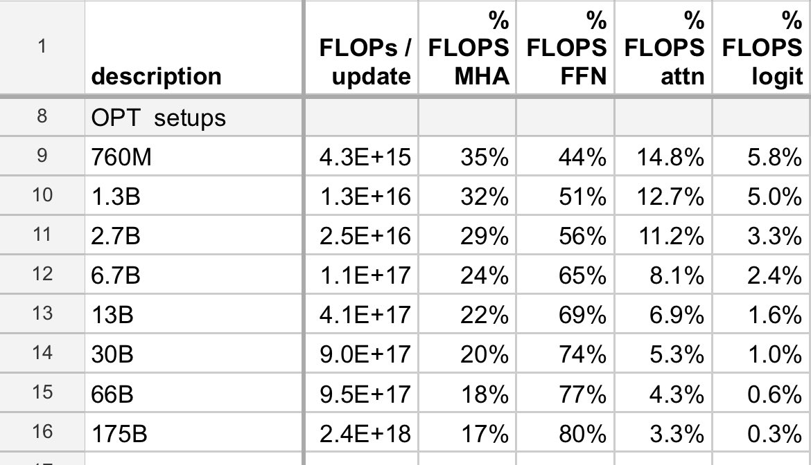





Generative Transformers
It
was
a
bright
cold
“masked” self-attention
Generally worse than BERT-like encoder transformers in producing text representations, but usable for generation without fine-tuning
See Wang et al., 2022 for more.
When the models scale up, most of the compute is in the feed-forward (FFN) layers
FFN encodes facts and associations: Geva et al., 2021
$$y_{0}$$
$$y_{1}$$
$$y_{2}$$
$$y_{3}$$
$$y_{4}$$
START
It
was
a
bright
[credit: Stephen Roller]

Slide 43
Sequence-to-Sequence
Using Transformer
Notes:
~45 min in

Slide 44










Sequence-to-Sequence Modeling
Je
n'
aime
pas
cela
$${\hat{y}}_{1}$$
$${\hat{y}}_{2}$$
$${\hat{y}}_{3}$$
$${\hat{y}}_{4}$$
$${\hat{y}}_{5}$$
How can we perform seq2seq translation with transformer attention?
$$x_{1}$$
$$x_{2}$$
$$x_{3}$$
$$x_{4}$$
$$x_{5}$$
I
do
not
like
it

Slide 45



Seq2Seq with Transformer Attentions
Je
n'
aime
pas
cela
$${\hat{y}}_{1}$$
$${\hat{y}}_{2}$$
$${\hat{y}}_{3}$$
$${\hat{y}}_{4}$$
$${\hat{y}}_{5}$$
$$h_{1}$$
$$h_{2}$$
$$h_{3}$$
$$h_{4}$$
$$h_{5}$$
self-attention
$$x_{1}$$
$$x_{2}$$
$$x_{3}$$
$$x_{4}$$
$$x_{5}$$
I
do
not
like
it

Slide 46










Seq2Seq with Transformer Attentions
Je
n'
aime
pas
cela
$${\hat{y}}_{1}$$
$${\hat{y}}_{2}$$
$${\hat{y}}_{3}$$
$${\hat{y}}_{4}$$
$${\hat{y}}_{5}$$
$$h_{1}$$
$$h_{2}$$
$$h_{3}$$
$$h_{4}$$
$$h_{5}$$
$$g_{1}$$
$$g_{2}$$
$$g_{3}$$
$$g_{4}$$
$$g_{5}$$
self-attention
“masked” self-attention
$$x_{1}$$
$$x_{2}$$
$$x_{3}$$
$$x_{4}$$
$$x_{5}$$
$$y_{0}$$
$$y_{1}$$
$$y_{2}$$
$$y_{3}$$
$$y_{4}$$
I
do
not
like
it
Je
n'
aime
pas
START

Slide 47















Seq2Seq with Transformer Attentions
Je
n'
aime
pas
cela
$${\hat{y}}_{1}$$
$${\hat{y}}_{2}$$
$${\hat{y}}_{3}$$
$${\hat{y}}_{4}$$
$${\hat{y}}_{5}$$
How should we connect the encoder and decoder self-attention to the transformer attention?
Transformer attention
$$W_{q}$$
$$W_{k}$$
$$W_{v}$$
Query
Key
Value
Vector format
$$h$$
$$g$$
self-attention
“masked” self-attention
$$x_{1}$$
$$x_{2}$$
$$x_{3}$$
$$x_{4}$$
$$x_{5}$$
$$y_{0}$$
$$y_{1}$$
$$y_{2}$$
$$y_{3}$$
$$y_{4}$$
I
do
not
like
it
Je
n'
aime
pas
START

Slide 48


Seq2Seq with Transformer Attentions
Je
n'
aime
pas
cela
$${\hat{y}}_{1}$$
$${\hat{y}}_{2}$$
$${\hat{y}}_{3}$$
$${\hat{y}}_{4}$$
$${\hat{y}}_{5}$$
“encoder-decoder”
transformer
Transformer attention
$$W_{q}$$
$$W_{k}$$
$$W_{v}$$
“encoder”
transformer
Query
Key
Value
$$h$$
$$g$$
self-attention
“masked” self-attention
$$x_{1}$$
$$x_{2}$$
$$x_{3}$$
$$x_{4}$$
$$x_{5}$$
“decoder”
transformer
$$y_{0}$$
$$y_{1}$$
$$y_{2}$$
$$y_{3}$$
$$y_{4}$$
I
do
not
like
it
Je
n'
aime
pas
START
Useful for denoising auto-encoding, e.g BART or T5

Slide 49
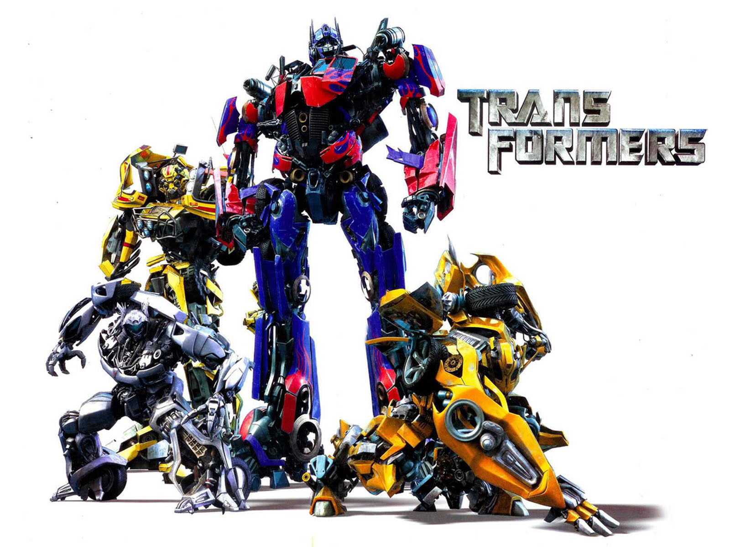
And Many More… Next week!

