Slide 1


Spacecraft Design Lab – Communication Protocols
D.J. Morvay

Slide 2
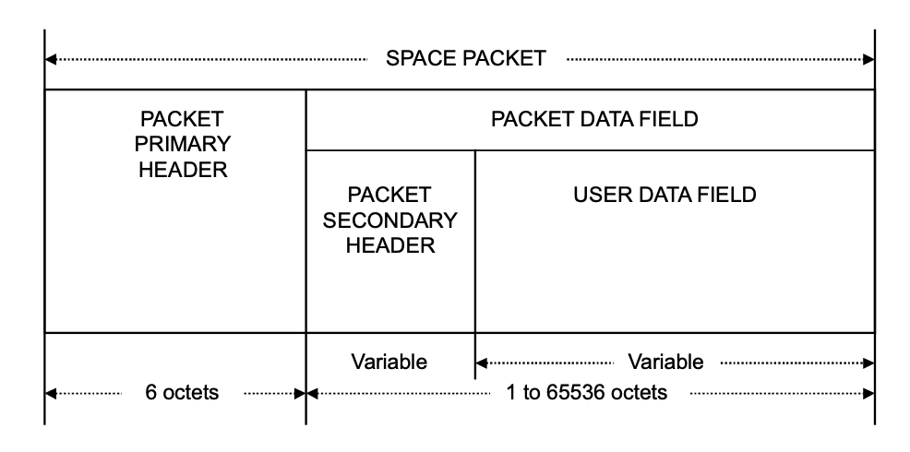
Option #1 – Space Packet Protocol
General Information
Primary Packet Header – 6 octets (bytes)
Packet Data Field - 1 to 65536 octets
Consists of at least 7 and at most 65542 octets

Slide 3
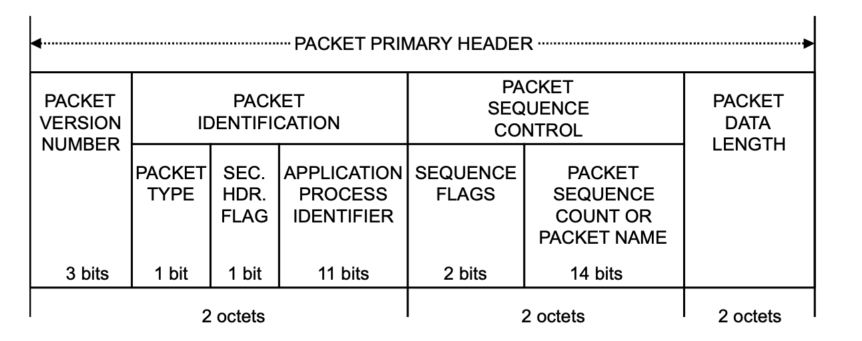
Space Packet Primary Header

Slide 4
Space Packet Primary Header – Part #1
Packet Version Number (3 bits) - Set to ‘000’
Packet Identification Field (13 bits)
Packet Type (1 bit)
‘0’ -> Telemetry,
‘1’ -> Telecommand
Secondary Heading Flag (1 bit)
‘0’ -> No Secondary header
‘1’ -> Secondary header present
Application Process Identifier (11 bits, Mission Specific)
Identify sending and receiving application process

Slide 5
Space Packet Primary Header – Part #2
Packet Sequence Control Field (16 bits)
Sequence Flags (2 bits)
’00’ -> Continuation Segment
‘01’ -> First segment
‘10’ -> Last segment
‘11’ -> Unsegmented
Packet Sequence Count (14 bits)
If Packet Type == ‘0’ (telemetry), then field contains packet sequence count
If Packet Type == ‘1’ (telecommand), then field contains packet sequence count OR packet name
Packet Data Length (16 bits, Mission Specific)
Length count C that equals one fewer than the length (in octets) of the Packet Data Field

Slide 6
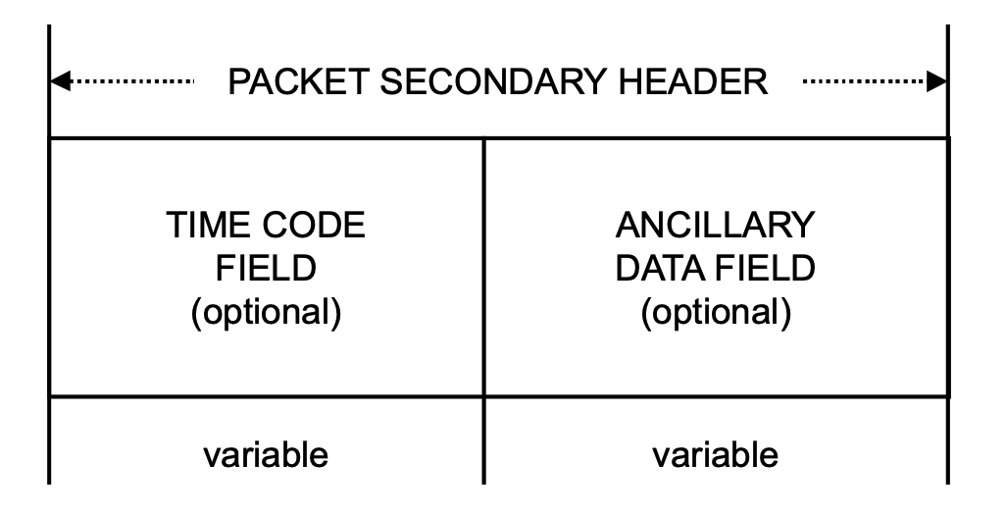
Packet Data Field
Packet Secondary Header (Variable Length, Mission Specific)
Consists of…
Time Code Field
Ancillary Data Field
Time Code + Ancillary Data
Consistent mission specific data in Ancillary Field
User Data Field (Variable Length)
Application data supplied by the sending user (AKA all other data)

Slide 7
Key Takeaways of SPP
Can send long messages (images and memory data)
Separate the messages into a group of Space Packets
Ex: ½ image in message #1 and ½ image in message #2
Constructed to support telemetry and telecommands
Mission specific PIDs
Ex: PID 0x10 == Battery Information
Ex: PID 0x11 == Power Off Commands
Consistent data with Secondary Headers

