Slide 1


RL WORKSHOP
Eyob Dagnachew

Slide 2
Schedule
RL intro
MDP’s
Policy Iteration
MC learning
Function approx
Policy gradient methods
Self play
Env

Slide 3
RL Intro
What is RL?
At a very high level, RL is the process of learning to act and accomplish goals in dynamic environments
This is inspired by some ideas in psychology that behavior is reinforced by through the idea that behaviors that result in praise/pleasure tend to repeat and behaviors that bring “pain” go extinct
This leads to RL being a “trial and error” learning paradigm
Agents receive rewards for working towards a goal
Different representations of rewards and goals can alter the agents ability to perform well in specific scenarios found in RL (online learning, stochastic policies, etc)

Slide 4
MDP’S: Formalizing RL problem spaces
The MDP representation of the RL process is built on the Markov assumption: that all information needed to make an a acting given your current state is all encoded within your current state, no explicit access to previous states is needed

Slide 5
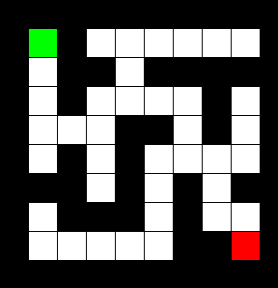
MDP’S: Formalizing RL problem spaces
Represented often times by 5 main items
State Space (S): Representation of all possible states to be in
Action Space (A): Representations of all possible actions to take
Transition Function (T:SxSxA → Real): Given state and action, take action
Represents P(s’|s, a): Probability of ending up in new state given state action pair
Reward Function (R:SxA → Real): Reward for specific state action pair
The last two can be mixed
P(s’, r|s, a) - Transition function can include reward
Policy (denoted by π) (π: S → A): Maps states to actions to take, what the agent uses to make decisions

Slide 6
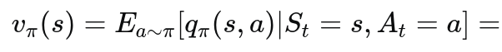
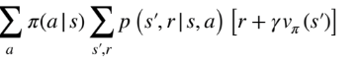
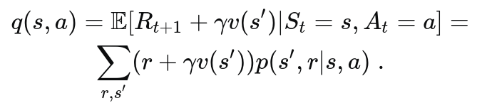
MDP’S: Cont
So how can we act on this representation?
Goal - Learn optimal policy: π* S → A
Maximize discounted reward
Gain best possible performance in an environment
How can we judge the quality of a policy?
Value/ Q-value functions
Value function (V:S → Real):
Represents the estimated value of being in a state while following policy
Q-Value function (Q:SxA → Real):
Represents the estimated value of being in a state and taking an action, then following policy

Slide 7
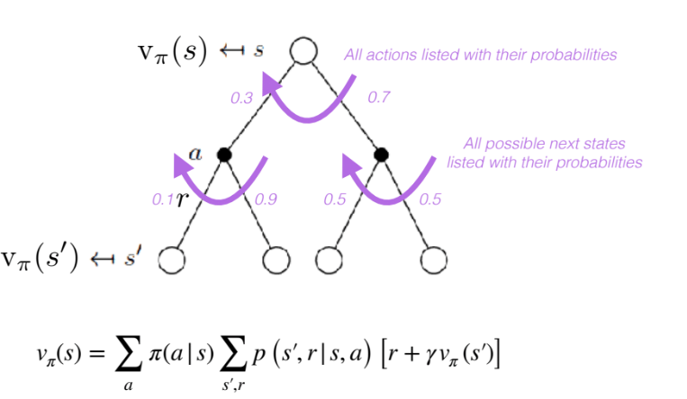
MDP’S: Value function visualization

Slide 8
Policy Iteration: Optimizing policy with the value function
Policy Iteration
Evaluate policy by estimating the values of each step till convergence
Improve your policy using reward and estimated values
Major assumption: we know the reward and transition functions

Slide 9
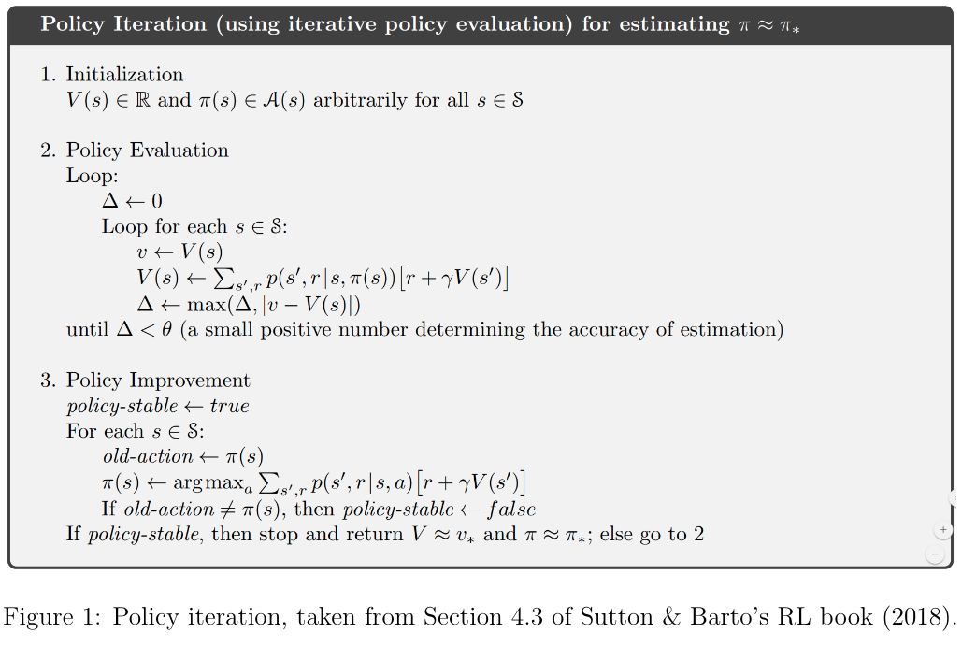
Policy Iteration: Pseudocode

Slide 10
MC methods: Dynamics free learning
Policy iteration was built using the assumption of environmental dynamics (transition function, reward functions,etc)
How can we still learn a policy assuming we don’t have those dynamics?
One method is plausible: Monte carlo learning
Core idea: instead of using the dynamics of the function to determine what state we end up and the rewards we get from that, we use our own experiences in the environment
We update the value of a state after simulation an entire episode starting from that state

Slide 11
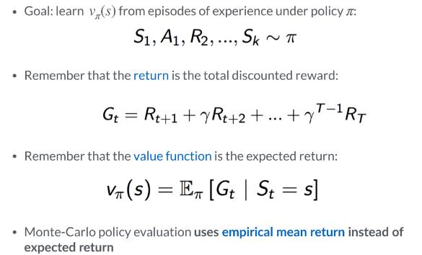
MC methods: Dynamics free learning

Slide 12
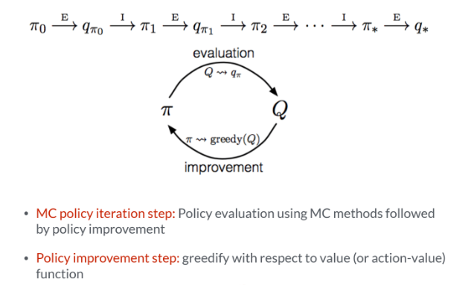
MC Learning Cont

Slide 13
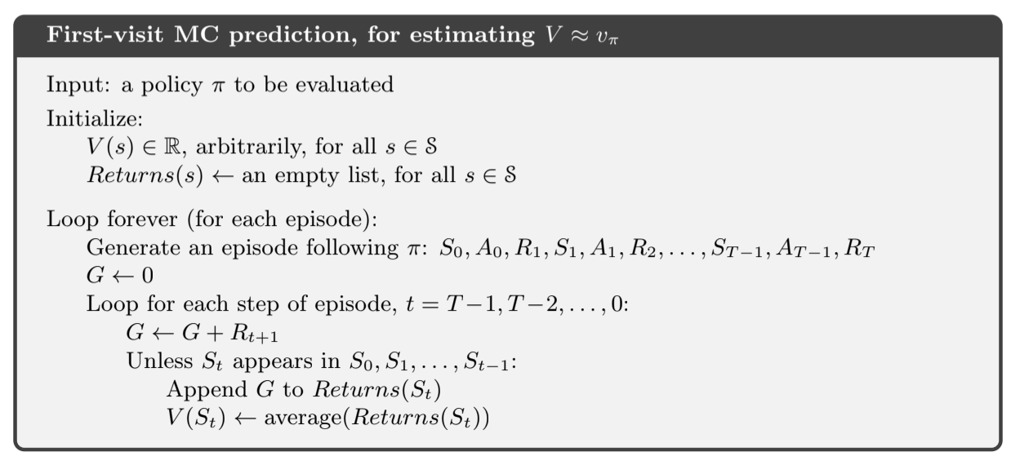
MC Learning: Pseudocode

Slide 14
FA: moving on from tabular methods
In both previous RL methods we continuously update each states value function through various methods
Policy iteration: we update by sampling every possible next state given an action
MC-learning: update state value with bootstrapped estimate return
But with FA we instead parameterize the value function with specific weights instead to better generalize learning of policy
From there we can use any linear function approximator to utilize GD to improve the weights performance in accuracy in relation to an objective function

Slide 15
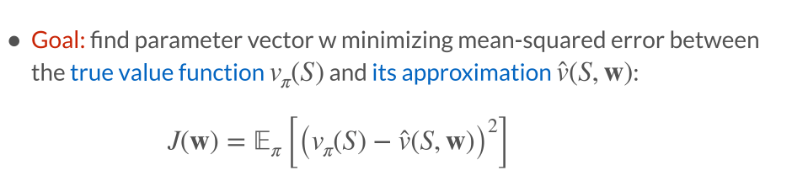
FA: moving on from tabular methods

Slide 16
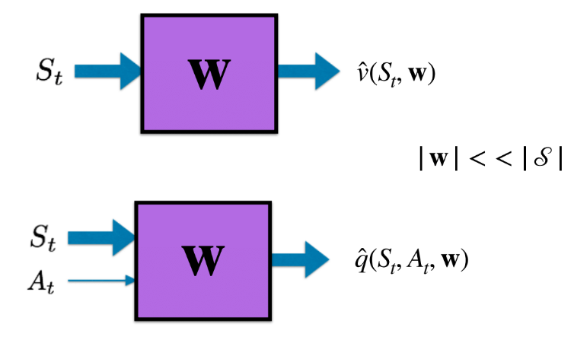
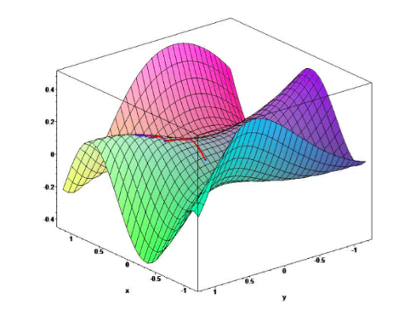
FA: moving on from tabular methods

Slide 17
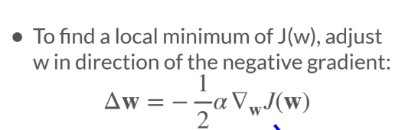
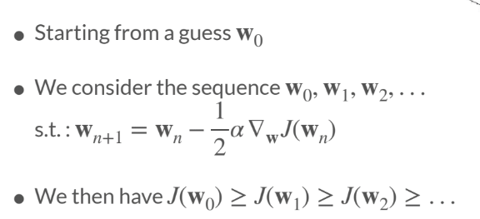
Gradient descent

Slide 18
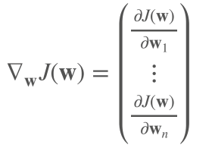
Gradient descent
Let J(w) be a differentiable function of parameter vector w
Define the gradient of J(w) to be:

Slide 19
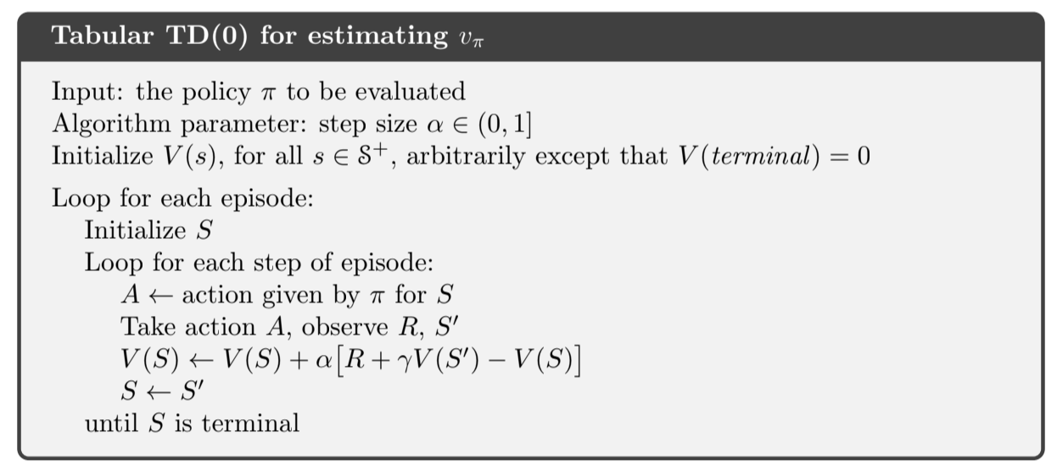
FA: example: TD learning w/0 FA

Slide 20
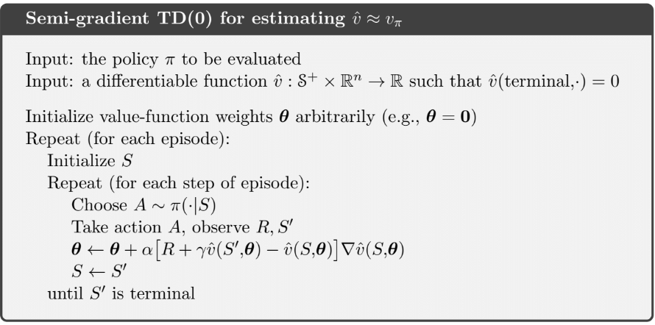
FA: TD learning with FA

Slide 21
Policy gradient methods: A new paradigm
Instead of parameterizing the value function of the state, parameterize the state and as a larger result the policy itself, removing the need for value functions
This means we can parameterize the policy along whatever lines we want, including, including having the policy parameters be the parameters of a probability distribution, allowing for probabilistic optimal policies, ideal for situations like poker where actions are sampled from this distribution

Slide 22
Policy optimization
Let U(Ө) be a policy objective (loss) function
General policy optimization pseudocode goes as such
Initialize policy parameters (Ө)
Sample trajectories by deploying policy with current parameterization
Compute gradient vector ▽ U(Ө)
Update policy parameters as such: Ө + α▽ U(Ө) (where α is step size)

Slide 23
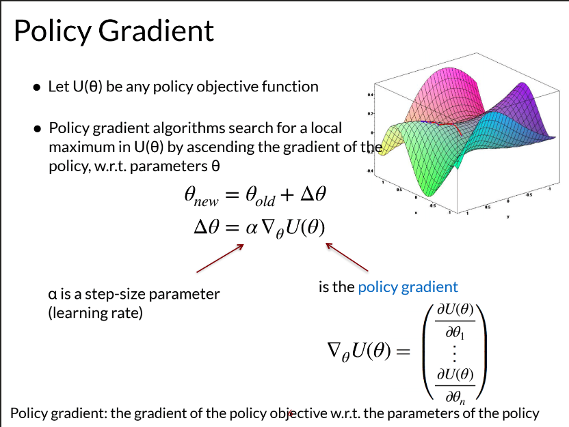
Policy optimization: an alternate view

Slide 24
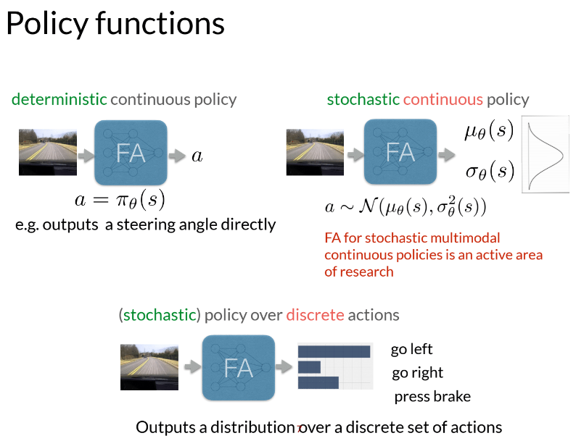
Types of policy parameterizations

Slide 25
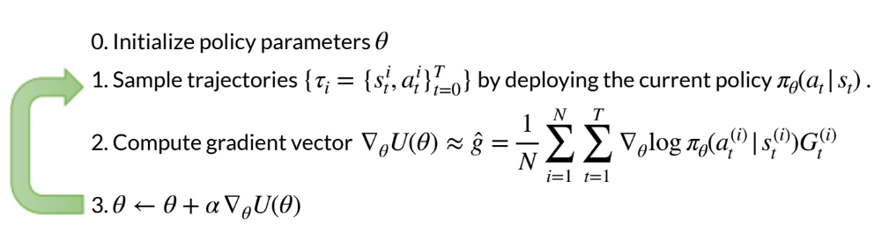
REINFORCE: taking advantage of policy gradients
From this method, as well as deriving a specific gradient we can state the final algorithm for this workshop using Policy gradients

Slide 26
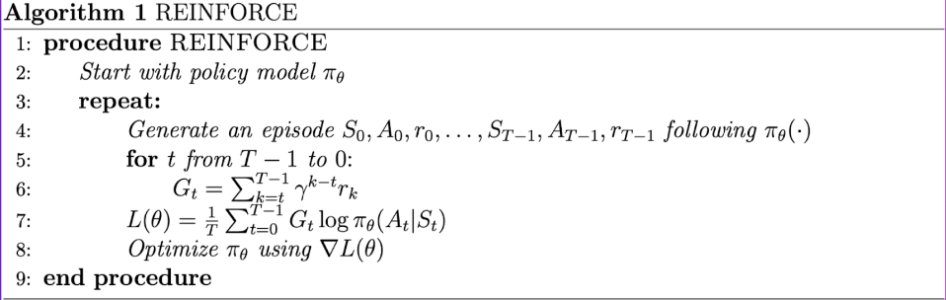
REINFORCE: taking advantage of policy gradients

Slide 27
MISC Topics

Slide 28
Gymnasium
Environment Collection: Gym is a Python library offering a range of environments for testing reinforcement learning algorithms.
OpenAI Support: Developed by OpenAI, Gym ensures quality environments compatible with various reinforcement learning techniques.
Simplified Usage: Gym provides a user-friendly interface, streamlining the process of experimenting with reinforcement learning algorithms.

Slide 29
Gymnasium: env
Environment Interface: The env class in Gym defines a common interface for interacting with reinforcement learning environments.
Unified Interaction: It abstracts the interaction between agents and environments, providing consistent methods for actions, observations, and rewards.
Some methods include, env.step, env.display
Some fields include: action_space, observation_space
Good to look through documentation

Slide 30
Self Play
Self-Play Concept: Self-play is a reinforcement learning technique where an agent learns by playing against itself rather than against fixed opponents or a pre-existing dataset.
Dynamic Opponent: In self-play, the agent's opponent evolves alongside its own learning process, adapting to the agent's current capabilities and strategies.
Continuous Improvement: Through iterative self-play, agents can continuously improve their strategies, leading to robust and adaptive behavior in a variety of environments or games.
Similar(ish) example:
Generative adversarial Imitation learning(GAIL)

Slide 31
Activity
Complete (and correct) and implementation of the REINFORCE Algorithm
Collab link:
https://tinyurl.com/2s4fskcj

