Slide 1

Week 2 Pokerbots

Slide 2
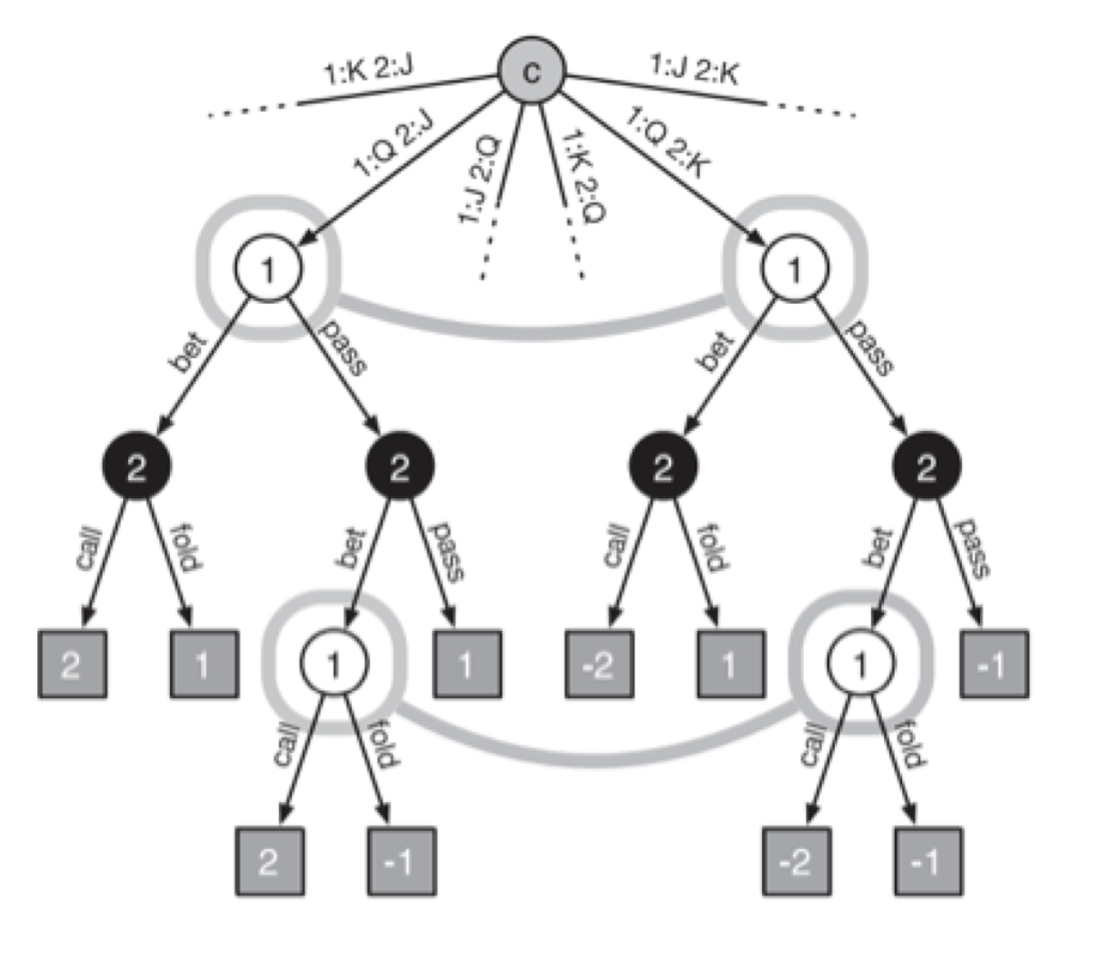
CFR Review
Mixed strategies:
Which action to take at a specific action node is not deterministic, it is a set of probabilities
Regret for taking an action:
Expected value of taking this action -
Expected value of following strategy
Chance sampling:
One combination of cards dealt to players is used/sampled for the algorithm, in vanilla CFR all combinations are used

Slide 3
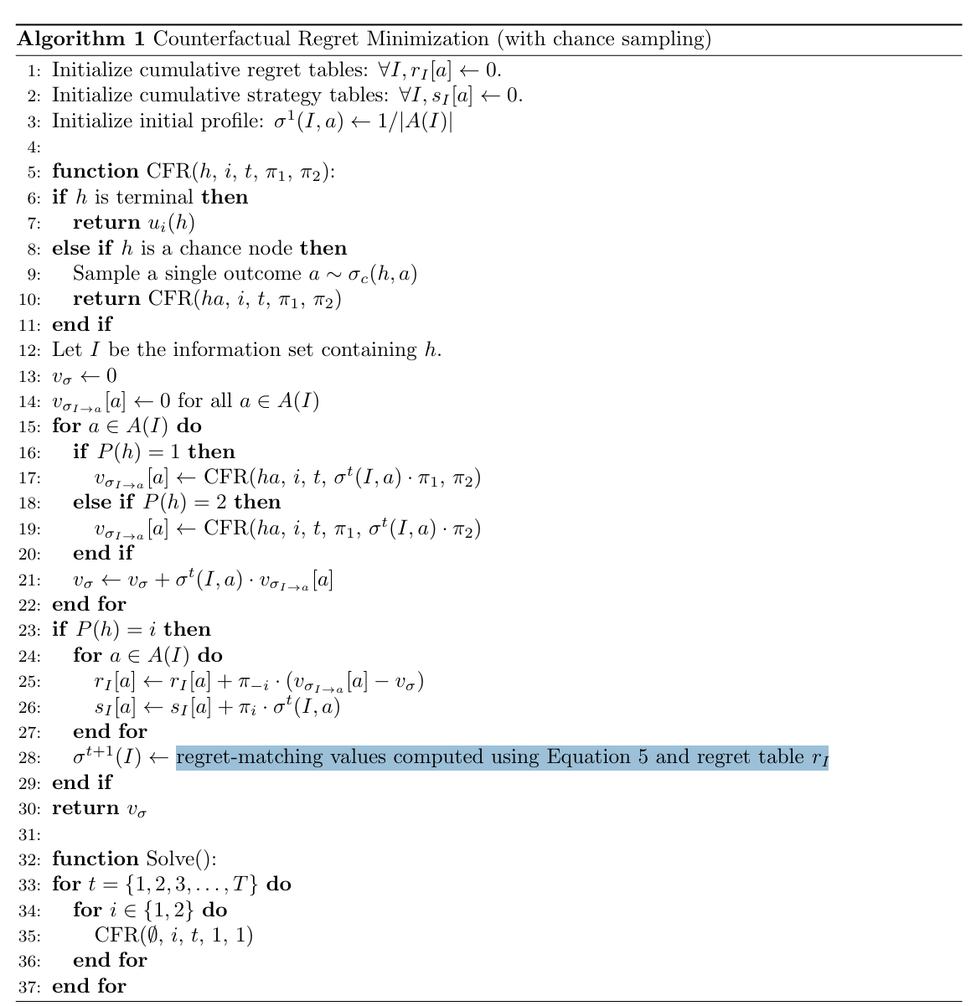
Regret matching
Last week, we implemented the cfr algorithm, except for one crucial part:
Regret Matching

Slide 4
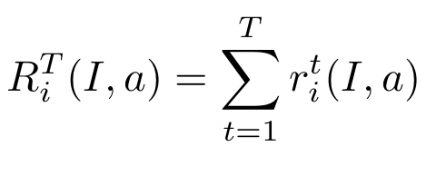

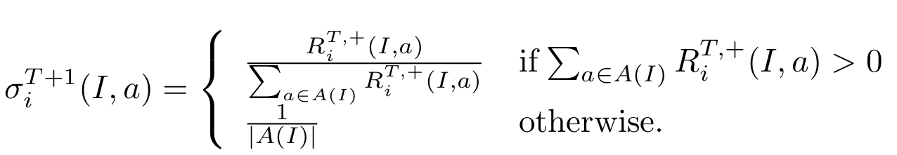
Regret Matching cont
Compute the proportion of regret over sum of all regrets experienced at the Information state
Determines the strategy player i will take at iteration T+1

Slide 5
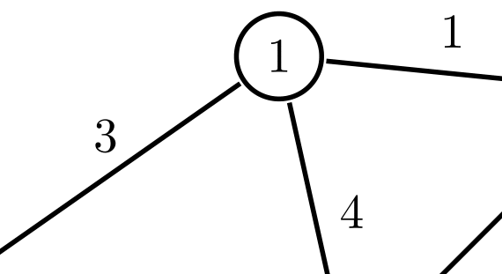
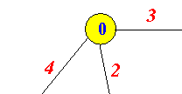

Practice
The numbers on each line are the regrets, compute the new probabilities for taking each action

Slide 6
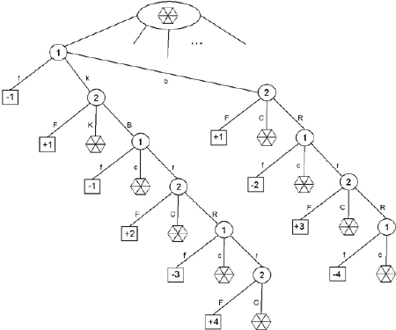
Number of States in Poker
No-limit Texas Holdem ~10^75 game states
Limit Texas Holdem ~ 10^18 game states
For reference:
Game states in chess ~ 10^44
Particles in the universe ~ 10^80

Slide 7
Abstraction
To handle the vast amount of game states that we must deal with in poker, we must abstract down the game state to a simpler representation
Want abstraction to cover all relevant parts of game tree without over-simplifying game tree
No rigorous way to define the ‘best’ possible abstractions, often trial and error/ knowledge of poker determines the best abstractions to make

Slide 8
Leduc Hold'em
Deck: 2 suits of Jack, Queen, King
Rounds: At the beginning of the game, each player receives one card and, after betting, one public card is revealed. Another round follows. At the end, the player with the best hand wins and receives a reward.
Rewards:
Winner: +(Raised chips)/2
Loser: -(Raised chips)/2

Slide 9
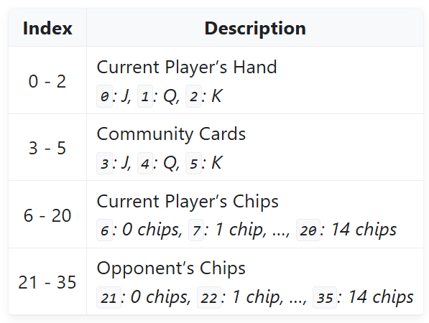
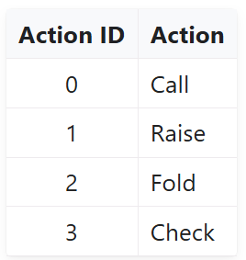
State representation in Leduc Hold’em
State represented as dictionary containing game obs and legal actions
Game obs is represented as 36 dim vector
Legal actions is a list of numbers from 0-3

Slide 10
Speeding up current implementation of CFR
The current version of cfr that we wrote last week works, but converges slowly (around 1000 iterations of walk_trees)
Today you will try to apply abstractions to the game tree of CFR and try to get the code to converge in fewer iterations, as well as implementing the regret-matching algorithm discussed on slide 2

Slide 11
Activity Here

