Slide 1





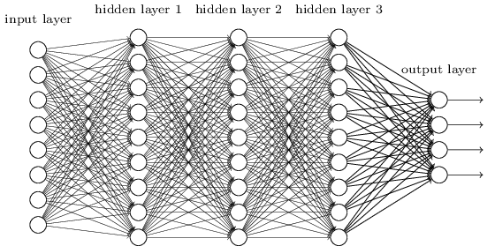
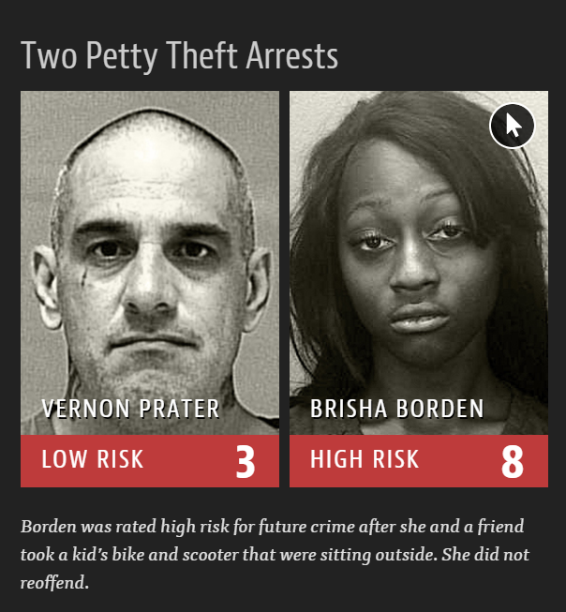
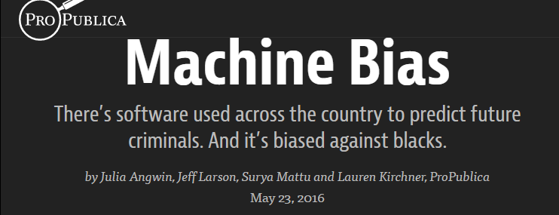


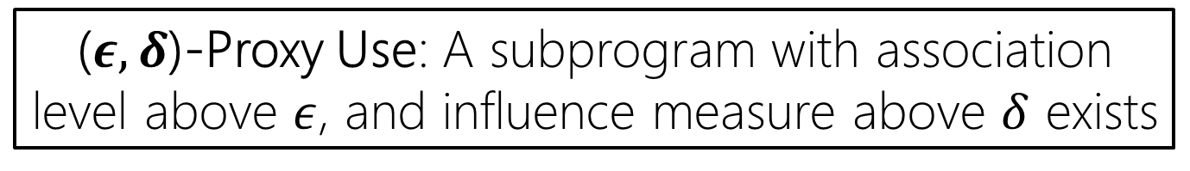
Use Privacy in Data-Driven Systems
Theory and Experiments with Machine Learnt Systems
Anupam Datta, Matt Fredrikson, Gihyuk Ko, Piotr Mardziel, Shayak Sen
Carnegie Mellon University
Harms due to inappropriate use in data-driven systems
Protected Attribute
?
?
Pregnancy
Associated
?
Credit | Web systems | Healthcare
Education | Law Enforcement | …
Scent-free Lotion
Use privacy constraints restrict the use of protected information types and some of their proxies in data-driven systems.
Pre-natal Vitamins
Used
Diaper Coupons
Stationaries
Target Ad System
Using pregnancy status (inferred via past purchases) for marketing [Target 2012]
Explicit Use
Proxy (or implicit) Use
Quantitative Input Influence*
Learning Systems as Programs
Two-Phase Definition
Classifier
(uses only income)
Scent-free Lotion
Diaper Coupons
Proxy
Is a subprogram associated to the protected attribute?
Age
Pre-natal Vitamins
21
Decision
Stationaries
Well-studied association measures
(e.g., Mutual Information)
Income
$90K
Implicate part (subprogram) of a system as the source of a violation
Subprogram
Use
Is a subprogram influential to the output of the program?
Replace feature with random values from the population, and examine distribution over outcomes.
OR ( IF { AND ( Shopped(Pre-natal vitamins),
Shopped(Scent-free lotion),
… ),
Diaper Coupons, Nothing }
IF { Shopped(Stationaries), Notebooks, Nothing } } )
➔ QII for subprograms
*Anupam Datta, Shayak Sen, Yair Zick. Algorithmic Transparency via Quantitative Input Influence. Oakland’16
Program
($ε,δ$)-Proxy Use: A subprogram with association level above $ε$, and influence measure above $δ$ exists
Experiments
contra
Advertisement targeting using the Indonesian Contraception Dataset
Features: Education, Children, Husband’s Job, etc
Classification: Contraception Methods
Protected attribute (removed in training phase): Religion
~1,500 individuals
student
Academic performance prediction using Portuguese Student Alcohol dataset
Features: Failures, Studytime, Father’s education level, Health status, etc
Classification: Grade
Protected attribute : Weekly alcohol consumption
~7,000 individuals
Submodel with Proxy Use violation
...
Submodel with Proxy Use violation
...
Protected Attribute
~
Protected Attribute
Education level is a proxy for religion
Concerning Use
~
Weekly
Alcohol Consumption
Study time used as a predictor for the academic performance
Acceptable Use
Education ≤ 3
Religion
Studytime < 2.5
true
false
true
false
...
...
...
...
Summary
Directions
Use Privacy restricts use (explicit or proxy) of protected information types
Axiomatically justified definition of proxy use
Algorithms for detection and repair
Implementation and evaluation for real world datasets, and commonly used ML models
Scale to larger systems and deep learning models
Implications for Fairness
goo.gl/qfOv7G
Notes:
Motivation: Learning Systems Threaten Privacy
Learning systems are ubiquitous
Some learning systems use personal, even sensitive information
Sometimes a learning system can use too much personal information such that it could infer on protected information [Target 2012 case]
Need theories to define what ‘use restrictions’ for the protected information type should be
Definitions
Explicit Use: well-studied from QII – key idea is to do the causal intervention, to see whether a feature had influence (was used) in the classifier.
If protected feature was used explicitly, we can use this method.
Proxy (implicit) Use
Modeling ML system
When protected feature was not used explicitly but can be ‘inferred’ through a users’ other attributes,
We need to view ‘inside’ of learning systems: we define a expression language for modeling learning systems
By doing so, we implicate some ‘part’ of a system as the source of a violation (explain with example of Target cases)
This ‘part’ is identified as a ‘subprogram’ in our language
Two-phase Definition
Using our notion of subprograms, we define proxy use by two-phase manner: association, influene
…justify from Target example
Quantitative version: (epsilon, delta)
Experiments
Took a dataset and trained models [without] including protected attributes –
Explain each result
[contra] violation in proxy use, violation in use privacy
[student] violation in proxy use, no violation in use privacy
Use Privacy from Proxy Use
Restrict ‘explicit or proxy use’ for certain purposes
Future Directions
Non-discrimination
Tradeoffs between (Privacy – Utility)
Relations with other Privacy concepts
Differential Privacy
Contextual Privacy
Privacy in complex models
Detection / Repair

