Slide 1
Task 5: Transparency
Co-PI Anupam Datta
Computer Science Department
Electrical and Computer Engineering Department

Slide 2

Personalized Privacy Assistant setting
(aggregate)
features
Personalized Privacy Assistant [PPA] uses two models:
Clusters that group users into similar preferences.
Decision tree to quickly put a user into a cluster (without relying on the features used to construct clusters).
PPA makes policy decisions based on cluster a user belongs to.
Task 5: Transparency Goal: explain the decision of the PPA.
F₁
F₃
F₃
Decision tree
C₁
C₂
C₃
C₁
Cluster 1
Cluster 2
Clusters
Cluster 3

Slide 3

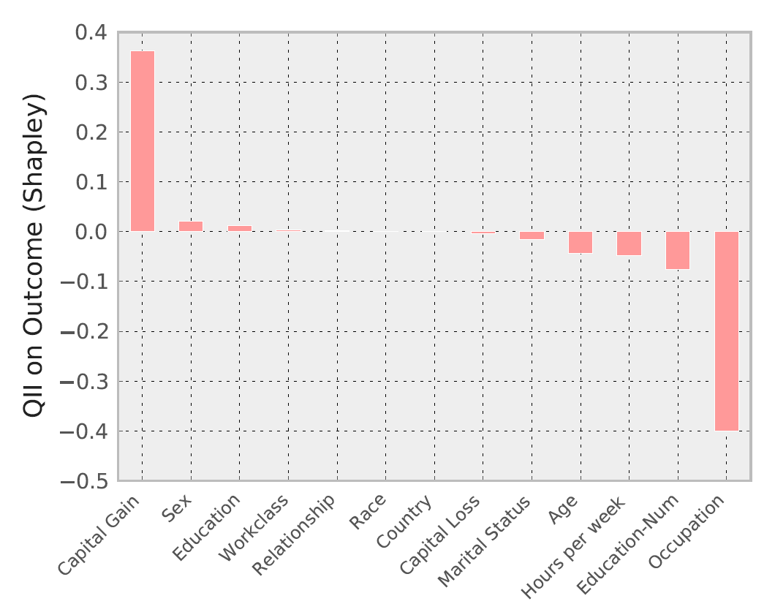
Quantitative Input Influence
In previous work, developed Quantitative Input Influence [QII].
Provides quantitative measurements on the causal influence of each feature on the outcome of a decision procedure (like PPA).
Core idea: causal intervention
What would happen to the decision outcome for an individual were some set of features S replaced randomly?
QII of S is high:
Features S have high influence on the positive outcome of decision.
QII of S is low:
S has high influence on negative outcome.
QII of S is zero: no influence.
S has no influence on the outcome.
features
Complex Procedure
outcome
QII
Figure: QII Example

Slide 4
Transparency for PPA
(aggregate)
features
First steps: apply QII to parts of the PPA decision pipeline.
Can answer: which aggregate features have high influence on my placement in a cluster?
Ongoing work: transparency for clustering models.
QII alone is a very coarse form of an explanation.
In addition to QII, we want to provide a hint as to what about the features is relevant to the outcome.
Ongoing work: explanation via abstraction (a simpler form of the original procedure).
F₁
QII
F₃
F₃
Decision tree
C₁
C₂
C₃
C₁
Cluster 1
???
Cluster 2
Clusters
???
Cluster 3

