Slide 1
Task 5: Transparency
Co-PI Anupam Datta
Computer Science Department
Electrical and Computer Engineering Department

Slide 2

Personalized Privacy Assistant setting
(aggregate)
features
Personalized Privacy Assistant [PPA] uses two models:
Clusters that group users into similar preferences.
Decision tree to quickly put a user into a cluster (without relying on the features used to construct clusters).
PPA makes policy decisions based on cluster a user belongs to.
Task 5: Transparency Goal: explain the decision of the PPA.
F₁
F₃
F₃
Decision tree
C₁
C₂
C₃
C₁
Cluster 1
Cluster 2
Clusters
Cluster 3

Slide 3

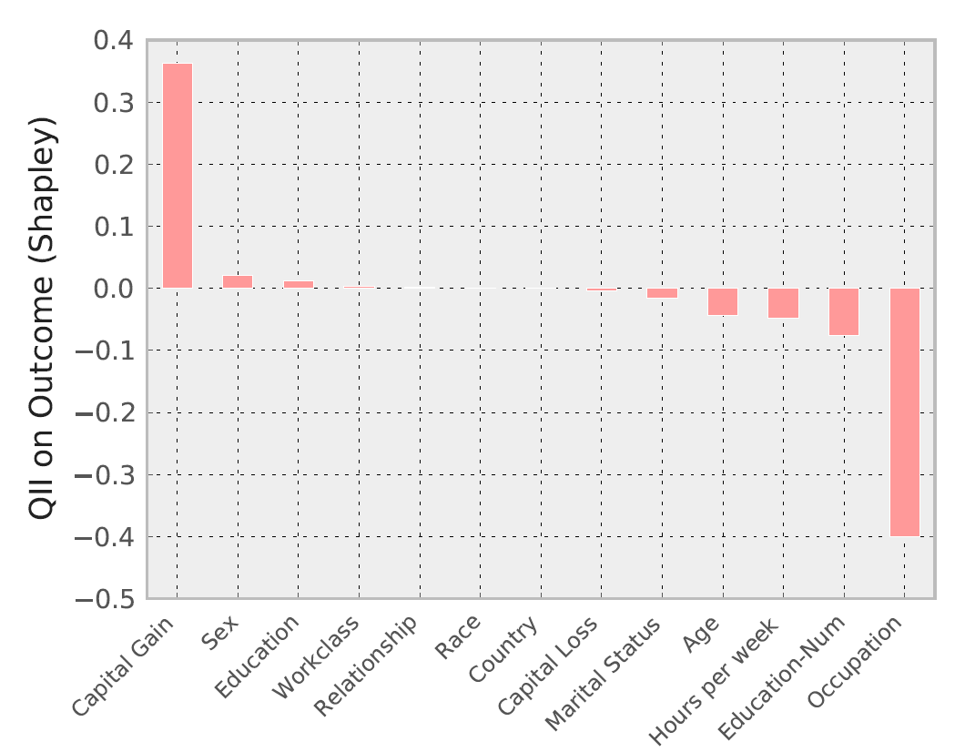
Quantitative Input Influence
In previous work, developed Quantitative Input Influence [QII].
Provides quantitative measurements on the causal influence of each feature on the outcome of a decision procedure (like PPA).
Core idea: causal intervention
What would happen to the decision outcome for an individual were some set of features S replaced randomly?
QII of S is high:
Features S have high influence on the positive outcome of decision.
QII of S is low:
S has high influence on negative outcome.
QII of S is zero: no influence.
S has no influence on the outcome.
features
Complex Procedure
outcome
QII
Figure: QII Example

Slide 4
Transparency for PPA
(aggregate)
features
First steps: apply QII to parts of the PPA decision pipeline.
Can answer: which aggregate features have high influence on my placement in a cluster?
Ongoing work: transparency for clustering models.
QII alone is a very coarse form of an explanation.
In addition to QII, we want to provide a hint as to what about the features is relevant to the outcome.
Ongoing work: explanation via abstraction (a simpler form of the original procedure).
F₁
QII
F₃
F₃
Decision tree
C₁
C₂
C₃
C₁
Cluster 1
???
Cluster 2
Clusters
???
Cluster 3

Slide 5
Quantitative Input Influence
features
Complex Procedure
outcome
In previous work, developed Quantitative Input Influence [QII].
Provides quantitative measurements on the causal influence of each feature on the outcome of a decision procedure (like PPA).
QII alone is a very coarse form of an explanation.
In addition to QII, we want to provide a hint as to what about the features is relevant to the outcome.
Idea: explanation via abstraction (a simpler form of the original procedure).
QII
Figure: QII Example

Slide 6

Explanations and Abstraction
Explanation via abstraction.
An abstraction of a procedure can serve as an explanation if:
Is sufficiently simple for a human to discern the cause of an outcome.
Preserves the causal relationships between influential features and outcomes.
Preserves behaviour of the procedure on the individual of interest. Does not need to be accurate for other individuals.
White-box abstraction
Can use structure of the procedure. E.g. tree nodes/leafs, clusters, etc.
Black-box abstraction
Need to create a new procedure but can use input/output behaviour of the black box. E.g. train a decision tree on a dataset agreeing with procedure and centered around individual of interest.
features
Complex Procedure
outcome
Abstraction
(subset of)
features
Simple Procedure
outcome

Slide 7
Abstractions for PPA decisions
(aggregate)
features
Personalized Privacy Assistant uses two models:
Clusters that group users into similar preferences.
Decision tree to quickly put a user into a cluster (without relying on the features used to construct clusters).
An explanation of a privacy policy decision will need to explain both:
Why was I placed in group (cluster) X?
Why was group (cluster) X formed?
Can use abstraction for explaining decision tree.
Ongoing work: explaining clusters.
F₁
Abstraction
F₃
F₃
Decision tree
F₃
C₁
C₂
C₃
C₁
C₃
Not C₃
Explanation
Cluster 1
Cluster 2
Clusters
???
Cluster 3

