Slide 1
Accountable Big Data Systems
Anupam Datta
Computer Science Department
Electrical and Computer Engineering Department
Carnegie Mellon University
MIT Big Data@CSAIL Data Privacy Series
September 7, 2016

Slide 2
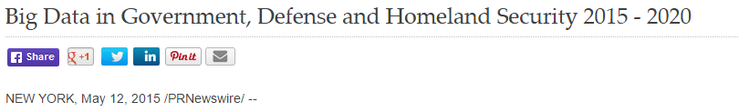

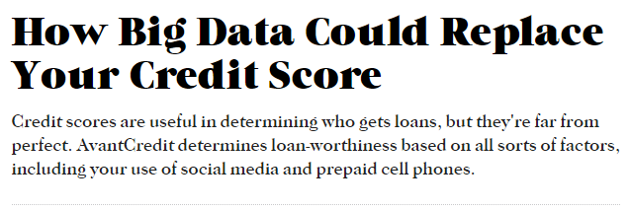
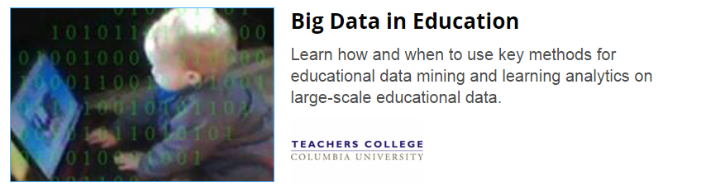
Big Data Systems are Ubiquitous
Credit
Web services
Healthcare
Education
Law Enforcement
…
Notes:
Learning Systems are Ubiquitous.
Machine learning and data analytics are increasingly being used in areas which have significant impact on peoples lives.
For example, in predictive policing, the police pays you a visit based on advice from a computer.
0:40
Transition: On the other hand these systems can be very opaque.

Slide 3


Big Data Systems Threaten Fairness Explicit Use [Datta, Tschantz, Datta 2015]
1816
Online
Advertising System
User data
Decisions
311
$200k+ Jobs

Slide 4
Big Data Systems Threaten Privacy Proxy Use [Datta, Fredrikson, Ko, Mardziel, Sen 2016]
Using pregnancy status for marketing [Target 2012]
Pregnant?
Associated
Accountable Big Data Systems
Oversight to detect violations and explain behaviors
Correction to prevent future violations
Used
Pre-natal vitamins?
Scent-free lotion?
Classifier
Diaper coupons?

Slide 5
Use Restrictions in Big Data Systems [Datta, Fredrikson, Ko, Mardziel, Sen, Tschantz 2016]
Do not use a protected information type (explicit or proxy use) for certain purposes with some exceptions
Non-discrimination:
Do not use race or gender for employment decisions; business necessity exceptions
Usage Privacy:
Do not use health information for purposes other than those of healthcare context; exceptions for law enforcement

Slide 6

Formalizing Explicit Use | Decisions with Explanations [Datta, Sen, Zick 2016]
How much causal influence do various inputs (features) have on a classifier’s decision about individuals or groups?
Age | 27
Workclass | Private
Education | Preschool
Marital Status | Married
Occupation | Farming-Fishing
Relationship to household income | Other Relative
Race | White
Gender | Male
Capital gain | $41310
…..
Negative Factors:
Occupation
Education Level
Positive Factors:
Capital Gain

Slide 7

Challenge | Correlated Inputs
Example: Credit decisions
Conclusion: Measures of association not informative
Classifier
(uses only income)
Age
Decision
Income
Notes:
Transition in: However, when inputs are correlated, input attribution can be challenging
Transition out: Further, people need different kinds of transparency reports

Slide 8
Challenge | General Class of Transparency Queries
Individual
Which input had the most influence in my credit denial?
Group
What inputs have the most influence on credit decisions of women?
Disparity
What inputs influence men getting more positive outcomes than women?
Notes:
Transition in: Further, people need different kinds of transparency reports
Transition out: To solve these problems ..

Slide 9
Result | Quantitative Input Influence (QII)
A technique for measuring the influence of an input of a system on its outputs.
Causal Intervention
Deals with correlated inputs
Quantity of Interest
Supports a general class of transparency queries
Notes:
Transition in: To solve these problems we develop a family of measures known as quantitative input influence.
Transition out: For the rest of this talk I will explain the definition of QII through these three key ideas.

Slide 10


Key Idea 1| Causal Intervention
Classifier
(uses only income)
Age
21
44
28
63
Decision
Income
$90K
$20K
$100K
$10K
Replace feature with random values from the population, and examine distribution over outcomes.
Notes:
Slow it down.
We go back to Joe’s credit denial. To determine whether Age had an influence on his outcome we replace his age with a random age from the population, and observe that his outcome does not change at all.
On the other hand, when we replace his income, this has a large impact on his outcome.
Essentially, by breaking the correlation between age and income, we can identify causal relations in the model.
Intuitively, the influence of income

Slide 11












QII for Individual Outcomes
$$U_{i}$$
Inputs: $i∈N$
$$X$$
$$x_{1}$$
$$x_{2}$$
…
$$x_{i}$$
…
$$X_{−i}U_{i}$$
$$x_{1}$$
$$x_{2}$$
…
$$u_{i}$$
$$x_{i}$$
…
$$c$$
$$c$$
Classifier
Outcome
$$Pr\left[c\left(X\right)=1 \right| X=x_{Joe}]$$
$$Pr\left[c\left(X_{−i}U_{i}\right)=1 \right| X=x_{Joe}]$$
Causal Intervention: Replace feature with random values from the population, and examine distribution over outcomes.
Notes:
Transition in: More formally
More formally, this is what things look like.
Consider a classifier that takes as input a vector of features x1 .. xn, and outputs 0 or 1.
I want to measure the influence of input i on the classification of some individual x
Transition out: One can generalize this..

Slide 12
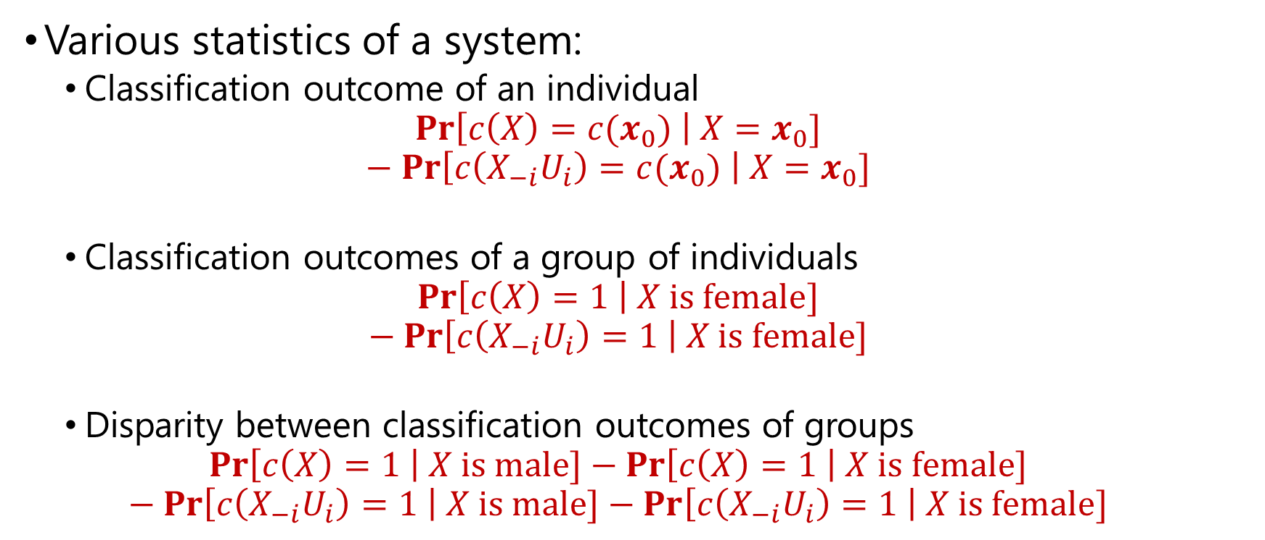
Key Idea 2| Quantity of Interest
Various statistics of a system:
Classification outcome of an individual
$$Pr\left[c\left(X\right)=c(x_{0}) \right| X=x_{0}]$$
$$− Pr\left[c\left(X_{−i}U_{i}\right)=c(x_{0}) \right| X=x_{0}]$$
Classification outcomes of a group of individuals
$$Pr\left[c\left(X\right)=1 \right| X is female]$$
$$− Pr\left[c\left(X_{−i}U_{i}\right)=1 \right| X is female]$$
Disparity between classification outcomes of groups
$$Pr\left[c\left(X\right)=1 \right| X is male]−Pr\left[c\left(X\right)=1 \right| X is female]$$
$$− Pr\left[c\left(X_{−i}U_{i}\right)=1 \right| X is male]−Pr\left[c\left(X_{−i}U_{i}\right)=1 \right| X is female]$$
Notes:
Transition in: One can generalize this:
Talk about disparate impact.
General mathematical definition of quantity of interest.
Transiton out: Putting these pieces together.

Slide 13

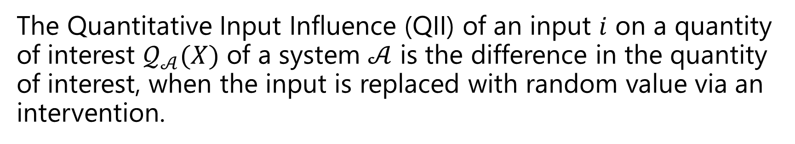
QII | Definition
The Quantitative Input Influence (QII) of an input $i$ on a quantity of interest $𝒬_{𝒜}(X)$ of a system $𝒜$ is the difference in the quantity of interest, when the input is replaced with random value via an intervention.
$$ι^{𝒬_{𝒜}}\left(i\right)=𝒬_{𝒜}\left(X\right)−𝒬_{𝒜}(X_{−i}U_{i})$$
Notes:
Transition in: Putting these pieces together
Transition out: To illustrate this simple QII definition,let’s look at some experiments.

Slide 14
Result | Quantitative Input Influence (QII)
A technique for measuring the influence of an input of a system on its outputs.
Causal Intervention
Deals with correlated inputs
Quantity of Interest
Supports a general class of transparency queries
Notes:
Transition: I’ll illustrate some of these concepts with an example of an explanation.

Slide 15
Result | Quantitative Input Influence (QII)
A technique for measuring the influence of an input of a system on its outputs.
Causal Intervention
Deals with correlated inputs
Quantity of Interest
Supports a general class of transparency queries
Notes:
Transition in: Now that we I’ve explained the first two pieces of the QII definition, we move to the third part. And this insight is a bit cute.

Slide 16
Challenge | Single Inputs have Low Influence
Classifier
Only accept old, high-income individuals
Young
Age
Decision
Low
Income
Notes:
Transition in: To see why we need something more than just influence of single inputs.
The influence of individual inputs may not be significant in itself.
For young, low income individual, age and income alone don’t influence the outcome.
However, jointly age and income can significantly influence outcome
Intersting things happen because of interactions between different features

Slide 17






Naïve Approach | Set QII
Replace $X_{S}$ with a independent random value from the joint distribution of inputs $S⊆N$.
$$ι\left(S\right)=𝒬\left(X\right)−𝒬(X_{−S}U_{S})$$
$$S$$
$$x_{1}$$
$$x_{2}$$
…
$$x_{i}$$
…
$$x_{1}$$
$$x_{2}$$
…
$$u_{i}$$
$$u_{1}$$
$$x_{i}$$
…
$$c$$
$$c$$
Notes:
Simple lifting of the randomized intervention from inputs $i∈N$ to sets of inputs $S⊆N$.
Set and marginal influence are only stepping stones.

Slide 18

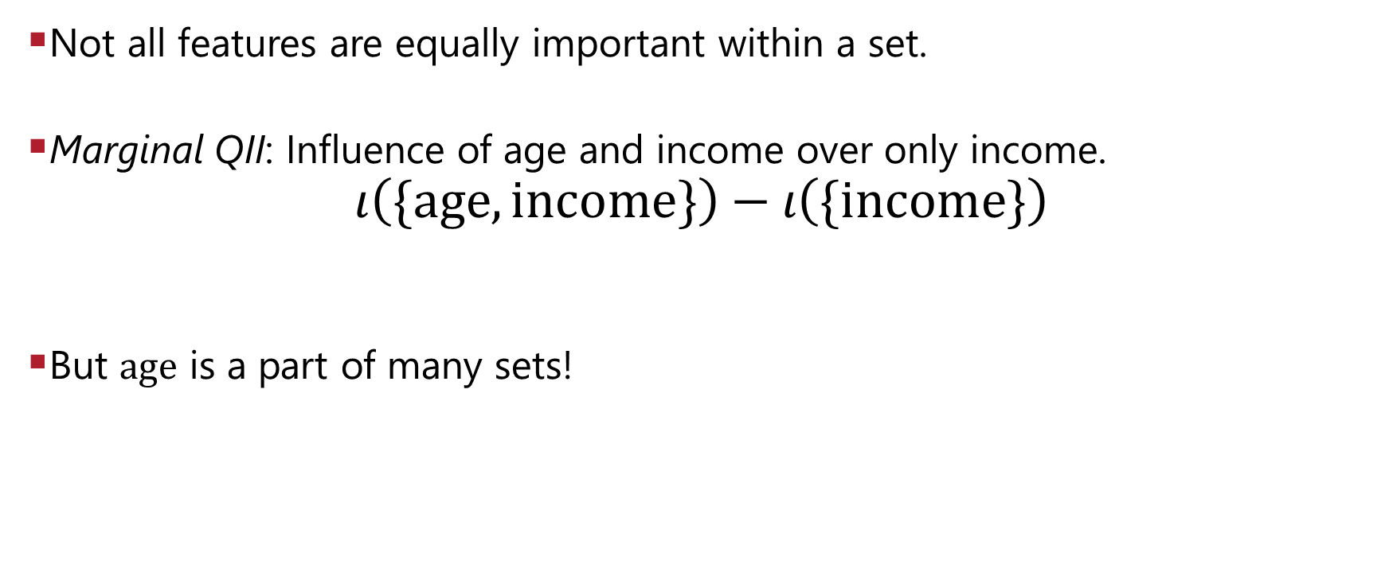


Marginal QII
Not all features are equally important within a set.
Marginal QII: Influence of age and income over only income.
$$ι\left(\{age, income\}\right)−ι\left(\{income\}\right)$$
But $age$ is a part of many sets!
$$ι\left(\{age, gender, job\}\right)−ι\left(\{gender, job\}\right)$$
$$ι\left(\{age\}\right)−ι\left(\{\}\right)$$
$$ι\left(\{age, gender\}\right)−ι\left(\{gender\}\right)$$
$$ι\left(\{age, job\}\right)−ι\left(\{job\}\right)$$
$$ι\left(\{age, gender, job\}\right)−ι\left(\{gender, job\}\right)$$
$$ι\left(\{age, gender, income\}\right)−ι\left(\{gender, income\}\right)$$
$$ι\left(\{age, gender, income,job\}\right)−ι\left(\{gender, income,job\}\right)$$

Slide 19
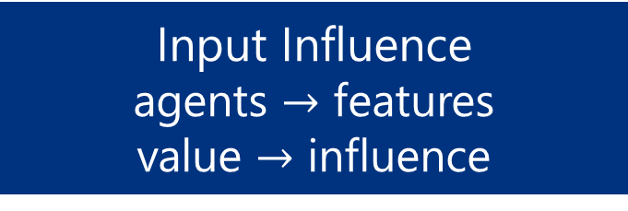
Key Idea 3| Set QII is a Cooperative Game
Cooperative game
set of agents
value of subsets
Voting
Revenue Sharing
Input Influence
agents $→$ features
value $→$ influence
Notes:
Transition in: Set QII can be viewed as a cooperative game.
Cooperative games come in all shapes and sizes.
Transition out: Turns out, according to a classic construction by Lloyd Shapley in 1953, … there is exactly one way of solving this problem, if we assume some very reasonable axioms.

Slide 20

Shapley Value
[Shapley’53] For cooperative games, the only aggregation measure that satisfies symmetry, dummy, and monotonicity is:
Need to compute sum over all subsets of features:
Efficient approximation by randomly sampling sets
Notes:
Transition in: Turns out, according to a classic construction by Lloyd Shapley in 1953, … there is exactly one way of solving this problem, if we assume some very reasonable axioms.
Transition out: Let’s look at what explanations look like in some of our experiments

Slide 21
Experiments | Test Applications
arrests
Predictive policing using the National Longitudinal Survey of Youth (NLSY)
Features: Age, Gender, Race, Location, Smoking History, Drug History
Classification: History of Arrests
~8,000 individuals
income
Income prediction using a benchmark census dataset
Features: Age, Gender, Relationship, Education, Capital Gains, Ethnicity
Classification: Income >= 50K
~30,000 individuals
Implemented with Logistic Regression, Kernel SVM, Decision Trees, Decision Forest
Notes:
Transition in: We conducted to experiments.
Transition out: Let’s look at a particular experiments.

Slide 22
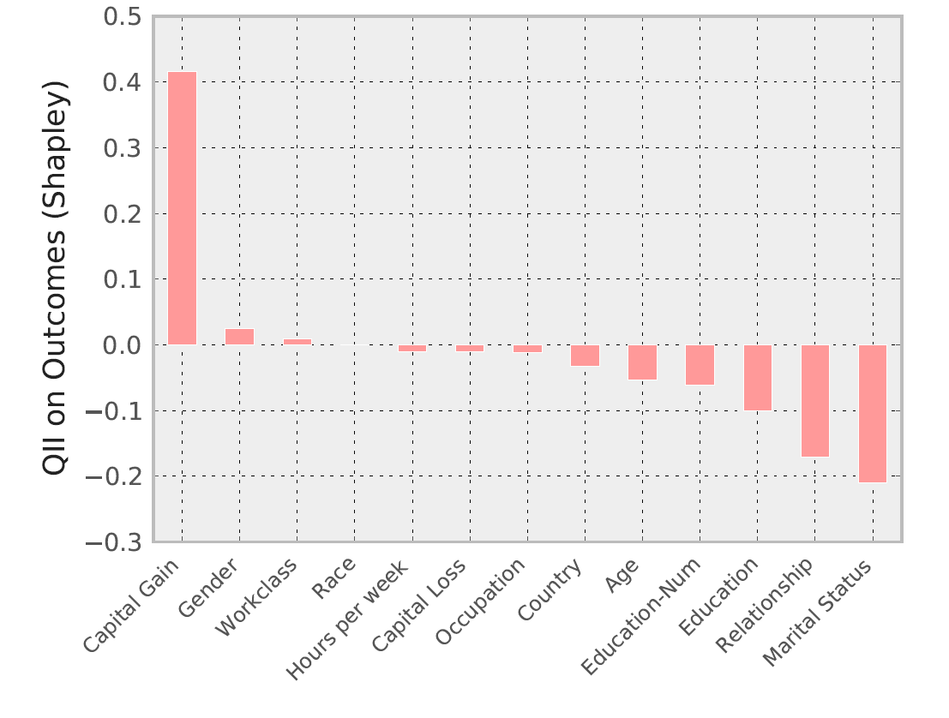
Personalized Explanation | Mr X
Age | 23
Workclass | Private
Education | 11th
Marital Status | Never married
Occupation | Craft repair
Relationship to household income | Child
Race | Asian-Pac Island
Gender | Male
Capital gain | $14344
Capital loss | $0
Work hours per week | 40
Country | Vietnam
Age | 23
Workclass | Private
Education | 11th
Marital Status | Never married
Occupation | Craft repair
Relationship to household income | Child
Race | Asian-Pac Island
Gender | Male
Capital gain | $14344
Capital loss | $0
Work hours per week | 40
Country | Vietnam
Can assuage concerns of discrimination.
income
income

Slide 23
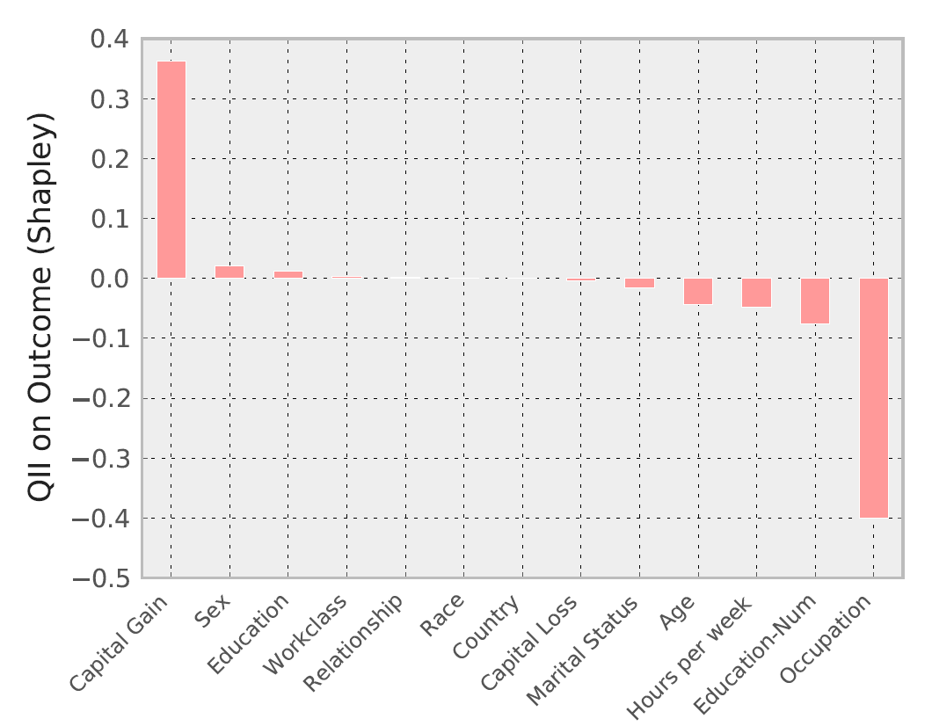
Personalized Explanation | Mr Y
Age | 27
Workclass | Private
Education | Preschool
Marital Status | Married
Occupation | Farming-Fishing
Relationship to household income | Other Relative
Race | White
Gender | Male
Capital gain | $41310
Capital loss | $0
Work hours per week | 24
Country | Mexico
Age | 27
Workclass | Private
Education | Preschool
Marital Status | Married
Occupation | Farming-Fishing
Relationship to household income | Other Relative
Race | White
Gender | Male
Capital gain | $41310
Capital loss | $0
Work hours per week | 24
Country | Mexico
Explanations of superficially similar people can be different.
income

Slide 24
Result | Quantitative Input Influence (QII)
A technique for measuring the influence of an input of a system on its outputs.
Causal Intervention
Deals with correlated inputs
Quantity of Interest
Supports a general class of transparency queries
Cooperative Game
Computes joint and marginal influence
Performance
QII measures can be approximated efficiently

Slide 25
Related Work: QII
Randomized Causal Intervention
Feature Selection: Permutation Importance [Breiman 2001]
Importance of Causal Relations [Janzing et al. 2013]
Do not consider marginal influence or general quantities of interest
Associative Measures
Quantitative Information Flow: Appropriate for secrecy
FairTest [Tramèr et al. 2015]
Correlated inputs hide causality
Interpretability-by-design
Regularization for simplicity (Lasso)
Bayesian Rule Lists [Letham et al. 2015]
Potential loss in accuracy

Slide 26
Related Work: Accountability for Use Restrictions
Accounting for proxies and their causal use is missing
Usage control in computer security, Sandhu and Park 2002
Information accountability, Weitzner et al. 2008
Audit algorithms for privacy policies, Garg, Jia, Datta 2011
Enforcing purpose restrictions in privacy policies, Tschantz, Datta, Wing 2012
Privacy compliance of big data systems, Sen, Guha, Datta, Rajamani, Tsai, Wing 2014
Fairness in big data systems
Group fairness [Feldman+ 2015]: detection and repair of disparate impact; does not account for proxy usage in general
Individual fairness [Dwork et al. 2011]: focus on correctness by construction not accountability

Slide 27
Use Restrictions in Big Data Systems [Datta, Fredrikson, Ko, Mardziel, Sen, Tschantz 2016]
Do not use a protected information type (explicit or proxy use) for certain purposes with some exceptions
Non-discrimination:
Do not use race or gender for employment decisions; business necessity exceptions
Usage Privacy:
Do not use health information for purposes other than those of healthcare context; exceptions for law enforcement
Accountable Big Data Systems
Oversight to detect violations and explain behaviors
Correction to prevent future violations

Slide 28
Open Problem
Accountable deep learning to ensure non-discrimination and usage privacy

Slide 29
Thanks!
Notes:
Figure out takeaway for the talk

