Slide 1
Accountable Big Data Systems with Proxy Usage
Peter Mardziel
(with Anupam Datta, Matt Fredrikson, Gihyuk Ko, Shayak Sen)
(work in progress, criticism welcome,desired)

Slide 2
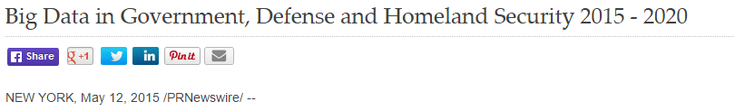
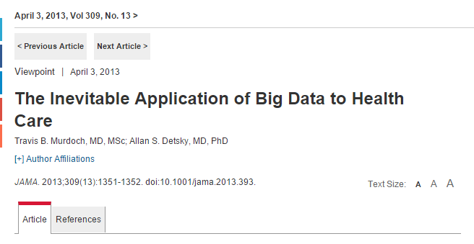
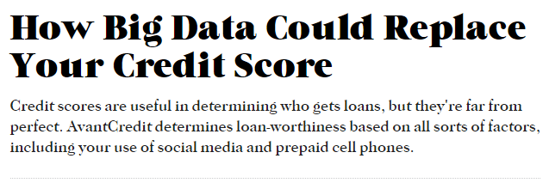
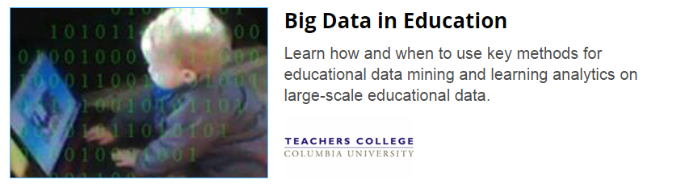
Big Data Systems are Ubiquitous
Credit
Web services
Healthcare
Education
Law Enforcement
…
Notes:
Learning Systems are Ubiquitous.
Machine learning and data analytics are increasingly being used in areas which have significant impact on peoples lives.
For example, in predictive policing, the police pays you a visit based on advice from a computer.
0:40
Transition: On the other hand these systems can be very opaque.

Slide 3


Big Data Systems Threaten Fairness Explicit Use [Datta, Tschantz, Datta 2015]
1816
Online
Advertising System
User data
Decisions
311
$200k+ Jobs

Slide 4
Big Data Systems Threaten Fairness/Privacy
Use of race (via zip-code) for credit decisions (redlining)
Using pregnancy status (via past purchases) for marketing [Target 2012]

Slide 5
Use Restrictions in Big Data Systems
Do not use a protected information type (explicit or proxy use) for certain purposes with some exceptions
Non-discrimination:
Do not use race or gender for employment decisions; business necessity exceptions
Usage Privacy:
Do not use health information for purposes other than those of healthcare context; exceptions for law enforcement

Slide 6
Formalizing Explicit Use | Decisions with Explanations [Datta, Sen, Zick 2016]
How much causal influence do various inputs (features) have on a classifier’s decision about individuals or groups?

Slide 7

Explicit Use Challenge | Correlated Inputs
Example: Credit offers
Conclusion: Measures of association not informative
Classifier
(uses only zip-code)
Zip-code
Decision
Race
Notes:
Transition in: However, when inputs are correlated, input attribution can be challenging
Transition out: Further, people need different kinds of transparency reports

Slide 8
Proxy Use Challenge | Uncorrelated Inputs
Example: Credit offers
Measures of association between input and output are not informative
Classifier
(uses only zip-code)
Zip-code
Decision
Race
Notes:
Transition in: However, when inputs are correlated, input attribution can be challenging
Transition out: Further, people need different kinds of transparency reports

Slide 9
Decision Trees
Zip-code
Classifier
Decision
Race
Race, Zip-code,…
Race, Zip-code,…
Race?
Zip-code?
Explicit use
white
black
z₁,z₃
z₂,z₄
Proxy use
(odd zip-codes are white,
even are black)
offer
no offer
offer
no offer
Decision
Decision

Slide 10
Self-fulfilling prophecy
Race, Zip-code, Interested
Zip-code?
z₁,z₃
z₂,z₄
Proxy use
(odd zip-codes are white,
even are black)
Problem: race not associated with decision.
Interested?
Interested?
yes
no
yes
no
offer
no offer
no offer
offer
Decision

Slide 11
Approach | Proxy Usage
Implicate part of a system as the source of a violation.
Race
Associated
Age
Income
Zip-code
Race
…
Classifier
Used
Credit offer?
Big data system

Slide 12

Violations
Race, Zip-code, Interested
Zip-code?
z₁,z₃
z₂,z₄
Proxy use
(odd zip-codes are white,
even are black)
Interested?
Interested?
yes
no
yes
no
offer
no offer
no offer
offer
Decision

Slide 13
Black-box vs. White-box
Race, Zip-code, Interested
Zip-code?
????
z₁,z₃
z₂,z₄
Zip-code
Decision
Interested?
Interested?
Race
no
yes
no
yes
offer
no offer
no offer
offer
Decision

Slide 14
Proxy Usage | Technical execution
Modeling systems
Characterizing Proxy usage
Detecting and repairing Proxy usage violations

Slide 15
Modeling Systems | Expression Language
⟨value⟩ ::= ℝ | True | False | ⟨string⟩
⟨exp⟩ ::= ⟨value⟩ | var
| op(⟨exp⟩ , … , ⟨exp⟩)
| if ( ⟨exp⟩ ) then { ⟨exp⟩ } else { ⟨exp⟩ }
Operations:
arithmetic operations: +, -, *, etc.
boolean connectives: or, and, not, etc.
relations: ==, <, ≤, >, etc.

Slide 16
Modeling Systems | Example
Race, Zip-code, Interested
if (Zip-Code == z₁ or Zip-Code == z₃) then {
if (Interested == “yes”)
then { “offer” }
else { “no-offer” }
} else {
if (Interested == “yes”)
then { “no-offer” }
else { “offer” }
}
Zip-code==z₁,z₃
true
false
Interested==yes
Interested==yes
true
false
true
false
offer
no-offer
no-offer
offer
Decision

Slide 17
Modeling Systems | Expression Language
⟨value⟩ ::= ℝ | True | False | ⟨string⟩
⟨exp⟩ ::= ⟨value⟩ | var
| op(⟨exp⟩ , … , ⟨exp⟩)
| if ( ⟨exp⟩ ) then { ⟨exp⟩ } else { ⟨exp⟩ }
Not in the language
var₁ = 42 + var₂ ;
somefun(var₁) ;
Expression semantics:
⟦exp⟧ : Instance → Value
Instance : Variable → Value
i₁ : race → “white”,
zipcode → 15221
Decision
Trees
Decision Forest
Bayes Rules
Linear
Regression
X Regression
…

Slide 18
Modeling Systems | Probabilistic Interpretation
Expression semantics:
⟦exp⟧ : Instance → Value
Let X be a random variable distributing instances of a database.
⟦exp⟧ : X → V
V is a random variable distributing the expression’s value.
Joint over input instances (X) and expression values (V_{i}) for each expression Exp_{i} .
Pr[ X, V₀, V₁, ..., V₉ ]
marginals: Pr[V₇ = True, V₀ = “offer”]
conditionals: Pr[V₇ = True | V₀ = “offer”]
Race, Zip-code, Interested
Exp₁
Exp₀
Zip-code==z₁,z₃
true
false
Exp₆
Exp₂
Exp₇
Exp₃
Interested==yes
Interested==yes
true
false
true
false
Exp₄
Exp₅
Exp₈
Exp₉
offer
no-offer
no-offer
offer
Decision

Slide 19
Proxy Usage | Technical execution
Modeling systems
Characterizing Proxy usage
Detecting and repairing Proxy usage violations

Slide 20
Characterizing Proxy Usage
Association
Usage / influence
Race
Associated
Age
Income
Zip-code
Race
…
Classifier
Used
Credit offer?
Big data system

Slide 21
Association
Race, Zip-code,…
Race, Zip-code,…
Exp₀
Exp₁
Zip-code=z₁,z₃
Zip-code=z₁,z₂
Proxy use
(odd zip-codes are white,
even are black)
No use
true
false
true
false
offer
no offer
offer
no offer
Decision
Decision
correlated random variables X_{race}, V₀ = ⟦Exp₀⟧X
uncorrelated random variables X_{race}, V₁ = ⟦Exp₁⟧X

Slide 22
Association
How do we measure association between random variables?
Pearson correlation:
“Is there a linear dependence between these variables?”
Spearman correlation:
“Is there some monotonic dependence between these variables?”
Information theoretic measures:
“How much does knowledge of one variable reduce my uncertainty about the other?”

Slide 23
Information Theory | The Briefest Introduction
Surprise
Entropy
Mutual Information

Slide 24
Information Theory | The Briefest Introduction
Surprise [ I(p) ] – a measure of ”information” or the “surprise” in an event of probability p.
I(1) = 0
I(0.5) = 1
I(0.25) = 2
I(0) = undefined (or “infinite surprise”)
I(p) = - lg p

Slide 25
Information Theory | The Briefest Introduction
Entropy [ H(X) ] – a measure of “information” in a random variable, or “expected surprise”.
H(X) = E_{x←X} I(Pr[X=x])
H(X) = 0 if no uncertainty Pr[X = x_{i}] = 1
H(X) = lg|X| if Pr[X = x] = 1/|X| for every x
The expected number of yes or no questions required to answer in order to determine the value of X.
Expected size (in bits) of an optimal compression of the value of X.

Slide 26
Information Theory | The Briefest Introduction
Conditional Entropy [ H(X | Y) ] – a measure of “information” in a random variable X that remains after observing Y.
H(X | Y) = E_{y←Y} H(X | Y=y)
H(X | Y) = 0 if Y completely determines X
H(X | Y) = H(X) if X,Y are independent

Slide 27
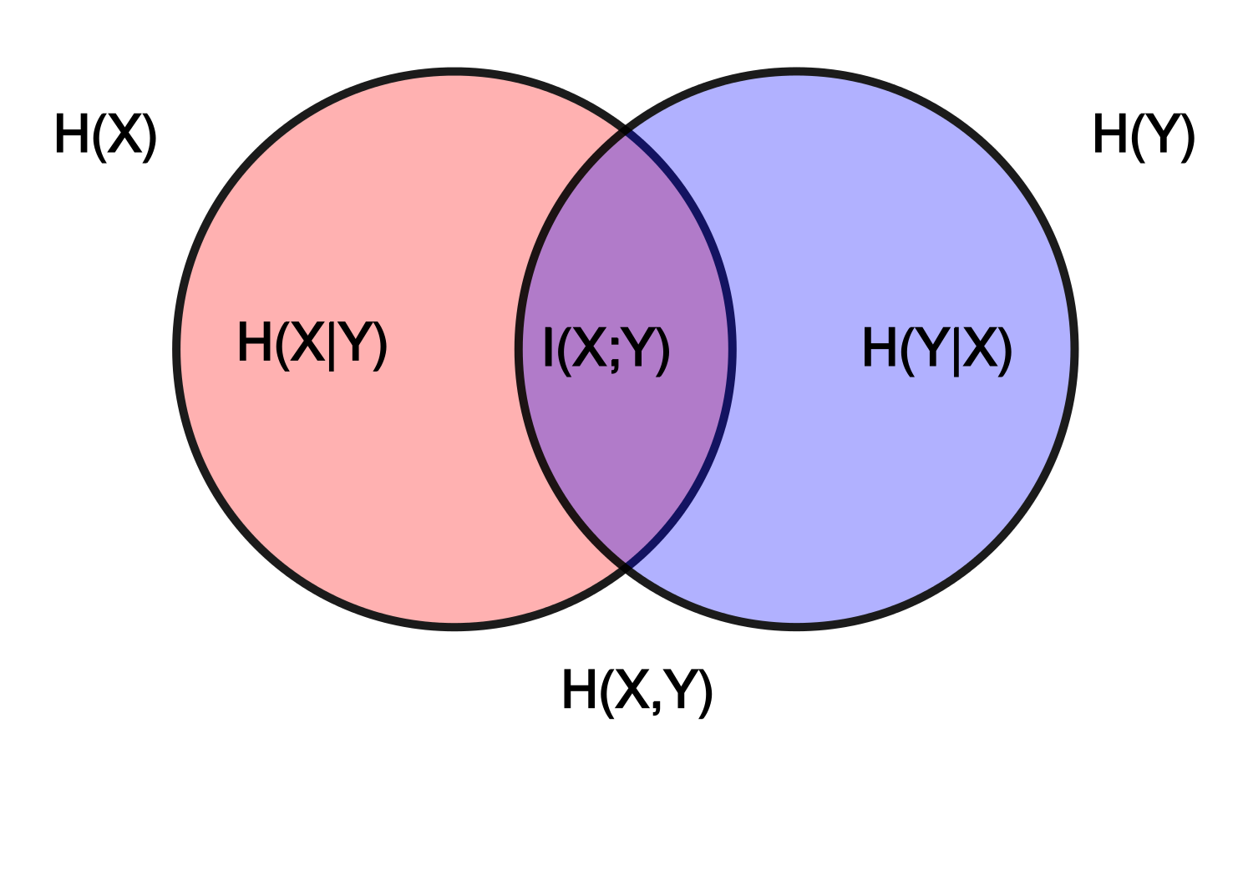
Information Theory | The Briefest Introduction
Mutual Information [ I(X;Y) ] – a measure of the dependence of two random variables.
I(X;Y) = H(X,Y) – H(X|Y) – H(Y|X)
I(X;Y) = 0 if X,Y are independent
I(X;Y) = H(X) = H(Y) = H(X,Y) if they are identical, correlated
0 ≤ I(X;Y) ≤ min{H(X), H(Y)} ≤ H(X,Y)

Slide 28
Association | Mutual Information
Race, Zip-code,…
Race, Zip-code,…
Exp₀
Exp₁
Zip-code=z₁,z₃
Zip-code=z₁,z₂
Proxy use
(odd zip-codes are white,
even are black)
No use
true
false
true
false
offer
no offer
offer
no offer
Decision
Decision
I(X_{race} ; ⟦Exp₀⟧X) is high
I(X_{race} ; ⟦Exp₁⟧X) is low

Slide 29
Association | Mutual Information
Race, Zip-code, Interested
I(X_{race} ; ⟦Exp₀⟧X) is low
Exp₁
Exp₀
Zip-code==z₁,z₃
I(X_{race} ; ⟦Exp₁⟧X) is high
true
false
Exp₆
Exp₂
Exp₇
Exp₃
Interested==yes
Interested==yes
true
false
true
false
Exp₄
Exp₅
Exp₈
Exp₉
offer
no-offer
no-offer
offer
Decision

Slide 30
Characterizing Proxy Usage
Association
Usage / influence
Race
Associated
Age
Income
Zip-code
Race
…
Classifier
Used
Credit offer?
Big data system

Slide 31
Use / Influence
1 == 2
true
false
Zip-code==z₁,z₃
...
true
false
Interested==yes
Interested==yes
...
...
true
false
true
false
offer
no-offer
no-offer
offer

Slide 32
Use / Influence
Zip-code==z₁,z₃
Zip-code==z₁,z₃
true
false
true
false
Interested==yes
Interested==yes
Interested==yes
Interested==yes
true
false
true
false
true
false
true
false
offer
no-offer
no-offer
offer
offer
no-offer
offer
no-offer
“Zip-code==z₁,z₃” has influence on outcome
“Zip-code==z₁,z₃” has NO influence on outcome

Slide 33












QII for Individual Outcomes
$$U_{i}$$
Inputs: $i∈N$
$$X$$
$$x_{1}$$
$$x_{2}$$
…
$$x_{i}$$
…
$$X_{−i}U_{i}$$
$$x_{1}$$
$$x_{2}$$
…
$$u_{i}$$
$$x_{i}$$
…
Intervention: replace a feature, keep everything else fixed.
$$c$$
$$c$$
Classifier
Outcome
$$Pr\left[c\left(X\right)=1 \right| X=x_{Joe}]$$
$$Pr\left[c\left(X_{−i}U_{i}\right)=1 \right| X=x_{Joe}]$$
Causal Intervention: Replace feature with random values from the population, and examine distribution over outcomes.
Notes:
Transition in: More formally
More formally, this is what things look like.
Consider a classifier that takes as input a vector of features x1 .. xn, and outputs 0 or 1.
I want to measure the influence of input i on the classification of some individual x
Transition out: One can generalize this..

Slide 34
Use / Influence
How much influence does expression Exp₁ have on the output for individual x₁?
Compare two executions of the system Exp₀
Without intervention: ⟦Exp₀⟧x₁
With intervention: ⟦Exp₀’⟧x₁
Exp₀’ is Exp₀ with Exp₁ replaced by ⟦Exp₁⟧x₂
Exp₁
Exp₀
Zip-code==z₁,z₃
true
false
Interested==yes
Interested==yes
true
false
true
false
offer
no-offer
no-offer
offer

Slide 35
Use / Influence
Without intervention: ⟦Exp₀⟧x₁
With intervention: ⟦Exp₀’⟧x₁ where Exp₀’ is Exp₀ with Exp₁ replaced by ⟦Exp₁⟧x₂
x₁ = (Zip-code = z_{1,}
Interested = yes,
Race = white)
⟦Exp₁⟧x₁ = True
⟦Exp₂⟧x₁ = offer
⟦Exp₃⟧x₁ = no-offer
⟦Exp₀⟧x₁ = offer
Exp₁
x₂ = (Zip-code = z_{2,}
Interested = yes,
Race = black)
⟦Exp₁⟧x₂ = False
⟦Exp₂⟧x₂ = offer
⟦Exp₃⟧x₂ = no-offer
⟦Exp₀⟧x₂ = no-offer
Zip-code==z₁,z₃
Exp₀
Exp₂
true
false
Exp₃
Interested==yes
Interested==yes
true
false
true
false
offer
no-offer
no-offer
offer
⟦Exp₁’⟧x₁ = ⟦Exp₁⟧x₂ = False
⟦Exp₂’⟧x₁ = ⟦Exp₂⟧x₁ = offer
⟦Exp₃’⟧x₁ = ⟦Exp₃⟧x₁ = no-offer
⟦Exp₀’⟧x₁ = no-offer

Slide 36
Use / Influence
Definition: (individual) Influence of Exp₁ in Exp₀ for x₁
Pr[⟦Exp₀⟧x₁ ≠ ⟦Exp₀’⟧x₁]
in Exp₀’, x₂ is sampled from X
Definition: (group) Influence of Exp₁ in Exp₀ for X
E_{x1←X} [ Influence of Exp₁ in Exp₀ for x₁ ]

Slide 37
Use / Influence
1 == 2
true
false
Zip-code==z₁,z₃
...
true
false
Interested==yes
Interested==yes
...
...
true
false
true
false
offer
no-offer
no-offer
offer
(Group) Influence of “Zip-code==z₁,z₃” in the whole tree is 0

Slide 38
Use / Influence
Zip-code==z₁,z₃
Zip-code==z₁,z₃
true
false
true
false
Interested==yes
Interested==yes
Interested==yes
Interested==yes
true
false
true
false
true
false
true
false
offer
no-offer
no-offer
offer
offer
no-offer
offer
no-offer
“Zip-code==z₁,z₃” has (group) influence on tree
“Zip-code==z₁,z₃” has zero (group) influence on tree

Slide 39
Quantitative Characterizing Proxy Usage
Association
Usage / influence
Race
Associated
Definition:
exp in system has (ε, δ)-proxy usage of A when
association of exp with A ≥ ε, and
influence of exp in system ≥ δ
Age
Income
Zip-code
Race
…
Classifier
Used
Definition:
a system has (ε, δ)-proxy usage of A when
it contains an exp with (ε, δ)-proxy usage of A
Credit offer?
Big data system

Slide 40
Proxy Usage | Technical execution
Modeling systems
Characterizing Proxy usage
Detecting and repairing Proxy usage violations
Accountable Big Data Systems
Oversight to detect violations and explain behaviors
Correction to prevent future violations

Slide 41
Witnesses
Race, Zip-code, Interested
Race, Zip-code,…
Exp₁
Exp₀
Zip-code==z₁,z₃
Exp₀
true
false
Zip-code=z₁,z₃
Exp₂
Exp₆
Exp₃
Exp₇
Interested==yes
Interested==yes
true
false
true
false
true
false
offer
no offer
Exp₈
Exp₉
Using Witnesses
Localize where the violation occurs in a system
Localize where scrutiny/human eyeballs need to be applied
Localize where repair should be applied
Exp₄
Exp₅
offer
no-offer
no-offer
offer
Decision
Decision

Slide 42
Detecting Proxy Usage
Does system have an (ε, δ)-proxy-usage of attribute Race?
Naive algorithm O(S*N²)
S -- number of expressions
N – dataset instances
Influence
in O(N)
Association
Approximation
Influence
Approximation
Influence Monotonicity
Amortized
Evaluation
…

Slide 43
Repairing Proxy Usage
Have (ε, δ)-proxy-usage violation, an expression Exp_{i}
How can we remove it?
Naive algorithm
Replace Exp_{i} with a constant
O( 1 ) // any constant
O( N * M ) // best constant, M – the number of values Exp_{i} can attain

Slide 44
Repair
Race, Zip-code, Interested
Race, Zip-code,…
Exp₁
Exp₀
Zip-code==z₁,z₃
true
Exp₀
offer
true
false
Zip-code=z₁,z₃
Exp₂
Exp₆
Exp₃
Exp₇
Interested==yes
Interested==yes
true
false
true
false
true
false
offer
no offer
Exp₄
Exp₅
Exp₈
Exp₉
offer
no-offer
no-offer
offer
Decision
Decision

Slide 45
Repairing Proxy Usage
Have (ε, δ)-proxy-usage violation, an expression Exp_{i}
How can we remove it?
(Slightly less) Naive algorithm
Replace an Exp_{i} (nearby violation Exp) with a constant O(s * N * M)
s – the number of “nearby” expressions

Slide 46
Nearby Expression Repair
...
true
false
Exp₁
Exp₀
Zip-code==z₁,z₃
...
Exp₂
true
false
Exp₅
Exp₃
Exp₄
true
Interested==yes
Interested==yes
...
...
true
false
true
false
offer
no-offer
no-offer
offer

Slide 47
Experiments
Income prediction using a benchmark census dataset
Gender, Education, Capital Gains, Ethnicity, others
Marital status Married-civ-spouse, Divorced, Never-married, Separated, Widowed, Married-spouse-absent, Married-AF-spouse
Age
Classification: Income <50k,>= 50K
~30,000 individuals
Income
model accuracy
83.6 %
...
after maximal repair 80.7 %
Age ≤ 30
~
Marital status
true
false
after minimal repair 81.7 %
...
...

Slide 48
Experiments
Contraception method of married women predicted from family information.
Wife's age, Husband's education, Number of children ever born, Wife's now working?, Husband's occupation, Standard-of-living index, Media exposure
Wife's education 1=low, 2, 3, 4=high
Wife's religion 0=Non-Islam, 1=Islam
Classification: Contraceptive method used 1=No-use 2=Long-term 3=Short-term
1473 individuals
Indonesian contraception
model accuracy
61.2%
...
after maximal repair 52.2%
Wife’s education ≤ 3
~
Wife’s religion
true
false
after minimal repair 61.2%
...
...

Slide 49
Further Problems
Parameter setting and interpretation (ε, δ)-proxy usage
Individual influence/association
Deep learning models / Neural networks
Adversarial considerations

Slide 50
The Big Picture
Race
Associated
Age
Income
Zip-code
Race
…
Classifier
Accountable Big Data Systems
Oversight to detect violations and explain behaviors
Correction to prevent future violations
Credit offer?
Big data system

