Slide 1
Data science week 12
August 2020 Data Science Cohort

Slide 2

Attendance Code
Attendance code time! Check the chat
Notes:
Start a 45 min timer

Slide 3
Michelle’s notes
Chaotic night for anyone else?
Class recordings can be found on Canvas in the attendance assignment for the week
Catch-up plans with Jessi
SHOUT OUT TO BETH!

Slide 4
Agenda
Today’s Agenda:
Concept Coverage
Special Guest Matthew Warner
Project Presentation – Corissa
Quiz Review
Q&A
Ask us anything (ML, Python, Career Cwestions)

Slide 5
Machine learning
What is Machine Learning?
Andrew Ng:
The field of study that gives computers the ability to learn without being explicitly taught
A well-posed learning problem is defined as: a computer program is said to learn from experience E with respect to some task T and some performance measure P, if its performance on T, as measured by P, improves with experience E.
Google:
ML systems learn how to combine input to produce useful predictions on never-before-seen data
Notes:
Other
Educating electronics with evaluting equations

Slide 6
Machine learning
Supervised vs unsupervised learning
Supervised: the algorithm is trained on labeled data.
You show the machine examples of things you want it to predict, and it will learn how to make more of those predictions
Examples: house prices, spam email filters
Unsupervised: the algorithm is trained on unlabeled data
You give the machine data and ask it to find interesting patterns for you
Examples: customer groups

Slide 7
Machine learning
Supervised learning: regression vs. classifiers
Regression: predicts a continuous variable
E.g. price, temperature, size
Classifier: predicts a category
E.g. loan default or not, tumor malignant or not

Slide 8
Machine learning
Useful vocabulary
Label – Prediction target
Feature – An aspect of the data point that will be used to model/predict a label
Example – one datapoint in your dataset, “one particular instance of your data”
Model – the relationship between features and label
Training – when you show the machine data to generate a model

Slide 9
Linear Regression
Linear regression: Supervised or unsupervised?
Type of machine learning where you’ll give your program a dataset with some features and labels, and it will fit an equation (line) to predict what other observations’ label will be

Slide 10
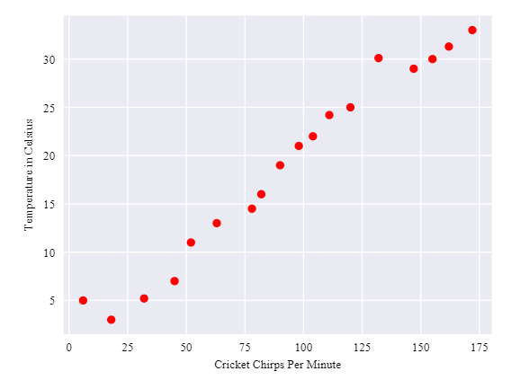
Linear Regression

Slide 11
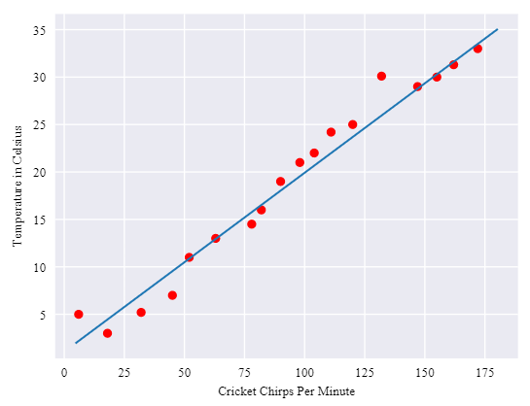
Linear Regression
Algebra class:
y = mx + b
Google:
y’ = b + w₁x₁
Coursera:
h_{θ}(x) = θ₀ + θ₁x
For more features: y’ = b + w₁x₁ +w₂x₂ + … w_{n}x_{n}

Slide 12
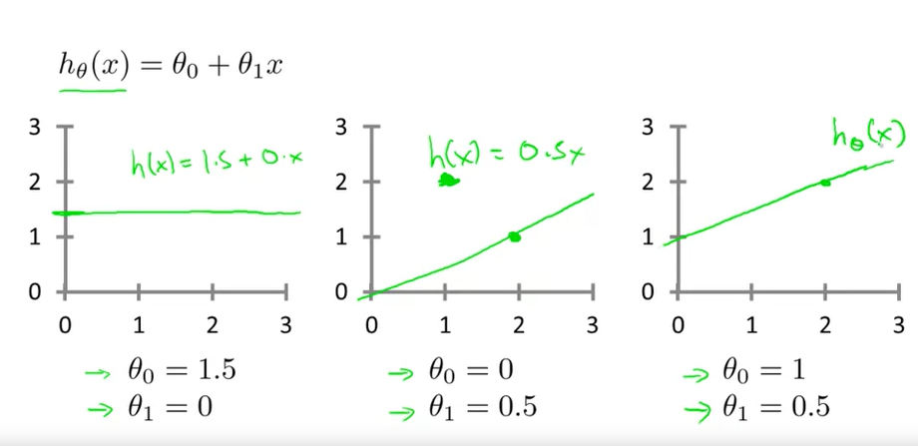
Linear Regression

Slide 13
Cost function
Okay, so in linear regression, you have some data points, you ask the computer to fit an equation to it, you use that equation to predict the label value of new points. Easy.
… how does the computer know what line to fit?

Slide 14
Cost function
Cost function
How a machine learning algorithm figures out if it’s getting better
Cost functions are a way to quantify how wrong the machine learning algorithm’s predictions are
Lower is better for a cost function
There are different type of costs functions for different algorithms. For Linear Regression, we’ve been looking at the squared error

Slide 15
Cost function
Cost function: (∑(prediction – actual)²)/M

Slide 16


Cost function
Google:
Coursera:

Slide 17
Gradient descent
Gradient descent
Initialize your weights randomly (“w” in Google terms, “θ” in Coursera terms)
Loop:
Calculate the cost function for those weights
Look at what it would take in changing the weights to make the cost function go down
Change the weights accordingly

Slide 18

Cost function
Google:
Coursera:
Notes:
Kelly – what I did here was explain this again in the context of the previous slide. So I said okay let’s randomly fit a line. Then I drew one, not the perfect one. I said okay just randomly we got this line. Let’s see what the errors are. Then I drew some error lines. And I said okay, let’s do a round of gradient descent. How can we draw a better line? Gradient descent is what tells us what direction to move the line.

Slide 19
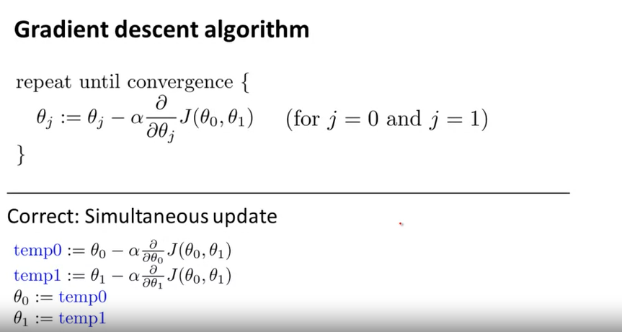
Gradient Descent
Notes:
Here I said okay here’s the technical description, and this looks like it has a lot of dense technical notation. But all it is saying it, let’s take a step towards the better line, where “better” means a step that makes the cost function smaller. How do we know what step to take to make the cost smaller?

Slide 20
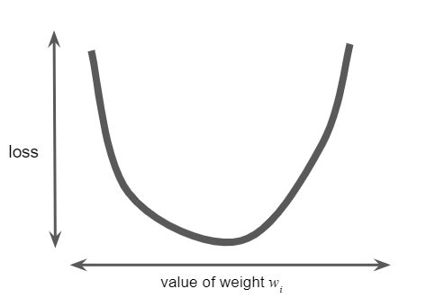

Gradient Descent
Notes:
We know because we can look at a cost function. So let’s say our random line we initialized gives us a cost here on the curve (draw a circle somewhere left of the minimum). We are going to try to improve our line. So let’s try a line that moves the cost function closer to the minimum.

Slide 21
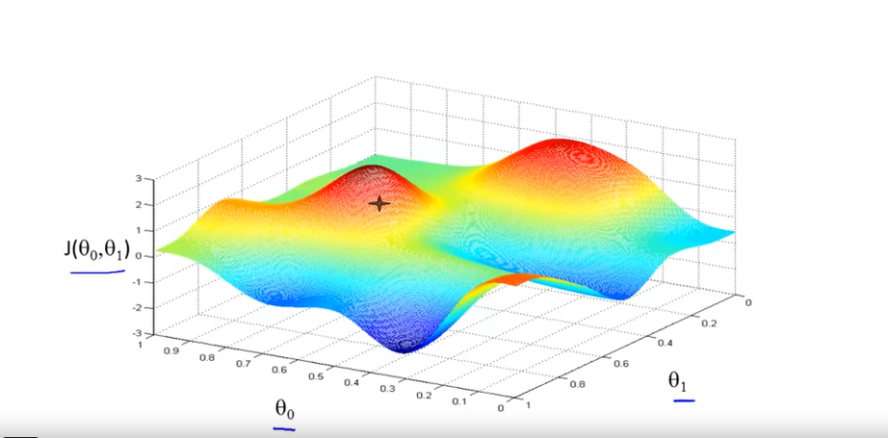
Gradient Descent
Notes:
3-D view of the same concept. Many minima, going to take steps that get us to a minimum the fastest (steepest slope).

Slide 22
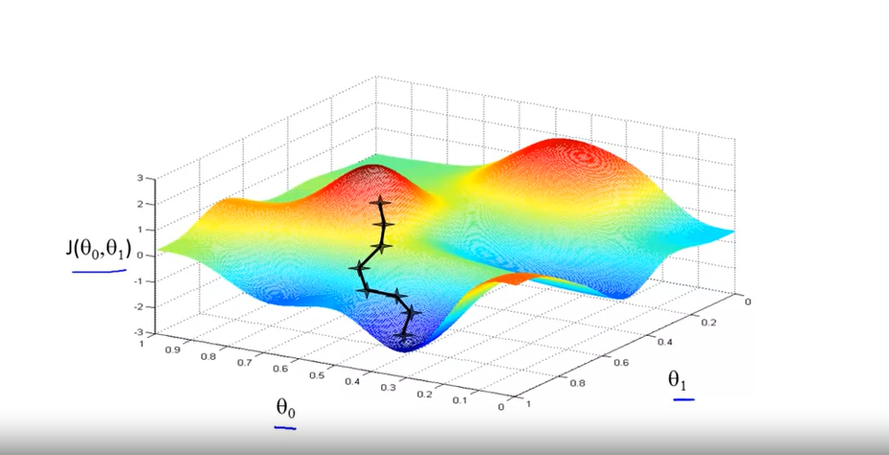
Gradient Descent

Slide 23
Gradient Descent
Notes:
Okay so back to this technical notation. All this is is the formula for HOW we step in the right direction. This is saying, take an alpha-sized step DOWN THE COST FUNCTION. How do we step “down” a function? Well, we know from Charlie’s lessons and from calculus that the derivative of a function is it’s slope/rate of change at a point. So we randomly start at a place in the cost function, take the derivative so we know how to move “down” it, and take an alpha-sized step in that direction.

Slide 24
Gradient descent
Marvelous Mentor Matt Momentarily Motivates us with Most Manageable Math

Slide 25
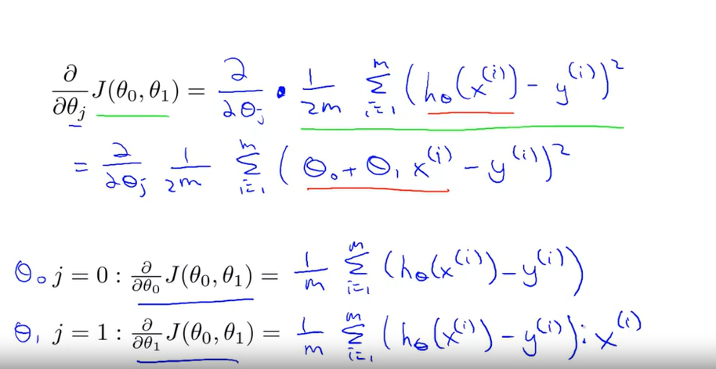
Gradient Descent for linear regression
Notes:
For single-variable linear regression, the cost function ends up being as written here. (H(x)-y)^2 is just the mean squared error. The cost function. You don’t have to know how to calculate the partial derivative of that function, you can just take our word/Andrew Ng’s word for it that it ends up being the equations down at the bottom. If you sub in (theta naught plus theta 1 times x) for h(x), you can take the partial derivative of this cost function, and end up with the two equations at the bottom. Ok? If you don’t have a strong calculus background, the take home message should be this. If you have a cost function, you can take the partial derivative of it to tell the computer how to make your line better. And that’s how Machine Learning works.

Slide 26
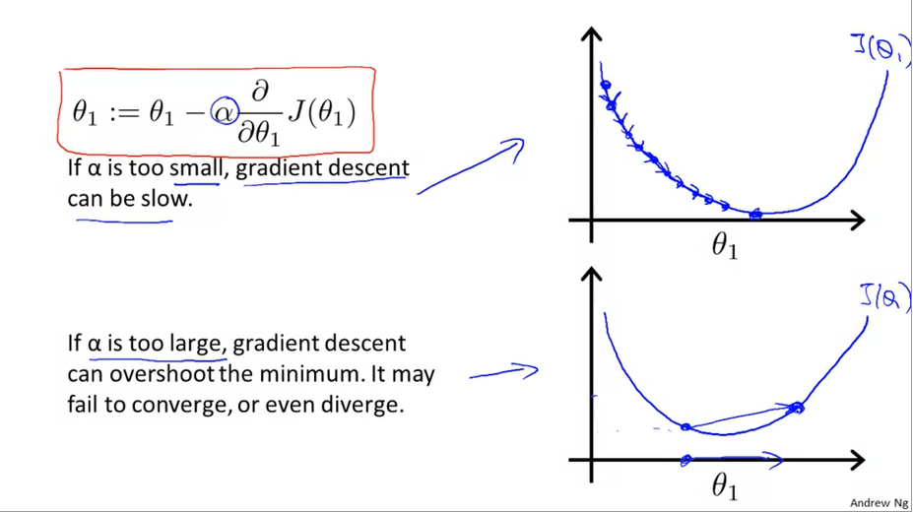
Gradient Descent
Notes:
Let’s talk more about alpha. Now that we know that the partial derivative tells us how to take a step, let’s look at how we take those steps.

Slide 27
Presentation
Corissa!
Notes:
Start a 45 min timer

Slide 28
Quiz: Cousera linear regression with one variable https://www.coursera.org/learn/machine-learning/exam/QeJ50/linear-regression-with-one-variable

Slide 29
Quiz: Cousera linear regression with multiple variables https://www.coursera.org/learn/machine-learning/exam/7pytE/linear-regression-with-multiple-variables

Slide 30
Q&A
Ask us anything
Heart of the flipped classroom model
Machine learning, Python
Career Cwestions

