Slide 1

Assignment 3
Web Crawler and NLP task prototypes
Developed by Coenraad F. Mulder as completion of the MA5851 Master Class.
Notes:
Good day, everyone. My name is Coenraad Mulder, I am a Solutions Architect and Data Scientist by trade. This presentation shows how the work I have developed as part of my MA5851 master class can be used by a development team for further processing.

Slide 2

Github Repository
Github Repository: https://github.com/cmulder75/masterclass
To get started, use command: git clone https://github.com/cmulder75/masterclass.git
Deliverables listed in the ”rendered” directory
Code in the main directory
Notes:
I have used Github as source code repository, it’s a a hosting platform for version control and collaboration by distributed teams. You will find all the source code for this assignment, including the rendered outputs in the cmulder75/masterclass repository on Github.

Slide 3
Code management using github
Default branch (main)
Branches
develop
features
bugs
Github repository contains two branches:
develop: development branch used for new feature development etc.
- main: the main source code branch
Typical development workflow
Clone main branch into develop
Develop code using the develop branch
Check in code to Github as backup
Create pull request
Approve pull request and merge
main → develop
develop → main
Notes:
Github repository can be split into any structure that works for you. The general guideline is that no development work should ever be done on the main branch. In our environment we typically use branches for development, features and bugs.
All development work is done on one of the sub branches. As you are developing code, you can regularly check in your code to the repository using git push. This allows your work to be version controlled, and also backed up remotely.
Once the development have been completed, a pull request is created that will allow your newly developed changes to be merged into the main branch. This process is repeated for any new development task.

Slide 4

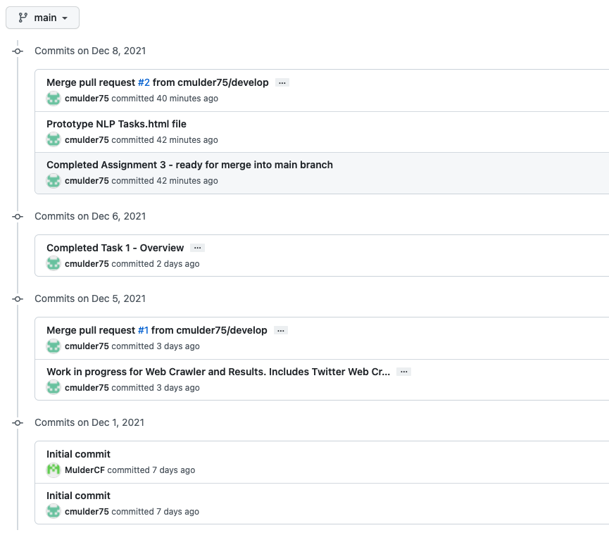
Pull requests and merge
Notes:
Once a code commit is ready to be merged into the main branch, you create a pull request for it on Github. As you can see in this example, merge requests were created on 5 December and on 8 December for the main branch. Github allows you to review changes, create pull requests, revert to previous versions of files and to merge pull requests into the main branch. There are numerous tutorials available on Youtube to show you how you can incorporate git and github as part of your development process. I can highly recommend having a look at the content from the Net Ninja.

Slide 5
Limitations of the web crawler
Only looking at search query string for one keyword search - have not been tested for multiple keywords
Not stress tested for larger result sets, restricted to 1000 Tweet results
NLTK cleaning does not take into consideration n-grams
New York identified as ‘New’ and ’York’, not a combined term

Slide 6
Limitations of the harvested data
Only keyword search – all Tweets contain keyword
Possible to extend to use Hashtags rather than keyword search within Tweet text
Language-specific - only English harvested and processed

Slide 7
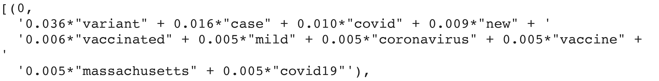
Limitations of the NLP TASKS
LDA limitations:
Sequentiallity of data is lost
When you refer to the identified topics, no sequence to the words returned
Which translates to: variant case covid new vaccinated mild coronavirus vaccine Massachusetts covid19
Sentiment analysis limitations:
Misspellings, grammatical mistakes
Sarcasm and irony misinterpreted
Analysis is language-specific

Slide 8
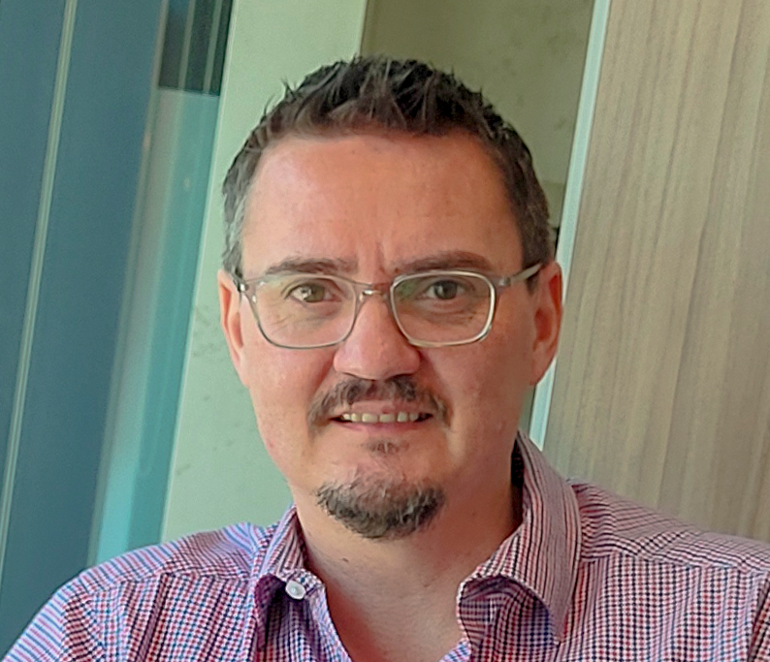
Thank you for your time!
email | coenraad.mulder@my.jcu.edu.au
linkedin | https://www.linkedin.com/in/coenraadmulder/
twitter | https://twitter.com/muldercf
Notes:
Thank you for your time, and feel free to reach out to me should you have any questions in this regard.

