Slide 1

BioCADDIE Harvester Project: Distributed Data Discovery using GitHub, YAML and Markdown
Chris Mungall
Lawrence Berkeley National Laboratory
@chrismungall
https://github.com/cmungall/biocaddie-gym/

Slide 2

Well it could be worse, at least I’m not doing metadata

Slide 3
How can we make it easier to attach metadata?
…Even fun?
Or at least part of the culture
Idea:
Target tech-savvy subset of dataset providers
Provide guidelines and tooling that mesh with with their work habits
If it works, extend to a wider variety of providers

Slide 4
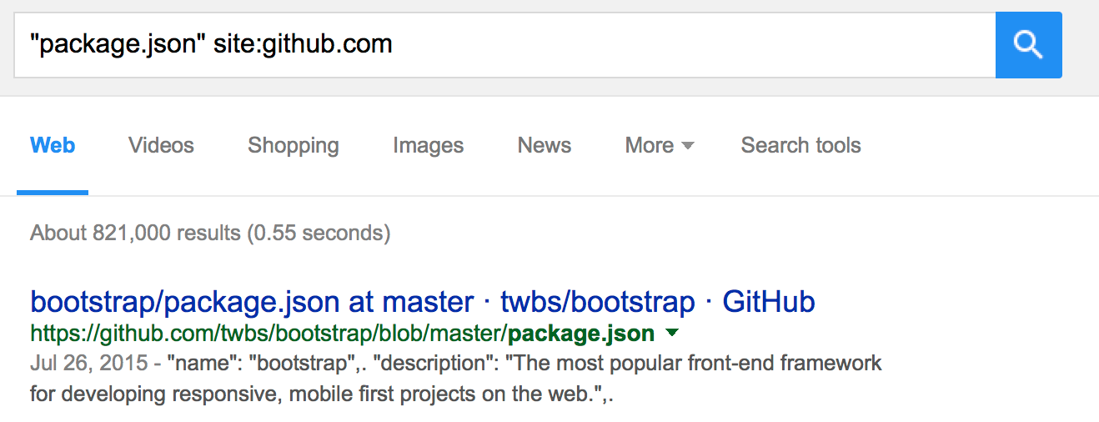
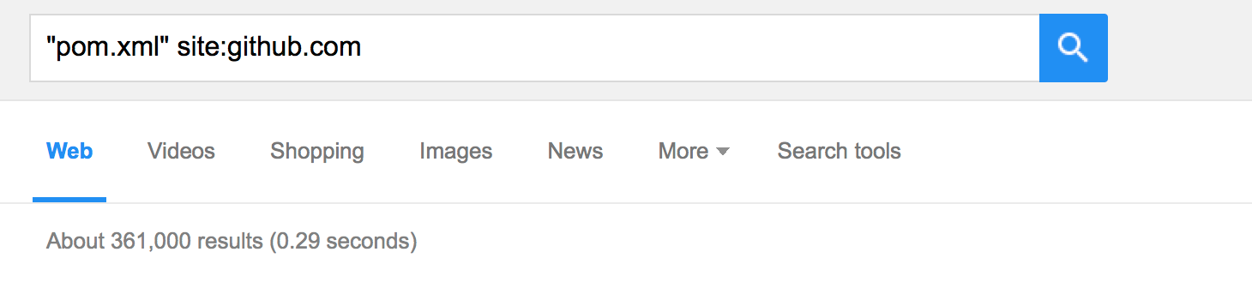
Observation: Coders love providing metadata
…Why?
…Can we get dataset providers to share this love?
Notes:
Restricting search specifically to social coding site github
They love it our of necessity: the metadata is not passive, it’s immediately actionable and integrated into how they work.
That’s all very well, but that’s code, not datasets

Slide 5



Modern code
ecosystem
Deposit, Edit
code
Code
metadata
no
Build
Unit Tests
Integration Tests
Success?
yes
Deploy/
Pull Request
Notes:
“code metadata” is a part of the ecosystem of tools used by modern software providers, part of software licecycle

Slide 6
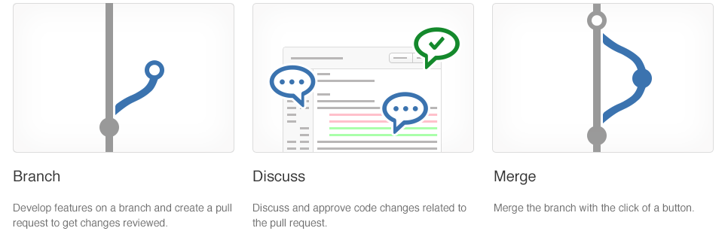
Git enables social coding

Slide 7
Where software leads, other knowledge artefacts often follow
Objection: Datasets are not code
Different purpose
Different communities and culture
However
Many similarities
Culture often follows, e.g. open source
Many ontologies now developed on github

Slide 8
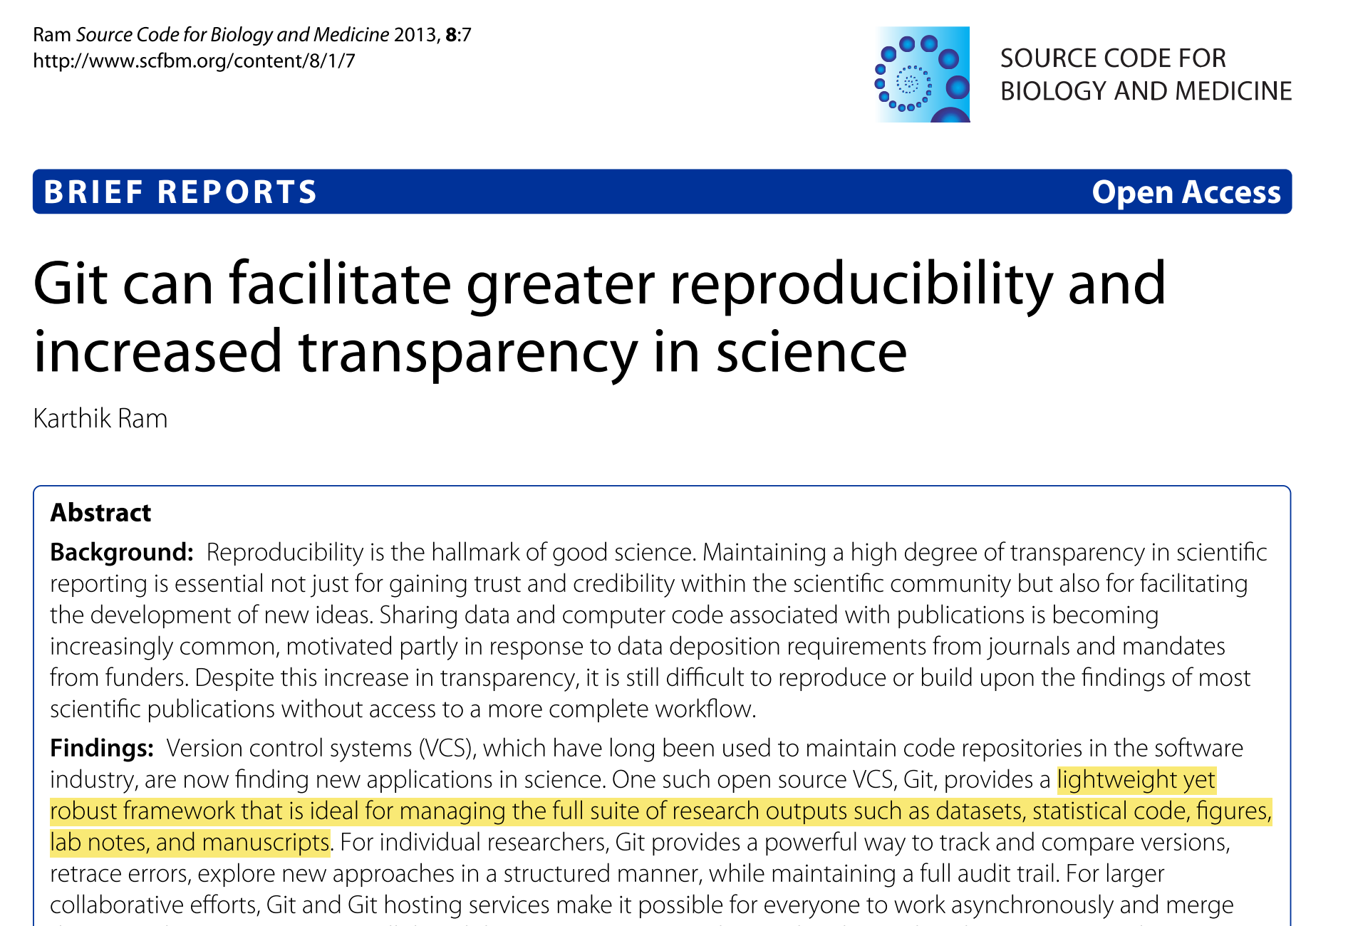
Notes:
Mention Git-LFS

Slide 9
Case studies: OBO and GloBI
OBO (Open Biomedical Ontologies) Foundry Registry overhaul
Switched from centralized metadata file to GitHub based system
Collaborative editing of markdown/yaml metadata files
Changes instantly published using GitHub-Pages
https://github.com/OBOFoundry/OBOFoundry.github.io
Global Biotic Interactions (GloBI) Data Index
Dataset providers deposit a globi.json file in any GitHub repository
Automatically indexed in GloBI search index
http://globalbioticinteractions.org/

Slide 10
bioCADDIE Harvester proposal
Define a simple format (YAML) metadata file
Leverage GitHub social coding ecosystem
Continuous integration and validation (Travis)
Web Views (GitHub pages)
Discoverability (bioCADDIE)
Develop demonstration pilot projects

Slide 11
Other Cloud Storage
(NIH Commons etc), Dryad, Figshare etc
dataset
metadata
Dataset 1
Dataset 2
no
GitHub
Pages
Success?
yes
BioCADDIE
DDI
Notes:
“code metadata” is a part of the ecosystem of tools used by modern software providers

Slide 12
The metadata file: original Harvester proposal
Simple YAML syntax
Define JSON-LD @context
Use HCLS profile
Deposit in root directory of github repo
Either:
The same repo where data is stored OR
A pure metadata repo that points to external storage
Note:
Automatically incorporated in DOI payload via Zenodo
Validate using Travis-CI
https://github.com/cmungall/biocaddie-gym/milestones/YAML%20Schema

Slide 14
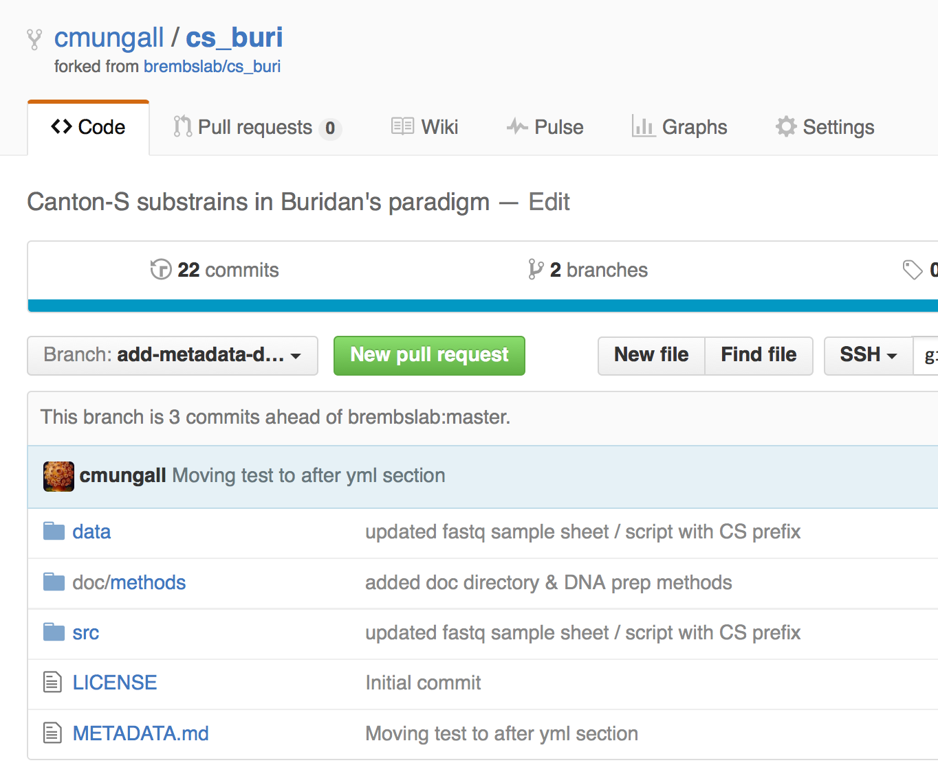
Pilot project example

Slide 15
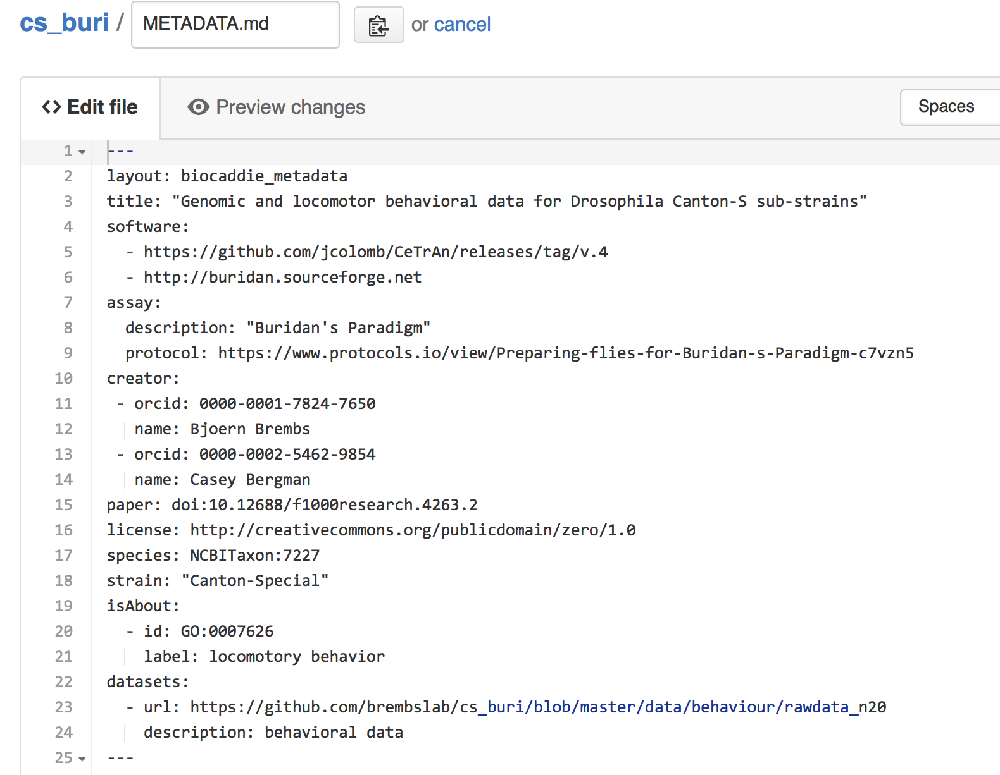

Slide 16
Alignment of standards
First step:
Align with ongoing work in bioCADDIE
https://github.com/biocaddie/WG3-MetadataSpecifications
Pilot: Turns out dataset provider was already committed to providing metadata
Using DDI XML
Question: what is the bioCADDIE approach?
Heterogeneity + converters?
One standard to rule them all?

Slide 17
Publishing and indexing
Default YAML view is low level
Use GitHub pages to provide an instant local view over data and data description
Add a GitHub harvester to bioCADDIE
https://github.com/cmungall/biocaddie-gym/milestones/Publishing

Slide 18
Current Progress and Project Repository
Current location:
https://github.com/cmungall/biocaddie-gym
Will move to main bioCADDIE github org?
Milestones:
https://github.com/cmungall/biocaddie-gym/milestones
(Dates need to be shifted to accommodate new project start date)

Slide 19
What next? Will this scale?
Goals of pilot:
Demonstrate feasibility with tech-savvy users
Next steps, making it more accessible:
Authoring tools
E.g. ISA-enabled GitHub edit hooks
Integrate with dataset repositories (figshare, dryad)
Work with git{hub,lab} to make more accessible?

