Slide 1

Phenote: A biological data annotation editor using ontologies.
Nicole Washington
Lawrence Berkeley National Labs
www.phenote.org

Slide 2
What is an annotation?
What types of concepts are captured?
  Assertions A-->B
  Evidence
  Source
Using CVs in annotation
Interoperability
Types of annotations:
  Class-class
  Class-instance
  Instance-instance

Slide 3
Annotation
Evidence
Assertion
Source
Subject
relationship
Object
Attribution
Property values
[0..n]

Slide 4
Annotation:
Phenotypes
in literature
Evidence:
Experiment
Accession
Assertion
Source:
Publication
Subject:
Genotype
influences
Object:
Phenotype
Attribution:
Curator name
Property Values:
Date,
Organization,
Version

Slide 5
Annotation: Phenotypes in Literature
EQ style: Entity + Quality
  Entity = Anatomy, GO process, Disease
  Quality = PATO
Precomposed-phenotypes:
  Entity = Mouse anatomy (refining Q)
  Quality = Mammalian Phenotype

Slide 6

Annotation:
Phenotypes
in literature
Assertion
E=eye disc
(FBbt:00001768)
Q=condensed
(PATO:0001485)
PMID:8431945
eya¹
influences
M. Ashburner
(Date, 10/26/2007)
(Organization, Flybase)
(Version,1)

Slide 7
Annotation:
Phenotypes
in literature
Assertion
P=anophthalmia
(MP:0001293)
PMID:8431945
EYA1
influences
M. Ashburner
(Date, 10/26/2007)
(Organization, Flybase)
(Version,1)

Slide 8
Annotation:
GO format
Evidence:
Evidence Code
Assertion
Source:
Publication
Subject:
Gene
Participates in
Object:
GO term
Attribution:
Curator name
Property Values:
Date,
Organization

Slide 9
Annotation:
GO format
Evidence:
IMP
Assertion
Source:
Publication
Subject:
Eya1
Participates in
Object:
Eye development
(GO:0001654)
Attribution:
Curator name

Slide 10
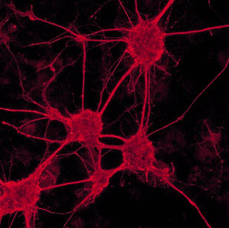
Annotation:
Image Data
B
Evidence:
Assay ID
A
Assertion
Source:
ImageID
Subject:
NeuronA
targets
Object:
NeuronB
Attribution:
Curator name
Property Values:
Date,
Organization

Slide 11
Annotation:
Drug Resistance
Evidence:
Experiment
Accession
Assertion
Chemical
(CHEBI)
associated
Disease
(Disease Ontology)
PMID:1234567
John Q Person
(Date, 10/27/2007)
(Organization, XYZ)
(Version,2)

Slide 12
Phenote - software uses
Record annotations in structured format
Uses controlled vocabularies
Configurable annotation ‘definition’

Slide 13
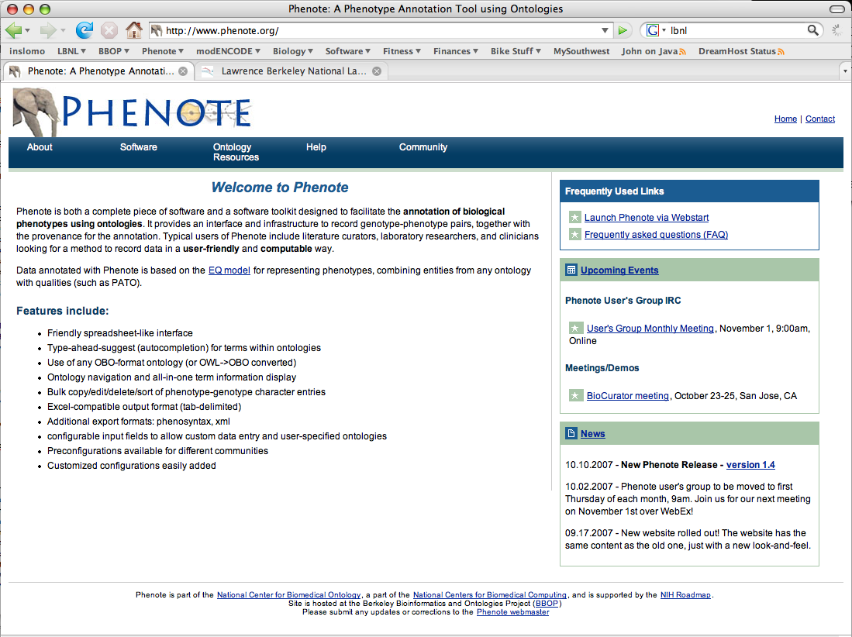

Slide 14
Phenote features (demo)
Friendly spreadsheet-like interface
Type-ahead-suggest (autocompletion) for terms within ontologies
Use of any OBO-format ontology (or OWL->OBO converted)
Ontology navigation and all-in-one term information display
Bulk copy/edit/delete/sort of phenotype-genotype character entries
Excel-compatible output format (tab-delimited)
Additional export formats: phenosyntax, xml, (obo & owl on its way)
configurable input fields to allow custom data entry and user-specified ontologies
Preconfigurations available for different communities
Customized configurations easily added

Slide 15
Phenote User Community
Literature curation
Capturing data - annotation during experiments
Genomic - phenotype comparison
Beyond phenotypes

Slide 16
Future Directions
Add new interfaces, views on data
“Comparisons” between annotations
Analysis of annotations
  Enrichment - chart of annotations
  View annotations in the context of the ontologies
  View of annotations in context of phylogeney
Long range plans - “itunes” style for local analysis/manipulation, with OBD
  Fetch annotations from global databases, perform analysis locally.

Slide 17
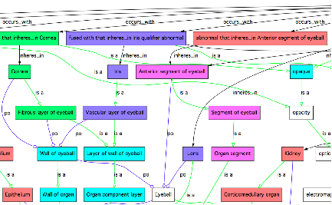

Slide 20





Acknowledgements
LBNL
  Mark Gibson
  Chris Mungall
  John Day-Richter
  Suzanna Lewis
NCBO funding
Collaborations:

Slide 21
We’re hiring!
Two software developers
  Database developer (NCBO/BIRN)
  OBO-Edit developer
http://www.berkeleybop.org

