Slide 1

Domain and Family Ontology
Building an ontology of protein domains and families to support GO classification
https://www.ebi.ac.uk/panda/jira/browse/GO-144
https://trello.com/c/yOniQ2Uv/92-automated-deepening-using-logical-definitions
Notes:
Asetofrecommendationstoaididentification,development,maintenance,andadoptionof language standards for environmental health data to enable data access, usability, and integration across diverse environmental and biomedical research programs.

Slide 2
Why do we need a DOMO?
To provide logical definitions (Equivalence Axioms) for the GO protein binding branch
What this gives us:
Auto-classification of Ontology
Auto-classification of Gene Products assigned to generic ‘protein binding’ class
Notes:
No one can define these terms adequately – they indicate tribes as much as distinct methodologies.
“The goal of this meeting is to establish a collaborative and cross-disciplinary group to inform the development of environmental health science language standards and applications that will aid data sharing, integration and analysis, and ultimately advance discovery in environmental health research. “

Slide 3
Background: Annotation deepening
Ontology (GO):
Neuron fate specification EquivalentTo ‘cell fate specification’ and results_in_specification_of some neuron
Ontology (CL):
‘sensory neuron’ SubClassOf neuron
GAF:
Tbx1 annotated to GO:0001708 ‘cell fate specification’, extension column: results_in_specification_of(CL:0000101) [sensory neuron]
Elk (Reasoner) ← deepening step
Tbx1 annotated to ‘neuron fate specification’
Notes:
GO:0048665 neuron fate specification FoldBasedPredictor GO:0001708 cell fate specification has_participant EMAP:1282 results_in_specification_of CL:0000101 sensory neuron IMP

Slide 4
Can we do this for protein binding branch of GO?
Competency Question:
Given annotations to GO:0005515 ‘protein binding’ and WITH column indicating binding partner,
Can we deepen to specific subclasses?
Approach:
Create a classification of proteins by domain family
Analogous to any other external ontology we use in GO, e.g. CL
Create equivalence axioms
E.g. “X binding” = binding and has_input some X
Treat WITH column for protein binding as if it were c16
Classify using reasoner

Slide 5
Why not use an existing ontology?

Slide 6
Connexins in PRO
is_a PR:000000001 ! protein
is_a PR:000007991 ! gap junction alpha-10 protein ***
is_a PR:000007992 ! gap junction alpha-3 protein ***
is_a PR:000007993 ! gap junction alpha-4 protein ***
is_a PR:000007994 ! gap junction alpha-5 protein ***
is_a PR:000007995 ! gap junction alpha-8 protein ***
is_a PR:000007996 ! gap junction alpha-9 protein ***
is_a PR:000007997 ! gap junction beta-1 protein ***
is_a PR:000007998 ! gap junction beta-2 protein ***
is_a PR:000007999 ! gap junction beta-3 protein ***
is_a PR:000008000 ! gap junction beta-4 protein ***
is_a PR:000008001 ! gap junction beta-5 protein ***
is_a PR:000008002 ! gap junction beta-6 protein ***
is_a PR:000008003 ! gap junction beta-7 protein ***
is_a PR:000008004 ! gap junction gamma-1 protein ***
is_a PR:000008005 ! gap junction gamma-2 protein ***
is_a PR:000008006 ! gap junction gamma-3 protein ***
is_a PR:000008007 ! gap junction delta-2 protein ***
is_a PR:000008008 ! gap junction delta-3 protein ***
is_a PR:000008009 ! gap junction delta-4 protein ***
is_a PR:000008373 ! gap junction alpha-1 protein ***
is_a PR:000008374 ! gap junction alpha-6 protein ***
is_a PR:000032240 ! gap junction epsilon-1 protein ***

Slide 7
Why not just use interpro?
Hierarchy in IPR is highly incomplete
Work needs to be done to align with GO protein binding hierarchy

Slide 8
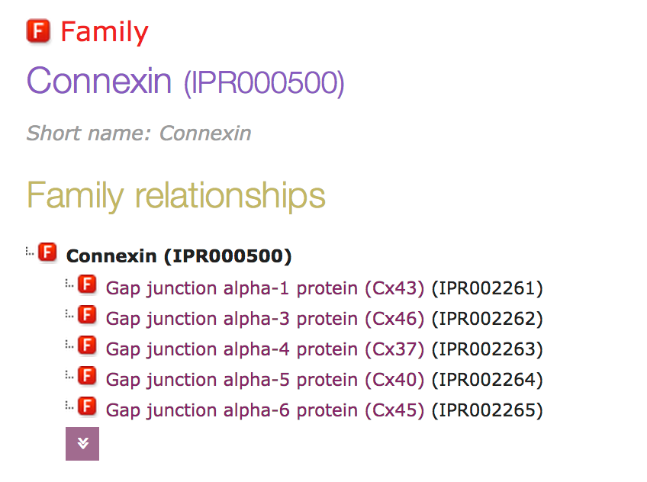
Connexins in InterPro

Slide 9
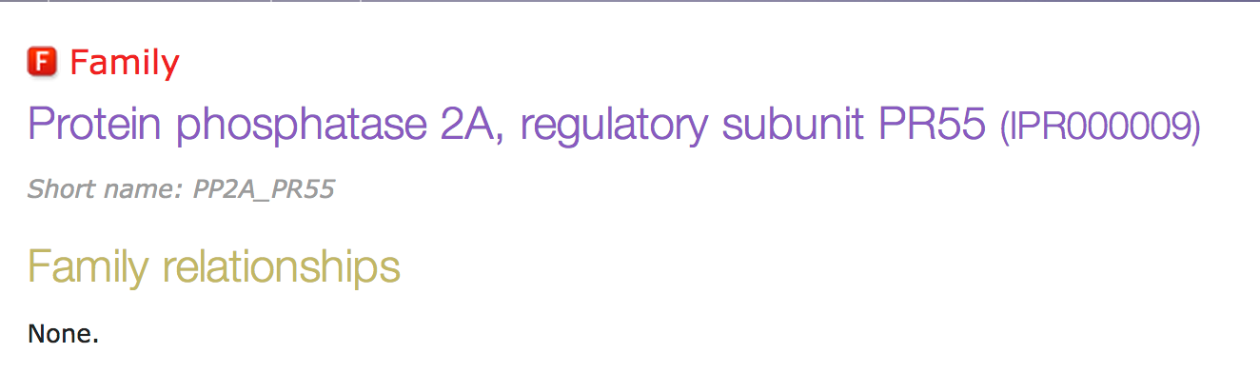
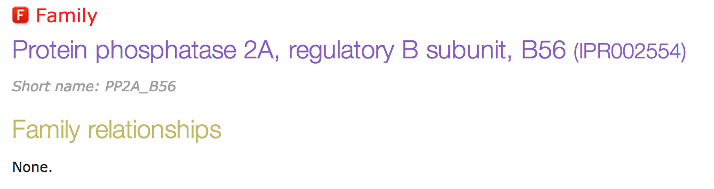
Protein phosphatases in IPR

Slide 10
Hybrid Approach
Use curated GO binding <-> IPR associations (Marijn’s work)
Mix with implicit protein dom/fam ontology extracted from GO
Mix with IPR classification
Auto-create logical definitions for GO

Slide 11
Examples

Slide 12
Results
[Heiko to fill in once we make the Jenkins job that uses domo]

Slide 13
Future Directions
We (GO) shouldn’t be doing this
But no one else was
Whose job?
IPR?
PRO?
Happy to hand over work
So long as group produces an OWL file with labels, synonyms, classification, etc we can use that

