Slide 1
Use of OWL in GO

Slide 2
Outline

Slide 3
Historic conception of GO

Slide 4
GO comes in different editions
Don’t be fooled – the default version is axiom-light
Go-plus

Slide 5
Axiomatic Structure of the GO
Table 1 from paper

Slide 6
Equivalence Axioms

Slide 7
Challenge of inter-ontology axioms

Slide 8
Relations
OBO Relations Ontology
Considerably different from RO-2005

Slide 9
Constraints in GO
Spatial disjointness
(‘part of’ some cytosol) DisjointWith (‘part of’ some nucleus)
[add an image of a cell]

Slide 10
We like annotations and annotation axioms

Slide 11
The GO development environment

Slide 12
The road to OWL
History: obo
Transition was long and painful still not complete

Slide 13
Editing environments
OE
Protégé 4/5/Web

Slide 14
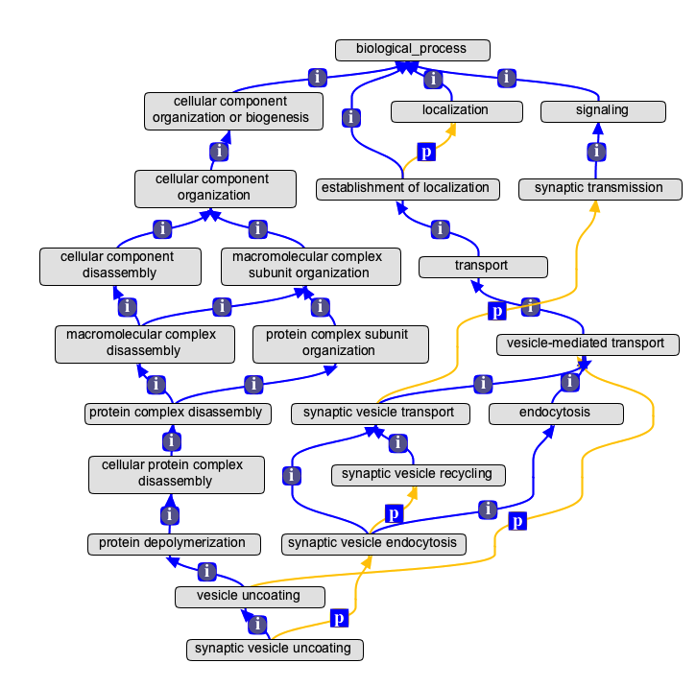
Plugins

Slide 15
TermGenie

Slide 16
Smuggling a little EL into databases
‘annotation extensions’

Slide 17
Ontology build pipeline
File-based
Makefiles & Scripts, unix-style
Jenkins

Slide 18
Challenges

Slide 19
Multiple autonomous ontologies

Slide 20
Tooling

Slide 21
Future

Slide 22
Mainstreamizing OWL

Slide 23
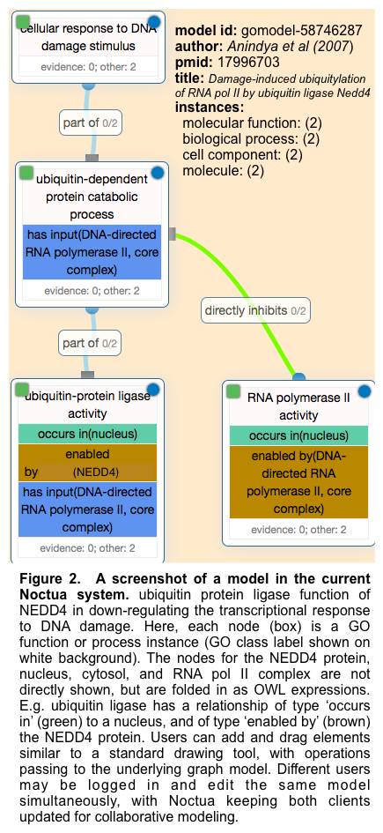
Rise of the ABoxes

Slide 24
Conclusions

