Slide 1
From OBO to OWL and back again – a tutorial
David Osumi-Sutherland, Virtual Fly Brain/FlyBase
Chris Mungall – GO/LBL

Slide 2
I use OBO, why should I care about OWL?
OWL 2 is a W3C standard with a large and growing ecosystem of developers.
Using OWL ontologies in Protégé 4 you can use fast reasoners to:
Query your ontology
This could be the basis for sophisticated queries on your website
Quickly find mistakes
Automate classification
Non-lossy round tripping from OBO to OWL and back is now easy
continue developing in OBO while taking advantage of OWL and Protégé for reasoning
This may be a first step to developing in OWL/Protégé

Slide 3
Take home messages
An ontology is a classification
There are lots of useful ways to classify stuff
Maintaining multiple classification schemes by hand is hard
So automate what you can
Everybody makes mistakes
So get the computer to find errors for you
Re-use other people’s work where possible
import class hierarchies and relations
use common patterns

Slide 4
What is an ontology ?
A set of defined, inter-related terms to use in annotation/metadata/knowledge bases.
A classification
A query-able store of (scientific) knowledge that uses logical inference.
Notes:
Not interested in philosophical debates about this – want to keep it practical.

Slide 5
What is an ontology ?
A set of defined, inter-related terms to use in annotation/metadata/knowledge bases.
A classification
A query-able store of (scientific) knowledge that uses logical inference.
Notes:
Not interested in philosophical debates about this – want to keep it practical.

Slide 6
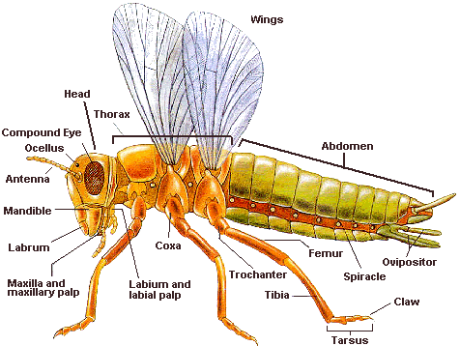
Textual definition is often primary in OBO ontologies
Relationships formalize at least some of the textual
definition
name: insect leg
def: “A paired ventral appendage of the
thoracic segments, used for walking”
is_a appendage
relationship: part_of ‘thoracic segment’
relationship: has_function_in: walking
Notes:
Emphasise that relationships are part of the definition. In this case, not all detail is formalised: ventral and paired are ignored.

Slide 7
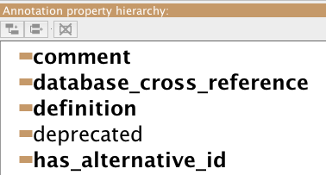
Attaching textual information to a class in OWL
Annotation properties provide URIs and labels for textual info attached to a term. In the current OBO to OWL translation we use:
OBO name = rdfs:label
OBO def = IAO:definition
…

Slide 8
What is an ontology ?
A set of defined, inter-related terms to use in annotation/metadata/knowledge bases.
A classification
A query-able store of (scientific) knowledge that uses logical inference.
depends on
depends on
depends on

Slide 9
What (use) is an ontology?
A set of defined, inter-related terms to use in annotation.
Relations between terms allow annotations to be grouped in scientifically meaningful ways
requires an ontology to be an accurate and scientifically meaningful classification and store of scientific knowledge.

Slide 10
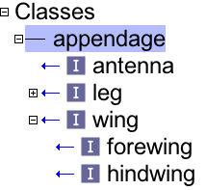
What is an ontology ?
A classification
appendage
antenna
wing
forewing
hindwing
Notes:
Make graph of hierarchy

Slide 11




OBO-OWL cheat sheet: classification
OWL Manchester Syntax
antenna SubClassOf appendage
OBO format :
name: antenna
is_a: appendage
Protégé
OBO-Edit:

Slide 12
What is an ontology ?
A classification
There are lots of scientifically useful ways to classify a bit of anatomy.
its parts and their arrangement
its relation to other structures
what is it: part of; connected to; adjacent to, overlapping?
its shape
its function
its developmental origins
its species or clade
its evolutionary history?

Slide 13
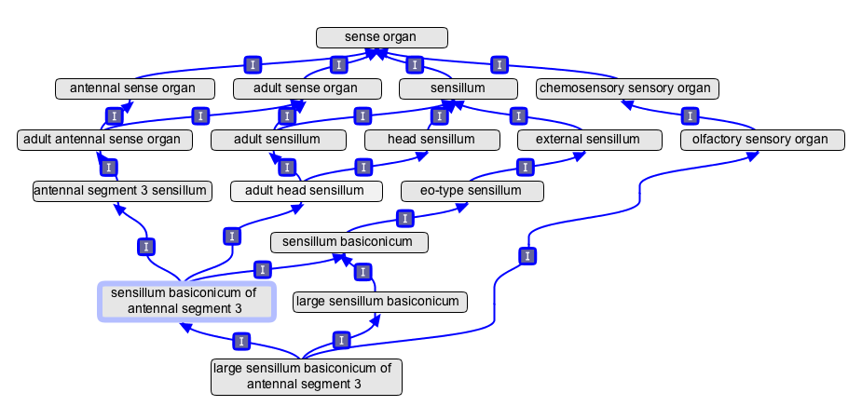
Manually maintaining an ontology with multiple classification schemes is hard
It is difficult to keep track of multiple classification chains to:
ensure completeness;
avoid redundancy;
avoid introducing error due to inheritance of classification criteria from a distant ancestor

Slide 14
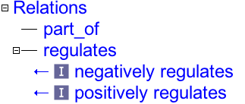
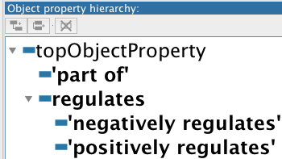
Relations – OBO vs OWL
OBO: relation
OWL: object property
part_of
Notes:
Add screen cap for object properties in Protege

Slide 15
class – class relationships are quantified
Class:Class relationships are many to many
Does the relation apply to all or just some of the class ?
we specify this with quantifiers:
∀: for all, all, only, every
∃: there exists, some

Slide 16
relationships between classes use quantifiers
OBO (quantifiers hidden)
name: leg
relationship: part_of thoracic segment
OWL (MS):
leg SubClassOf part_of some ‘thoracic segment’

Slide 17
Relationship record necessary conditions for class membership
Being part of a thoracic segment is a necessary condition of being in the class leg
‘leg’ SubClassOf part_of some thoracic segment
part_of some ‘thoracic segment
wing
leg

Slide 18
Directionality and quantifiers
✔
‘wing’ SubClassOf part_of some thoracic segment
‘thoracic segment’ SubClassOf has_part some ‘wing’
✗
has_part some
wing
thoracic segment
✗

Slide 19

Directionality and quantifiers
‘claw’ SubClassOf connected_to some ‘tarsal segment’
‘tarsal segment’ SubClassOf connected_to some claw
✔
✗
connected_to some
‘claw’
claw
tarsal segment
tarsal segments
✗

Slide 20
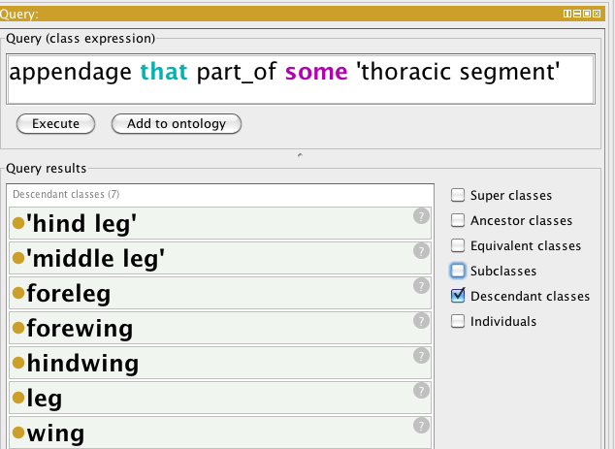
Relationships store knowledge in query-able form
part_of some ‘insect thorax’
wing
leg
forewing
hindwing
Notes:
Make screen shot for this

Slide 21


OBO-OWL cheat sheet: necessary conditions for class membership
OWL Manchester Syntax
antenna SubClassOf part_of some head
OBO format :
name: antenna
relationship: part_of head
Protégé
OBO-Edit:

Slide 22
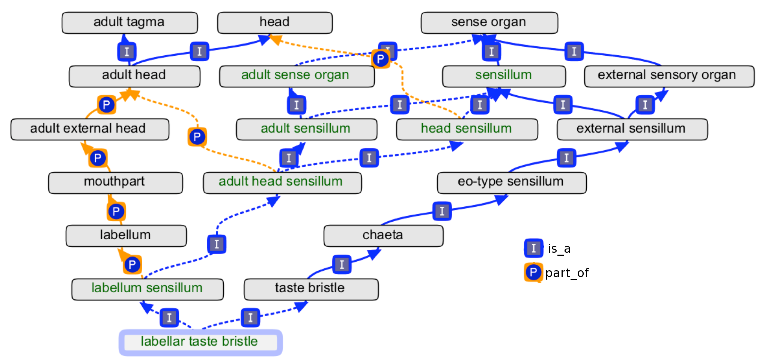
Manually maintaining an ontology with multiple classification schemes is hard
So automate what you can.

Slide 23
How much classification to automate
Aim to classify at least enough that only a single is_a hierarchy is maintained by hand.
Only add equivalent class definitions when you are confident you can completely formalise a definition.
Automating classification is often hard. How would you define this using an equivalent class statement:
name: arthropod paired, metameric, segmental appendage def: “An organism subdivision that is metameric (divided into segments sharing some structural features with each other), protrudes from the head or body to which it is attached by an articulation and which contains parts of multiple anatomical systems including somatic musculature. Each instance is part of a bilateral pair within a single segment. Adjacent segments (podomeres) are connected by a joint and contain muscle attachment sites.”
Notes:
The point is not to read all the text, just to note that it is complicated. Note that this approach differs from Simon’s, as I understand it, of making formal defs primary and aiming for complete Rector demoralization.

Slide 24
The knowledge an ontology contains can be used to automate classification
English: Any sense organ that functions in the detection of smell is an olfactory sense organ
OWL Manchester Syntax
antennal sense organ
EquivalentTo ‘sense organ’
and capable_of some ‘detection
of smell’
OBO format :
name: antennal sense organ
intersection_of: sense organ
intersection_of: capable_of detection
of smell
olfactory
sense
organ
capable_of some detection of smell
sense organ

Slide 25
sense organ
capable_of some
detection of smell
nose
nose
olfactory
sense
organ
nose
olfactory
sense
organ
capable_of some detection of smell
sense organ

Slide 26

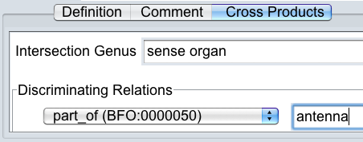
OBO-OWL cheat sheet: necessary and sufficient conditions for class membership
OWL Manchester Syntax
antennal sense organ EquivalentTo ‘sense organ’ that part_of some antenna
(that / and are interchangable in MS)
OBO format :
name: antennal sense organ
intersection_of: sense organ
intersection_of: part_of antenna
Protégé
OBO-Edit:

Slide 27
ERROR MESSAGES ARE YOUR FRIENDS! – They tell you you’ve screwed up before you get embarrassing emails complaining that you’ve screwed up
Notes:
Slightly patronising slide, but made this because I think non-coders often think having lots of error messages is a chore. I know I used to.

Slide 28
Some classes don’t intersect
OWL DisjointWith OBO: disjoint_from
X
Y
X
Y
✗

Slide 29
Some classes don’t overlap
anatomical
space
anatomical
structure
lumen of gut
muscle
muscle
lumen
of gut
✗

Slide 30
Some classes don’t overlap
anatomical
space
anatomical
structure
lumen of gut
muscle
anatomical
space
anatomical
structure
muscle
lumen
of gut
✗

Slide 31
Some relations only apply between particular classes.
D
domain
R
range
anatomical
structure
D
R
biological
process
capable_of
X SubClassof capable_of some Y
X
Y
anatomical
structure
biological
process

Slide 32
Some classes don’t overlap
anatomical
structure
biological
process
nose
detection of smell
biological
process
anatomical
structure
✗
✗
nose
detection of smell

Slide 33
anatomical
structure
D
R
biological
process
capable_of
detection of smell SubClassof capable_of some nose
anatomical
structure
biological
process
detection of smell
‘
detection of smell
‘
nose
nose
✗
✗

Slide 34
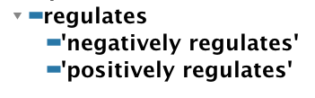
Some relations entail others
negatively regulates
regulates
negatively_regulates some ‘cell division’
regulates some ‘cell division’
X
X

Slide 35

Some relations chains entail relations
regulates
part_of
regulates
X regulates some Y
Y part_of some Z
X regulates some Z

Slide 36
Take home messages
An ontology is a classification
There are lots of useful ways to classify stuff
Maintaining multiple classification schemes by hand is hard
So automate what you can
Everybody makes mistakes
So get the computer to find errors for you
Re-use other people’s work where possible
import class hierarchies and relations
use common patterns
Notes:
Last point will be dealt with later by Chris.

