Slide 1
Capstone Project 2
Predicting NFL Offensive Play Calling

Slide 2
The Goal
Machine Learning
Types of Offense
Feature Importance
Use Machine Learning to classify run and pass plays
Looking at offensive trends in play by play data for pass heavy teams
What can the accuracy of the model or its features tell us about offensive trends?

Slide 3
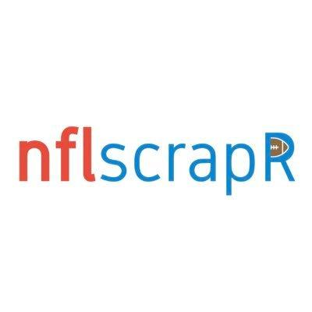
Data
Data downloaded from Github user who implemented NFLscrapR
NFLScrapR is a R package used to download and analyze data from the NFL
Downloaded Play by Play data from 2009-2019 for all regular season games
Data included 498,392 rows and 256 columns

Slide 4
Data Wrangling
Reducing the amount of columns
No missing values
Removed special teams plays, QB kneels and spikes
Created a binary play type column where pass play = 1 and run play = 0.
Made seperate data sets for Patriots and Saints

Slide 5
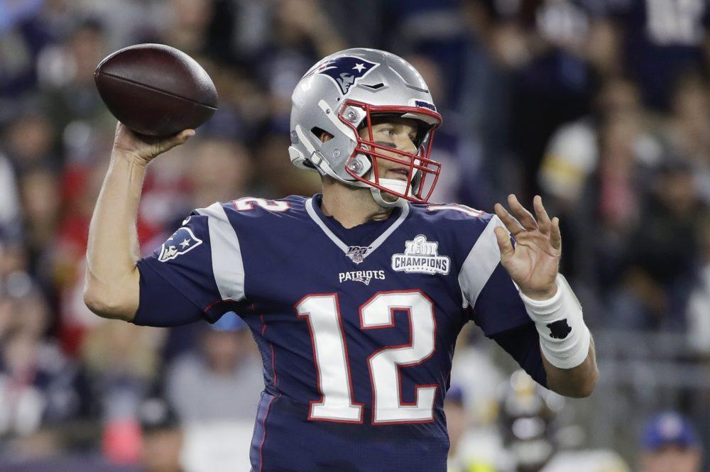
New England Patriots

Slide 6
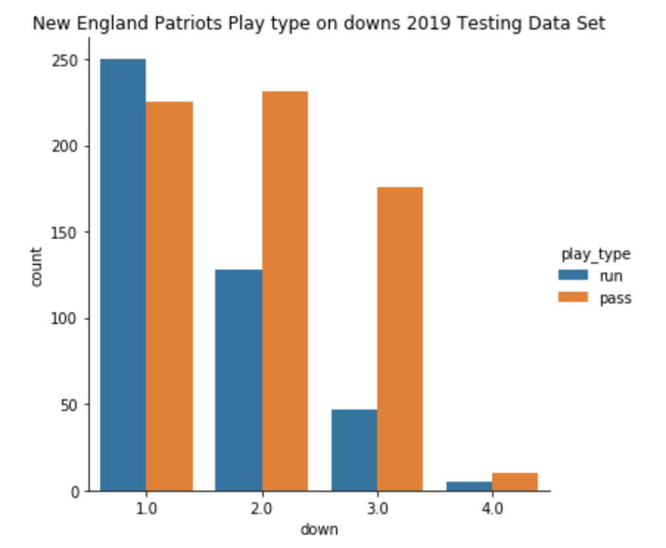
Exploratory Data Analysis
Looked at play type distributions for the 2019 regular season
Looked at play type distributions between top players
Where the Patriots were throwing the ball

Slide 7
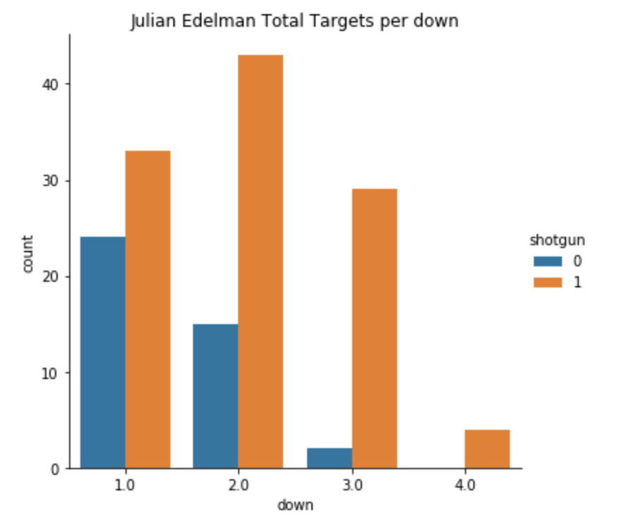
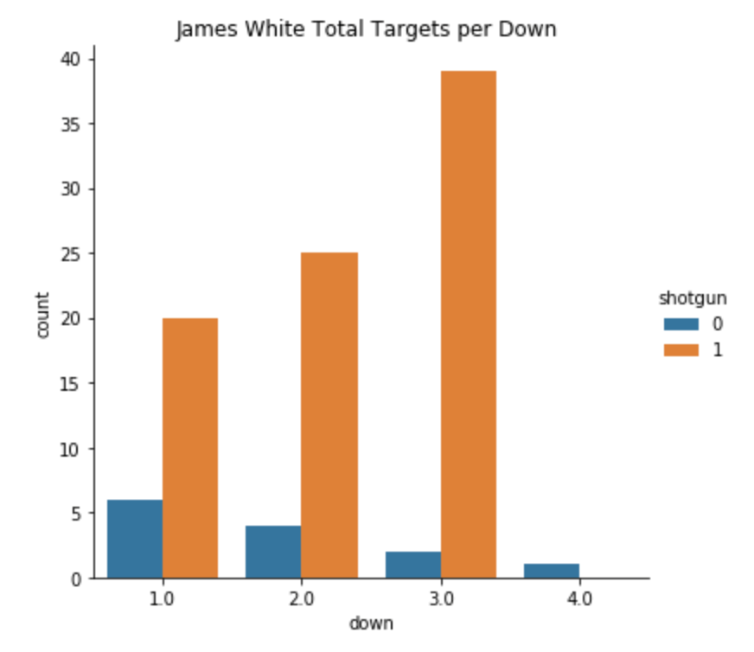
Exploratory Data Analysis

Slide 8
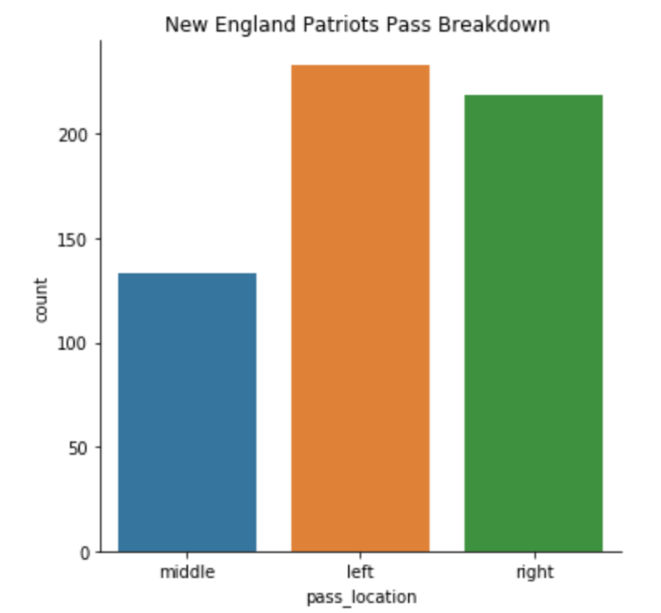
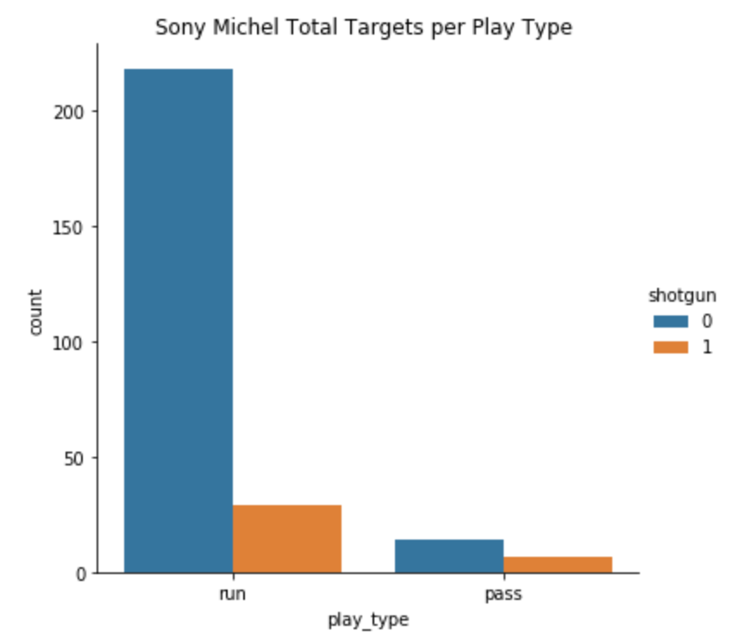
Exploratory Data Analysis

Slide 9
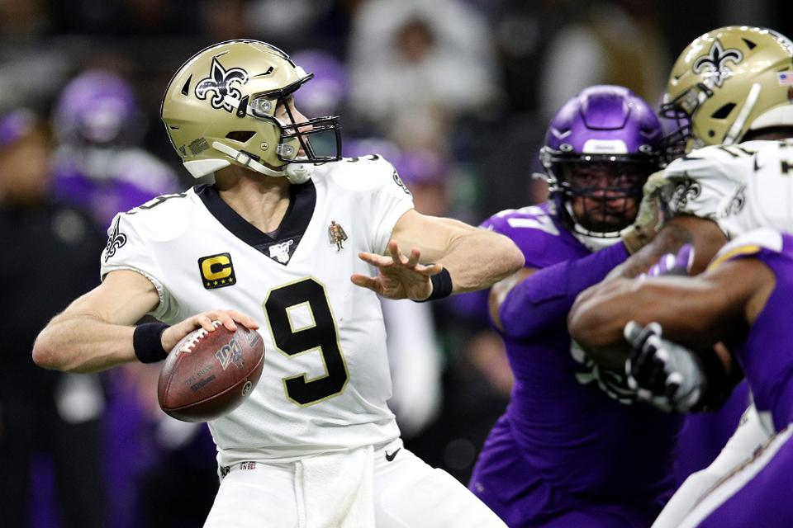
New Orleans
Saints

Slide 10
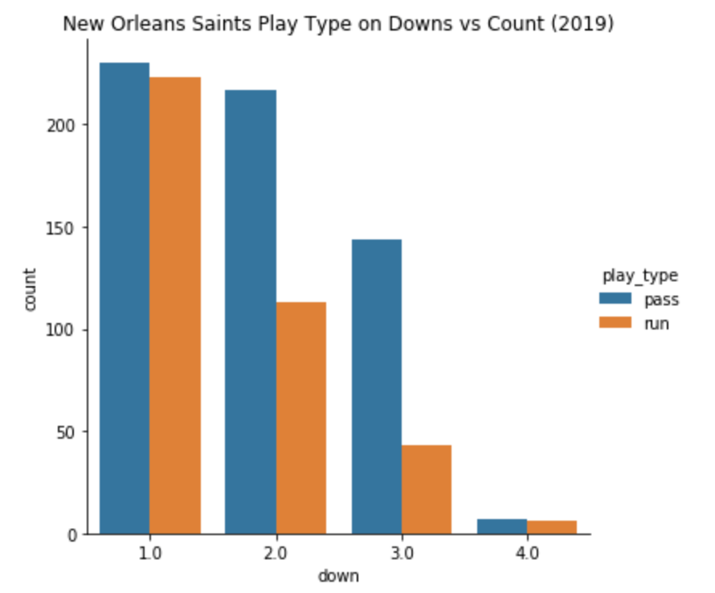
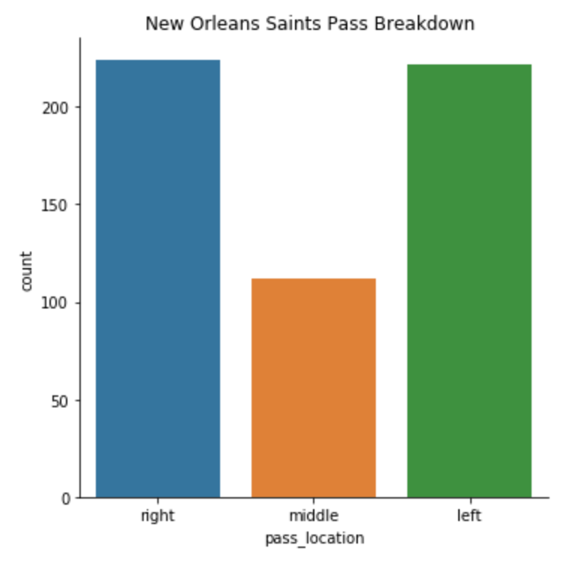
Exploratory Data Analysis

Slide 11
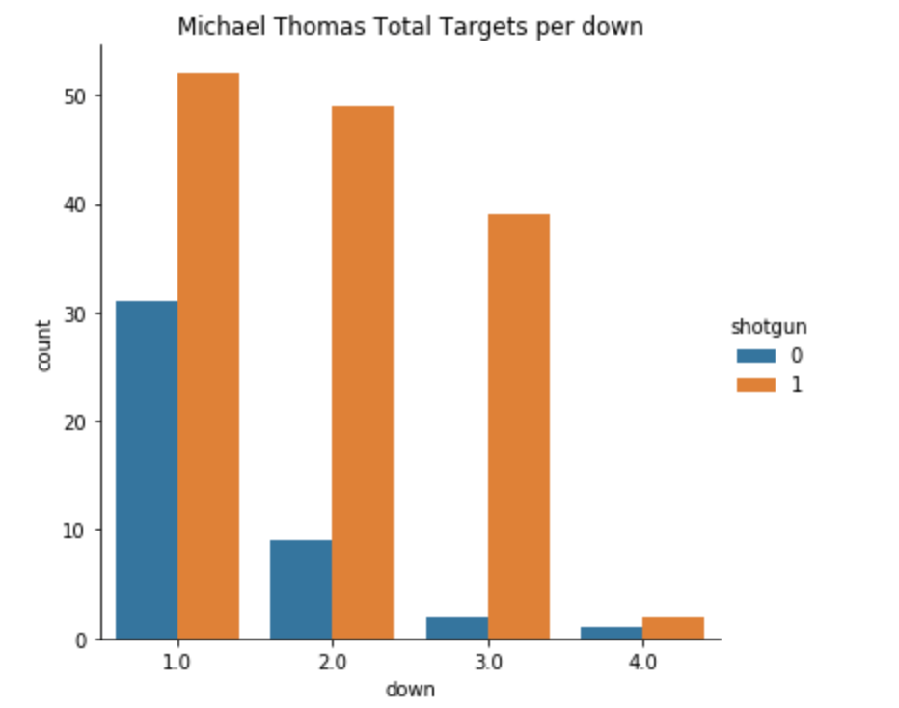
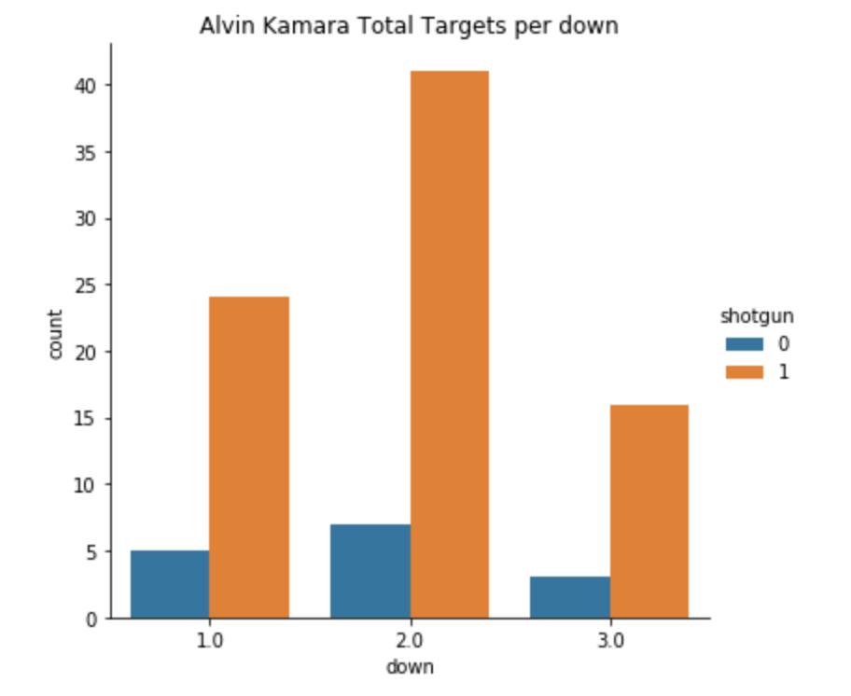
Exploratory Data Analysis

Slide 12
Gradient Boosting Classifier
Combines weak learning models to create a strong predictive model
Optimizes loss functions
Binary cases use a single regression tree
Popular classifier method for complex data sets

Slide 13
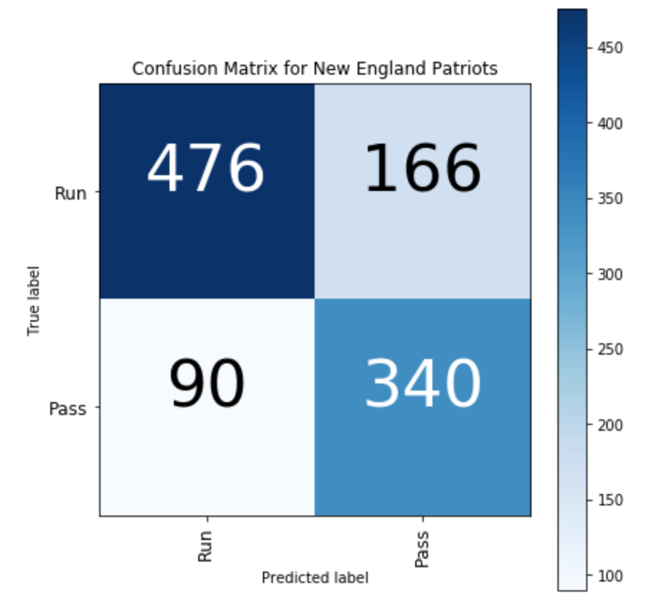
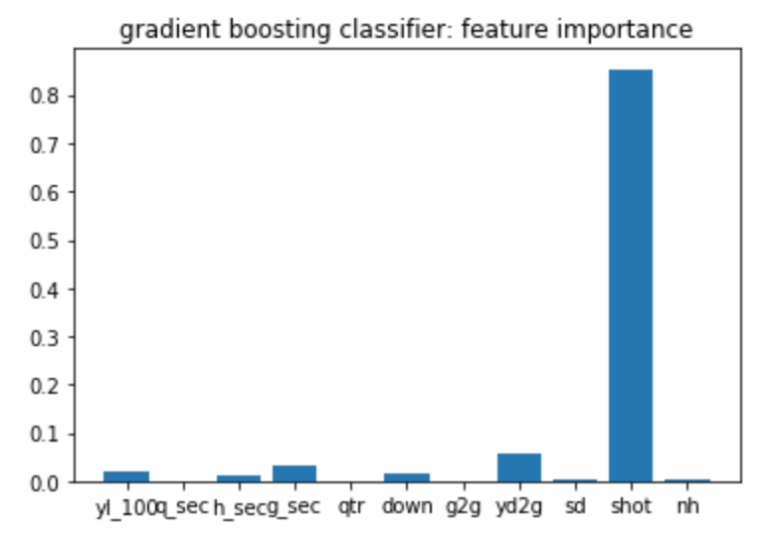
New England Patriots Results (76.12% Accuracy)

Slide 14
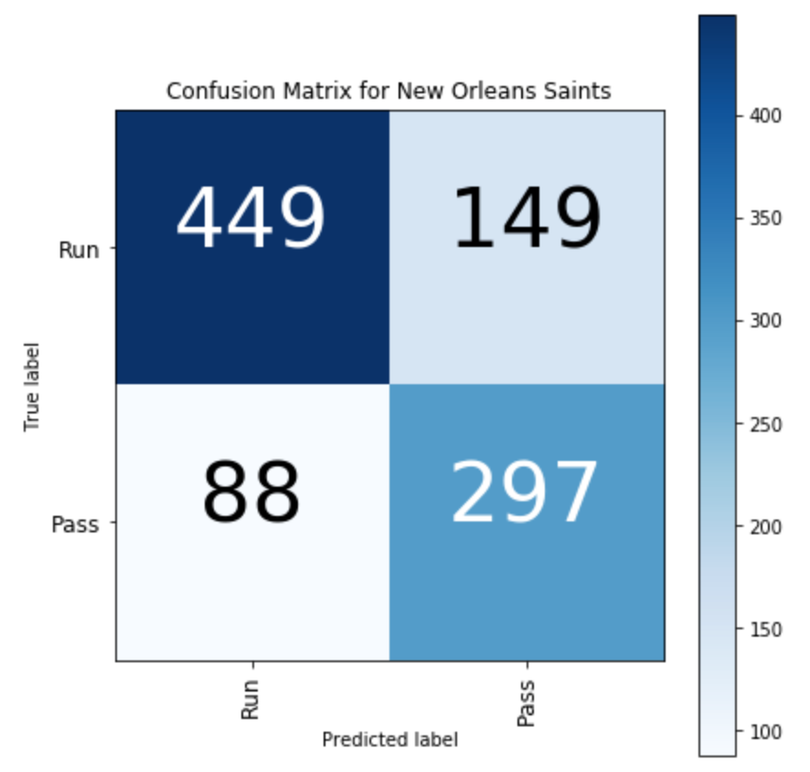
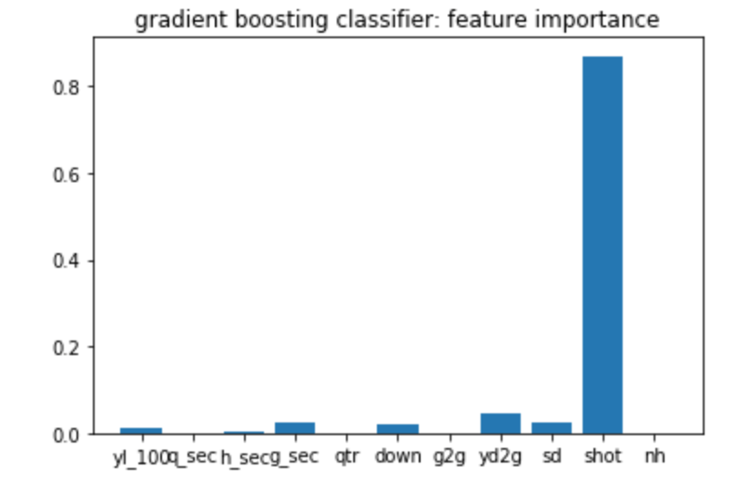
New Orleans Results (75.89% Accuracy)

Slide 15
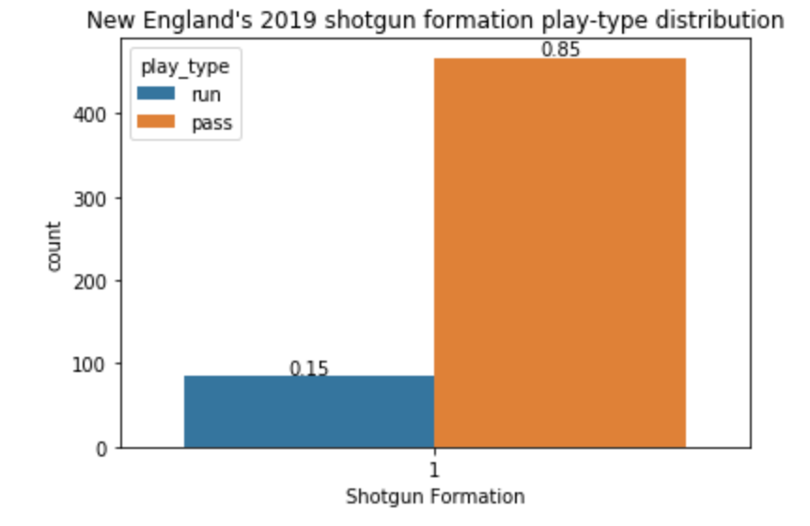
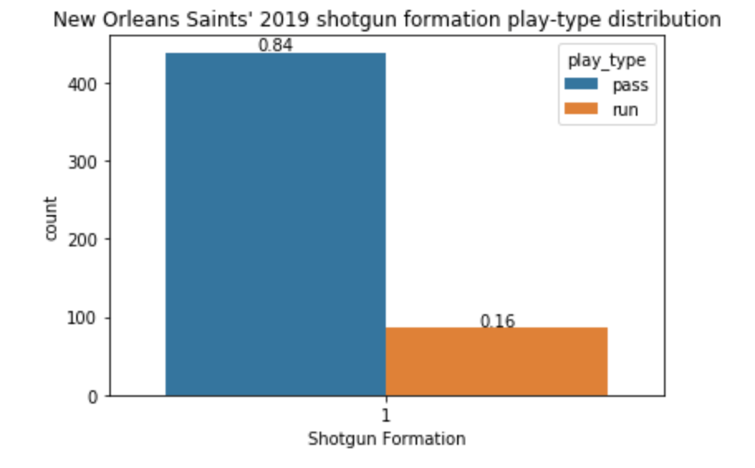
Results

Slide 16
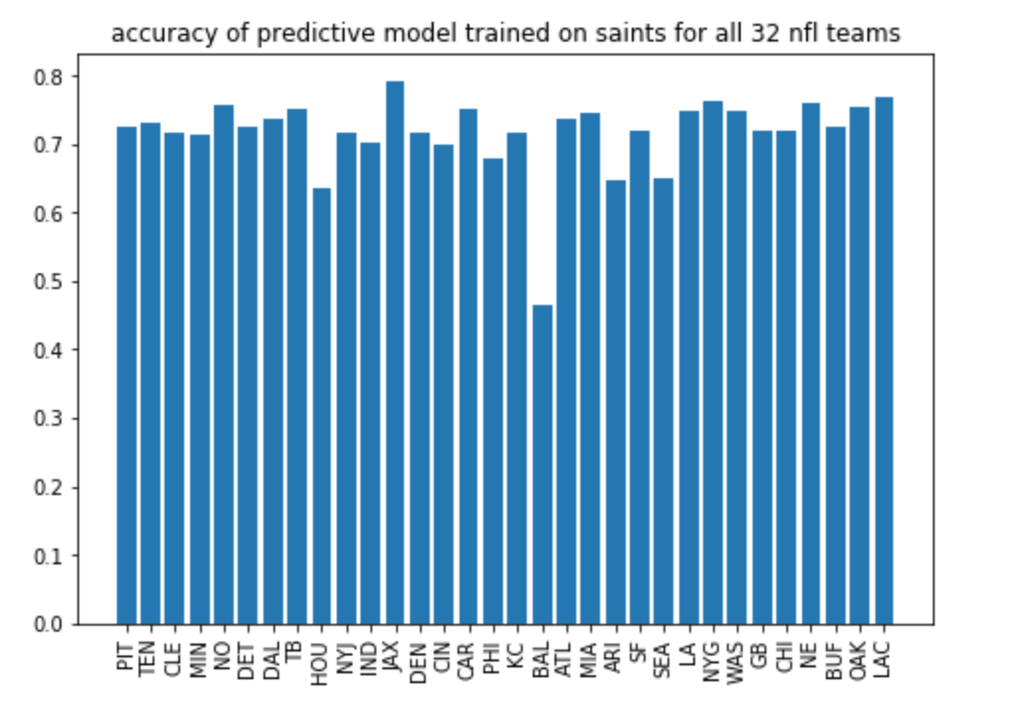
Predicting all 32 teams
Using Patriots as training data

Slide 17
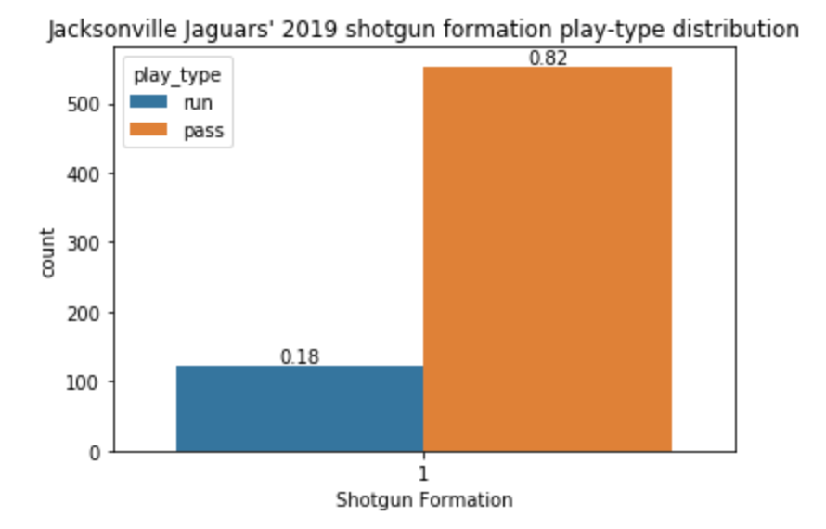
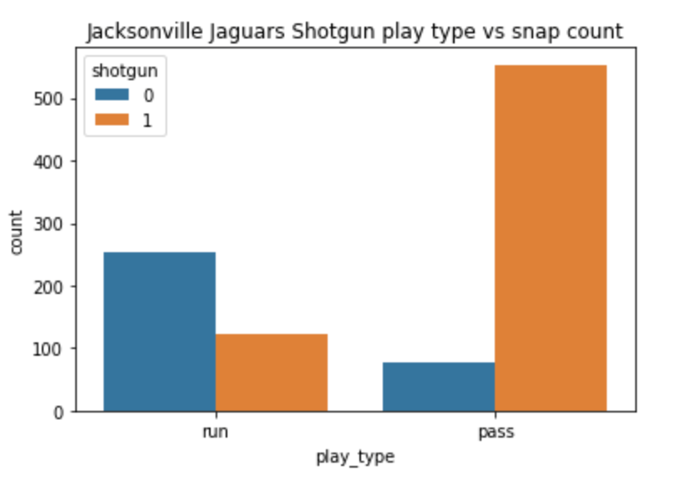
Why is the Jaguars Accuracy (79.32%) the highest?

Slide 18
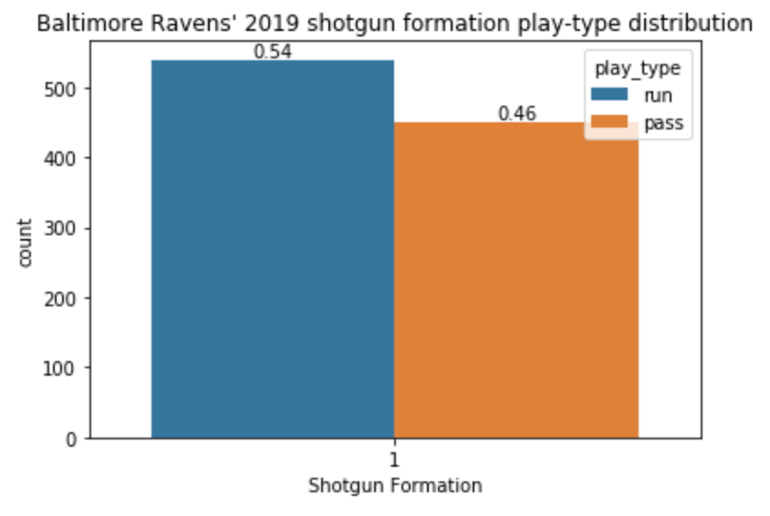
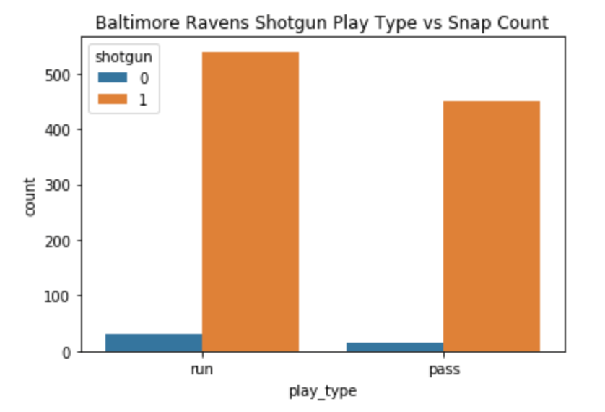
Why is the Baltimore Ravens Accuracy (46.57%) so Bad?

Slide 19
Next Steps
Use Jaguars as the training set to improve accuracy or respective training sets
Add and Look into other features that might increase accuracy
Use AWS player tracking to give real time play prediction

