Slide 1
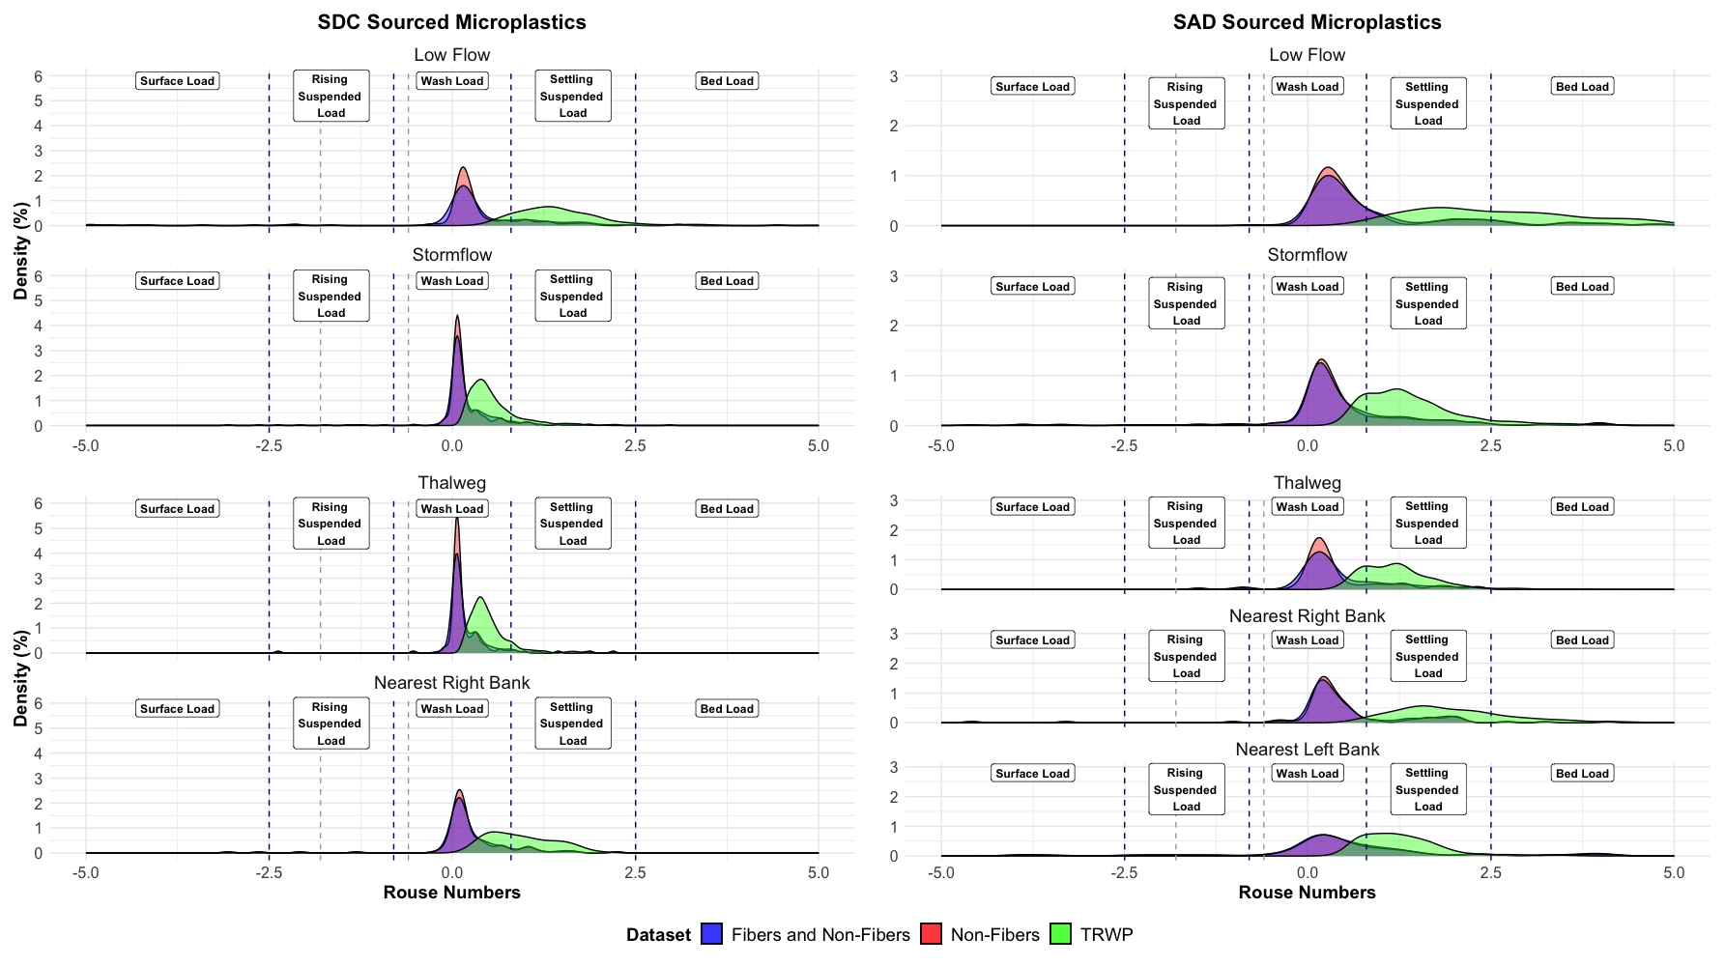
Wash Load Transport:
Fibers & Non-Fibers: 72%
Non-Fibers: 76%
TRWPs: 10%
Wash Load Transport:
Fibers & Non-Fibers: 60%
Non-Fibers: 64%
TRWPs: 0.88%
Wash Load Transport:
Fibers & Non-Fibers: 91%
Non-Fibers: 91%
TRWPs: 84%
Wash Load Transport:
Fibers & Non-Fibers: 69%
Non-Fibers: 69%
TRWPs: 16%
a
b
Wash Load Transport:
Fibers & Non-Fibers: 72%
Non-Fibers: 75%
TRWPs: 21%
Wash Load Transport:
Fibers & Non-Fibers: 94%
Non-Fibers: 95%
TRWPs: 90%
Wash Load Transport:
Fibers & Non-Fibers: 72%
Non-Fibers: 73%
TRWPs: 2.7%
Wash Load Transport:
Fibers & Non-Fibers: 85%
Non-Fibers: 85%
TRWPs: 44%
Wash Load Transport:
Fibers & Non-Fibers: 63%
Non-Fibers: 58%
TRWPs: 20%
c
d

Slide 2
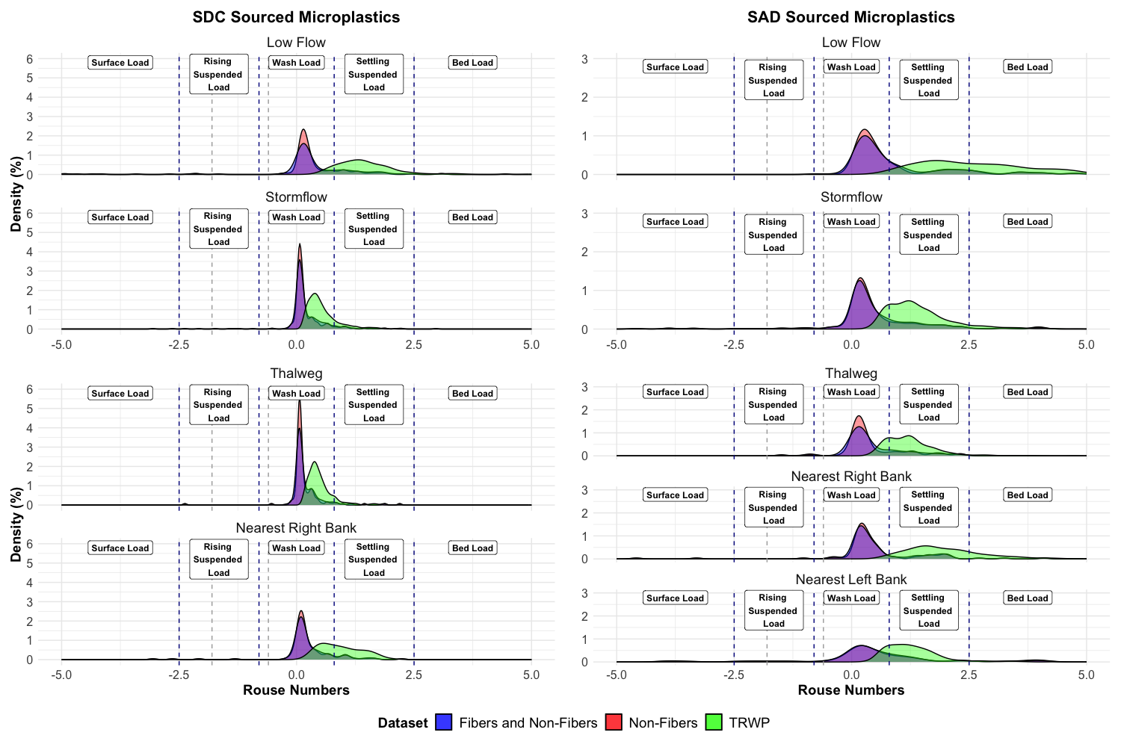
Wash Load Transport:
Fibers & Non-Fibers: 72%
Non-Fibers: 76%
TRWPs: 10%
Wash Load Transport:
Fibers & Non-Fibers: 60%
Non-Fibers: 64%
TRWPs: 0.88%
Wash Load Transport:
Fibers & Non-Fibers: 91%
Non-Fibers: 91%
TRWPs: 84%
Wash Load Transport:
Fibers & Non-Fibers: 69%
Non-Fibers: 69%
TRWPs: 16%
a
b
Wash Load Transport:
Fibers & Non-Fibers: 72%
Non-Fibers: 75%
TRWPs: 21%
Wash Load Transport:
Fibers & Non-Fibers: 94%
Non-Fibers: 95%
TRWPs: 90%
Wash Load Transport:
Fibers & Non-Fibers: 72%
Non-Fibers: 73%
TRWPs: 2.7%
Wash Load Transport:
Fibers & Non-Fibers: 85%
Non-Fibers: 85%
TRWPs: 44%
Wash Load Transport:
Fibers & Non-Fibers: 63%
Non-Fibers: 58%
TRWPs: 20%
c
d

Slide 3
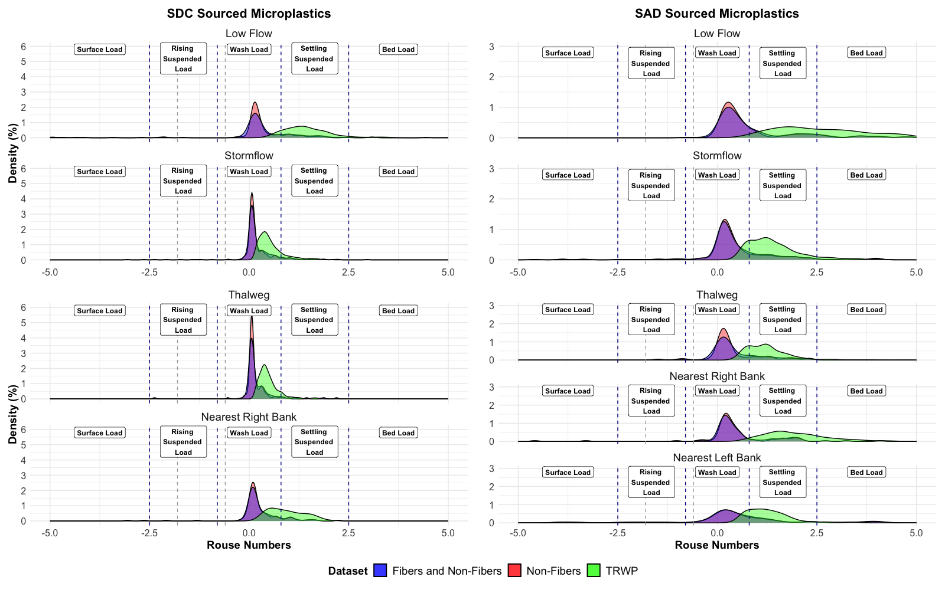
Wash Load Transport:
Fibers & Non-Fibers: 72%
Non-Fibers: 76%
TRWPs: 10%
Wash Load Transport:
Fibers & Non-Fibers: 60%
Non-Fibers: 64%
TRWPs: 0.88%
Wash Load Transport:
Fibers & Non-Fibers: 91%
Non-Fibers: 91%
TRWPs: 84%
Wash Load Transport:
Fibers & Non-Fibers: 69%
Non-Fibers: 69%
TRWPs: 16%
a
b
Wash Load Transport:
Fibers & Non-Fibers: 72%
Non-Fibers: 75%
TRWPs: 21%
Wash Load Transport:
Fibers & Non-Fibers: 94%
Non-Fibers: 95%
TRWPs: 90%
Wash Load Transport:
Fibers & Non-Fibers: 72%
Non-Fibers: 73%
TRWPs: 2.7%
Wash Load Transport:
Fibers & Non-Fibers: 85%
Non-Fibers: 85%
TRWPs: 44%
Wash Load Transport:
Fibers & Non-Fibers: 63%
Non-Fibers: 58%
TRWPs: 20%
c
d

Slide 4
Wash Load Transport:
Fibers & Non-Fibers: 72%
Non-Fibers: 76%
TRWPs: 10%
Wash Load Transport:
Fibers & Non-Fibers: 60%
Non-Fibers: 64%
TRWPs: 0.88%
Wash Load Transport:
Fibers & Non-Fibers: 91%
Non-Fibers: 91%
TRWPs: 84%
Wash Load Transport:
Fibers & Non-Fibers: 69%
Non-Fibers: 69%
TRWPs: 16%
a
b
Wash Load Transport:
Fibers & Non-Fibers: 72%
Non-Fibers: 75%
TRWPs: 21%
Wash Load Transport:
Fibers & Non-Fibers: 94%
Non-Fibers: 95%
TRWPs: 90%
Wash Load Transport:
Fibers & Non-Fibers: 72%
Non-Fibers: 73%
TRWPs: 2.7%
Wash Load Transport:
Fibers & Non-Fibers: 85%
Non-Fibers: 85%
TRWPs: 44%
Wash Load Transport:
Fibers & Non-Fibers: 63%
Non-Fibers: 58%
TRWPs: 20%
c
d

