Slide 1
App Uploader For Remote Embedded Devices

Slide 2
Outline
The aim of the project is to develop a system that can upload code directly from a webpage to a remote embedded device (specifically an espruino device)
The system should be able to both send code to, and read data from, these devices
This can be achieved through Web Bluetooth

Slide 3
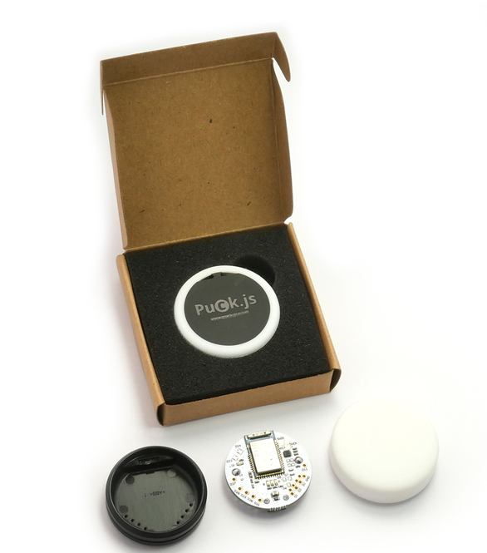
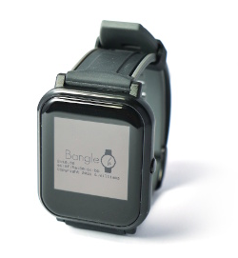
Espruino
Espruino is a javascript interpreter designed for microcontrollers and embedded/IoT devices
There are specific Espruino hardware devices
puck.js - a Bluetooth button/sensor
bangle.js - Espruino powered smartwatch
Pico – USB microcontroller
http://www.espruino.com/

Slide 4
Web Bluetooth
Web Bluetooth is an API which allows web browsers to communicate with Bluetooth devices
Supported on Chrome (mobile and desktop), Edge and Opera. It is not currently implemented on ios browsers, however there are various ios apps which offer web bluetooth support
Combined with Espruino, Web Bluetooth allows for the development of IoT apps and devices using javascript

Slide 5
App Uploader
Currently, there are two main methods of uploading code onto an espruino device
A web IDE available at https://www.espruino.com/ide/
An appstore for bangle.js available at https://banglejs.com/apps/
This project aims to develop another solution – One that allows users to interact with espruino hardware directly from any webpage/webapp
The user should be able to load a single URL and be able to communicate with external devices directly from a single page

Slide 6
Project Plan
Research the Web Bluetooth API
Explore the open source repositories for the espruino web IDE to get a feel for how code uploading is handled
Develop an API that can be easily integrated with any website, allowing for dynamic 2-way communication between the site and remote hardware
This should be well documented and easily extendable
Develop “proof of concept” apps showing the capabilities of the system
Dissertation Write Up (Concurrently with the development process)

