Slide 1

Team Mercury Abhi Trivedi, Danny Brown, Geoff Schaeffer, and Rob Black
Final Presentation- 12/05

Slide 2
ABHI Stuff

Slide 3
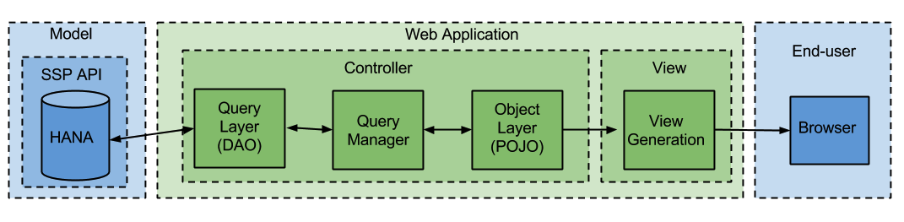
Architectural Overview
Design is highly modular
Design decouples presentation, business logic, and data access
Promotes extensibility and reuse of components

Slide 4
Framework Selection
Given that the end product is a web application, the first major task is to select a framework.
The major benefits of using a framework for development are:
Ease of development
Built-in support for the Model-View-Controller Pattern
Frameworks under consideration were:
Play
JRuby
Spring
Grails

Slide 5
Framework Selection
Criteria to evaluate frameworks
Heroku Compatibility
For ease of deployment
Language Extensibility
For potential changes in the future
Ease of Use
For speed of development
The ability to leverage existing work
For speed of development
Existing HANA API Framework
For potential close integration in the future
Satisfying the project requirements
For actually building what the customer wants

Slide 6
Framework Selection
Comparison of Frameworks
 | Play | JRuby | Spring | Grails
Heroku | Supported | Supported | Supported | Supported
HANA APIs | Written in Play | N/A | N/A | N/A
Language extensibility | Could shift to Scala | N/A | N/A | N/A
Ease of use | High ease of use | No teammember familiarity | High ease of use | No teammember familiarity
Leverage existing work | N/A | Potential to leverage existing Ruby work | N/A | N/A
Satisfies Project Requirements | Yes | No - project requires shift away from Ruby | Yes | More research needed

Slide 7
Framework Selection
Play Framework was selected
Had the edge in Ease of Use, Extensibility, and the fact that the HANA APIs are currently using Play
JRuby
Would have allowed leveraging of previous work, but didn’t fit project guidelines
Spring
Easy to use, but didn’t have as many advantages as Play
Grails
No team member familiarity
Since speed was an important factor, this impacted Grails

Slide 8
Governance
Documentation Guidelines
SenWeb documents all classes with class level and method level comments.
SenWeb is commented in order to generate documentation from the JDK “javadoc” tool.
Testing Guidelines
Use JUnit 4.11 for testing by annotating methods with @Test and classes with @RunWith(JUnit4.class).
SenWeb provides Unit and Integration test cases for all classes and logical modules.

Slide 9
Design Patterns
Model View Controller
The standard pattern for building web applications.
Pros
Separates presentation from the underlying data
Provides a high degree of maintainability for a codebase
Cons
Requires more effort to set up correctly
Analysis
Modern development frameworks provide most of this heavy lifting, so the benefits can be obtained at a lower cost.

Slide 10
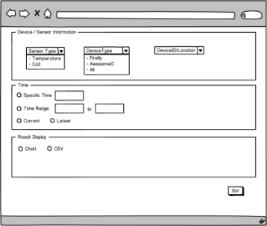
Design Patterns
UI Wizard
Presentation layer pattern
Pros
Minimizes errors and misunderstandings
Provides Clear Flow and prompt feedback throughout the process
Cons
Forces the user to follow steps as we define them
Analysis
Clarity and ease-of-use outweighs the restriction on users’ process

Slide 11
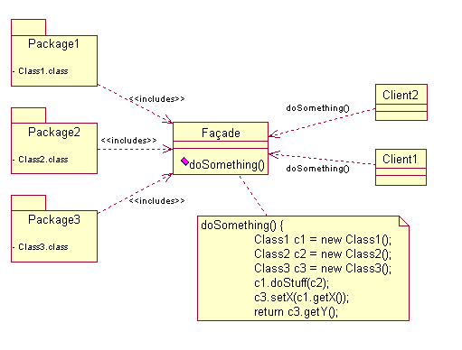
Design Patterns
Facade
Our Query code is a facade for the underlying API
The web app is a facade for users for the API
Pros
Clarity of implementation
Proper separation of concerns
Hiding of implementation details
Cons
Additional time spent in up-front design
Analysis
Makes code clean and effective

Slide 12
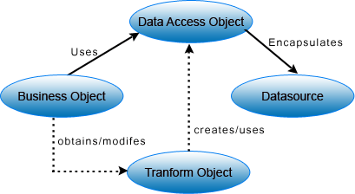
Design Patterns
Data Access Object
Separate the connection with an underlying data source from the rest of the business logic code
For SenWeb, the HANA API specific DAO is what is hiding behind our Query Facades.
Pros
Modularizes code
Proper separation of concerns
Cons
Requires more code to maintain
Analysis
Allows us to insulate higher-level classes from lower-level ones

Slide 13
Danny Stuff

Slide 14
ROB Stuff

Slide 15
ABHI Stuff - Conclusion

