Slide 1

Team Mercury Abhi Trivedi, Danny Brown, Geoff Schaeffer, and Rob Black
Project Presentation- 11/14

Slide 2
Agenda
Project 3 Background
Architectural Overview
Framework Selection
Requirements Gathering
User Interface
Separation of Concerns
Future Work

Slide 3
Project 3 background
Rewrite currently existing Ruby on Rails web application in Java
Currently existing app located at: http://cmu-sds.herokuapp.com/
At least as functional as current application
Utilize Sensor Service Platform APIs (HANA)
Enable multiple types of sensors
Focusing on implementation of:
Query database for metadata
Query database for sensor readings
Upload of sensor data
Visualization
Work closely and integrate with team focusing on:
Add/Edit/Remove of metadata
Enhancing data models

Slide 4
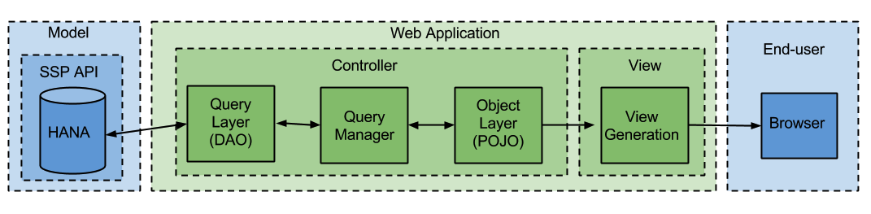
Architectural Overview
Design is highly modular
Design decouples presentation, business logic, and data access
Promotes extensibility and reuse of components

Slide 5
Framework Selection
Given that the end product is a web application, the first major task is to select a framework.
The major benefits of using a framework for development are:
Ease of development
Built-in support for the Model-View-Controller Pattern
Frameworks under consideration were:
Play
Jruby
Spring
Grails

Slide 6
Framework Selection
Play Framework was selected based on criteria
 | Play | JRuby | Spring | Grails
Heroku | Supported | Supported | Supported | Supported
HANA APIs | Written in Play | N/A | N/A | N/A
Language extensibility | Could shift to Scala | N/A | N/A | N/A
Ease of use | High ease of use | No teammember familiarity | High ease of use | No teammember familiarity
Leverage existing work | N/A | Potential to leverage existing Ruby work | N/A | N/A
Satisfies Project Requirements | Yes | No - project requires shift away from Ruby | Yes | More research needed

Slide 7
Requirements Gathering
VP Requirements
Use-cases
See Appendix
API Spec
https://github.com/SensorServicePlatform/APIs
Based on the requirements, created a mockup user interface
Based on the Wizard Design Pattern

Slide 8
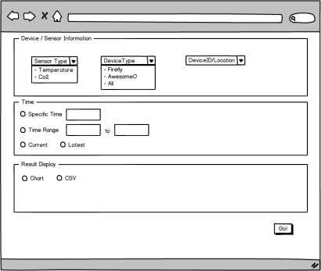
User interface

Slide 9
User interface
Based on the requirements, created a mockup user interface for querying the database for sensor readings
We concluded this is a multi-step process
We believe the Wizard Design Pattern provides the implementation to solve the problem
Wizard Design Pattern
Pros:
Provides clear flow and prompt feedback through the process
Minimizes errors and misunderstandings
Cons:
Forces the user to follow the steps as we define them

Slide 10
Separation of concerns
Query Layer
Uses the Adapter Pattern to decouple Data Access from Business Logic
Example: API changes to a different protocol, changes only affect Query Layer
Query Manager
Uses the Mediator Pattern to promote loose coupling by keeping objects from referring to each other explicitly
Example: This layer changes only when new functionality is added
Object Layer
Insulate Presentation from upstream implementation details
Example: New views can be created independently of the back-end
See Appendix: Class Diagram for more detail

Slide 11
Future work
Complete implementation of Query Database for Sensor Readings APIs
Complete implementation of Query Database for Metadata APIs
Complete implementation of Upload of Sensor Data APIs
Technical documentation

Slide 12
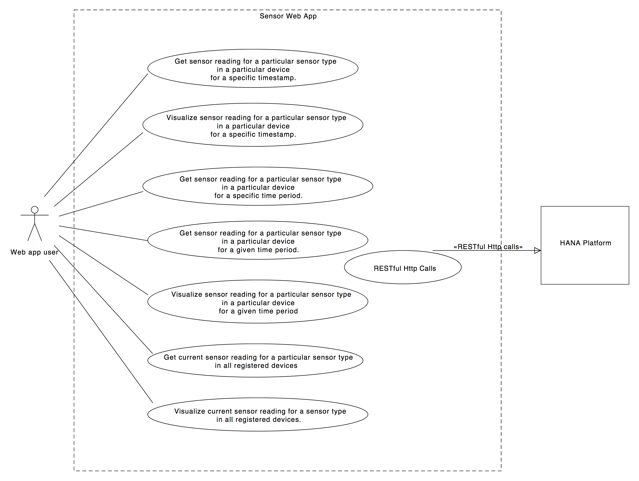
Appendix: USE case diagram

Slide 13
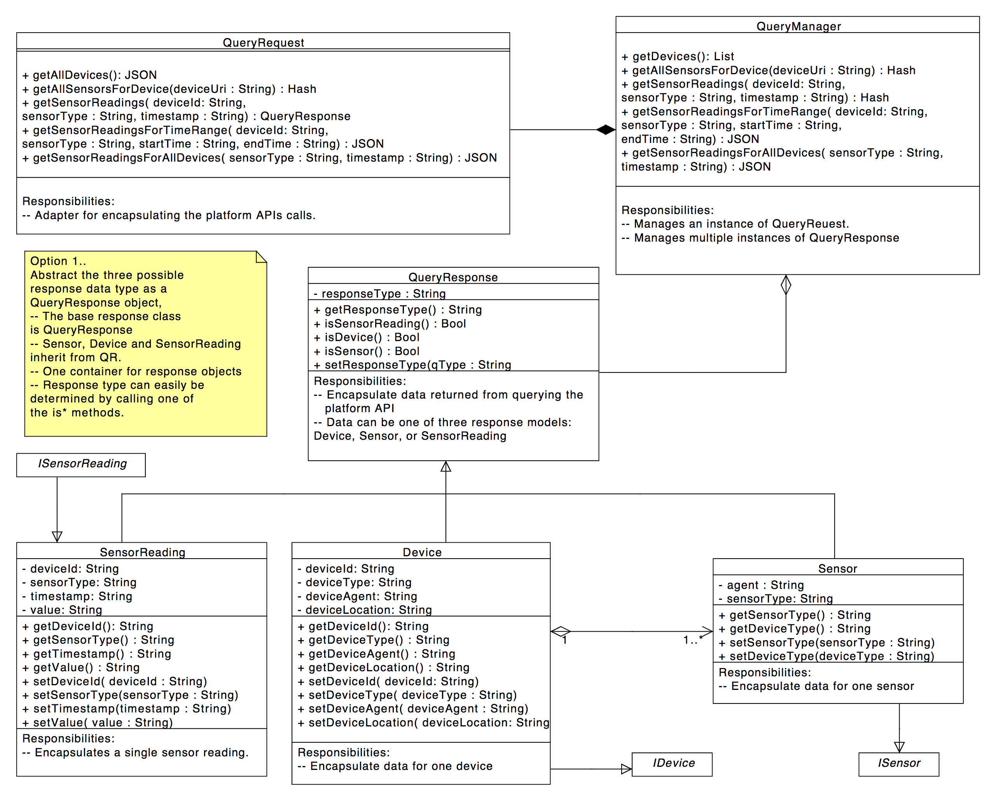
Appendix: Class diagram

