Slide 1

SenWeb Project 3 – Part-time
Presenters: Abhi Trivedi, Danny Brown, Geoff Schaeffer, Rob Black
Advisor: Jia Zhang
Sponsor: Bob Iannucci

Slide 2
Agenda
Background and Motivation
Current and Proposed solution
System Design
System Implementation
Demo
Analysis
Future Work

Slide 3
Motivation

Slide 4
Who and Why?
VP Engineering
“Simple, extensible and low cost design”
“Easily maintenance”
Project Guide
“Easy transition between teams”
“Minimum viable technology stack: lower learning curve”
Developers
“APIs should be simple and easy to incorporate”
“Well defined and extensive API”
End Users
“Ease of use”
“Single access point for visualization”

Slide 5
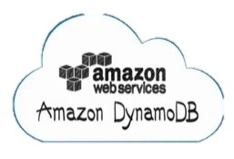



What and How?
Dynamo DB to store the sensor reading data
PostgreSQL Relational database to store the data for data other than sensor readings
Rails application to serve the functionality of SDS
jqplot is applied as the visualization tool
*Representation by
Team 4 – Architecture Design Class (2012)

Slide 6

Introducing: SAP® HANA
Dynamo DB to store the sensor reading data
PostgreSQL Relational database to store the data for data other than sensor readings
Rails application to serve the functionality of SDS
jqplot is applied as the visualization tool
In-memory database solution for accelerated analytics

Slide 7

Introducing: SAP® HANA
Dynamo DB to store the sensor reading data
PostgreSQL Relational database to store the data for data other than sensor readings
Rails application to serve the functionality of SDS
jqplot is applied as the visualization tool
In-memory database solution for accelerated analytics
No native support for HANA.

Slide 8
Proposed Application
In-memory database solution for accelerated analytics
Java based application to expose RESTful APIs for sensor data
D3 applied as the visualization tool
Java based Web application utilizing RESTful APIs for data visualization
Sensor Data as a Service (REST)
API Module
Web Module

Slide 9
System DESIGN

Slide 10
Design Philosophy
Separation of concerns
Low coupling / High cohesion
Promotes extensibility and reusability and enhances maintainability.

Slide 11
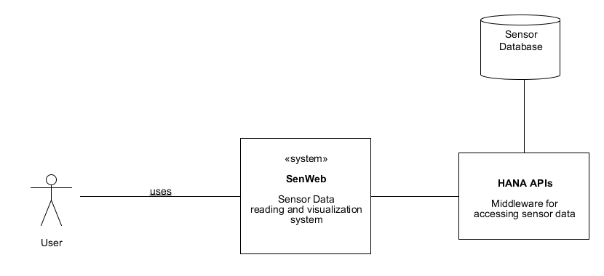
Contextual View

Slide 12
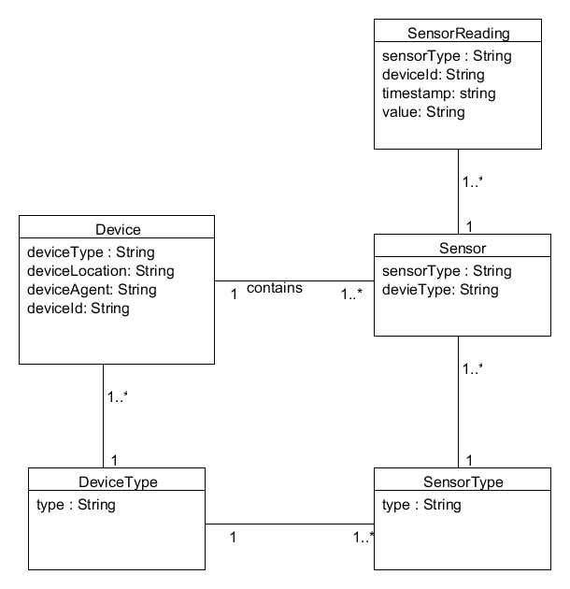
Informational View

Slide 13
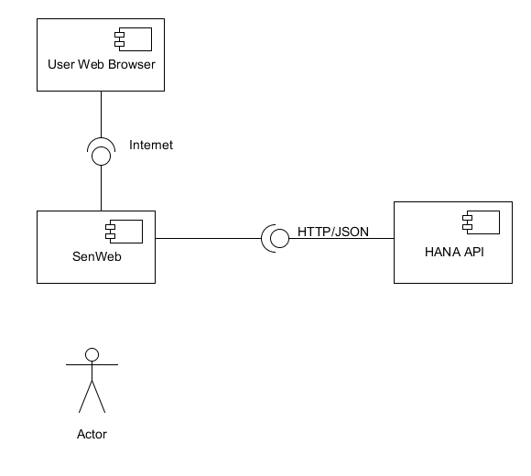
Functional View

Slide 14
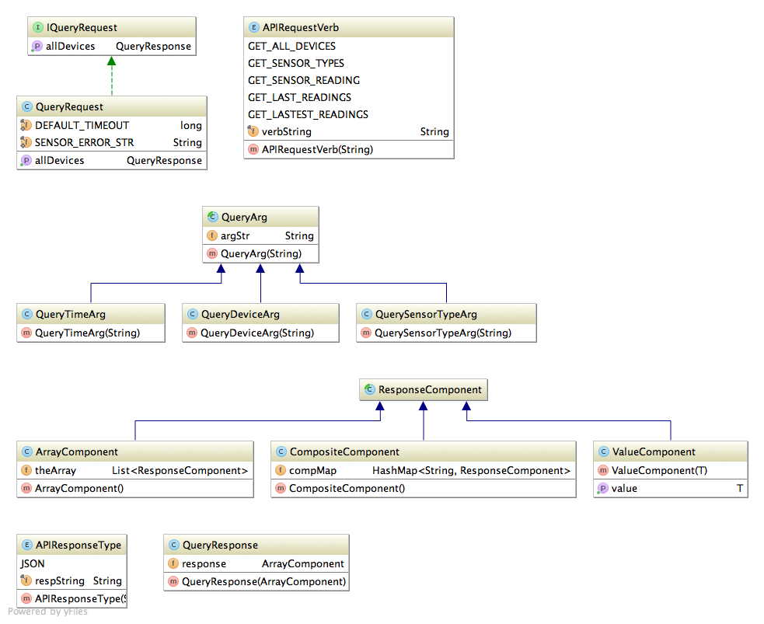
Logical View

Slide 15
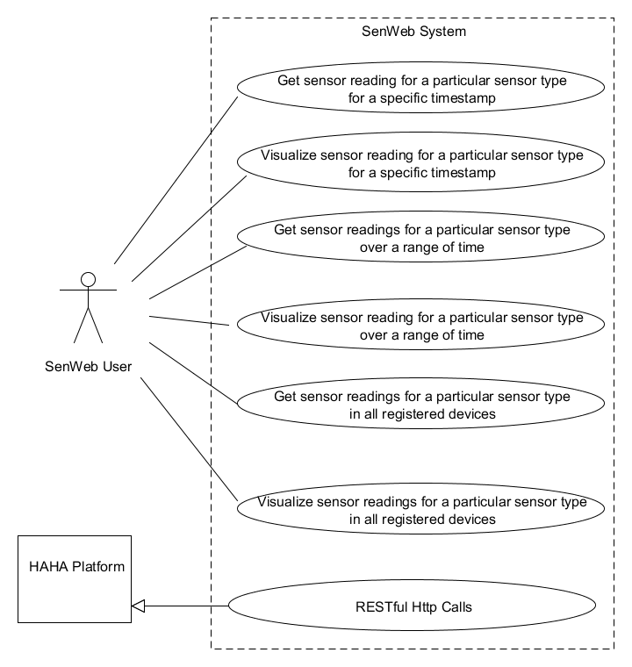
USE CASE MODEL

Slide 16
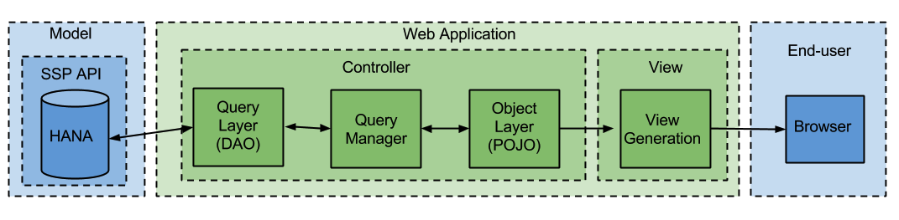
Architectural Overview
Design is highly modular
Design decouples presentation, business logic, and data access
Promotes extensibility and reuse of components

Slide 17
Design Pattern: Model View Controller
Model View Controller
The standard pattern for building web applications
Pros
Separates presentation from the underlying data
Provides a high degree of maintainability for a codebase

Slide 18
Design Pattern: Model View Controller
Model View Controller
Cons
Requires more effort to set up
Analysis
Modern development frameworks provide support for MVC pattern, so benefits can be obtained at a lower cost

Slide 19
System Implementation

Slide 20
Framework Selection
Given that the end product is a web application, the first major task is to select a framework.
The major benefits of using a framework for development are:
Ease of development
Built-in support for the Model-View-Controller Pattern
Frameworks under consideration were:
Play
JRuby
Spring
Grails

Slide 21
Framework Selection
Criteria to evaluate frameworks
Heroku Compatibility
For ease of deployment
Language Extensibility
For potential changes in the future
Ease of Use
For speed of development
The ability to leverage existing work
For speed of development
Existing HANA API Framework
For potential close integration in the future
Satisfying the project requirements
For actually building what the customer wants

Slide 22
Framework Selection
Comparison of Frameworks
 | Play | JRuby | Spring | Grails
Heroku | Supported | Supported | Supported | Supported
HANA APIs | Written in Play | N/A | N/A | N/A
Language extensibility | Could shift to Scala | N/A | N/A | N/A
Ease of use | High ease of use | No teammember familiarity | High ease of use | No teammember familiarity
Leverage existing work | N/A | Potential to leverage existing Ruby work | N/A | N/A
Satisfies Project Requirements | Yes | No - project requires shift away from Ruby | Yes | More research needed

Slide 23
Framework Selection
Play Framework was selected
Had the edge in Ease of Use, Extensibility, and the fact that the HANA APIs are currently using Play
JRuby
Would have allowed leveraging of previous work, but didn’t fit project guidelines
Spring
Easy to use, but didn’t have as many advantages as Play
Grails
No team member familiarity
Since speed was an important factor, this impacted Grails

Slide 24
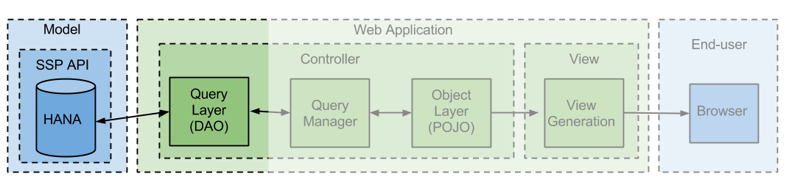
In-Depth: Query Layer
Query Layer insulates other modules from the implementation details of the API
It accomplishes this by providing a Facade for a Data Access Object

Slide 25
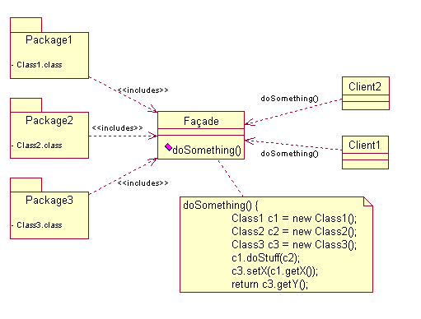
Design Pattern: Facade
Facade
Our Query code is a facade for the underlying API
The web app is a facade for users for the API
Pros
Clarity of implementation
Proper separation of concerns
Hiding of implementation details

Slide 26
Design Pattern: Facade
Facade
Cons
Additional time spent in up-front design
Analysis
Makes code clean and effective

Slide 27
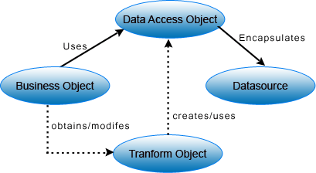
Design Pattern: Data Access Object
Data Access Object
Separate the connection with an underlying data source from the rest of the business logic code
For SenWeb, the HANA API specific DAO is what is hiding behind our Query Facades.

Slide 28
Design Pattern: Data Access Object
Data Access Object
Pros
Modularizes code
Proper separation of concerns
Cons
Requires more code to maintain
Analysis
Allows us to insulate higher-level classes from lower-level ones

Slide 29
In-Depth: Query Layer
Entry point into Query Layer for the rest of the business logic is the IQueryRequest interface.
Example methods of IQueryRequest:
public QueryResponse getAllDevices();
public QueryResponse getSensorTypes(QueryDeviceArg dType);

Slide 30
In-Depth: Query Layer
IQueryRequest methods map to APIs
public QueryResponse getAllDevices();
Maps to: http://einstein.sv.cmu.edu/get_devices/json
public QueryResponse getSensorTypes(QueryDeviceArg dType);
Maps to: http://einstein.sv.cmu.edu/get_sensor_type/<"device_type">/json
Return type of IQueryRequest methods is QueryResponse

Slide 31
In-Depth: Query Layer
QueryResponse uses the Composite Pattern to provide a generic response to a query
Currently the API returns JSON, however if it changes in the future (to XML, Object, Key->Value Mapping, etc.) then only the Query Layer that converts API response into QueryResponse needs to change.

Slide 32
In-Depth: Query Layer
Currently two classes implement IQueryRequest
QueryRequest
Provides communication with the actual HANA API
MockQueryRequest
Returns properly formatted JSON strings that are hardcoded
For testing purposes
Also useful for development when the HANA API is unavailable

Slide 33
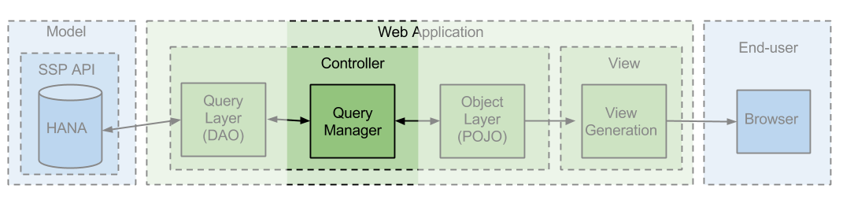
In-Depth: Query Manager
QueryManager provides another layer of insulation between the Object Layer and the QueryLayer
It is responsible for providing the Object Layer with specific objects built from the generic QueryResponses
QueryManager methods provide utility that the Object Layer wants in terms the Object Layer understands, so the Object Layer doesn’t have a direct dependency on the API.

Slide 34
In-Depth: Query Manager
Example methods of QueryManager
public List<Device> getDevices()
public List<SensorType> getSensorTypes(String deviceType)
public List<DeviceType> getDeviceTypes()
public List<DeviceType> getDeviceTypes(SensorType sensorType, List<DeviceType> deviceTypeList)
public List<String> getDeviceIds(DeviceType deviceType)
public List<SensorReading> getSensorReadings(Map<String, String> parameters)
public List<String> getAllSensorTypes()

Slide 35
In-Depth: Query Manager
QueryManager methods map to IQueryRequest methods
public List<Device> getDevices()
Maps to public QueryResponse getAllDevices()
public List<SensorType> getSensorTypes(String deviceType)
Maps to public QueryResponse getSensorTypes(QueryDeviceArg dType)

Slide 36
In-Depth: Query Manager
Internally, QueryManager methods follow the general procedure of
Making an IQueryRequest using QueryRequestFactory
Call an IQueryRequest method
Convert the QueryResponse to Objects

Slide 37
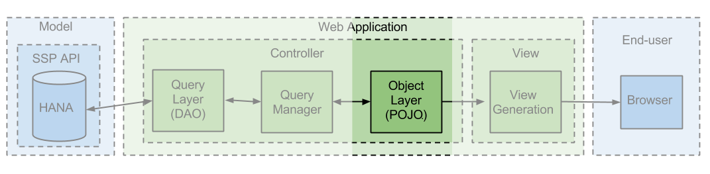
In-Depth: Object Layer
(Plain ‘Ol Java) Object Layer provides the Presentation Layer with pure Java representations of the elements to display

Slide 38
In-Depth: Object Layer
Objects in Object Layer
SensorType
DeviceType
Sensor
Device
SensorReading

Slide 39
In-Depth: Object Layer
SensorType
Represents a SensorType (e.g. “Temp”)

Slide 40
In-Depth: Object Layer
DeviceType
Represents a DeviceType (e.g. “Firefly_v3”)
Contains a List of SensorType

Slide 41
In-Depth: Object Layer
Sensor
Maps a DeviceType to a SensorType

Slide 42
In-Depth: Object Layer
Device
Contains the Device ID
Contains DeviceType
Contains deviceAgent
Contains deviceLocation

Slide 43
In-Depth: Object Layer
SensorReading
Collects together
ID of device
Type of sensor
Data value
Timestamp

Slide 44
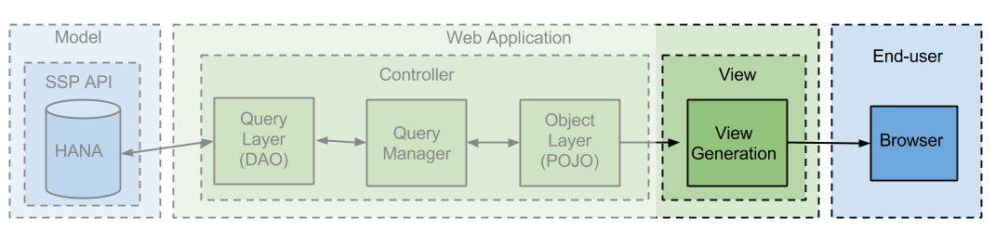
In-Depth: Presentation Layer
Presentation Layer provides a UI view to the end users of SenWeb
Uses the UI Wizard Pattern to guide users in the dashboard

Slide 45
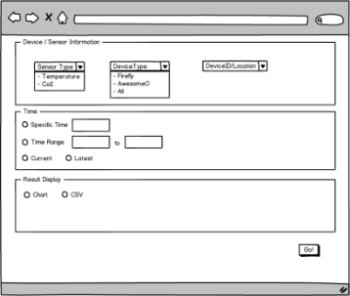
Design Pattern: UI Wizard
UI Wizard
Presentation layer pattern
Pros
Minimizes errors and misunderstandings
Provides Clear Flow and prompt feedback throughout the process

Slide 46
Design Pattern: UI Wizard
UI Wizard
Cons
Forces the user to follow steps as we define them
Analysis
Clarity and ease-of-use outweighs the restriction on users’ process

Slide 47
In-Depth: Presentation Layer
The Presentation Layer will be the focus of our Demo

Slide 48
Notes on Overall Governance
Documentation Guidelines
SenWeb documents all classes with class level and method level comments.
SenWeb is commented in order to generate documentation from the JDK “javadoc” tool.
Testing Guidelines
Use JUnit 4.11 for testing by annotating methods with @Test and classes with @RunWith(JUnit4.class).
SenWeb provides Unit and Integration test cases for all classes and logical modules.

Slide 49
SenWeb Architecture
To reiterate:
Design is highly modular
Design decouples presentation, business logic, and data access
Promotes extensibility and reuse of components

Slide 50
DEMONSTRATION

Slide 51
Demo
Application available at:
https://cmu-senweb.herokuapp.com

Slide 52
Analysis
Architectural Advantages
Play Framework allowed for rapid prototyping (MVC pattern)
Modularity of code made testing easier (DAO, Facade patterns)
Opportunities for Improvement
URLs (“routes” in Play terms) that our AJAX calls use are not 100% RESTful.
Multiple calls to Sensor Service Platform API with nearly every page request.
Caching of metadata may provide better performance.

Slide 53
Future work key takeaway

Slide 54
Future work
Add implementation for Category 4 APIs
Represents CRUD operations
Sensors
Devices
Device Agents
Sensor Types
Device Types
Implement role based access control.
Increase charting ability for Dashboard page.
More real-time visualization support to really utilize HANA’s abilities.

Slide 55
Key Takeaway
Design: Modular, Decoupled and componentized
Macro: Modular service oriented architecture with RESTful protocol
Micro: Design patterns selected based on context
Play Framework: Compatible and Java based.
Further expansion
Discoverable and configurable RESTful APIs
Support complete CRUD operation on sensor data
Role based access restrictions
Real-time visualization

