Slide 1
Open NEX
Social Networking
Project Management
Chih Chi Hu
Juanchen Li
Gautam Madaan
Vinay Venkatesh
Advisor - Jia Zhang
[18-653] Software Architecture and Design, Spring 2015

Slide 2
Overview
Introduction
What is Open NEX
Related Work
Design and Implementation
Demo
Experiments & Analysis
Project Details
Future Enhancements

Slide 3

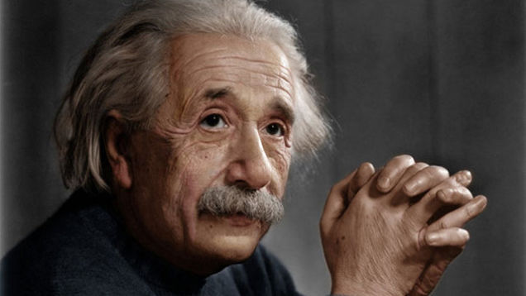

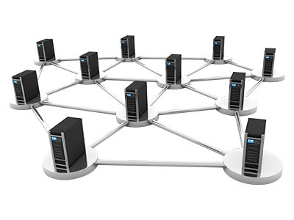
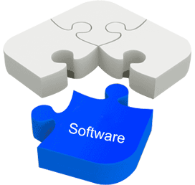

About
NASA
Scientists
Services
Shared Platform
Loads of data

Slide 4



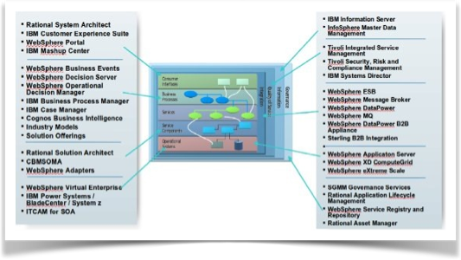

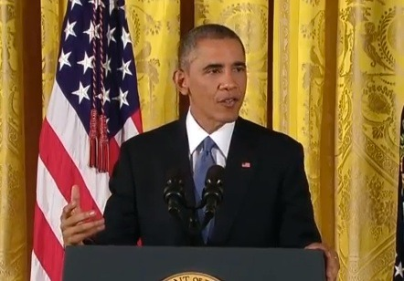
Why

Slide 5



Related Work
NASA Earth Exchange
Social networks
Project management frameworks

Slide 6
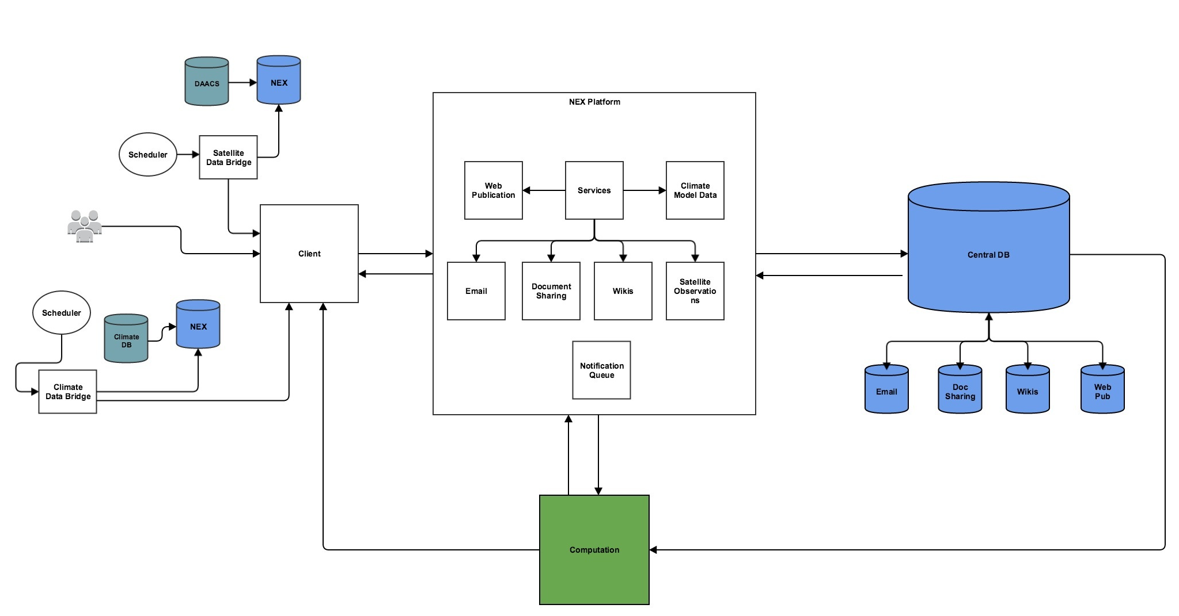
Overall Design

Slide 7

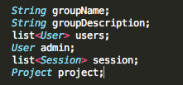



Design
Groups
Sessions
Users
Tasks
Projects

Slide 8
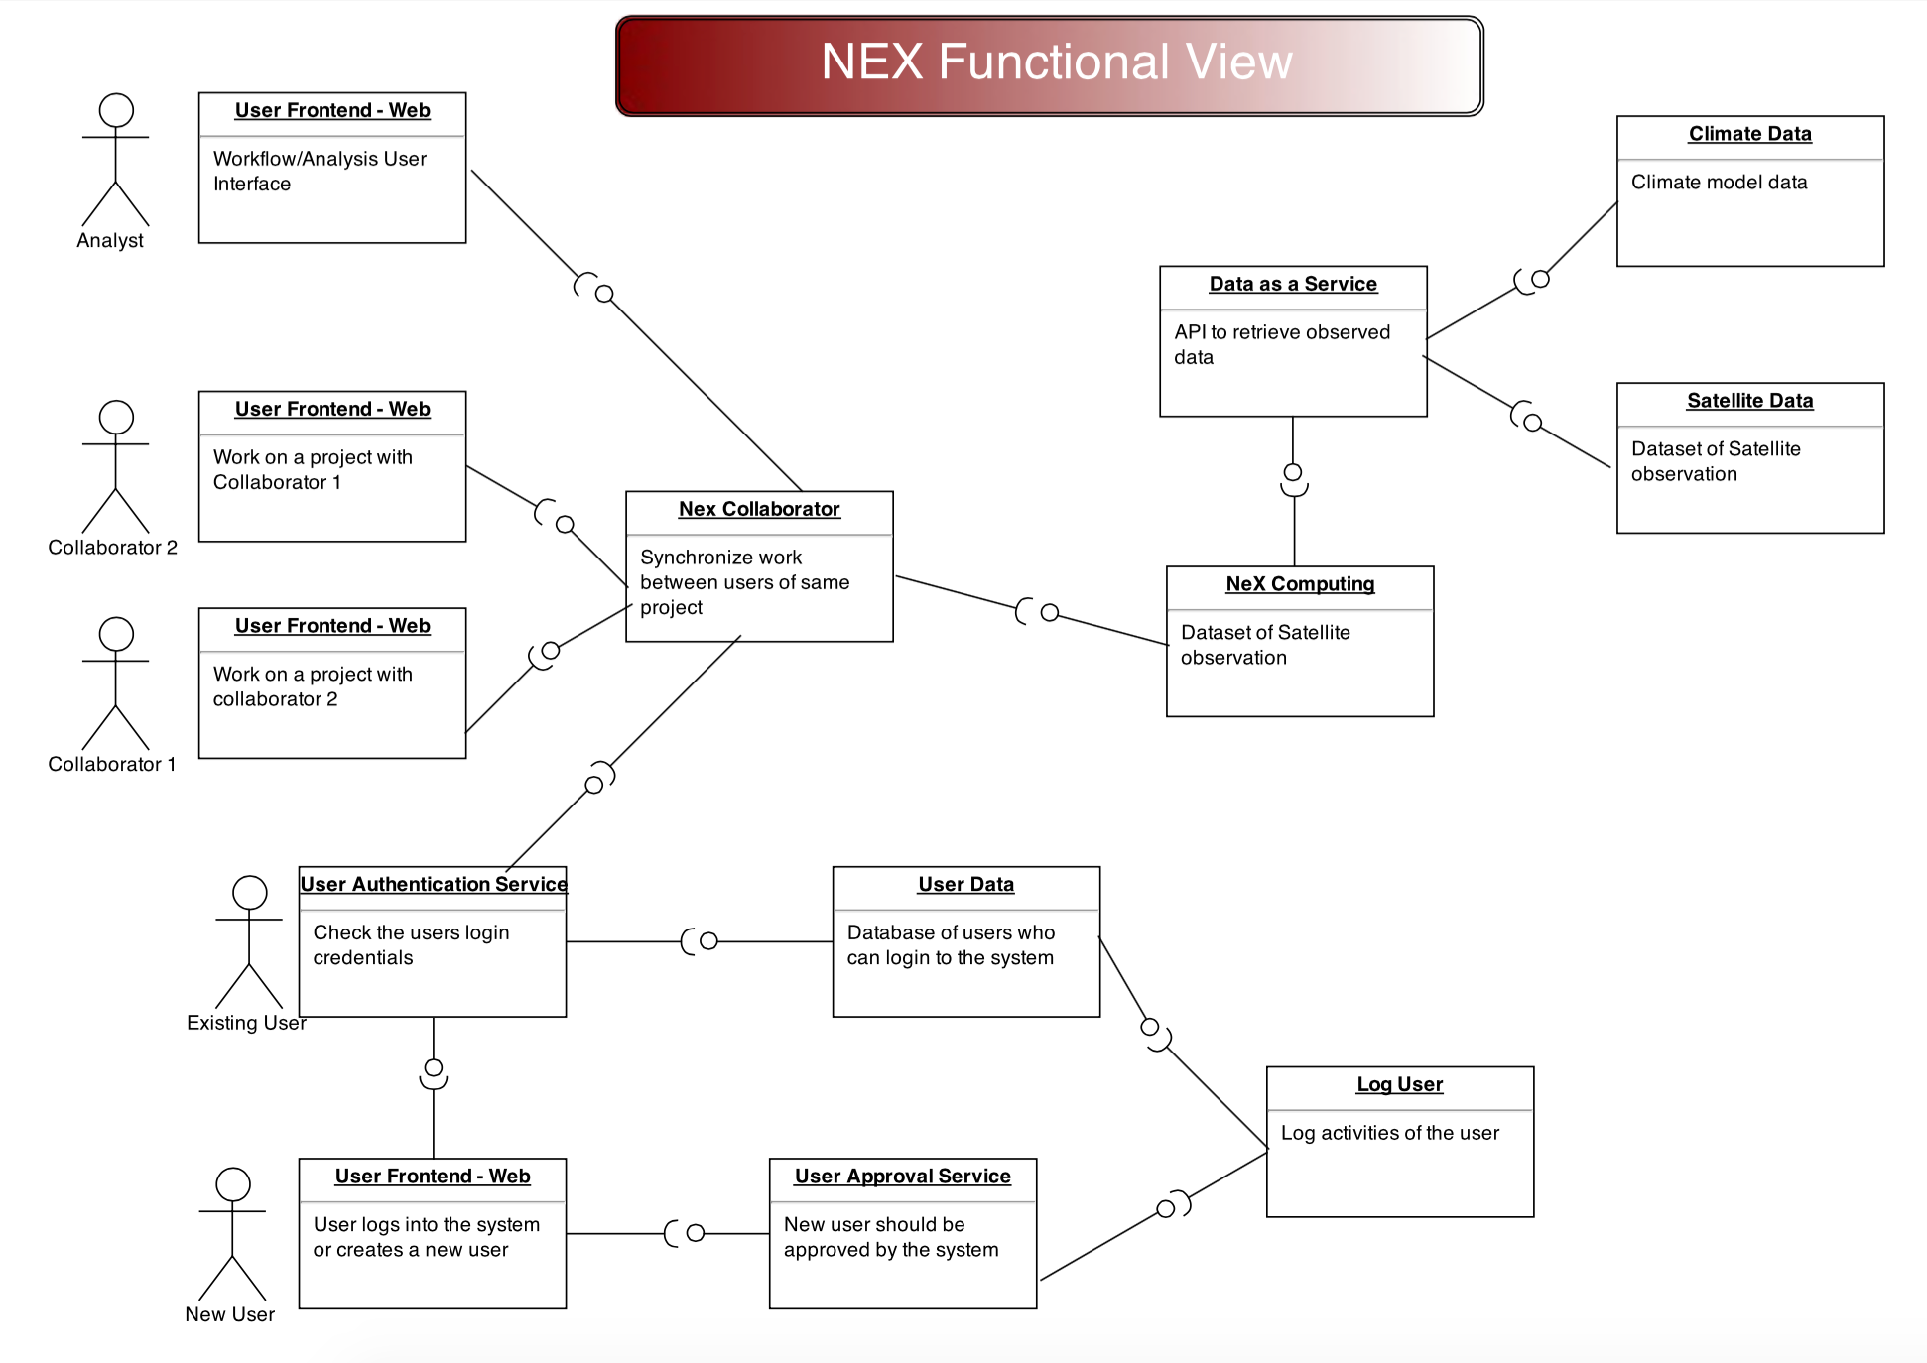

Slide 9
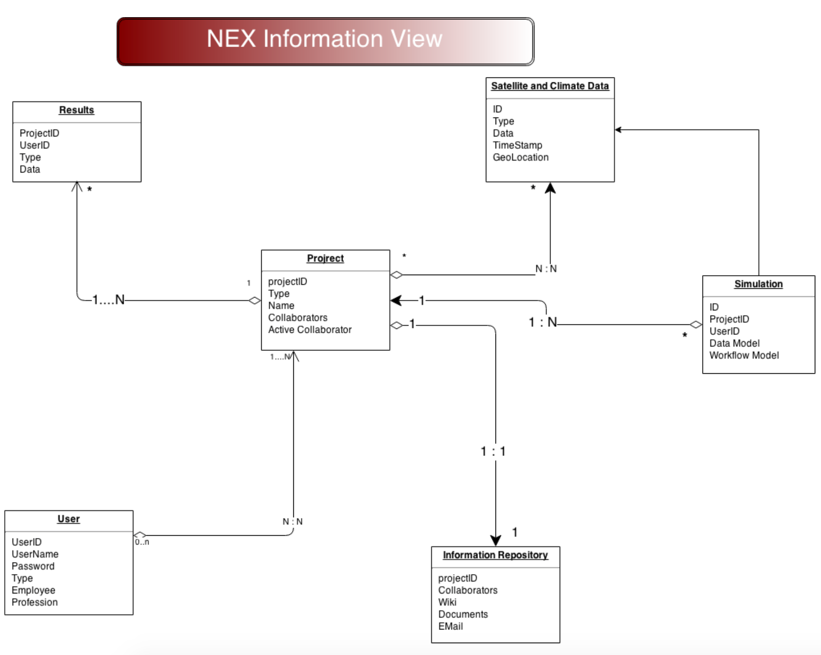

Slide 10
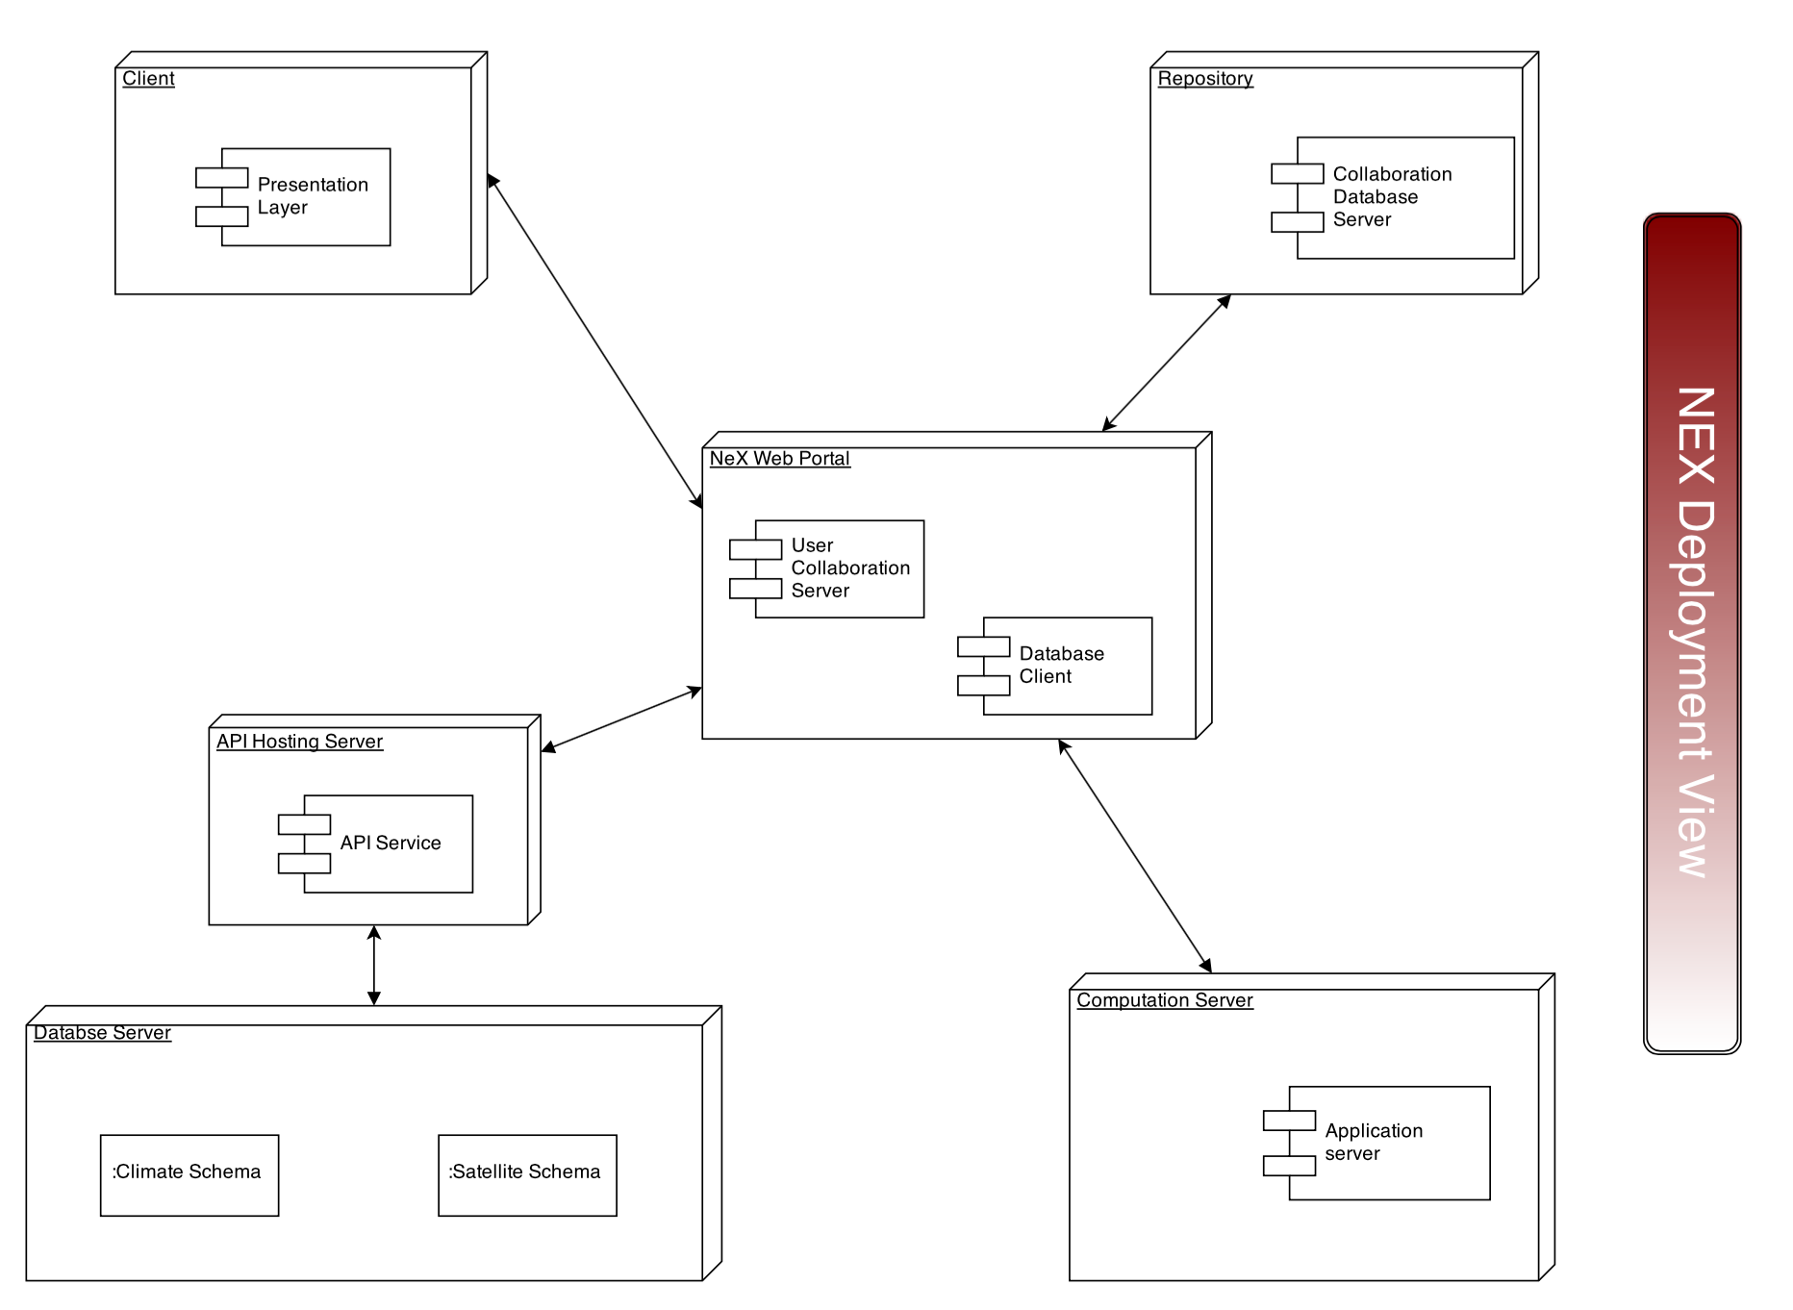

Slide 11
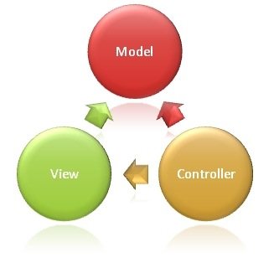



System Implementation
Java
Scala
MVC
Play
Framework
RESTful API
html
Git
Relational DB

Slide 12
Demo

Slide 13
Experiments & Analysis
Using Play framework
lightweight
scalable
Using RESTful API
split up development tasks
modular
reusable
extendable
interoperable

Slide 14


Requirements
Web browser
Play framework
Java Development Kit 6+

Slide 15

Building the Project
Code is available from Github
https://github.com/cmusv-sc/OpenNEX-Team6
In the project directory >$ play run
Access the project on a web browser via http://localhost:9000 (hosted on port 9000 by default)

Slide 16
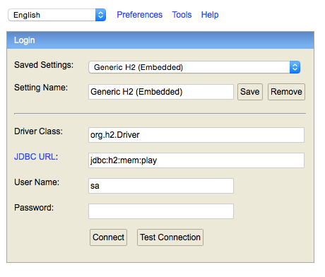
Accessing the Database
In the project directory >$ play
In the play CLI >$ h2-browser (A new browser will pop up).
Verify that the JDBC URL is correct in the new browser. Find db.default.url="jdbc:x" in application.conf

Slide 17
Known Bugs
Access Control: Implemented by another team. Prior to integration, user logins are not persisted across pages

Slide 18
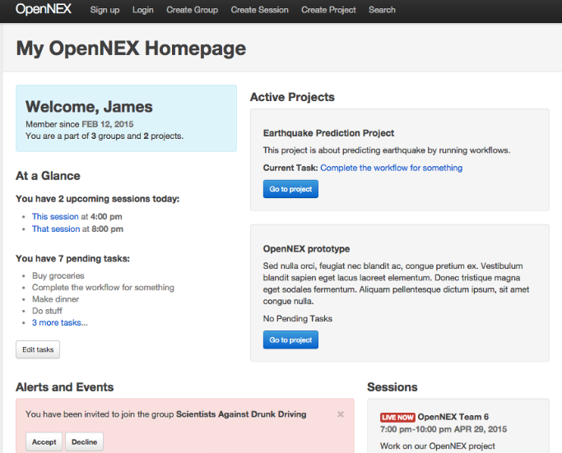
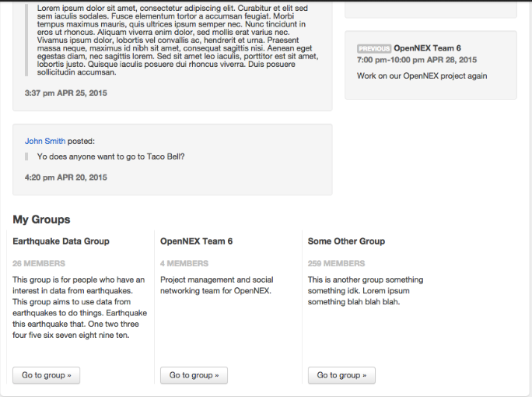
Future Enhancements
Integrate access control, share data, share workflow, share software, manage computing power
Expand functionality for user experience
Providing web interfaces to populate groups, projects, sessions
Notification feed and history
security
Improve error checking & parsing

Slide 19

Open NEX
A collaboration platform for the entire world to collaborate in conducting earth science research

Slide 20
Thank you.

Slide 21
Contact Info
chih.chi.hu@sv.cmu.edu (510) 501-0353
juanchen.li@sv.cmu.edu (808) 990-7710
gautam.madaan@sv.cmu.edu (408) 368-8895
vinay.venkatesh@sv.cmu.edu (408) 406-1324

