Slide 1
Trust-Based
Recommendation System
Sponsor: NASA
Point of Contact: Petr Votava
Faculty Advisor: Jia Zhang
Team: Krutika Kamilla, Abhishek Mukhopadhyay,
MustafaTasdemir, Jisha Vadake Muthiyil
INI Project Practicum, Fall 2014

Slide 2
Outline
• Motivation
• Project Background
• Related work
• System design
• System implementation
• Demo
• Experiments/analysis
• Conclusions and future work
1

Slide 3
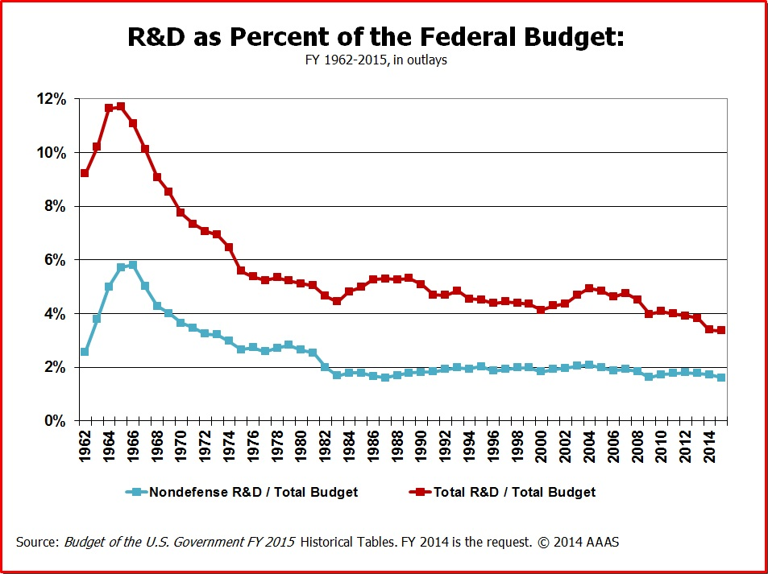
Motivation
R&D spending worldwide - $1.6 trillion, U.S. - $465 billion.
Continuous contraction in budget through the past 50 years
Necessitates efficient utilization of these funds.
2
Notes:
http://www.battelle.org/docs/tpp/2014_global_rd_funding_forecast.pdf
http://www.aaas.org/page/historical-trends-federal-rd
http://www.aaas.org/sites/default/files/Budget_0.jpg

Slide 4
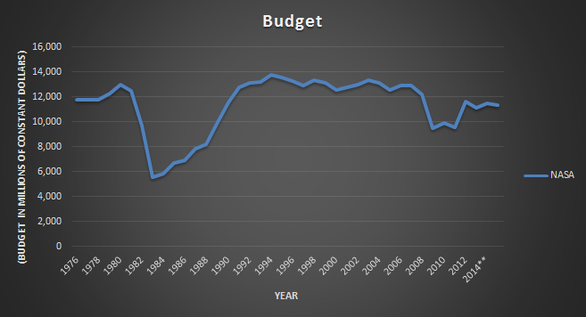
Motivation
NASA faces the same constraints. Coupled with scientists working on disparate domains but overlapping problem sets.
Need to accelerate research through collaboration. Accelerate collaboration by making it easy to identifying collaborators working on the same problems.
3
Notes:
http://www.aaas.org/page/historical-trends-federal-rd
http://www.aaas.org/sites/default/files/Agencies_0.xlsx

Slide 5
Outline
• Motivation
• Project Background
• Related work
• System design
• System implementation
• Demo
• Experiments/analysis
• Conclusions and future work
4

Slide 6
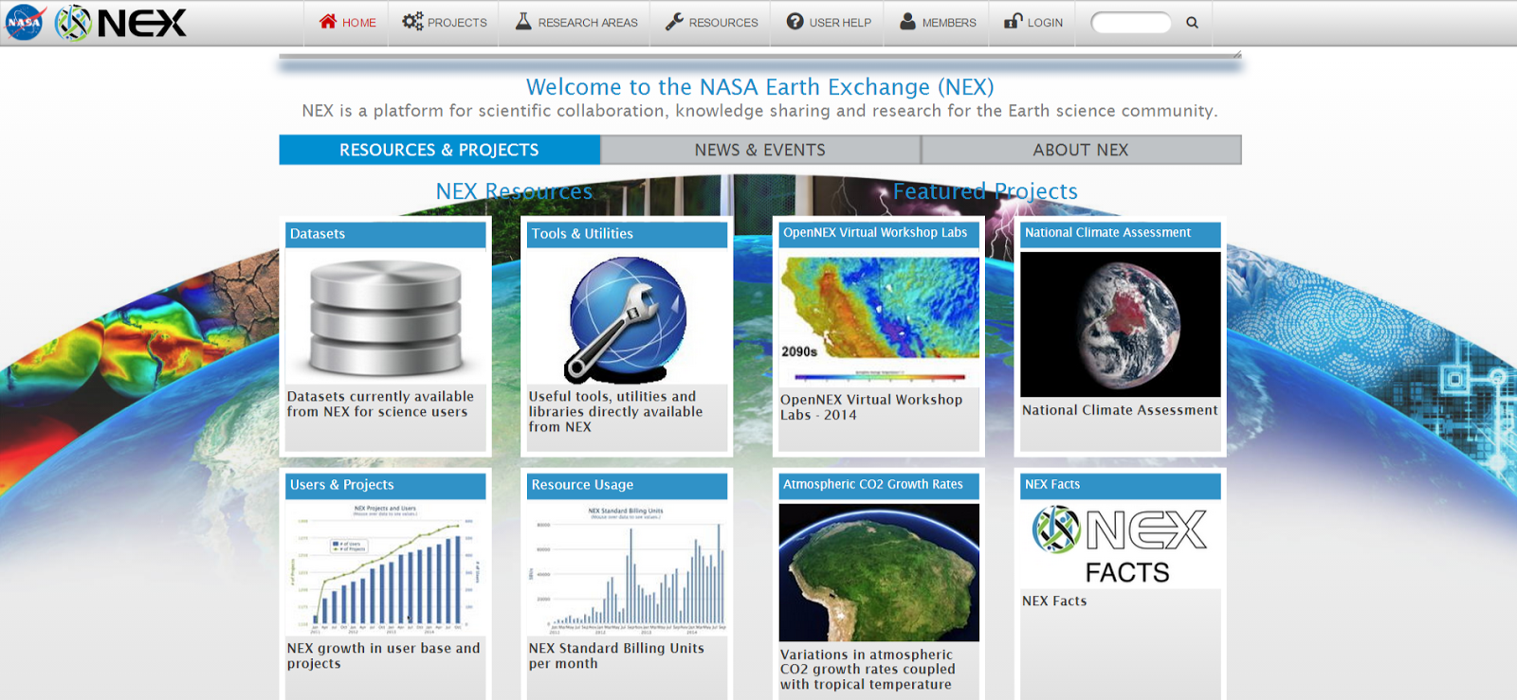
Project Background
NASA’s Earth Exchange (NEX) platform aims to provide a cloud-based platform as a service to accelerate big data analytics and scientific collaboration in Earth science.
Possibility of extending to or integrating with subject domains
5

Slide 7


Project Background
Collaboration between NASA and CMU-SV started 2 years back.
Need of a system which recommends experts and collaborators based on domain and trust.
Previous teams have worked on machine learning the trust score and trying to predict future collaborators.
Need to make a working product prototype.
6

Slide 8
Outline
• Motivation
• Introduction
• Related work
• System design
• System implementation
• Demo
• Experiments/analysis
• Conclusions and future work
7

Slide 9
Existing products
Many platforms exist for scientific collaboration
Global resources and university databases
Top ones are:
ResearcherID
ResearchGate
PubMed
8

Slide 10
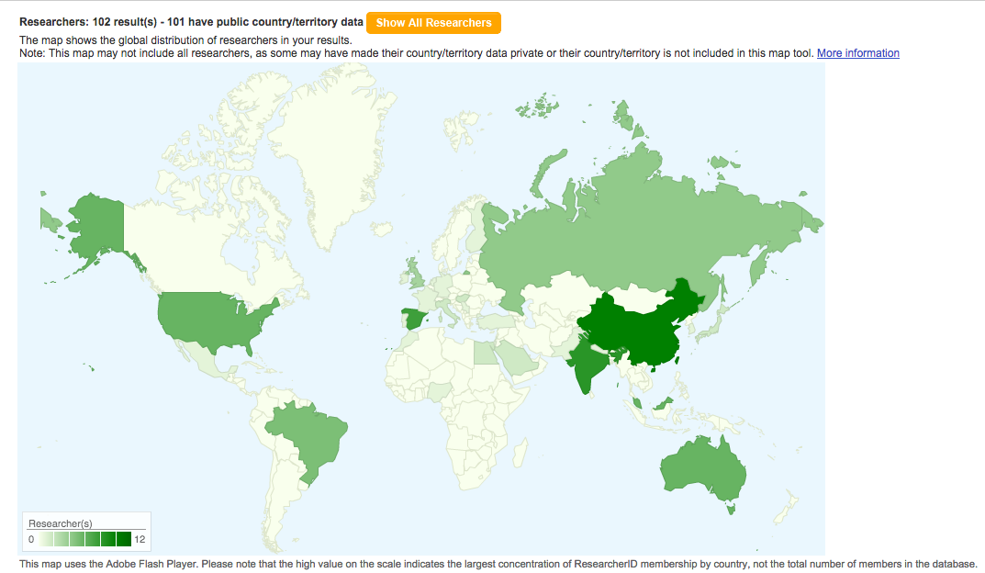
Existing products
ResearcherID(Thomson Reuters)
One of the best tool available
Users are identified with ORCID(
Open Researcher and Contributor ID)
Four different search interfaces
Option to map the geographical location
Interactive map
Commercial and Proprietary
9

Slide 11
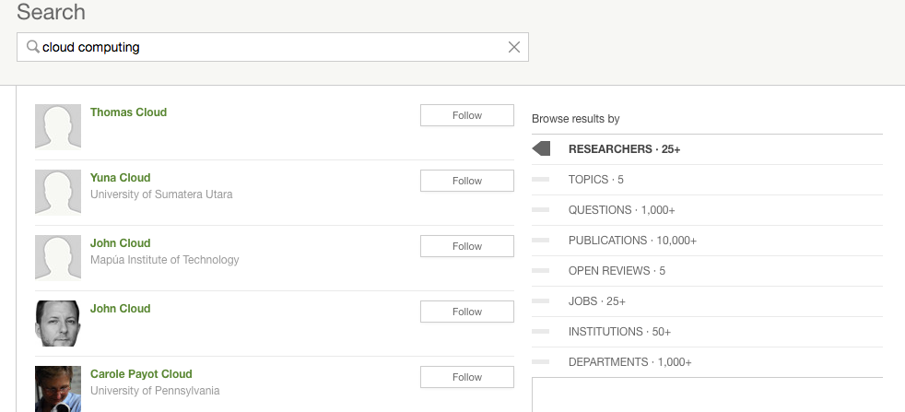
Existing products
ResearchGate:
Helps researchers collaborate
Can search for researchers, publications and publish papers
Researchers need to
create a profile and
upload their works
Stats about your paper
Search is not intuitive
10

Slide 12
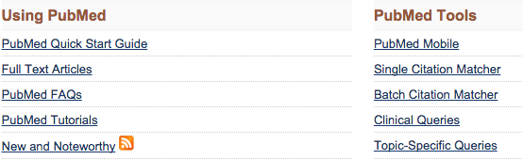
Existing products
PubMed
Simple search and comprehensive search
PubMed for handheld devices
Relatively older database
No information for collaboration
PubMed does not track citations
11

Slide 13
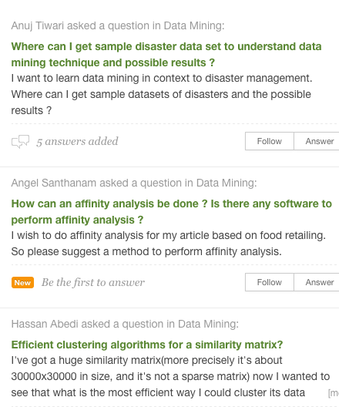
The GAP
No good visualization
No method to calculate
trustworthiness
Most of the products are
discussion forums or
networking sites
12

Slide 14
Outline
• Motivation
• Introduction
• Related work
• System design
• System implementation
• Demo
• Experiments/analysis
• Conclusions and future work
13

Slide 15
System Design - Quality Attributes
Accessibility
Available via browser
Usability
Easy and intuitive to use
Extensibility
Flexible enough to integrate new modules
14

Slide 16
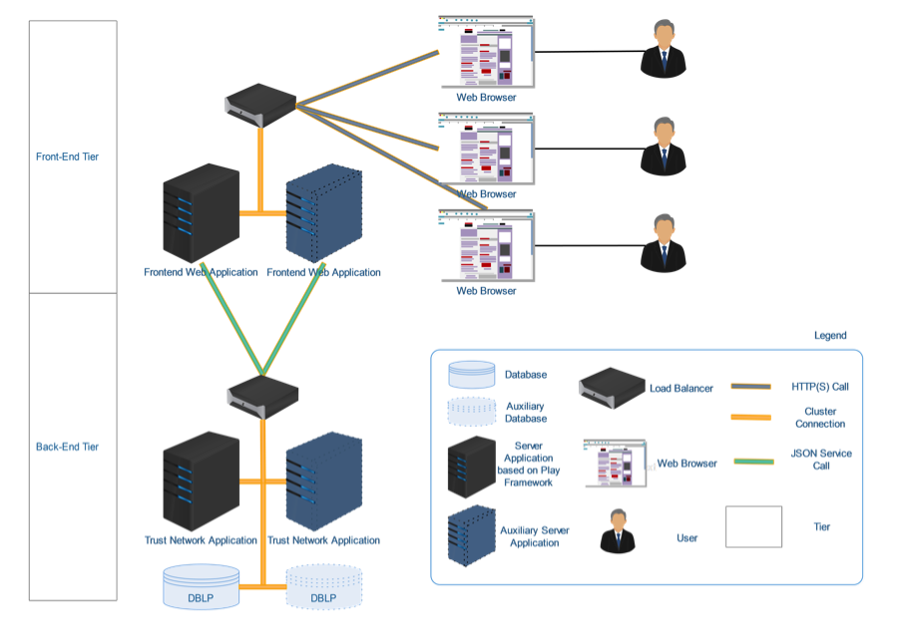
System Design - Architecture
2-tiered architecture
Ready for service-based API
Horizontally Scalable
Maintainable
15

Slide 17
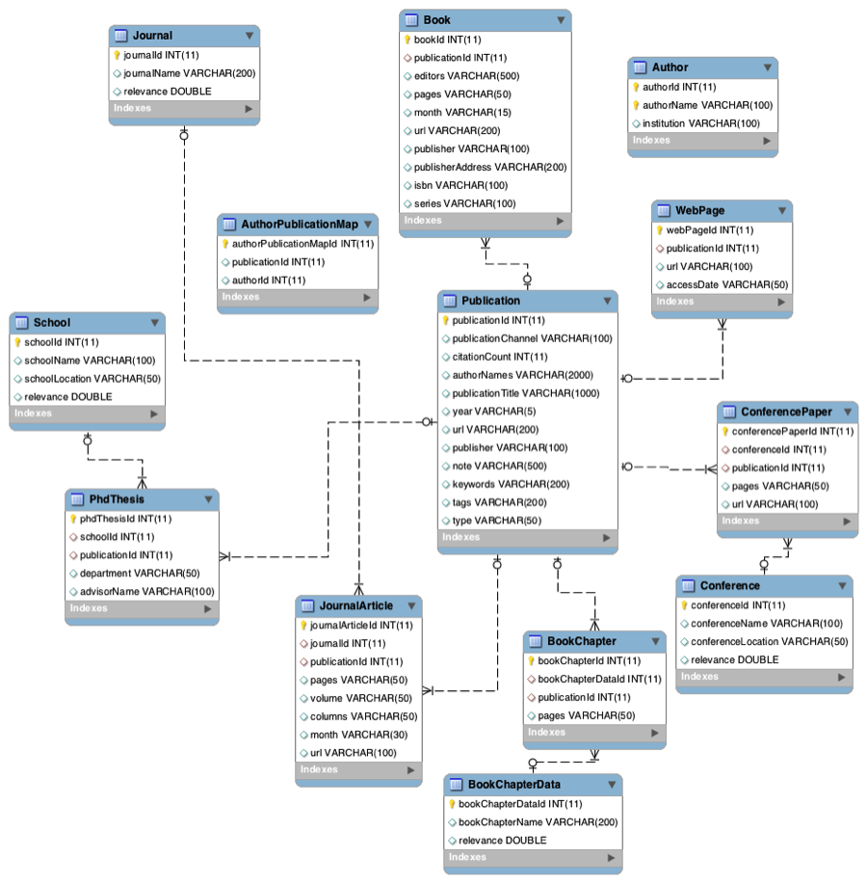
System Design - Modeling
Relational dataset
Data normalization to increase efficiency
Convenient for new data source association such as online social data
16

Slide 18
Outline
• Motivation
• Introduction
• Related work
• System design
• System implementation
• Demo
• Experiments/analysis
• Conclusions and future work
17

Slide 19
ETL - I
Big Data
Data size ~2GB, about 4.5M publications and nearly twice as many authors
Load and insert into database
Load all data into memory
Iteratively send to database for insertion
Straightforward and intuitive
But,
Very inefficient due to JVM and system memory size
So, this inherited approach was abandoned
18

Slide 20
ETL - II
Load DBLP and citations dataset
Stream data source (XML) due to huge size
Use of a custom parser due to file complexity
More complex but robust and efficient approach
Export to files instead of directly loading
Iterative insertion is inefficient due to big data set
Using csv files to bulk load is a lot faster
18

Slide 21
Data Fetch
MySQL database is used in the back end
Prepared statement object is used for sending objects to the database
prepared statements pre-compile SQLs
Each SQL is put into different re-usable methods
19

Slide 22
Trust Score Calculation
Trust score consists of two components: a knowledge factor and a social factor
Knowledge factor is built upon publication records and knowledge reputation
Three important deciding factors of the Knowledge factor:Publication Channel (C), Publication Time(T) and citation power
Contribution of each these factors depend on the weights( ) assigned
20

Slide 23
Trust Score Calculation cont.
Social factor takes into coauthorship
Coauthorship count and time scaled coauthorship and calculated
Time scaled coauthorship weights depend on the time of coauthorship
Final trust score = (CoauthorshipCount*TimeScaledCoauthorship)+KnowledgeFactor
21

Slide 24
Web Application - Backend
Play framework(Java) used to serve up the data to the frontend.
Connects to the database of choice. MySQL is in use now but multiple databases can be used if needed.
Wraps the data in business logic required to serve up the correct Nodes and Links(edges) of the graph being queried.
Serves up data in json format in RESTful manner, making it feasible to run this as a stand alone web service.
22

Slide 25
Web Application - Frontend
Play framework(Java) used to request and receive data from the backend.
Uses a combination of Java and Scala to render the web pages.
Extensive use of jQuery and Ajax to handle client side events and callbacks for more data.
Uses D3.js to render the graphs and related animations.
23

Slide 26
Outline
• Motivation
• Introduction
• Related work
• System design
• System implementation
• Demo
• Experiments/analysis
• Conclusions and future work
24

Slide 27
Demo
Below is the youtube link to a demo video
We demonstrate a few main use cases of our application in the video
https://www.youtube.com/watch?v=qPMCTP_8eo8&feature=youtu.be
25

Slide 28
Outline
• Motivation
• Introduction
• Related work
• System design
• System implementation
• Demo
• Experiments/analysis
• Conclusions and future work
26

Slide 29
Experiment and Analysis
Large Dataset- need to verify the accuracy of data(Verified the search result by querying for CMU professors and checking if all their publication is listed for a topic)
Data is not complete- some attributes were missing
Since framework is in place, we can import any useful dataset in future and leverage the framework.
27

Slide 30
Challenges Faced and Steps Taken
Loading DBLP dataset-exporting dblp into csv and then loading it
Inefficient Trust calculation mechanism- improvised how the trust algorithm consumes data
Good Visualization technique-experimented different methods
Understanding the code base(no proper documentation)-spent more time
Performance bottleneck-not our focus, but still we tried to add indexes, partitions in tables.
28

Slide 31
Outline
• Motivation
• Introduction
• Related work
• System design
• System implementation
• Demo
• Experiments/analysis
• Conclusions and future work
29

Slide 32
Conclusion and Future Work
Final product has a reliable trust calculation technique.
It has a robust ETL process in place for future data load
Architecture of the project is strong enough for building new features on top of it and adding new scientific exploration dataset
Use inverted index in the back end
Provision to track citations
Option to create user profile
30

Slide 33
Acknowledgement
We wish to acknowledge the contribution of Prof. Jia Zhang, for her guidance and continuous support.
We thank Petr Votava for his encouragement, feedback and support.
Thank You.
31

Slide 34
References
http://www.battelle.org/docs/tpp/2014_global_rd_funding_forecast.pdf
http://www.aaas.org/page/historical-trends-federal-rd
http://www.aaas.org/sites/default/files/Budget_0.jpg
http://www.aaas.org/sites/default/files/Agencies_0.xlsx
32

Slide 35

Questions?
33

