Slide 1
18653 Presentation
Team 11

Slide 2

Introduction
০ A Scientific Social Network
০ Users can make connections, form groups and interact with group members and colleagues
০ A Scientific Workflow Management System
০ Designed to arrange a group of computational steps and workflows in a scientific application

Slide 3
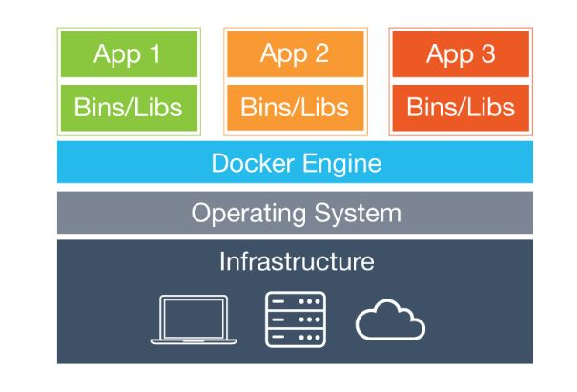
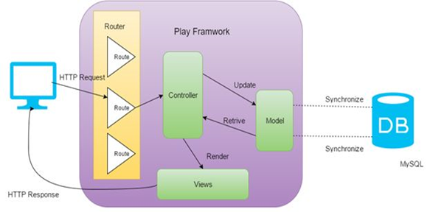
Enabling Techniques
০ Play Framework
০ Docker
Notes:
Play is an open source web application framework, written in Scala and Java, which follows the MVC architectural pattern.
Docker containers wrap up a piece of software in a complete filesystem that contains everything it needs to run: code, runtime, system tools, system libraries – anything you can install on a server.

Slide 4
Design Patterns Implemented
০ State Pattern ০ Composite Pattern
০ Iterator Pattern ০ Facade Pattern
০ Builder Pattern ০ Template Pattern
০ Adapter Pattern ০ Abstract Facotry Pattern
Notes:
Effective, Reasonable, flexibility, code readability, reuse.

Slide 5
State Pattern
০ Intent
Allow an object to alter its behavior when its internal state changes.
A state machine
০ Scenario
The behavior of an object depends on its state. The behavior need to change according to the run-time state. In common cases, the object may have numerous states.
০ Advantages
A set of clearly separate State subclasses with different business logic
০ Disadvantages
Result in a large number of State classes and increase the complexity of the program.
Notes:
Elevator: STOPING, RUNNING, OPENING, CLOSING

Slide 6
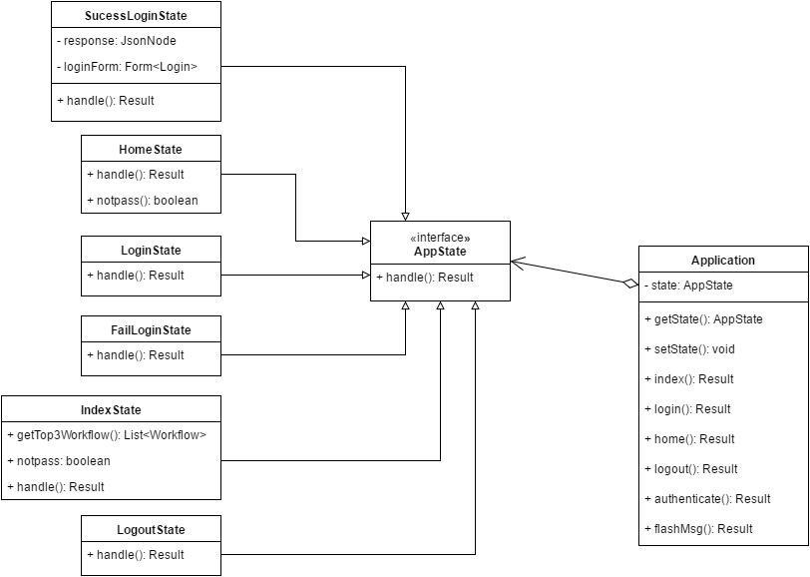
State Pattern UML

Slide 7
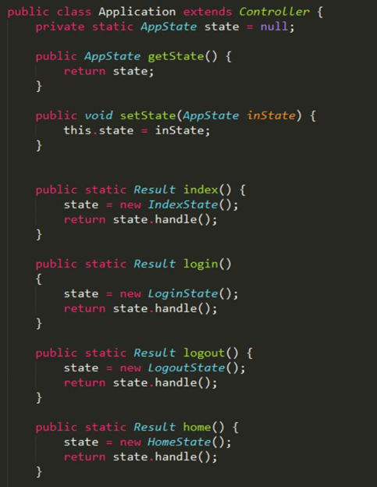
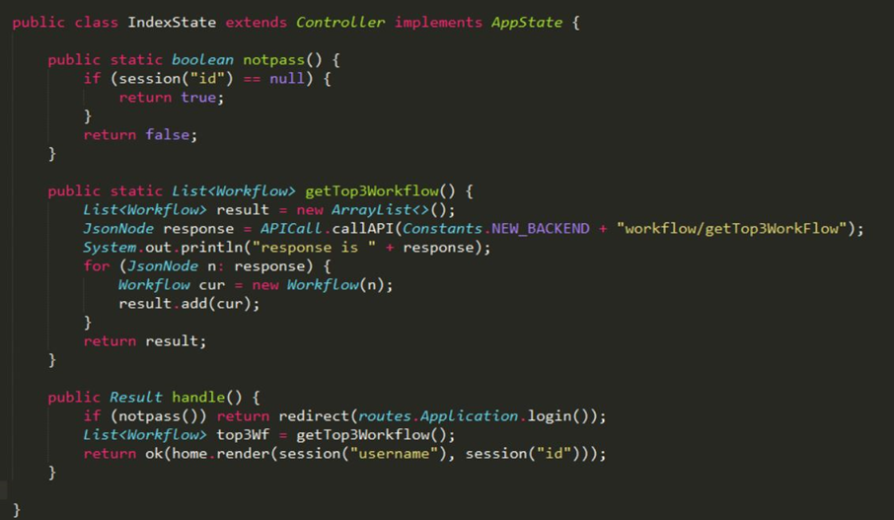
State Pattern Code

Slide 8

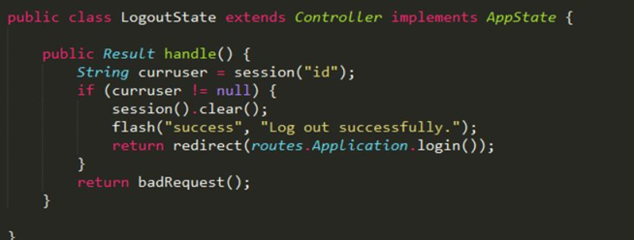
State Pattern Code

Slide 9
Iterator Pattern
০ Intent
Provide a way to access the elements of a collection sequentially without exposing its underlying representation.
Use the iterator object to take the responsibility of traversing elements
০ Scenario
Need to abstract the traversal of different data structures to simplify algorithms definition and implementation.
০ Advantages
No longer need to worry about what kind of collection is being used by algorithms.
Simplify the implementation of different algorithms to reuse same iterators on different collections and to subclass the iterator in order to change its behavior.
Notes:
Standard Iterator, separate the notion of algorithm from that of data structure, generic programming

Slide 10
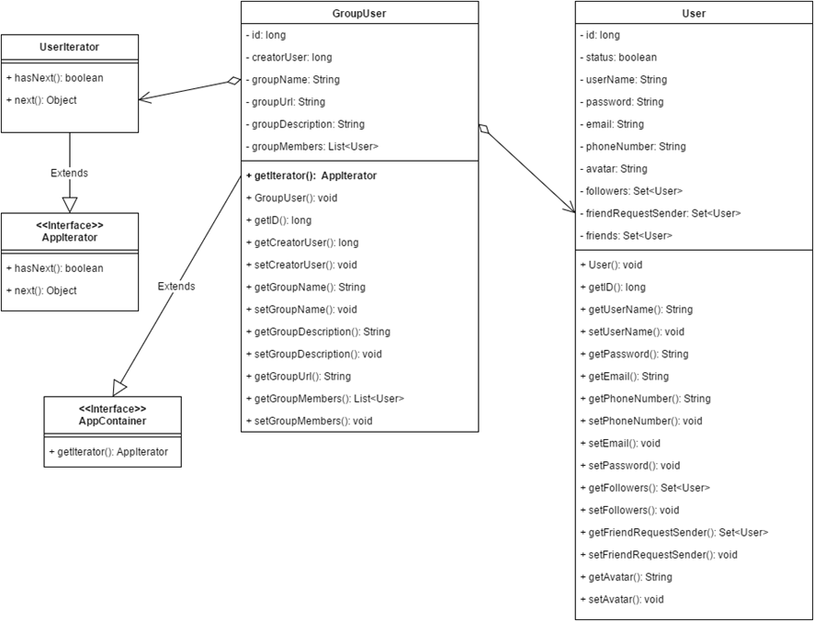
Iterator
Pattern UML

Slide 11
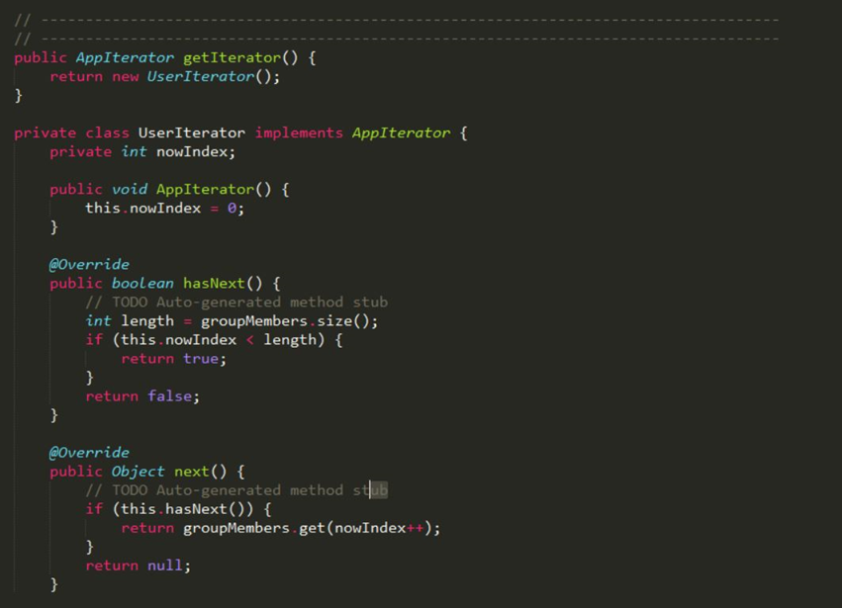
Iterator Pattern
Code

Slide 12
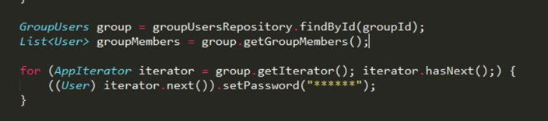
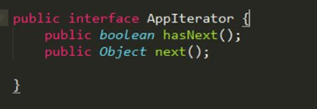

Iterator Pattern Code

Slide 13
Builder Pattern
Builder Pattern is a object creation design pattern. It builds a complex object using simple objects and using a step by step approach.
Provides one of the best ways to create an object.
A Builder class builds the final object step by step. This builder is independent of other objects.

Slide 14
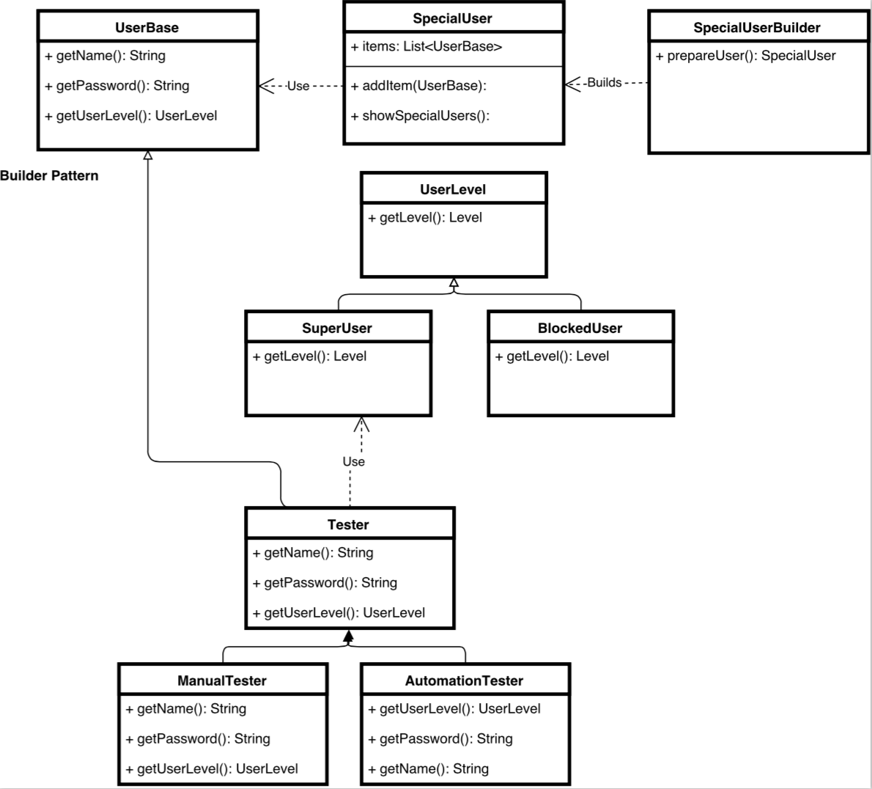
Builder
Pattern UML

Slide 15
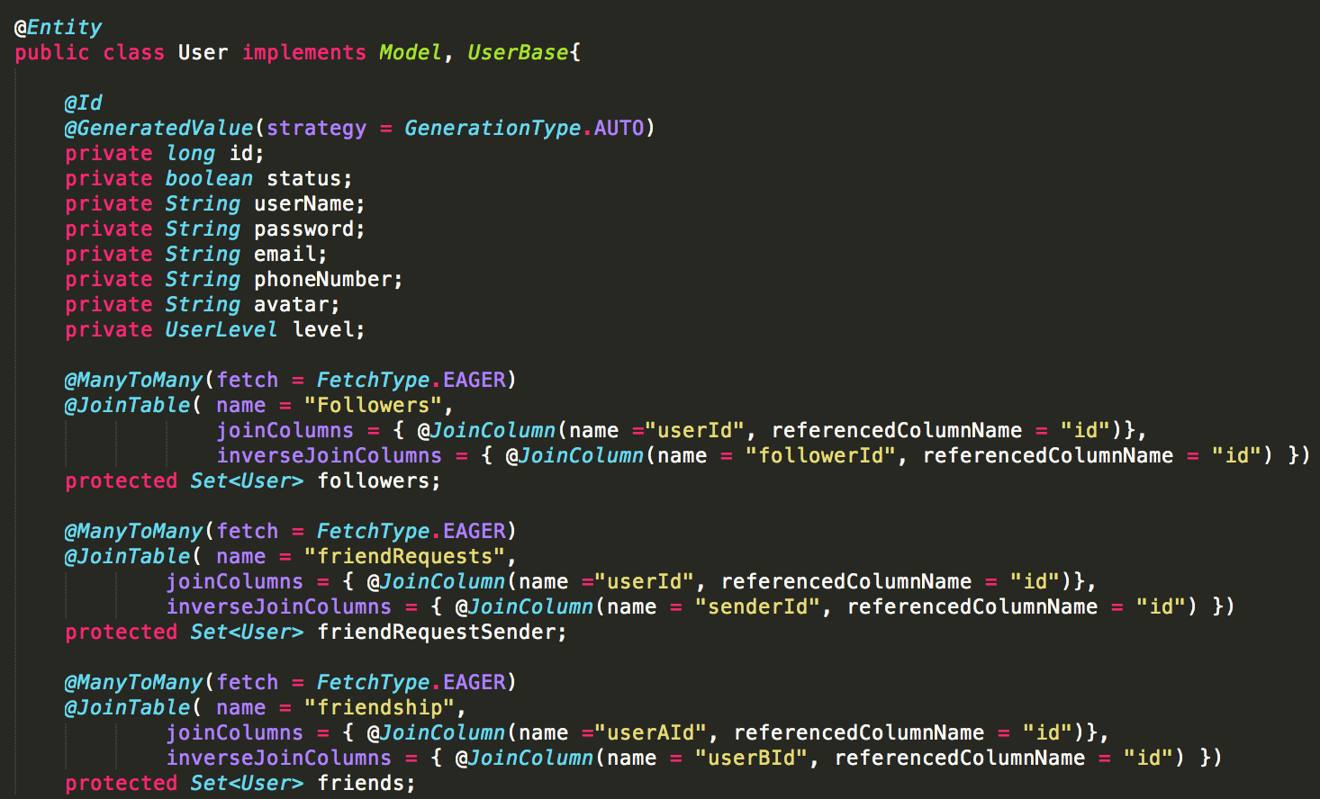
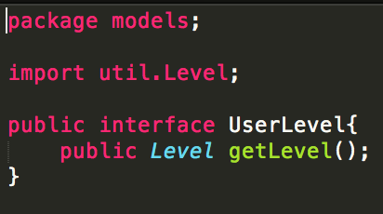
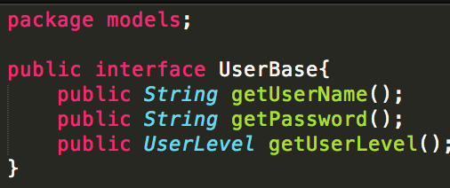
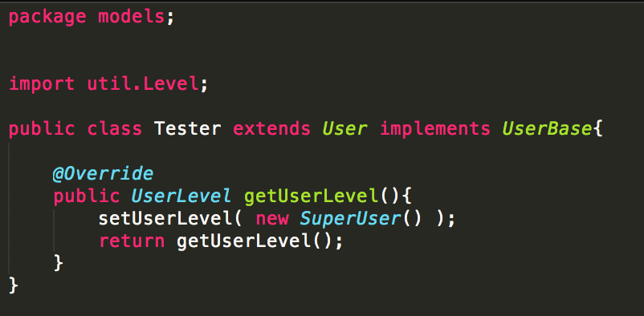
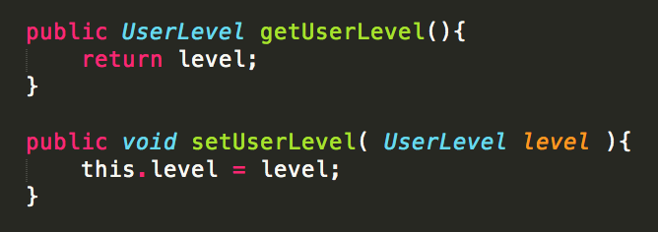
Builder Pattern

Slide 16
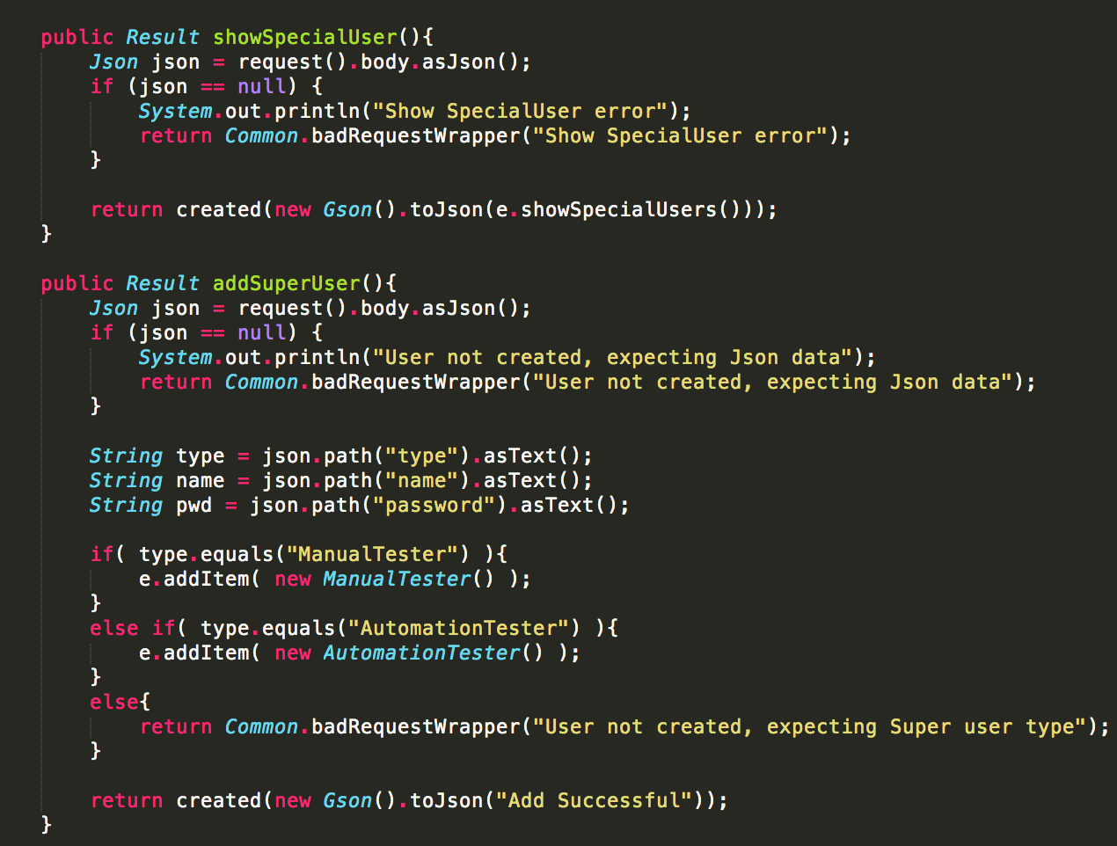
Builder Pattern

Slide 17
Adapter Pattern
Works as a bridge between two incompatible interfaces. In software engineering, the adapter pattern is a software design pattern that allows the interface of an existing class to be used as another interface. It is often used to make existing classes work with others without modifying their source code.
This pattern involves a single class which is responsible to join functionalities of independent or incompatible interfaces.

Slide 18
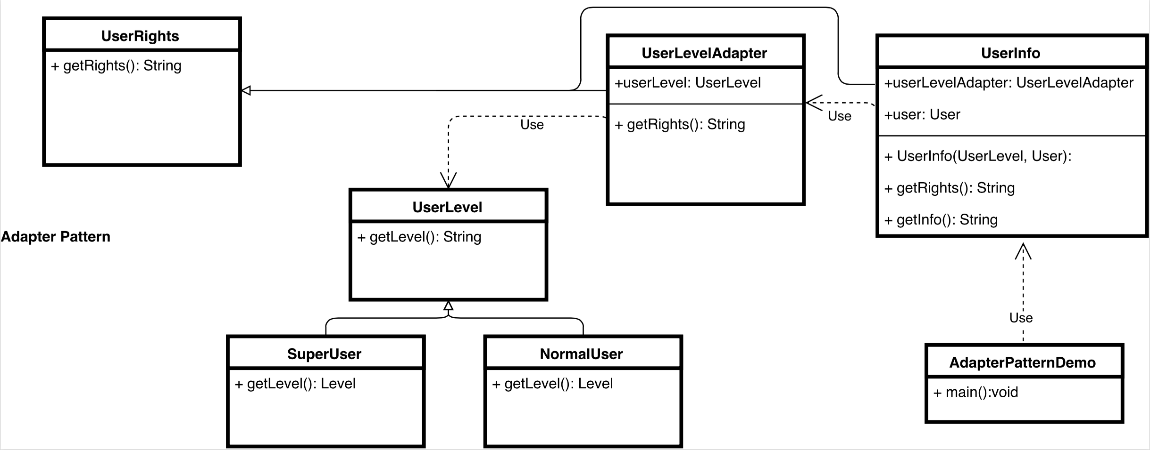
Adapter
Pattern UML

Slide 19
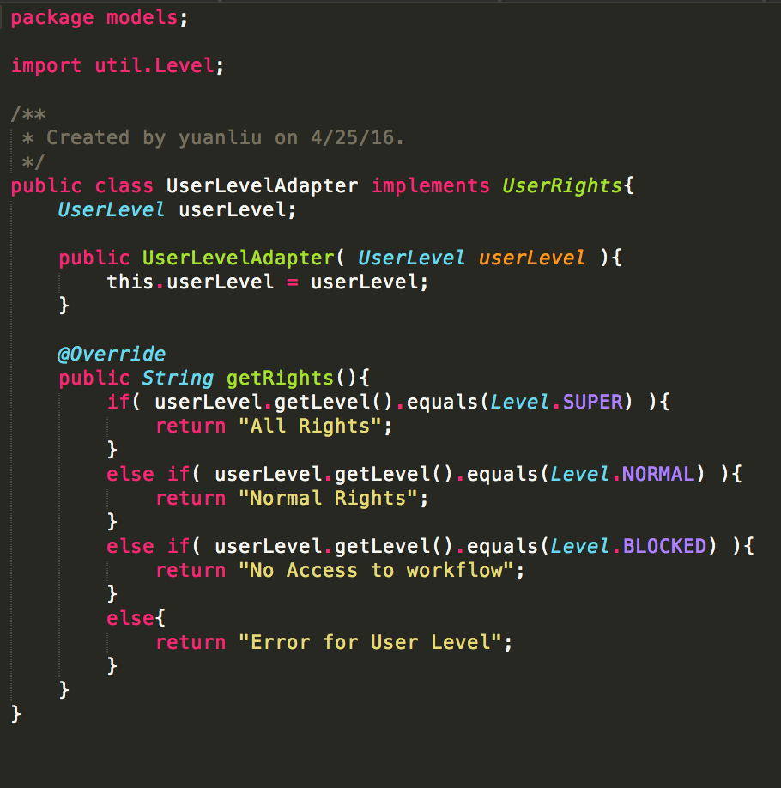
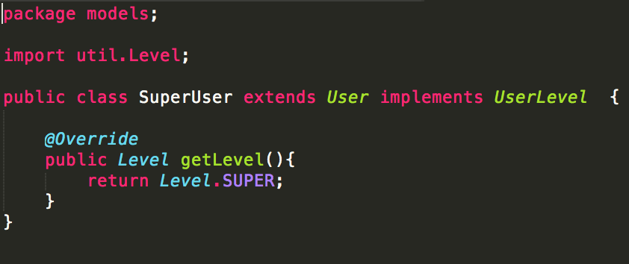
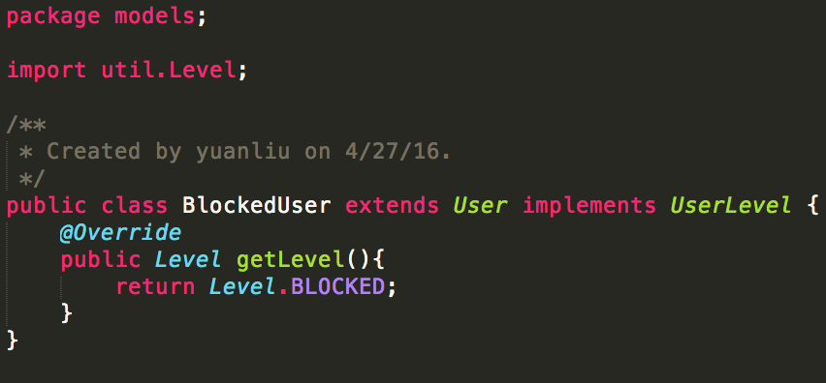
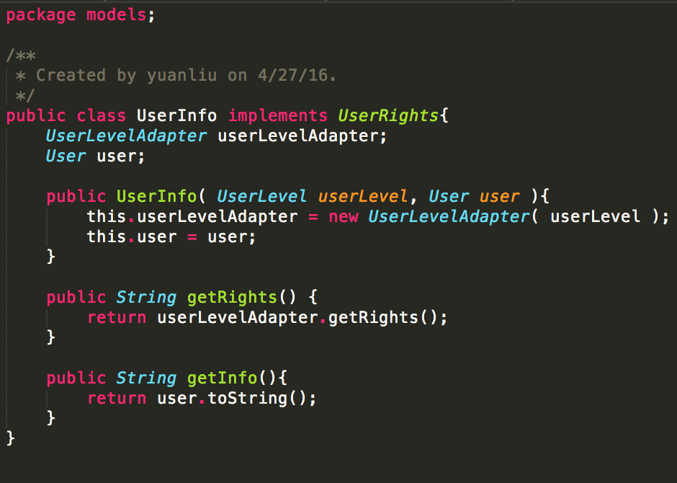
Adapter Pattern

Slide 20
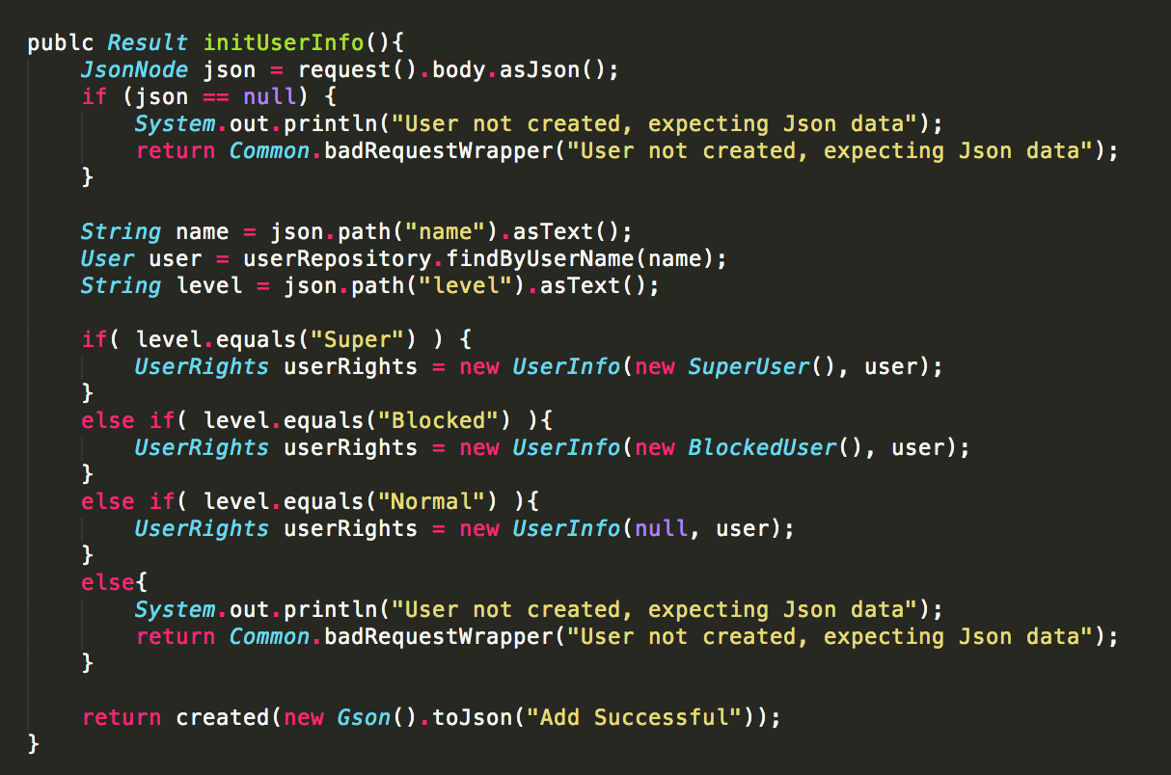
Adapter Pattern

Slide 21
Composite pattern
Composite pattern is used where we need to treat a group of objects in similar way as a single object.
The intent of a composite is to "compose" objects into tree structures to represent part-whole hierarchies.
Implementing the composite pattern lets clients treat individual objects and compositions uniformly. The key concept is that you can manipulate a single instance of the object just as you would manipulate a group of them.

Slide 22
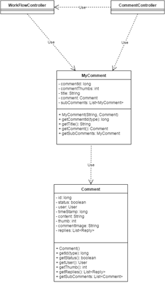
Class diagram
Comments can be divided into three types based on the number of thumbs up: hot, mediocre, negative.
A group of comments can be treated in a similar way as a single comment object. We may treat a group of hot comments and a single hot comment in a similar way.

Slide 23
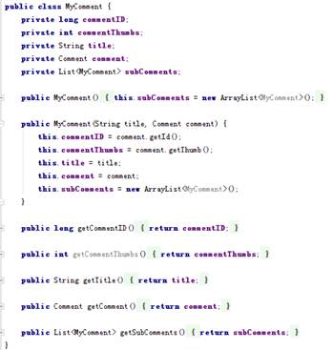
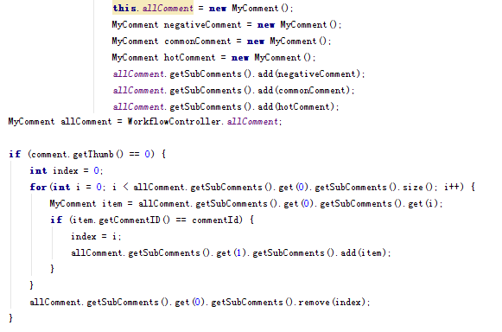
Code
Composite pattern class: How to use it:

Slide 24
Facade pattern
Purpose:
The purpose is to hide the complexities of the system.
Facade pattern will provide an interface to the client and client can use the provided interface to access the system.
Implementation:
involves a single façade class which provides simplified methods required by client.
Delegate is a object of façade class, and it will call the methods of existing system classes.

Slide 25
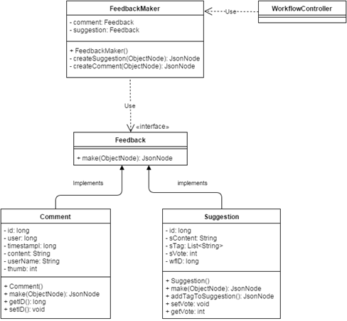
Class diagram
Implementation :
Comment and Suggestion are
feedback and will implement
the Feedback interface.
FeedbackMaker is the façade class and contains two objects of Comment and Suggestion class.
Client will utilize an object of the FeedbackMaker class to create a
comment or suggestion.

Slide 26
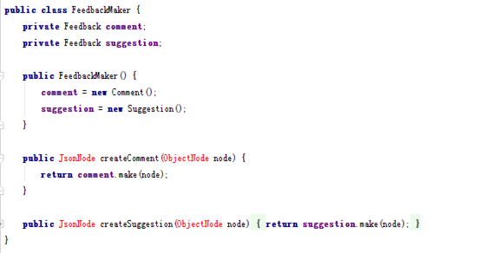


Code
Feedback class: Facade class:
Implementation:

Slide 27
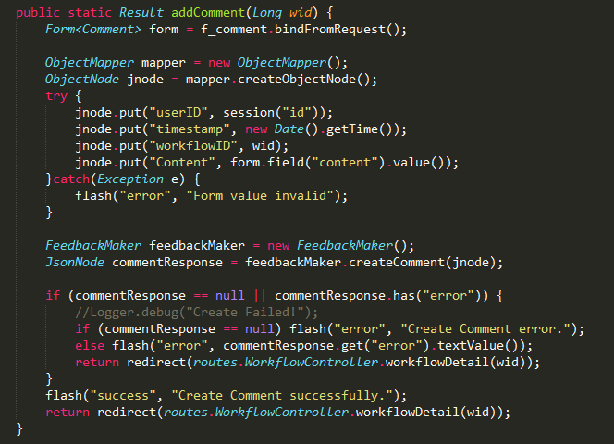
Code
How to use it:

Slide 28
Abstract Factory
Abstract factory is a factory of factories. An factory producer is used to produce different kinds of factories which are the child classes of the same abstract factory. Each concrete factory can generate a instance of corresponding class.
With abstract factory pattern, we can hide the details of the instantiation of classes. This gives us a lot of flexibility to decide what kind of class to generate.

Slide 29
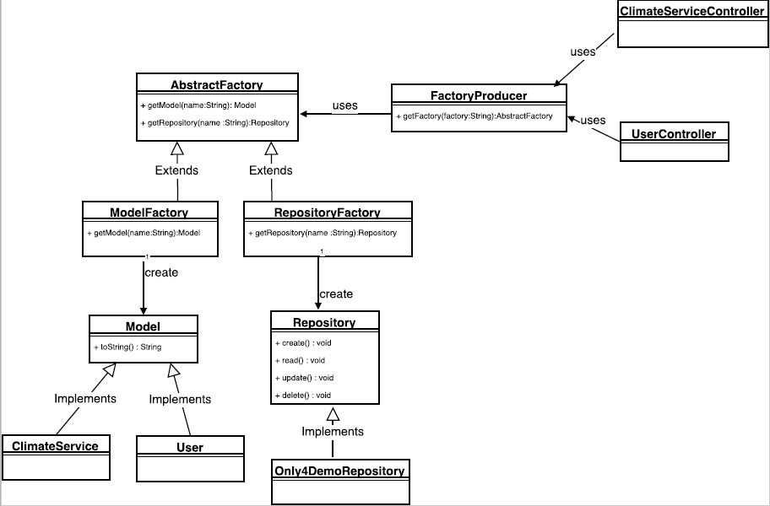
Abstract
Factory

Slide 30
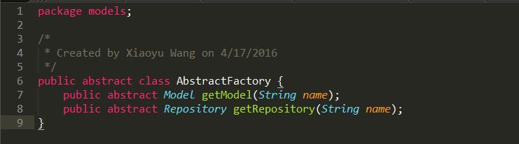
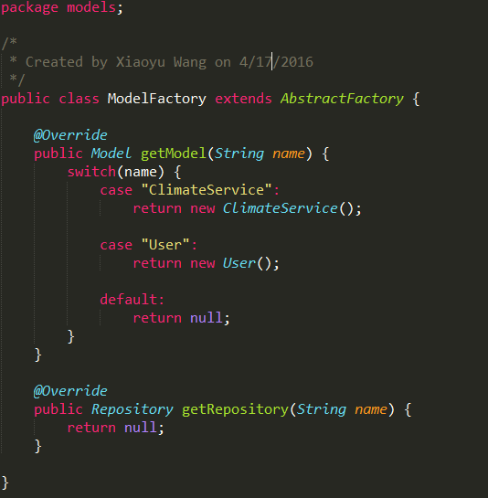
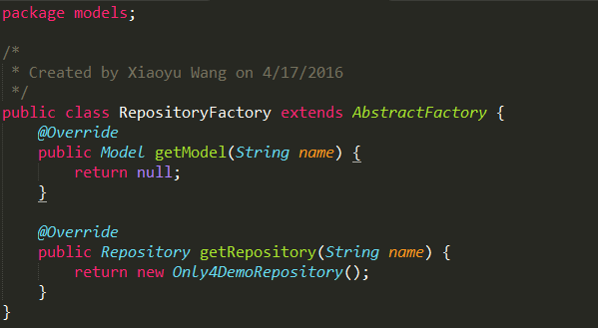

Slide 31
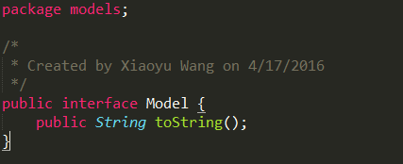
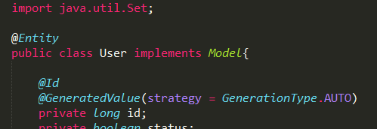
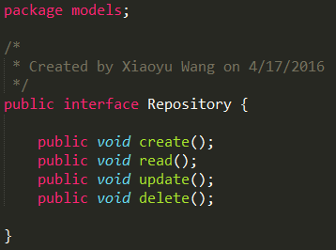
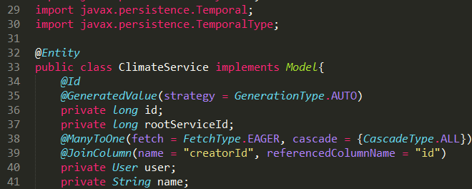

Slide 32
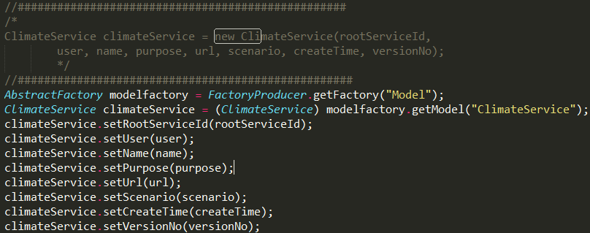
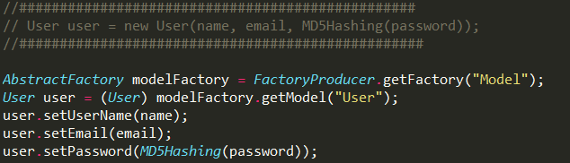

Slide 33
Template Pattern
Template Pattern is to use an abstract class to expose defined ways to execute its method. It has an concrete template method and several abstract methods. Those abstract methods are overridden in its subclasses.

Slide 34
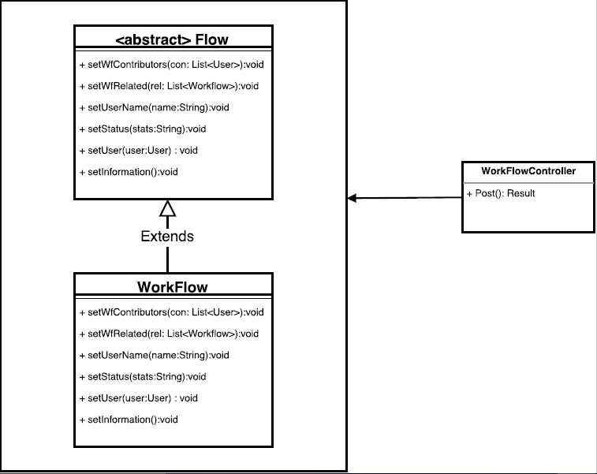
Template Pattern

Slide 35
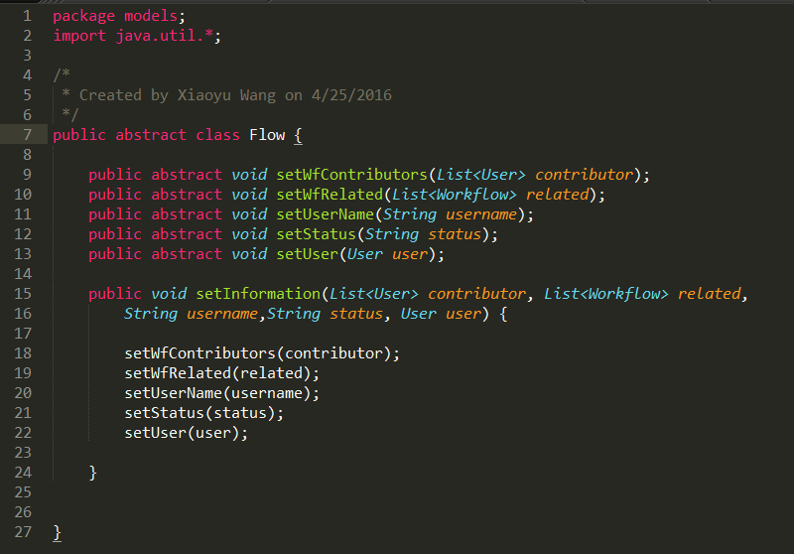
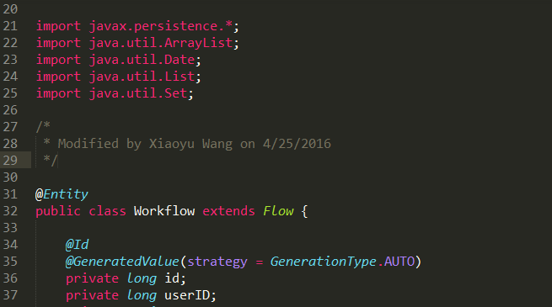
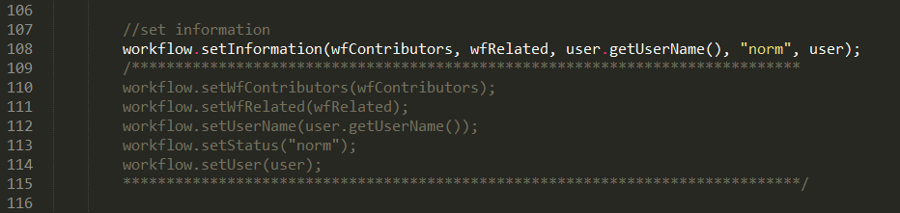

Slide 36
Thank you!

