Slide 1
18653 final presentation
team 14

Slide 2
Design Pattern Used (9 patterns)
Run: Iterator Pattern, Builder Pattern
Huanwen: Chains of Responsibility, Flyweight
Ge: Factory Pattern, Adapter Pattern
Varun: Decorator, Filter Pattern, State Pattern

Slide 3
Iterator
Iterator pattern is a design pattern in which an iterator is used to traverse a container and access the container's elements. The iterator pattern decouples algorithms from containers.
Here in our back-end code, we used Iterator pattern to help traverse all the replies in Comment class. First of all, I defined an ReplyIterator class in Comment class which implements Iterator interface. I rewrited the hasNext() and next() method to help us go through all replies in reply list. In comment controller, when we need to get all the replies in reply list, we just use ReplyIterator to do that thing.

Slide 4
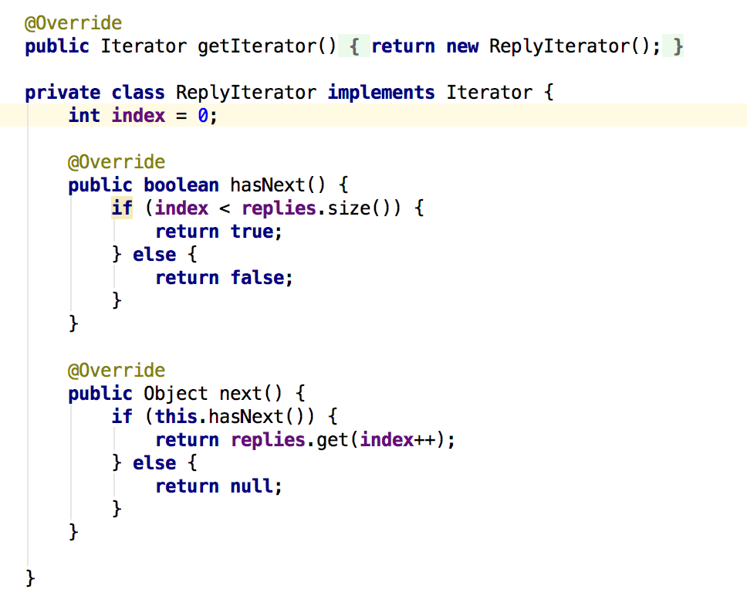
Iterator

Slide 5
Builder
Builder Pattern is a design pattern used to build complex pattern by using simple objects and using step by step approach. A builder class is needed in this pattern. This builder class builds the final object step by step. And this builder is independent of other objects.
In out implementation, we used builder pattern to help create new group. Group is divided into 5 different parts - id, creatoruser, groupname, groupdescription, groupurl. Abstract class GroupBuilder contains methods to create those fields step by step. Concrete is the class to extend GroupBuilder and implement abstract methods in detail. We also made a GroupDirector to manage the use of GroupBuilder. Whenever a new Group is needed to be created, I just call GroupDirector to make a new Group.

Slide 6
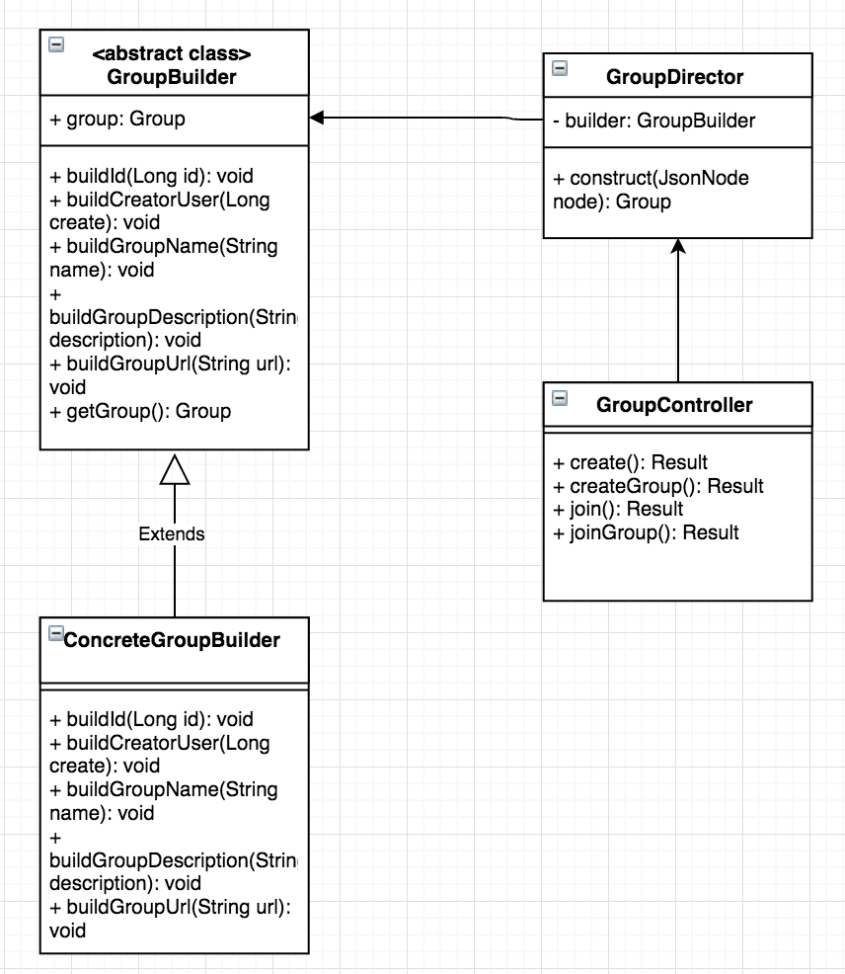
Builder

Slide 7
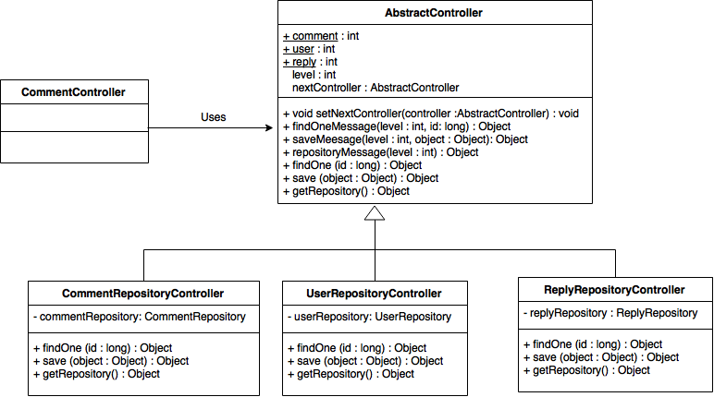
Chains Of Responsibility
Chains Of Responsibility is used to avoid coupling together between request sender and receiver, enable multiple objects have possibility to receive request. These object will be connect into a chain and pass the request along the chain until an object handles the request.
In our implementation, different repositories are different object. Thus I connected each repositories us into a chain, and handle multiple requests.

Slide 8
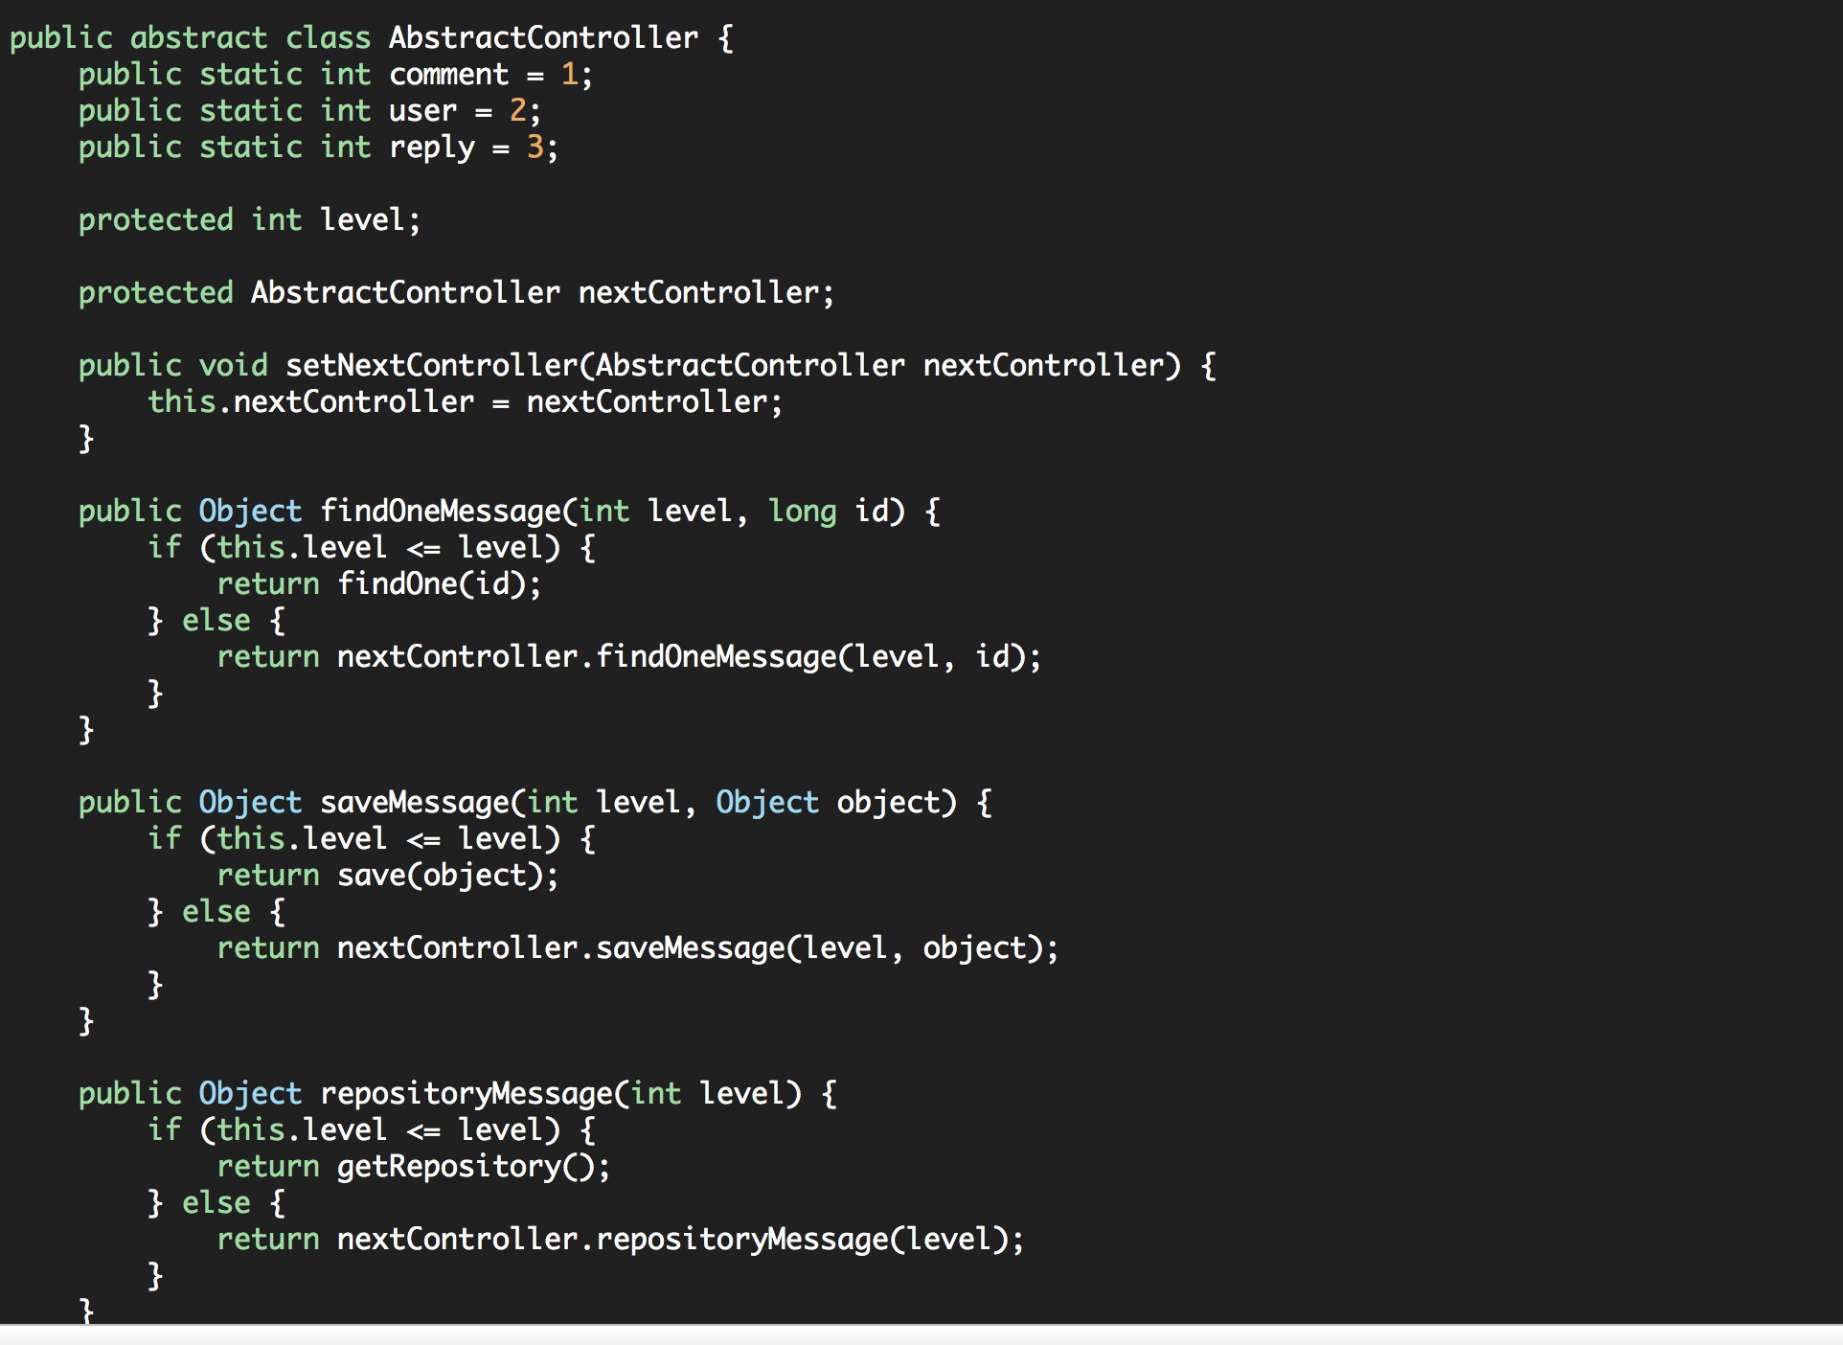
Chains Of Responsibility

Slide 9
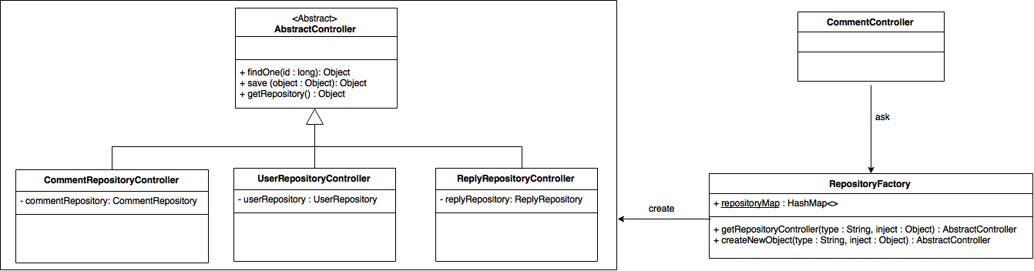
Flyweight Pattern
Flyweight Pattern is mainly used to reduce the number of object created so as to reduce memory usage and improve performance.
According to our design, we need to used the repository objects in different controller classes frequently. Therefore, we can use Flyweight pattern with static hashmap to store different repository object.

Slide 10
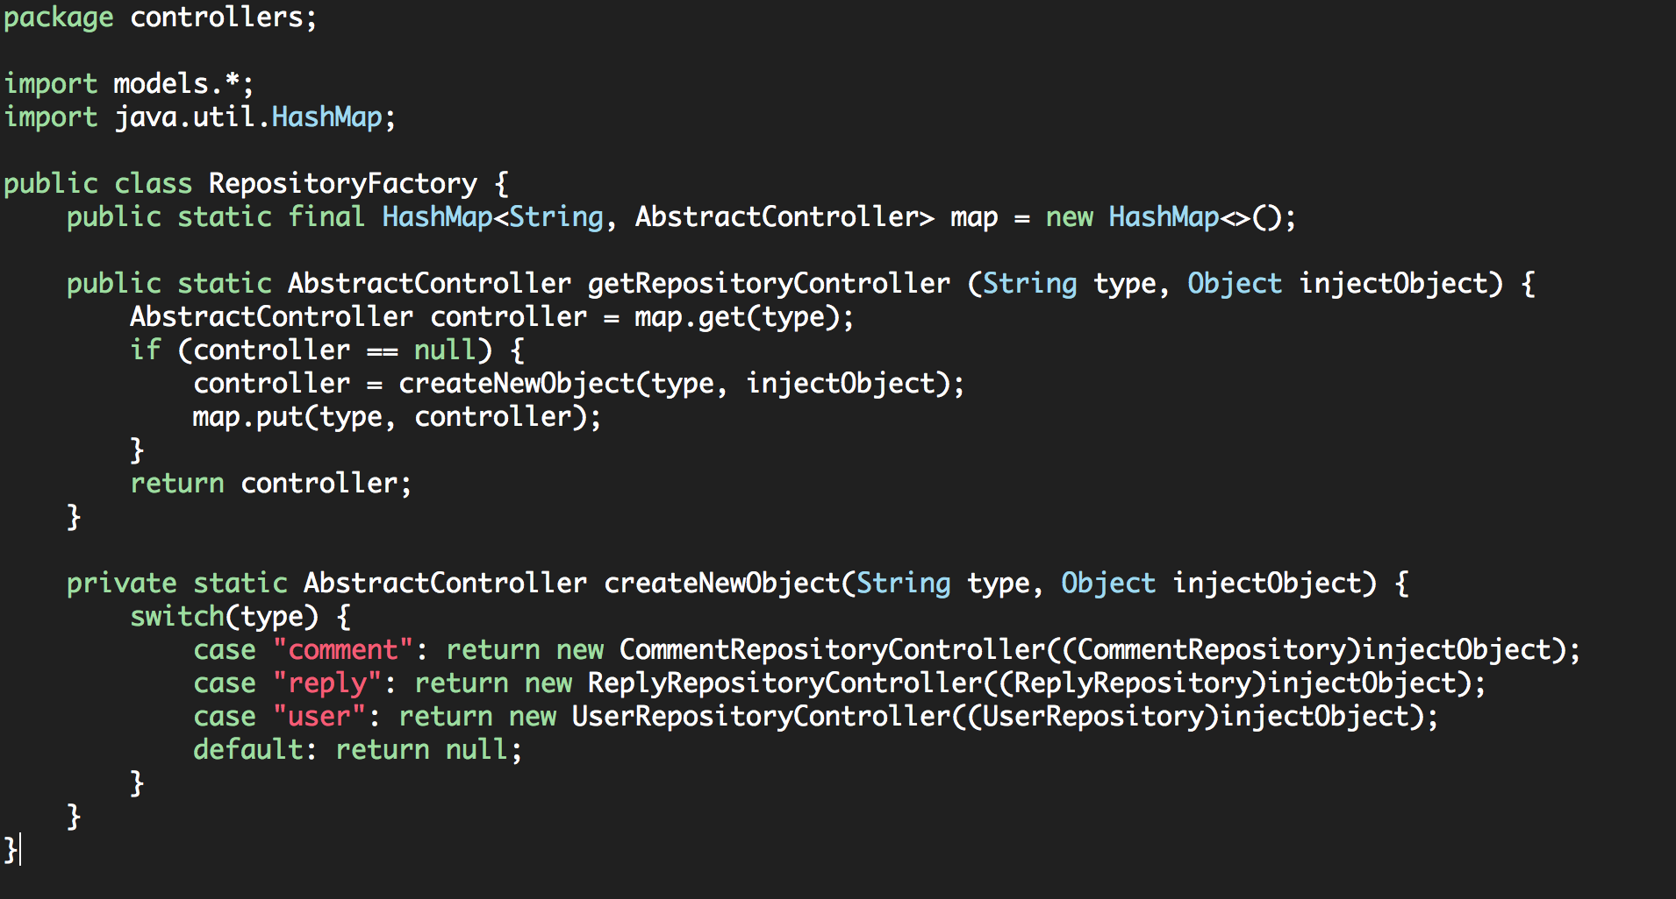
Flyweight Pattern

Slide 11
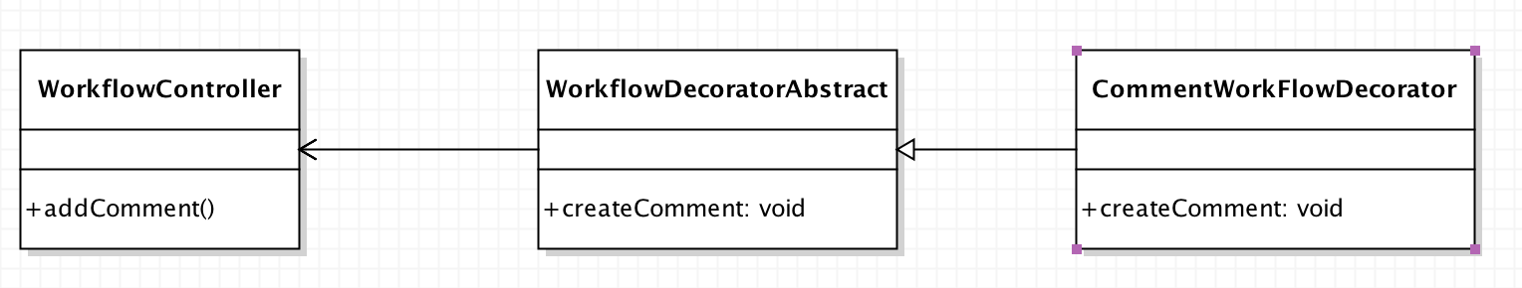
Decorator Pattern
The Decorator Pattern is used to enhance functionality of an existing object
Here, we use it to enhance the Workflow when adding a comment
Abstract Class WorkflowDecorator defines Abstract Decorator class with general functionality
Concrete class CommentWorkflowDecorator extends Abstract Class and performs action in WorkflowController

Slide 12
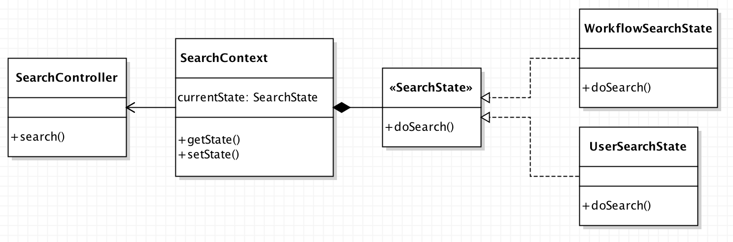
State Pattern
State Pattern is a behavorial design pattern used to control flow of the application based on its current state
We use it to control Search functionality based on different states: User search or Workflow Search
SearchContext maintains Current State, desbribed by SearchState Interface

Slide 13
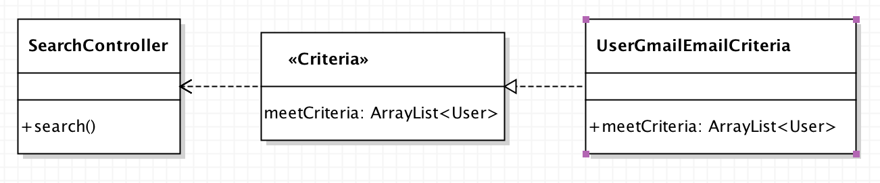
Filter/ Criteria Pattern
Criteria Pattern allows us to filter a set of objects based on a particular criteria.
We use to filter our search results to only show “GMail” users

Slide 14
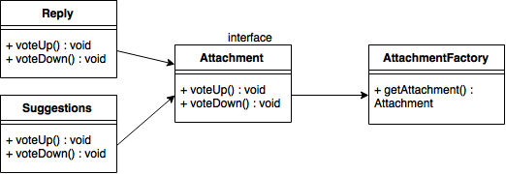
Factory Pattern
Factory pattern is one of the creational patterns that can be used to this project. It’s a design pattern for creating object using a common interface and without exposing the creation logic to the client.
We create Attachment interface containing voting functions, and making it implemented by Reply and Suggestions concrete classes. Then we create AttachmentFactory class to generate objects of the concrete classes based on parameters we send. Then when we want to create Reply or Suggestions object, we can directly use the factory and send different parameters.

Slide 15
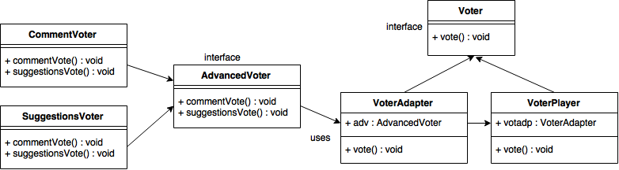
Adapter Pattern
Adapter pattern is one of the structural patterns used as a bridge between two incompatible interfaces. So we create Voter and AdvancedVoter interface to join functionalities, making them implemented by CommentVoter and SuggestionsVoter concrete classes. Then we create VoterAdapter class to implement Voter interface. And at last we create VoterPlayer class to implement AdvancedVoter and receiving different parameters.

Slide 16
Thank You!

