Slide 1
Project 3:
Workflow-centric Scientific Social Network
Sponsor- Professor Jia Zhang
Point of contact- Yiming Zhang
Faculty advisor- Professor Jia Zhang
Team- 7&8

Slide 2
Roadmap
Introduction
Motivation
Relative work
System design
System implementation
Future work

Slide 3

Introduction
Social Network for Discussion on Scientific WorkFlow
Web Application Functions
Multi-user Interaction
Notes:
The project provides a platform for scientists to post their scientific experiements and workflows, so that other scientists who are interested in the workflow can redo the experiements and make comments. Like any other social network web application, this project supports multiple user interaction.

Slide 4
Function
Authentication:
Registeration
Login
Social Interaction:
Following
Group Management
WorkFlow:
Posting
Access Control
Tagging
Comments

Slide 5
System Design
Frontend / Backend framework
API design
Database

Slide 6

Frontend / Backend
Backend
Play Framework
Controllers
MySQL
Frontend
Play Framework
Controllers
Views
in json format

Slide 7

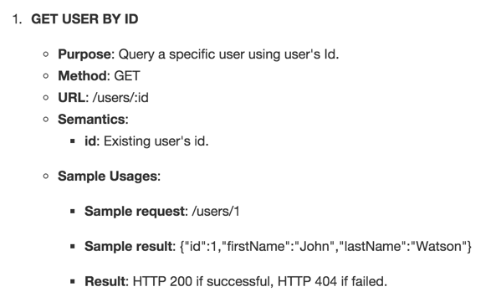
API Design
APIs are designed to hide the underlying implementation
Our designed followed contains:
Simple Name,
GET/POST method,
URL
APIs are well documented.
Following is an example:

Slide 8
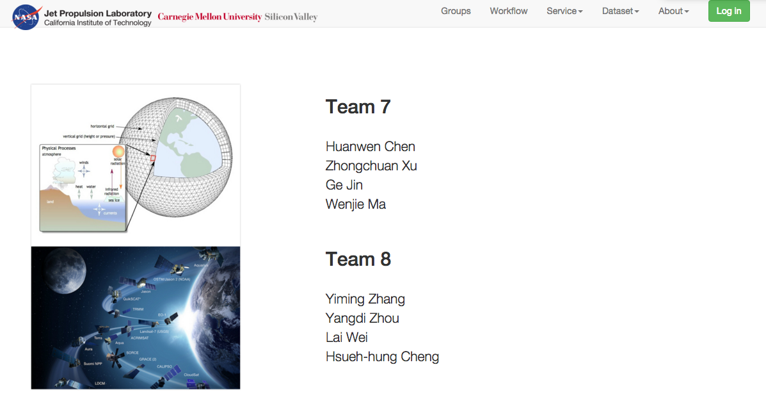
Page Flow - index

Slide 9
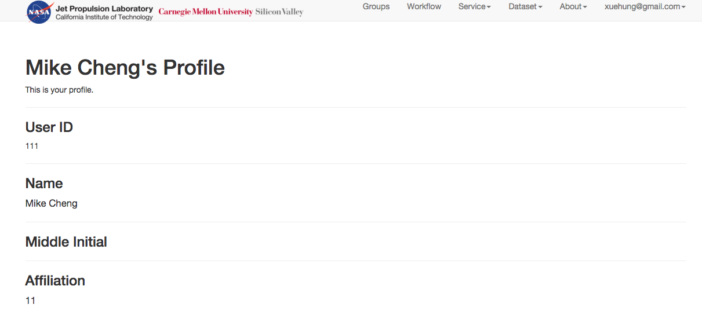
User Profile

Slide 10
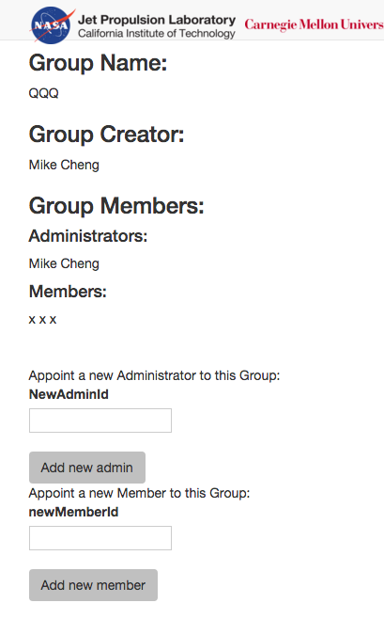
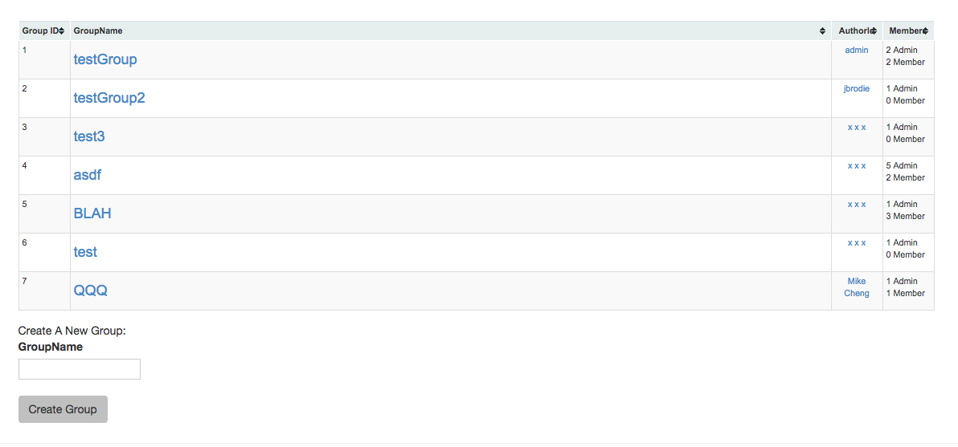
User Group

Slide 11
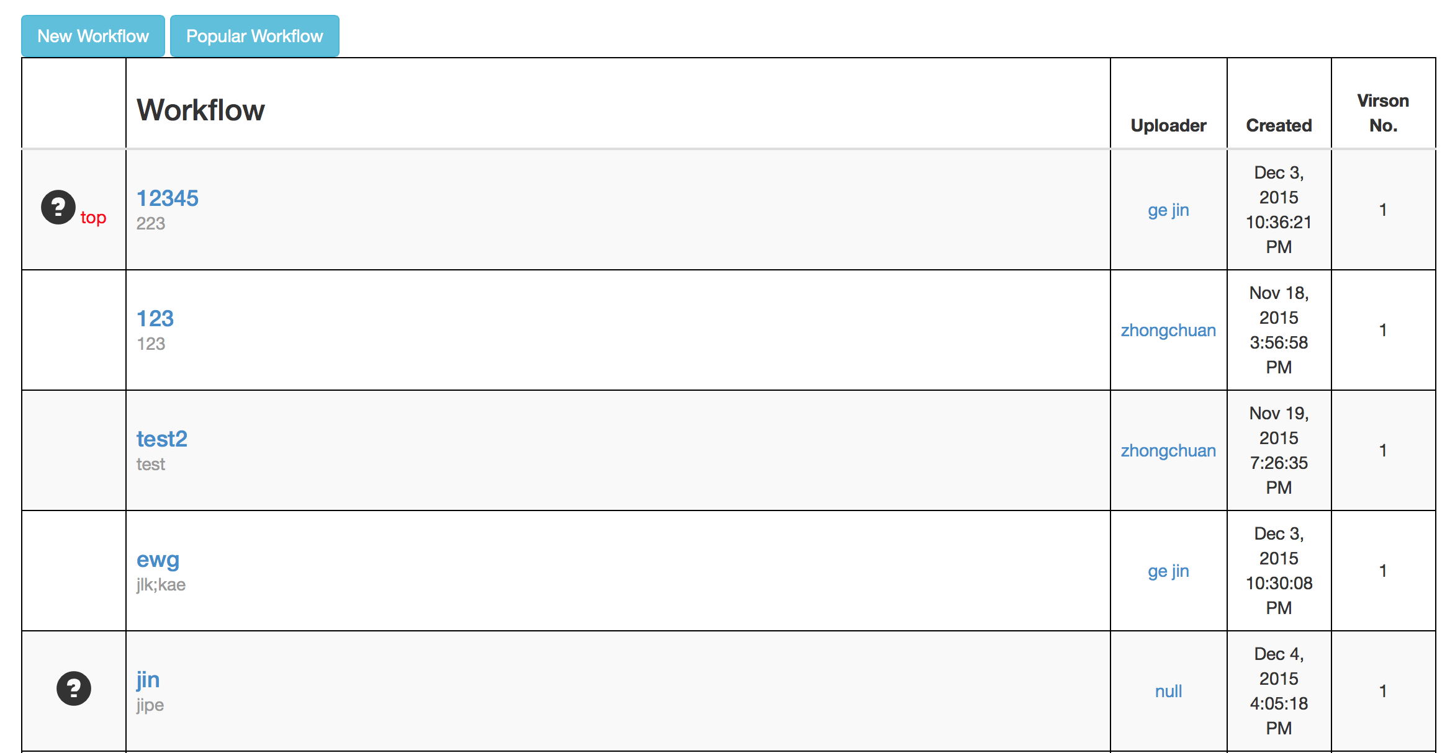
Workflow list

Slide 12
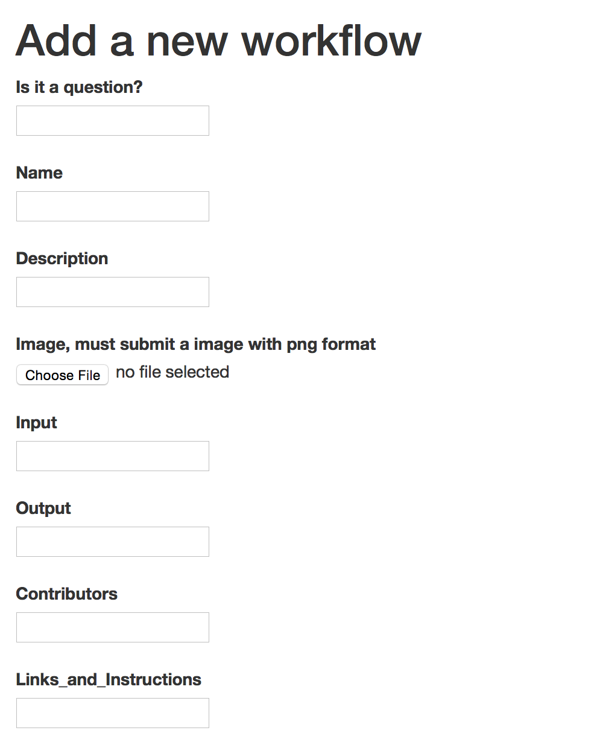
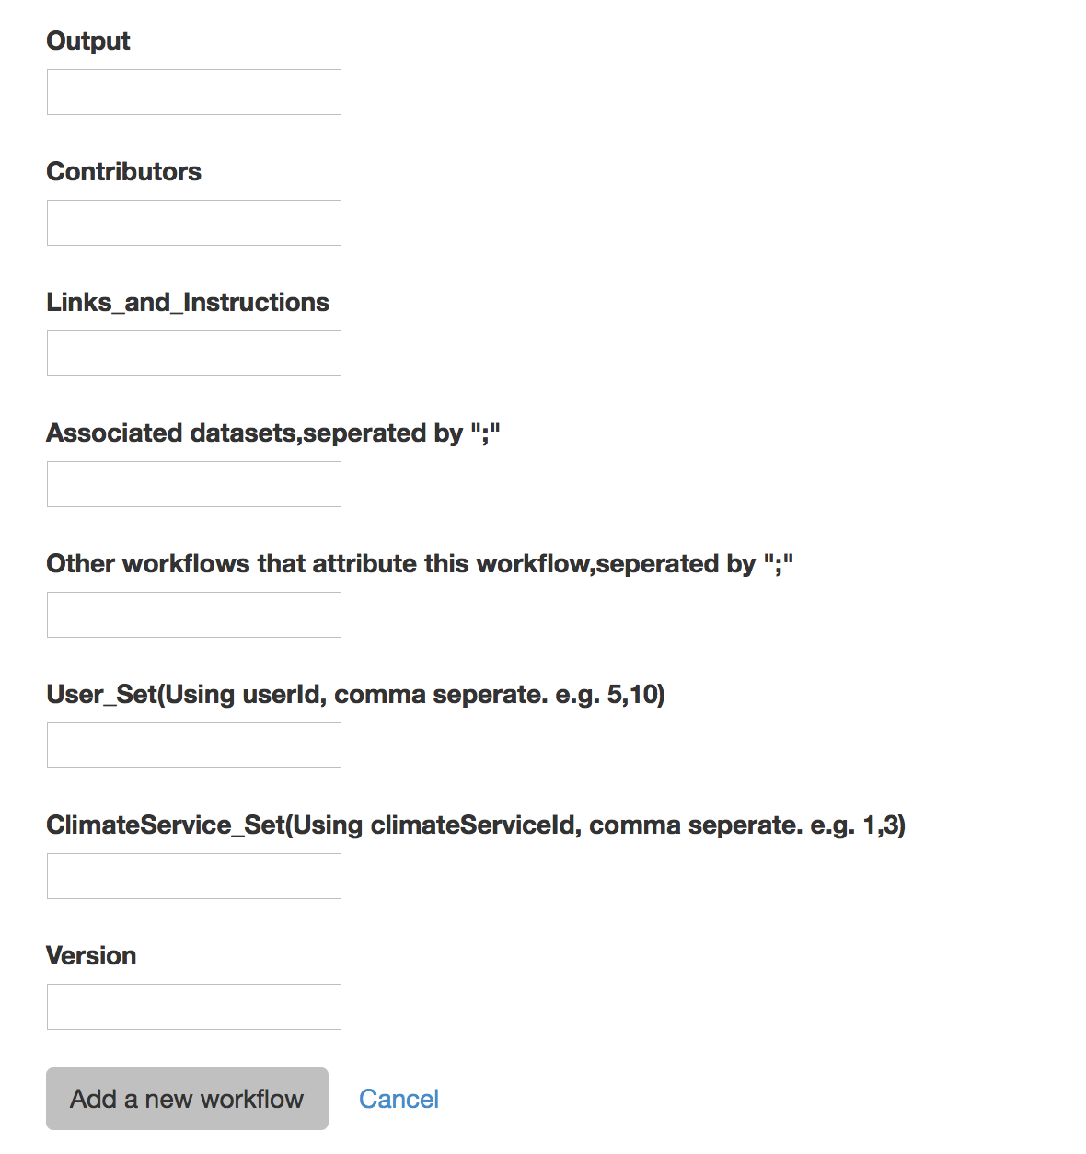
New workflow

Slide 13
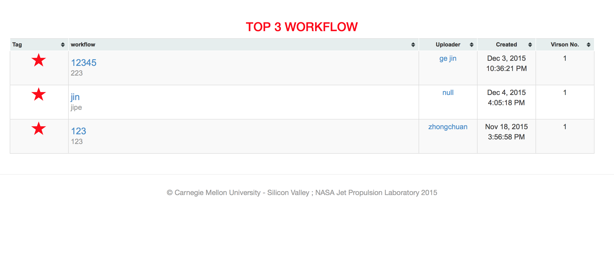
Popular workflows

Slide 14
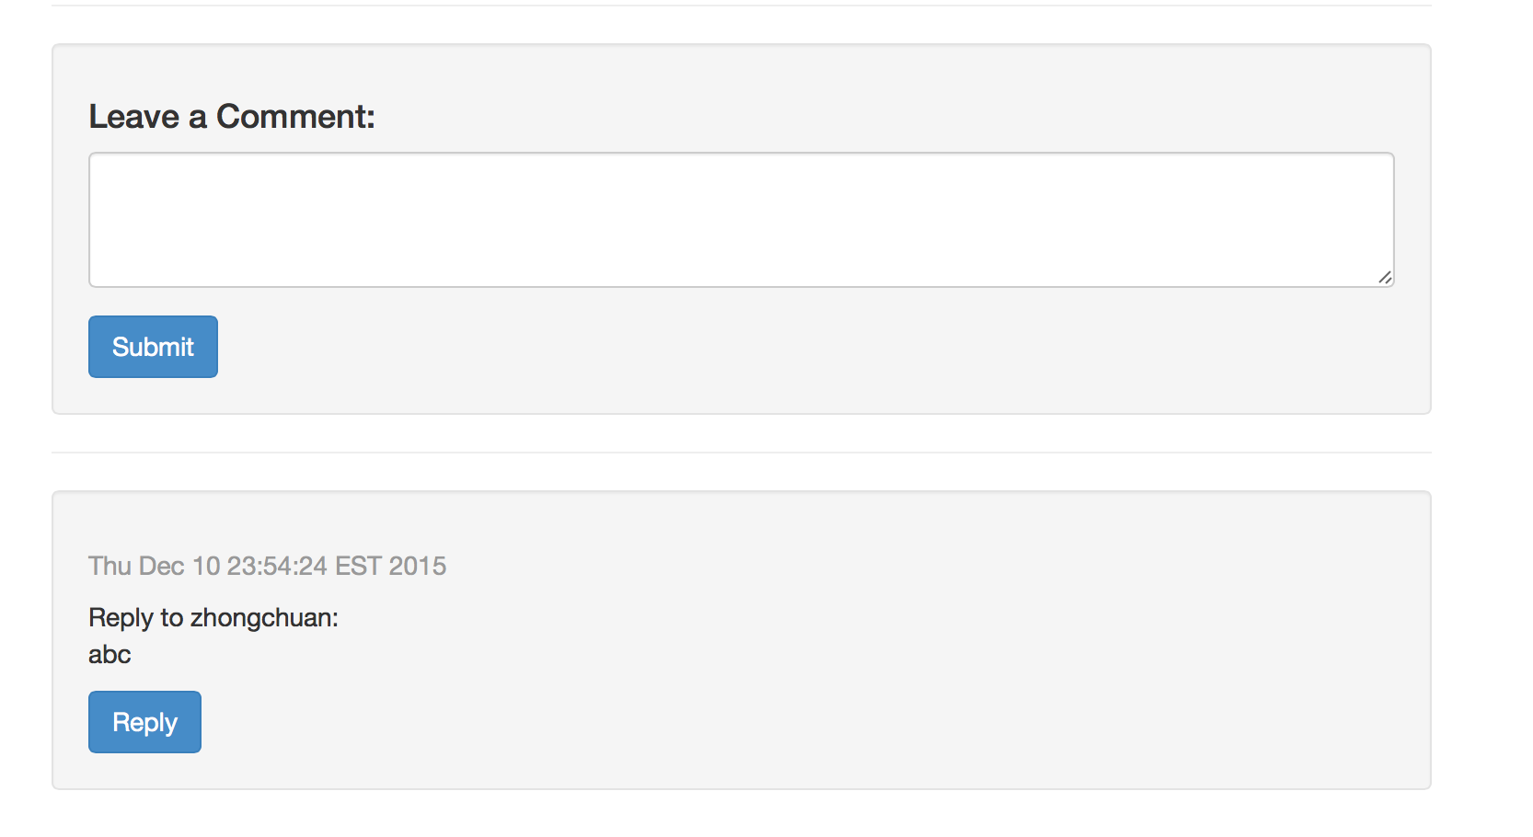
Add comment

Slide 15
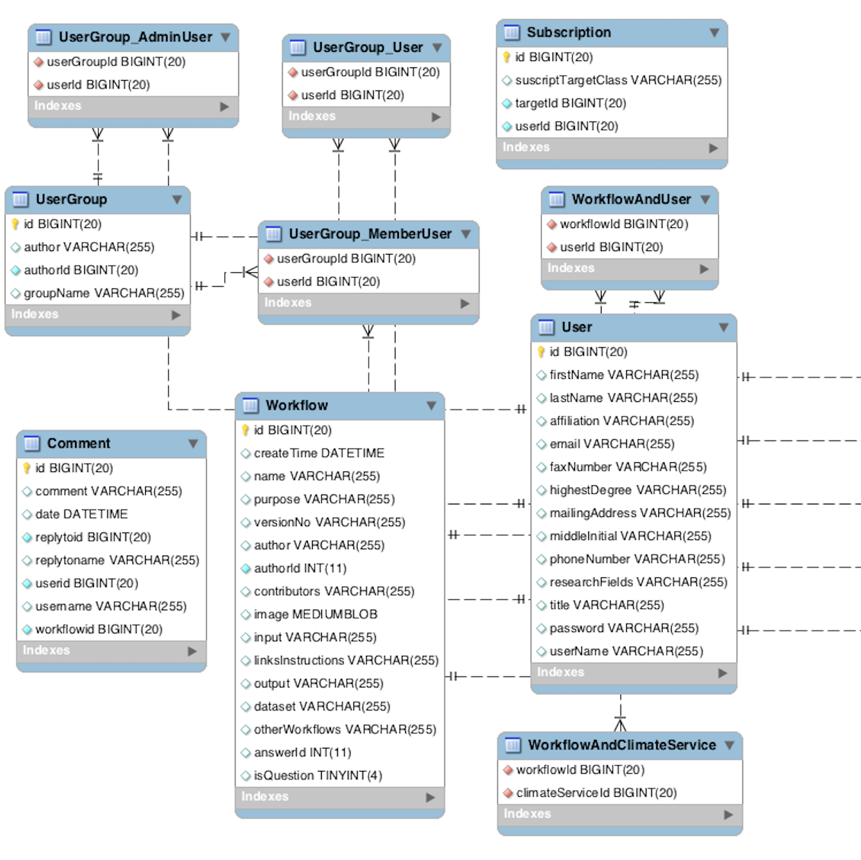
Database

Slide 16

User Group Related DB Scheme
UserGroup
UserGroup_AdminUser
Field | Type
id | bigint(20)
author | varchar(255)
authorId | bigint(20)
groupName | varchar(255)
Field | Type
UserGroup | bigint(20)
UserId | bigint(20)
UserGroup_MemberUser
Field | Type
UserGroup | bigint(20)
UserId | bigint(20)

Slide 17
Implementation
Workflow
Comment
Popularity
User
Profile
Subscribe/Follow
User Group

Slide 18
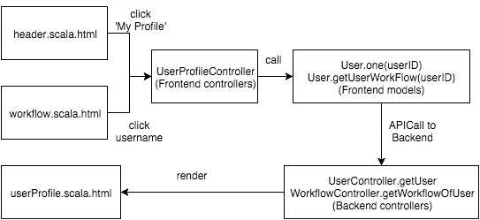
User Profile Implementation

Slide 19
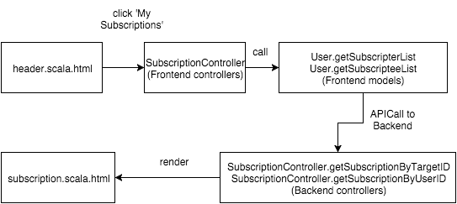
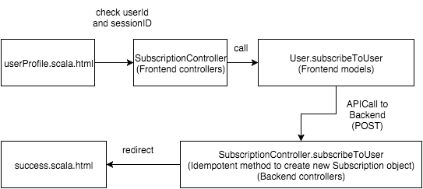
Subscribe Implementation
my subscription user profile

Slide 20
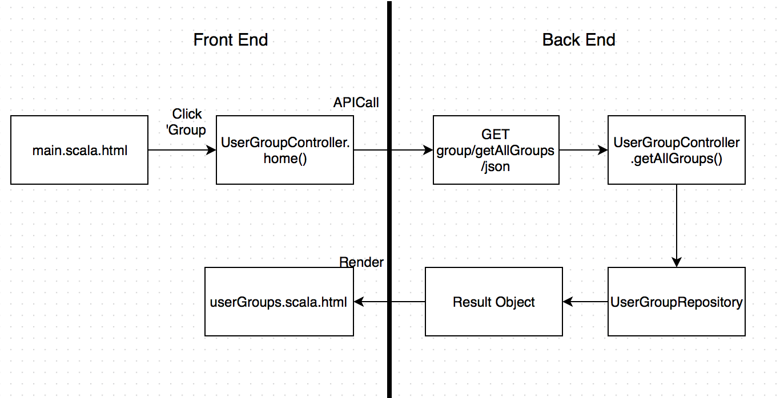
User Group Implementation 1

Slide 21
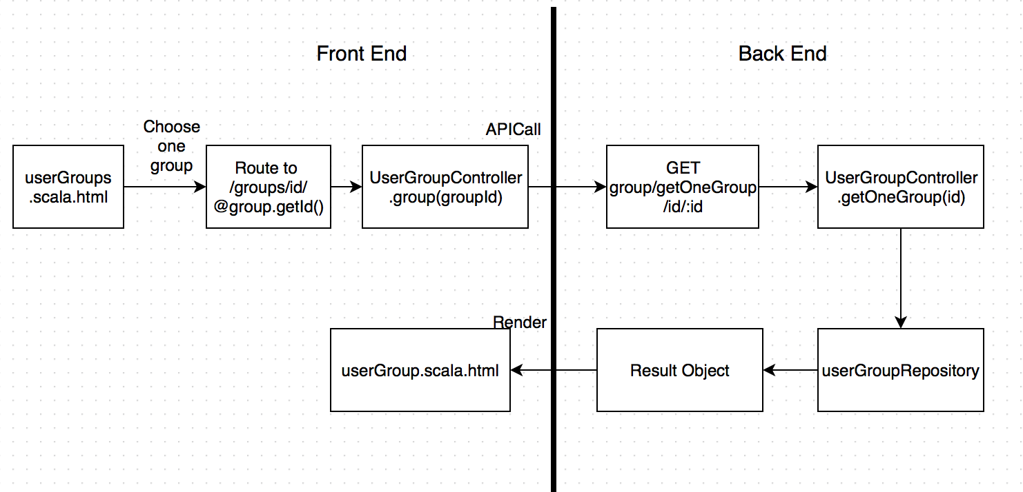
User Group Implementation 2

Slide 22
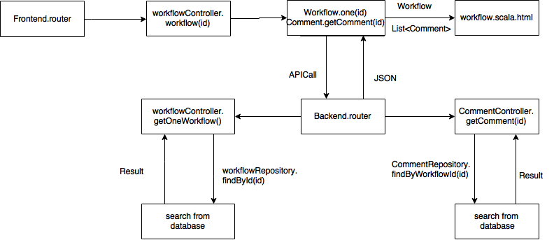
GetOneWorkflow Implementation

Slide 23
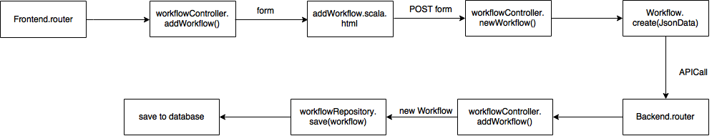
NewWorkflow Implementation

Slide 24
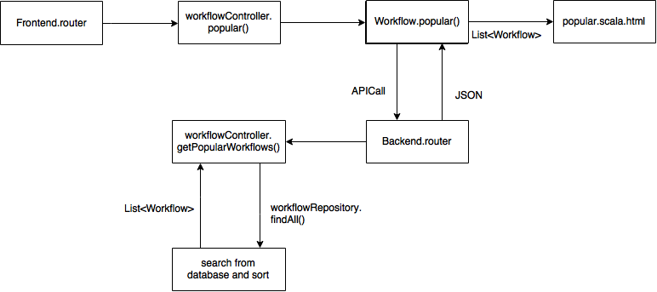
Popularity Implementation

Slide 25
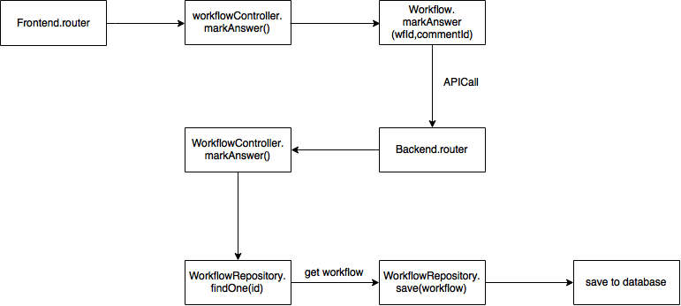
MarkAnswer Implementation

Slide 26
Future Work
Search Page
Users can mention other users in comments
User can edit / share posts

Slide 27
Thanks

