Slide 1
VIVO My Dream Team Builder Based on Linked Open Data Conforming to the VIVO Ontology.
Anup Sawant (Northwestern), Harshad Gado (Northwestern) Leslie DeChurch (Georgia Tech), Noshir Contractor (Northwestern)
VIVO 2014 Austin, Texas USA
1

Slide 2
Outline
Project Goals
VIVO My Dream Team Builder – terms and data sources
Team Builder
NU Scholars
VIVO
RDF
Triples
Architecture
Data collection & mapping
Application workflow
Software Stack
2

Slide 3
Project Goals
Move team building approach from staffing teams (CATME @ Purdue) to self-designing work teams.
Port the SONIC My Dream Team Builder recommendation heuristics to VIVO based My Dream Team Builder for university researchers (e.g. Northwestern University at first and then other universities hosting VIVO instances such as Cornell and Florida).
Gain practical experience in building systems that use
Linked Open Data (LOD)
SPARQL query language
Technology adoption study of the utilization and impact of our social-science grounded recommendation heuristics
3
Notes:
Our overarching goal is to conduct a technology adoption study for a online collaboration recommendation tool for research scientists, with an emphasis on testing and validating the efficacy of and user satisfaction with a suite of recommendation heuristics draw from social science research.

Slide 4
My Dream Team Builder – What is it
The My Dream Team Builder is an application that helps you select teammates based on your preferred personal characteristics and/or social network properties.
4

Slide 5
NU Scholars – What is it
Research networking tool and online experts profiling system.
Identifies research expertise across Northwestern.
Reveals existing and helps identify potential collaborations.
Shows research interests, publications, grants, patents, accomplishments, CV-type data, graduate programs.
Makes visible scholarly productivity and trends.
Helps find expertise and mentors for students, postdoctoral fellows, and other researchers.
5

Slide 6
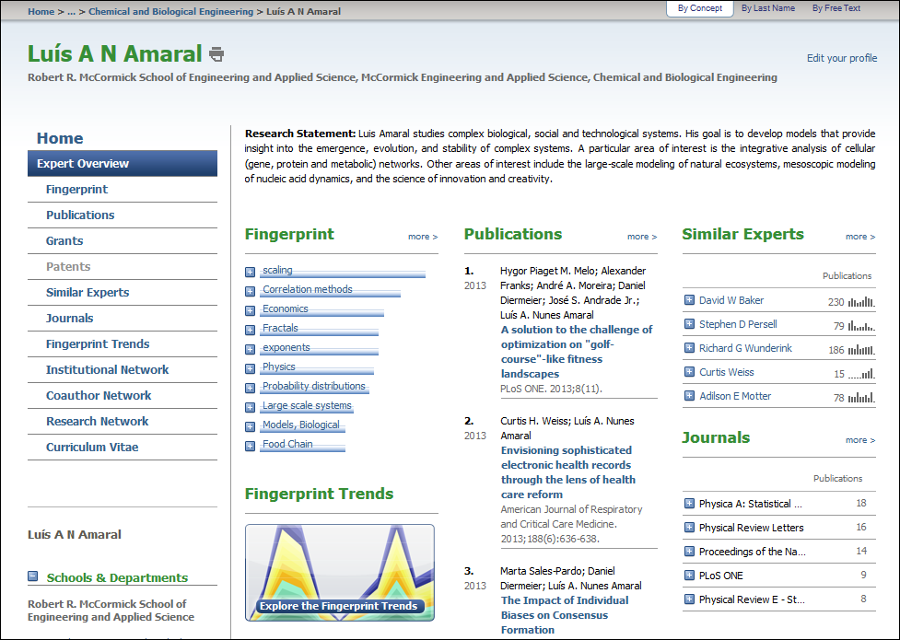
6

Slide 7
VIVO – What is it
Semantic-web-based research and researcher discovery tool.
People plus information on the research they do
VIVO principles :
Open software
Open data
Open ontology
Publicly-visible information, across disciplines.
For external as well as internal audiences.
An open, shared platform for connecting scholars, research communities, campuses, and the world using Linked Open Data (LOD).
People and more
Organizations, grants, programs, publications, events, facilities and research resources.
7

Slide 8
RDF
The Resource Description Framework (RDF) is a framework for expressing information about resources.
Resources can be anything, including documents, people, physical objects, and abstract concepts.
8

Slide 9
Triples
RDF allows us to make statements about resources. The format of these statements is simple. A statement always has the following structure:
<subject> <predicate> <object>
The subject and the object represent the two resources being related; the predicate represents the nature of their relationship.
The relationship is phrased in a directional way (from subject to object) and is called in RDF a property.
Because RDF statements consist of three elements they are called triples.
9

Slide 10
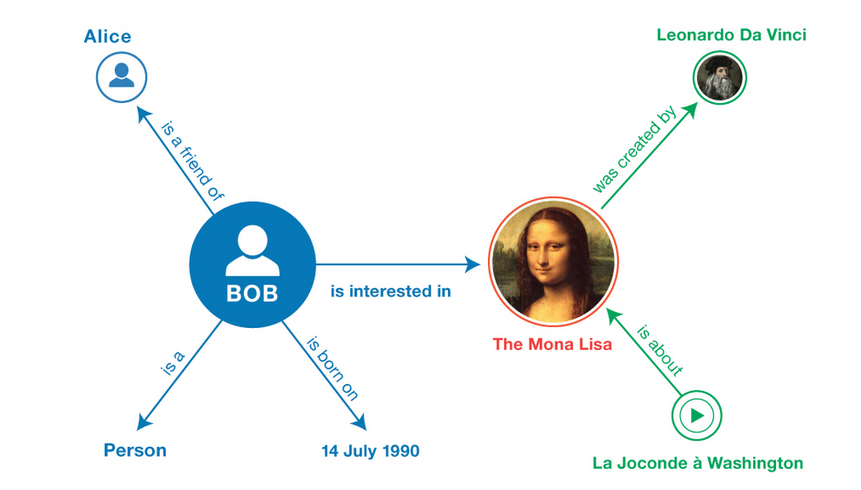
Triples
10
Notes:
Enriching a dataset by linking it to third-party datasets.
Building distributed social networks and recommendation engines by interlinking RDF descriptions of people across multiple Web sites.
Enabling cross-dataset queries to be performed using SPARQL.

Slide 11
Architecture
Recommendation Engine
Apache Fuseki
Jena
NU Scholars
Query, Recommend,
Profiles,
Teamboard.
xml
Networks and Heuristics
RDF triples
Mapper Layer
VIVO mapper
Survey mapper
Interaction
layer
Tables
records
Accept / reject invites
Survey Tool
xml
MySql
Messages
JDBC
Data Access Layer
Calculations
11

Slide 12
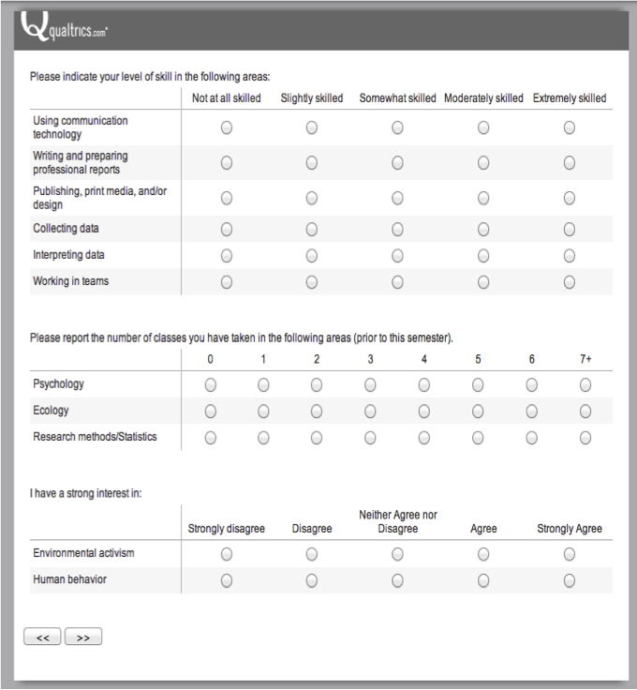
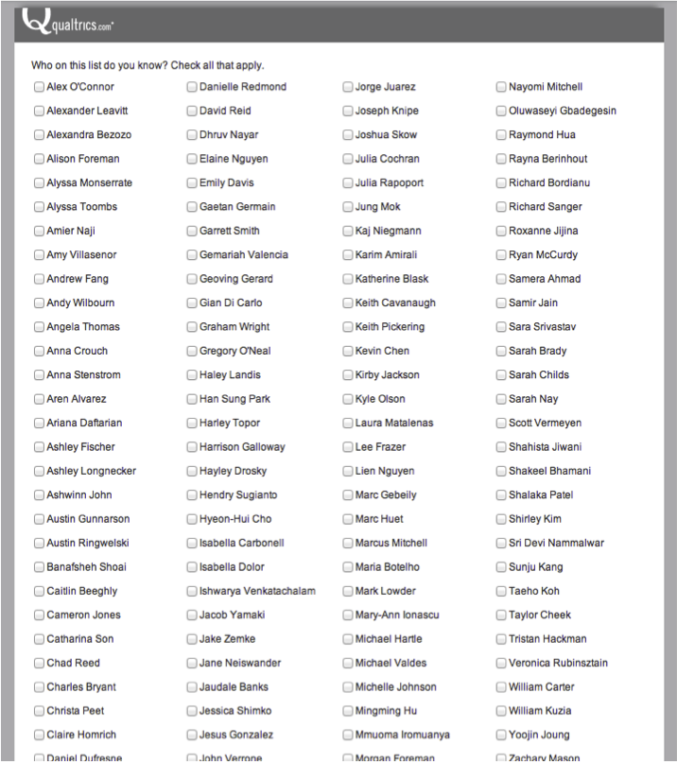
Data Collection
12

Slide 13
vivo:
Authorship
vivo:
Position
vivo:relates
vivo:relates
vivo:relates
vivo:relatedBy
vivo:
FacultyMember
vivo:relatedBy
vivo:relates
contact info for
has contact
info
vivo:relatedBy
vivo:relatedBy
bibo:
AcademicArticle
obo:
Contact
vivo:
Department
vcard:TEL
vcard:hasName
bibo:pmid
rdfs:label
rdfs:label
vcard:TITLE
vcard:Email
Telephone
Name
Pubmed Id
Name
Title
Email
Name
13

Slide 14
My Dream Team Builder Workflow
Users login
Form Query, manage profile
Recommendation list
Visit profile & invite
Accept / Reject invitations
Leave team if not satisfied.
Admin registration
Grow team till deadline
14

Slide 15
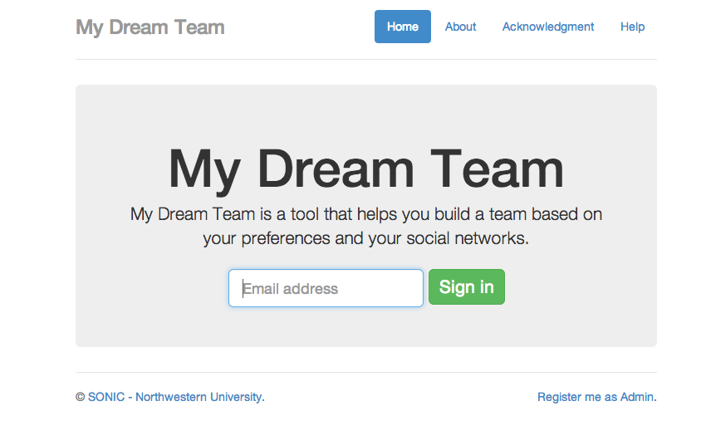
Admin Login – Setup the rules
15

Slide 16
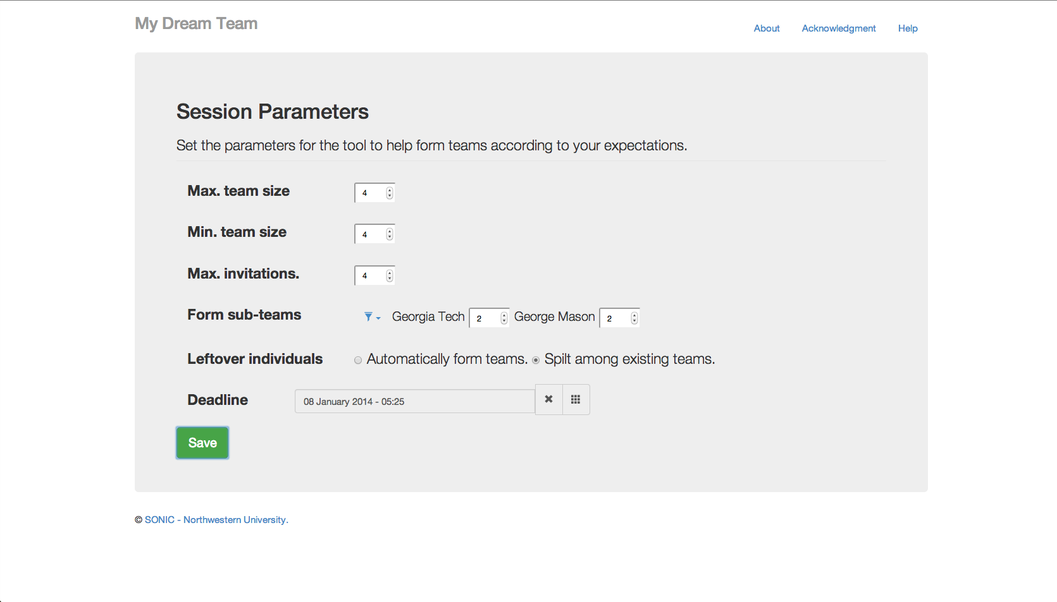
The Admin Page
16

Slide 17
Log in to find teammates
17

Slide 18
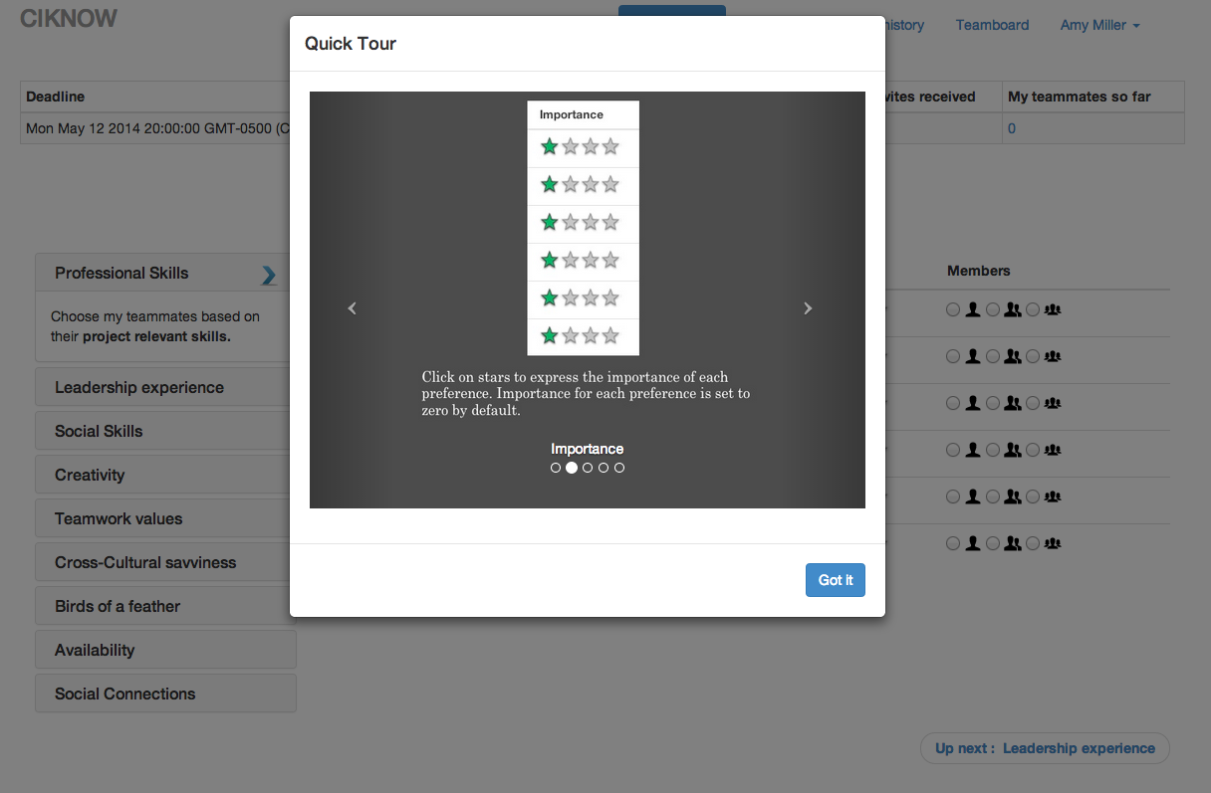
Quick Tutorial
18

Slide 19
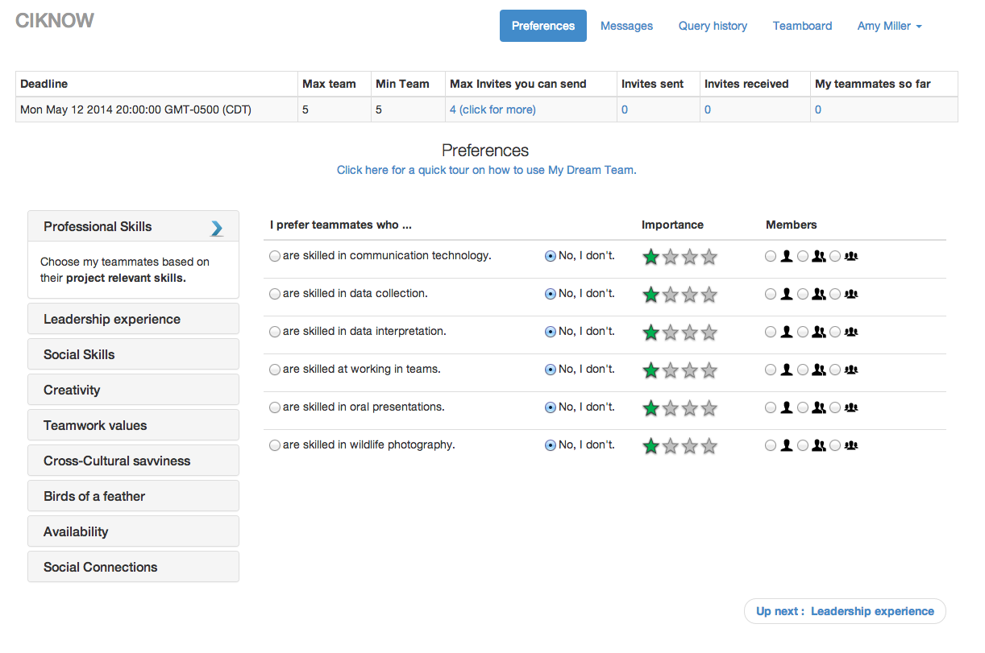
Set your teammate preferences (Query)
19

Slide 20
Professional Skills
20

Slide 21
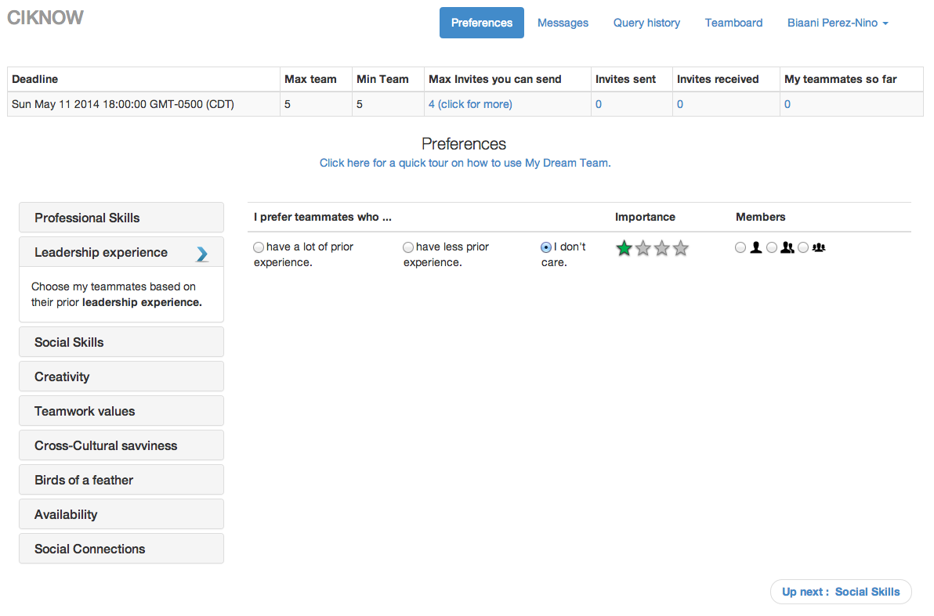
Leadership Experience
21

Slide 22
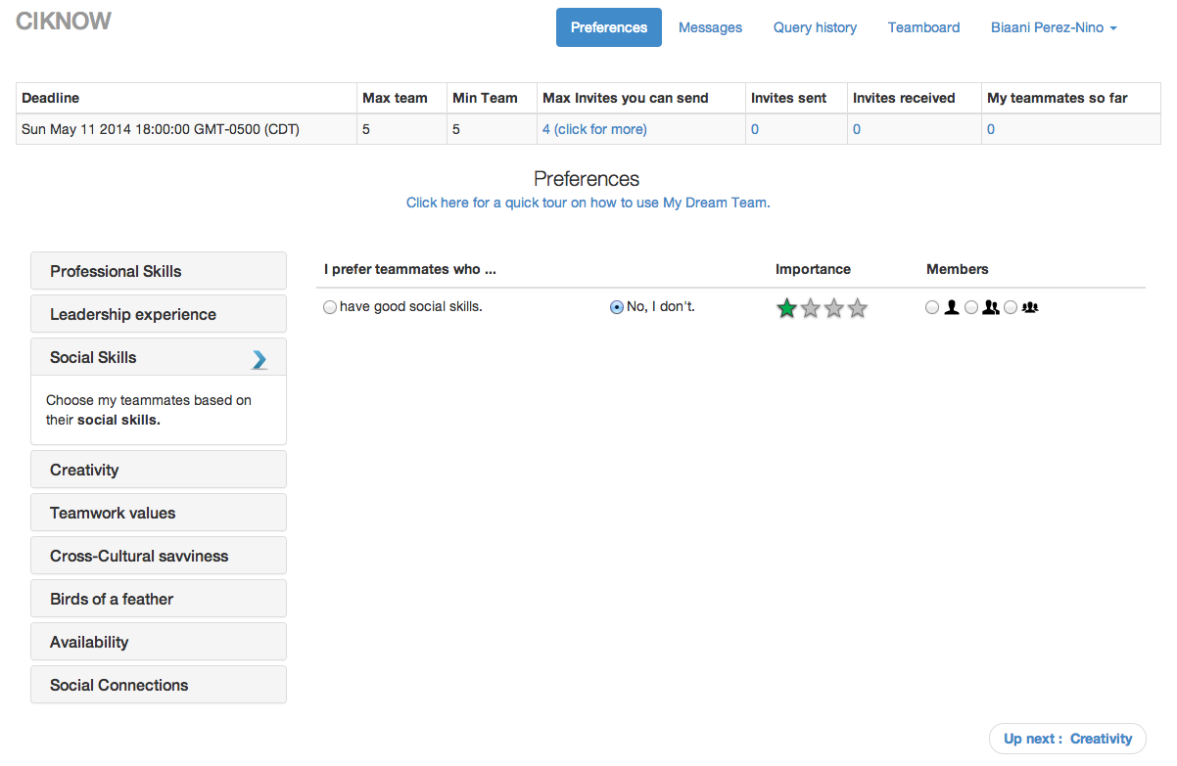
Social Skills
22

Slide 23
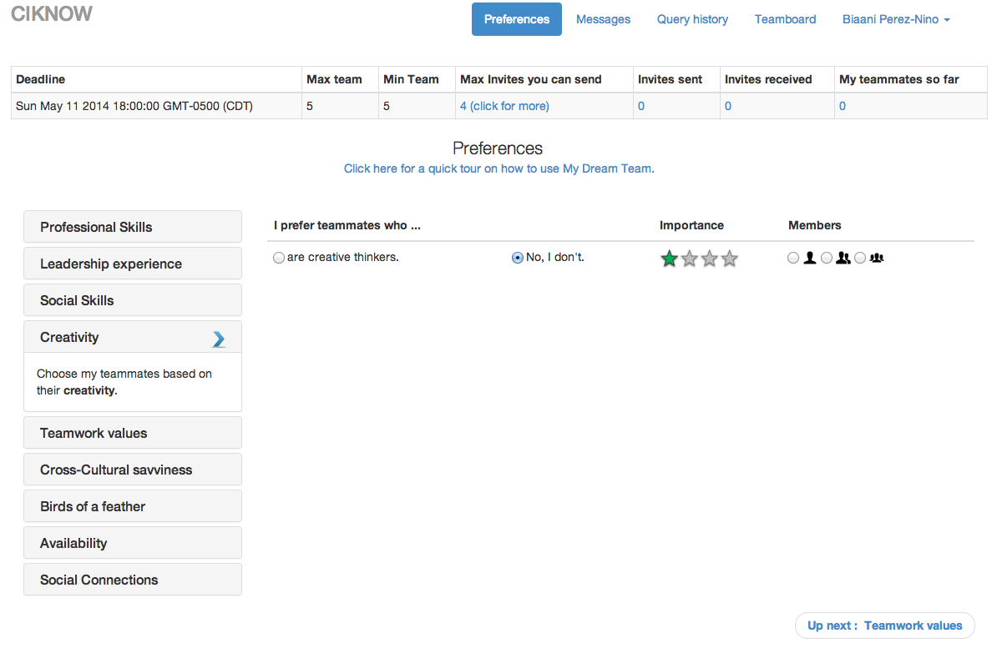
Creativity
23

Slide 24
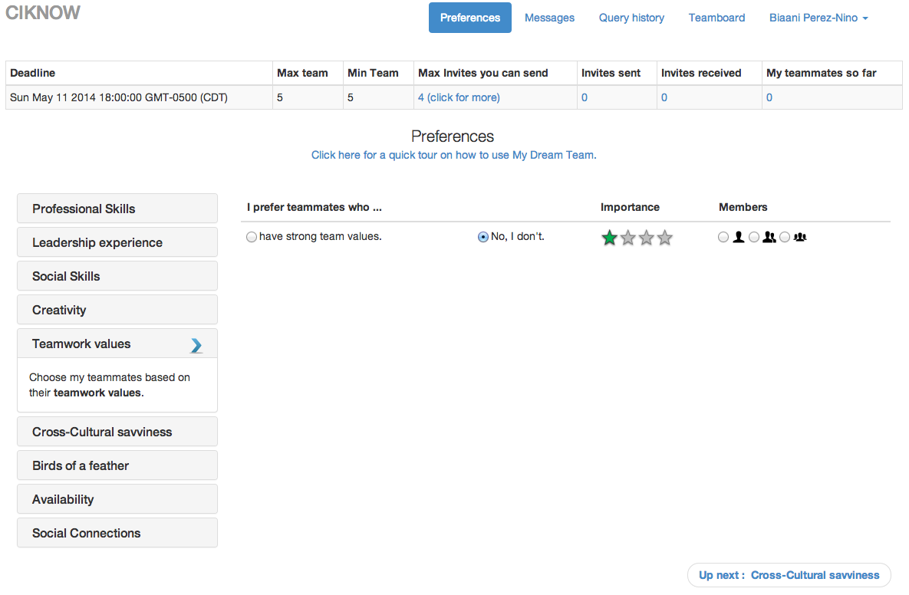
Teamwork values
24

Slide 25
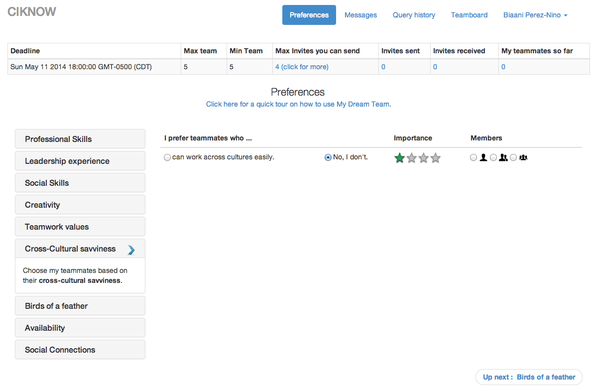
Intercultural Sensitivity
25

Slide 26
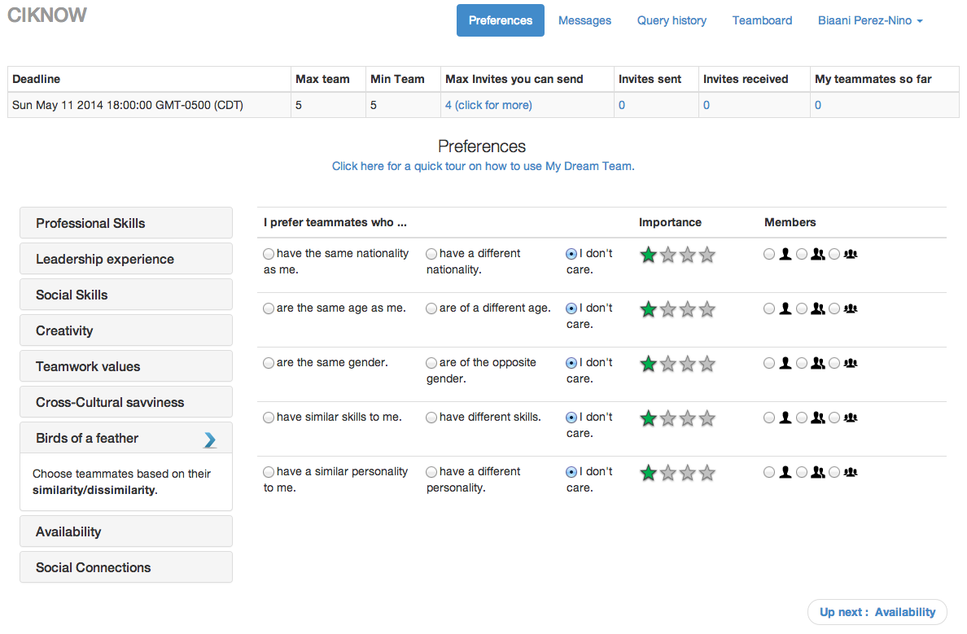
Homophily - Heterophily
26

Slide 27
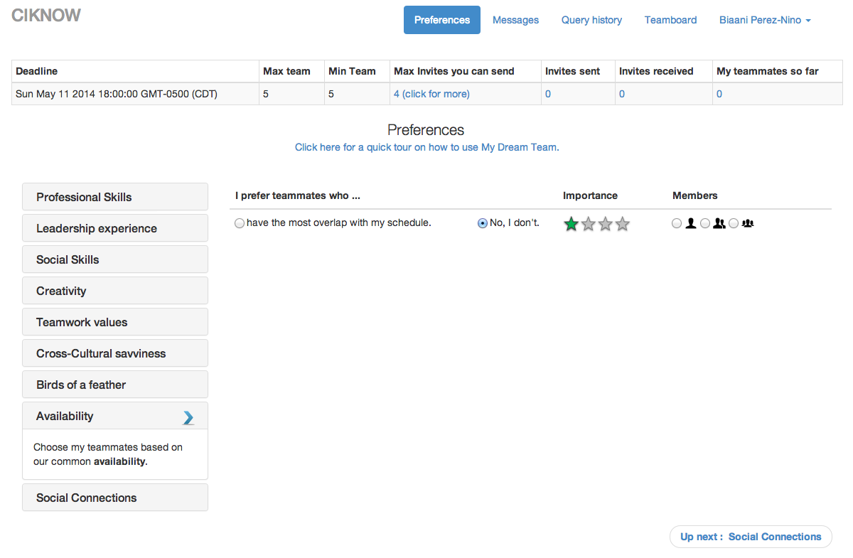
Availability
27

Slide 28
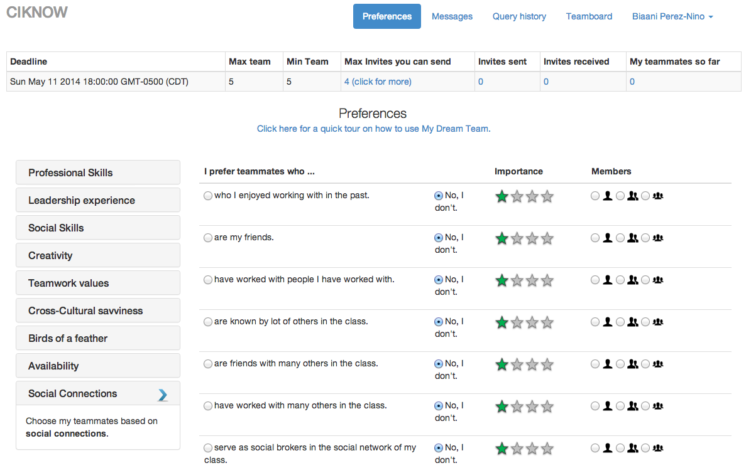
Social Networks
28

Slide 29
VIVO Teammate Preferences
I prefer teammates who… |  |  |  | Importance
Work in:
Work in my current/previous organization: | Yes | No | I don’t care
Have worked with me before: | Yes | No | I don’t care
Have worked with people I have worked with: | Yes | No | I don’t care
Have worked with many other researchers: | Yes | No | I don’t care
Have a high H-index: | Yes | No | I don’t care
Are social brokers in my co-authorship network: | Yes | No | I don’t care
29

Slide 30
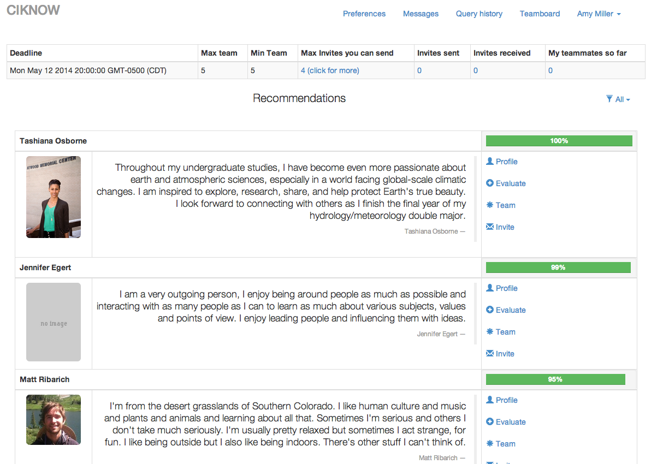


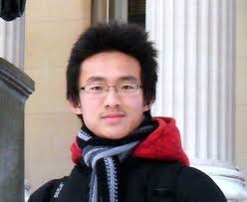
Teammate Recommendations
30

Slide 31
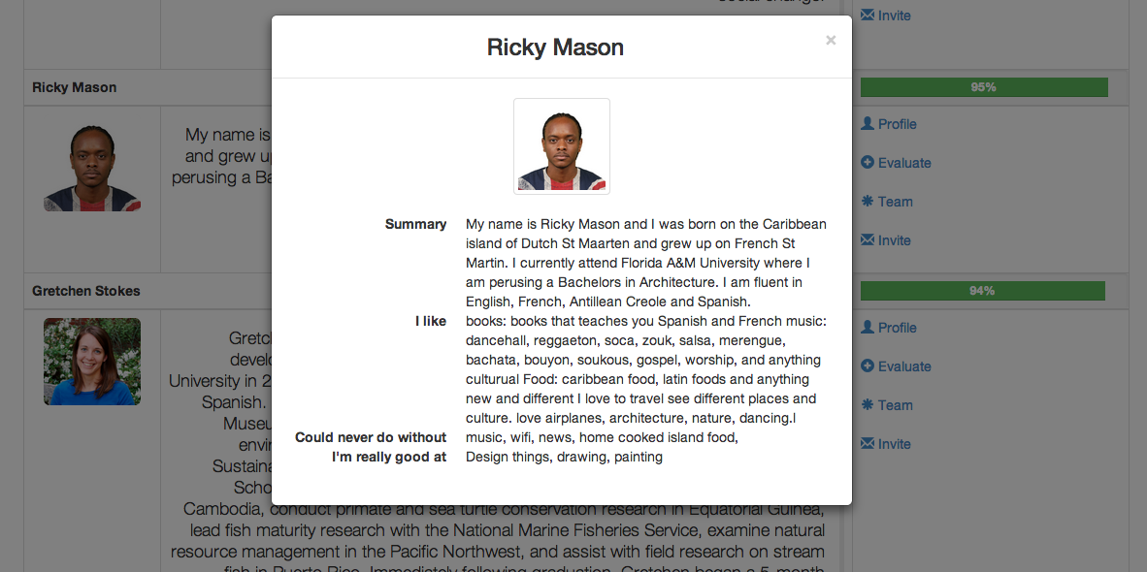


Profiles of potential teammates
31

Slide 32
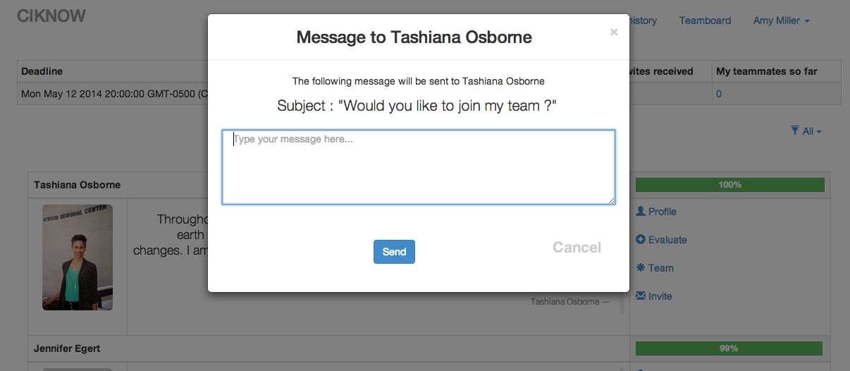
Send teammate invitations
32

Slide 33
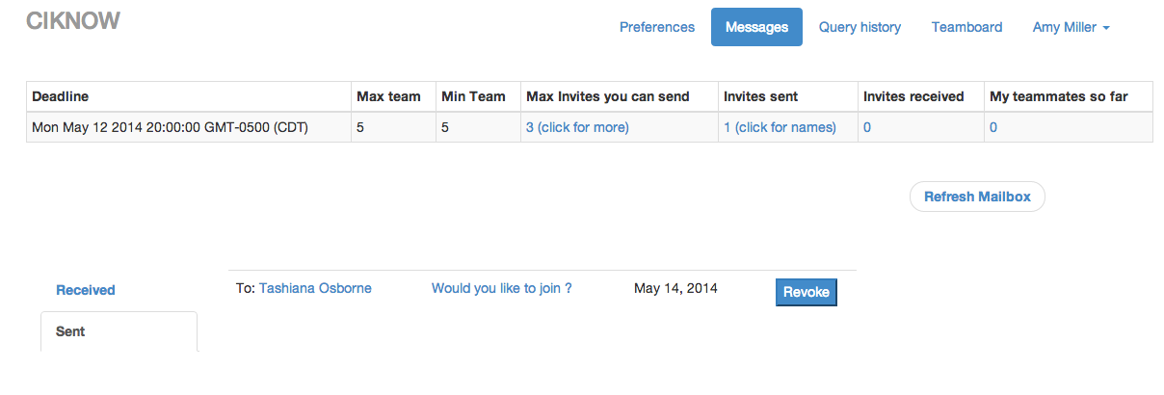
Review inbound invitations
33

Slide 34
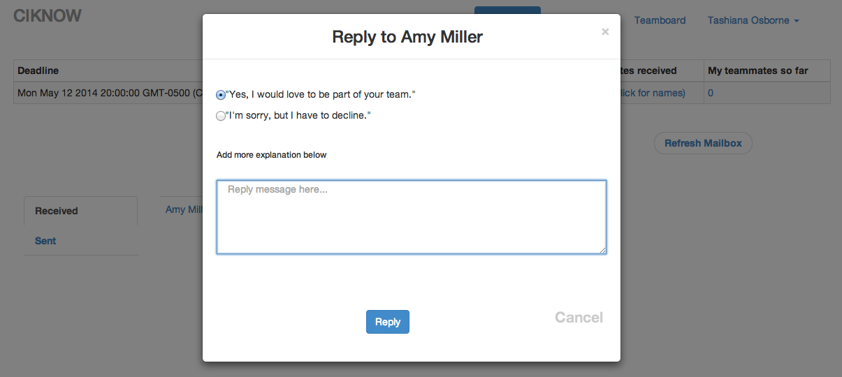
Reply to inbound invites
34

Slide 35
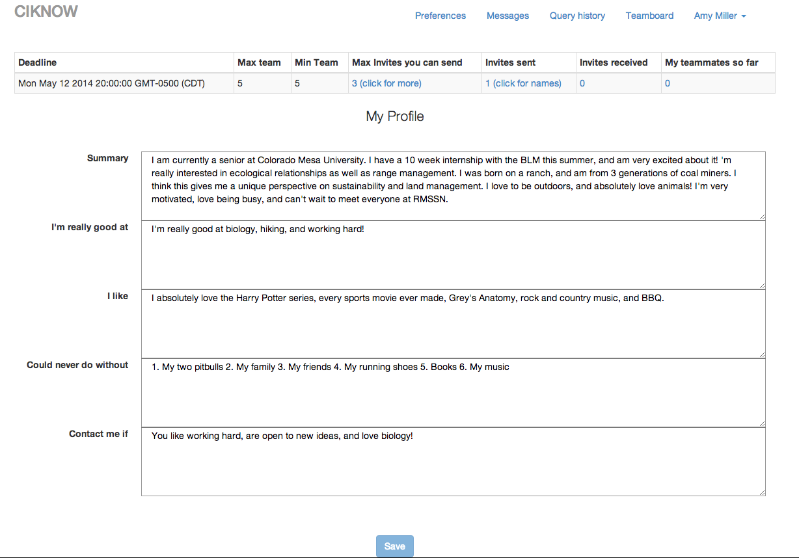
Not getting any invites ? : Polish your profile
35

Slide 36
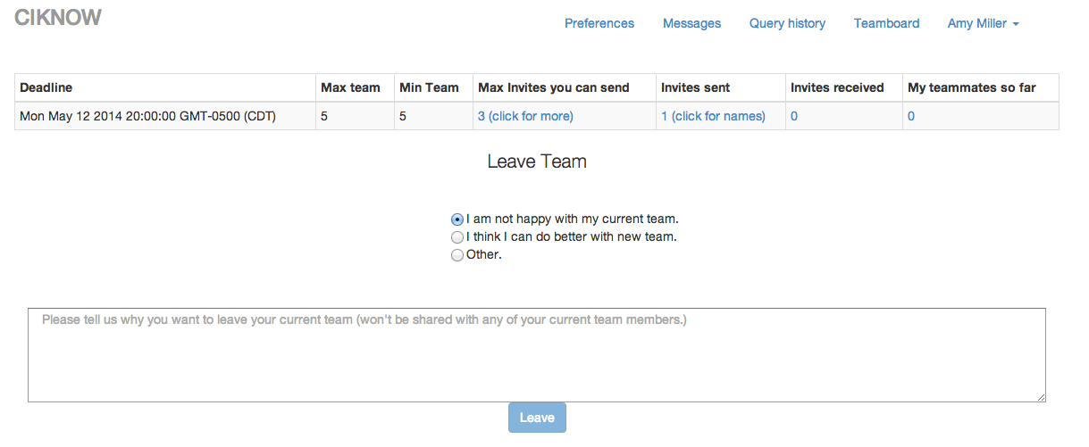
Think you can do better ? : Breakup
36

Slide 37
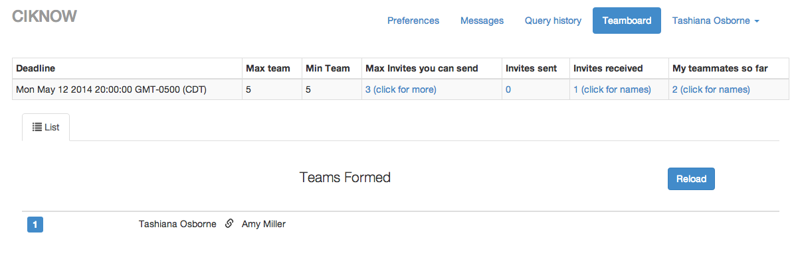
Monitor the situation : The Team Board
37

Slide 38
SONIC C-IKNOW VIVO Team Builder Open Source Software Stack
Java - programming language
Apache Jena
- RDF interface
- ARQ: SPARQL support
Java Universal Network/Graph Framework (JUNG) - social network analysis (SNA) algorithms
- Centrality measures
- Degree of nodes
JUNIT - unit testing and quality assurance
Knockout.js – dynamic bindings.
Bootstrap - HTML, CSS, JS framework
Data-Driven Documents (D3) - visualization
38
Notes:
The easy availability of high-quality, free and open source software tools greatly reduces the cost of getting started building sophisticated applications on top of rich linked open data such as VIVO. We must acknowledge the contributions of all those who worked on these projects without whom our work would not be possible.

Slide 39

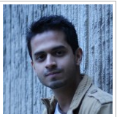

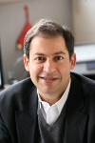
SONIC C-IKNOW VIVO My Dream Team Builder Contributors
Anup Sawant
Dr. Leslie
DeChurch
Harshad Gado
Dr. Noshir
Contractor
39

Slide 40
Thank you !!
Questions?
40

