Slide 1
Improving accessibility and cost-effectiveness of research publications
The role of public data
John Mark Ockerbloom
Manuel de la Cruz Gutierrez
University of Pennsylvania Libraries
VIVO Conference – August 2014 -- Austin, Texas

Slide 2



A local compliance issue
Libraries & School of Medicine TEAM
Grant compliance
PMC
NIH
Notes:
Let us start by talking about one project in particular that we’ve been working at Penn that has made us think a lot about these issues recently. It all started with a very defined need that the Abramson Cancer Center of the Perelman School of Medicine had: They needed to generate a report on the publications derived from a big grant that the center was given by NIH in 2010. Given NIH’s public access policies, this meant that all those articles had to be already deposited in PMC, the public access repository of NIH. Now, there are two factors that make it very laborious to create these reports: 1) there are more than 300 researchers associated with the ACC, 2) not ALL of the papers each researcher wrote during the period of the grant are associated with the center’s grant so you need to discriminate them somehow, and 3) You need to get their respective PMCIDs. Well, administrators at ACC heard of the work that PSOM IT and Penn Libraries have been doing with VIVO and most recently implementing this new tool, Symplectic Elements, that might just be able to give them the data they needed with much less hassle than using a combination of an existing homegrown database of publications ---called FEDS faculty expertise database--- and something like PubMed or Scopus. So after some synergistic work, we’ve been able to work out a solution for them that in the near future can be replicated across the university as everybody receiving NIH grant money needs to comply ---and we have many centers around Penn.

Slide 3
Many stakeholders beyond local ones
Publishers
Researchers
Funders
Libraries
Administrators
Public
Notes:
Anyways, let’s recognize now that there are other stakeholders beyond the ones we talked about in the case of ACC and let’s recognize too that the idea behind the public access mandates is the maximum yet efficient dissemination of scholarly outputs. This is what the funders want for the benefit of researchers, obviously, but also the public at large, because they want them to know that the tax money is being spent well, on research that ideally anyone could access ---If the public doesn’t see a tangible benefit of the research enterprise, federal grant money will keep drying up! OK, let’s go back to the stakeholders. Libraries not only want their researchers to comply but also to provide enduring access to scholarly outputs in general and also license collections that serve the needs of the campus community; researchers in turn want to really focus on their research so whatever someone else can do to help on this regard, like making it easy to comply and to access other peoples’ papers, makes them happy. Administrators want the researchers and the funders to be happy, so both research and grants keep flowing, and they like the libraries helping on this as well as being good stewards of collections, both licensed and the institution’s own, and preferably not asking for more money. Finally, publishers want also to provide greater access to publications, but have set forth certain conditions such as embargoes, and higher fees for making articles open access.

Slide 4
How much does it cost to make scholarly output accessible?
Pubmed: $4.5M; $48/manuscript
NSF: $125/dataset; $4/GB (estimate)
ArXiv: $6
CHORUS: “minimizes cost to (…) all users”
SHARE: ?
http://scholarlykitchen.sspnet.org/2013/07/16/the-price-of-posting-pubmed-central-spends-most-of-its-budget-handling-author-manuscripts/
http://www.academia.edu/4128499/Repository_of_NSF-funded_Publications_and_Related_Datasets_Back_of_Envelope_Cost_Estimate_for_15_years
Notes:
Which brings us to the question, how much it costs to make scholarly output accessible? And here I’m not talking only about papers, but also datasets. Well, here are some examples of importance: Pubmed’s operational costs are about 4.5M dollars per year, and it houses just over 3M articles currently; however, most of this money is spent not in providing actual access, but in creating the accessible manuscript document from the one that researchers ---or journals--- submit to the repository, on the order of $48 dollars per manuscript---work mostly done by systems operated or created by contractors. Contrast that to the cost of making accessible a paper in the ArXiv: about $6 ---granted, the processing of submissions and their subsequent management is pretty automatic in this case. Then we have an estimate of how much it may cost to create a repository that would provide access to the scholarship products by NSF grantees over a period of 15 years: The estimate is that there would be an upfront cost of $125 per one dataset associated with a publication, and that it would cost $4/GB to maintain access to these resources thereafter---all to the tune of $170M, assuming that NSF-funded researchers would publish at about the same rate as they do now. Next we have the answer to the OSTP memo of last year by the publishers ---mainly the big, traditional publishers--- that at the moment say they can build an infrastructure, named CHORUS (Clearinghouse for the Open Research of the United States) for access to papers and datasets that “minimizes costs to the government and all users” so it’s not clear yet how much we’re talking about in here but it does uphold the provision of embargoes---an impediment to greater access. Finally, important associations of higher education institutions are instead going for an infrastructure of their own, named SHARE (SHared Access Research Ecosystem) that is more open than the publishers’ but for which we still don’t know what the costs will be.

Slide 5


Advantages of openly published, globally analyzable information
journalprices.com
Data on journals’ price per article or citation
Standardization and transparency!
Notes:
John and I believe that in order to make the best decisions on how to improve access and cost-effectiveness of research publications is important to leverage the existing data on the requirements that the different stakeholders have and the actions they are taking. Examples of these data are Sherpa Romeo, a database providing standardized publisher policies on copyright and self-archiving, Sherpa Juliet, a database of research funders’ open access policies, again provided in a standard format, and journalprices.com, a database of journals’ price per article or price per citation.

Slide 6

The real price of Open Access: Transparency at the article level
The cost of open access publishing: a progress report
Average Article Processing Charge (APC): £1821
Traditional subscription publishers’ APC >>
Born-digital open access publishers’ APC
Biggest publishers: 1) ELSEVIER 422 articles (20%)
2) PLOS 305 (14%), and 3) WILEY 271 (13%)
Notes:
Moreover, there’s even now data on costs associated with publication of individual articles that can be leveraged for an evidence-based debate about Open Access models and eventual platform support ---like the ones described previously. The Wellcome Trust in the UK, a major funder of biomedical research, made public the cost associated with publishing 2126 open access articles in the year 2012-13. Some interesting findings were that the average article processing charge, that you’ll see referred to as APC from now on in the slides, was about £1821, which is nearly $3,100. Also, the average article processing charge of traditional subscription publishers (such as Elsevier, Wiley, etc.) was found to be much more than that charged by born-digital open access publishers (such as PLOS). This already uncovers issues with this hybrid open access model, where traditional subscription publishers made an article open access within a journal that has subscription charge for all other articles within it. And finally, it revealed that the biggest publishers for Wellcome Trust grantees were #1 ELSEVIER with 422 articles (20% of the total number of articles submitted and paid for), #2 PLOS with 305 articles (14% of the total) , and #3 WILEY with 271 articles (13% of the total).

Slide 7
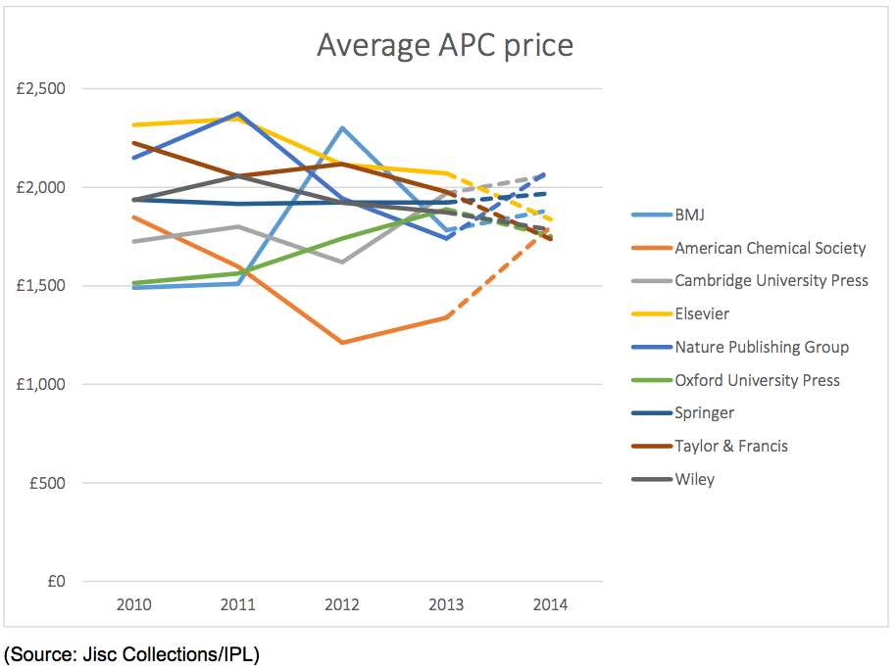
The real price of publishing: Transparency at the article level
JISC collections data
Number of APCs and the total APC expenditure of 24 UK higher education institutions
(2010-2014)
Notes:
In an even more recent release of public data on article processing charges, this one by JISC, a not-for profit, (for the most part) government funded company that negotiates with publishers on behalf of UK universities, reveals a dataset even larger than the one by the Wellcome Trust. This dataset includes aggregated and anonymized data on article processing charges incurred by 24 UK higher education institutions over a period of 4 years. It also includes not only open access articles but also papers accessible only by subscription charges. An interesting result is shown in this figure, that in different colors show the average article processing charges for the largest traditional subscription publishers. Although I could talk to you about the trends we see here, the main point I want to do now is that it is this kind of open data that will allow us in the future to better provide access in the future in a cost effective way to all interested consumers and producers of scholarship. We need more of this coming… and it can all start with grass roots movements. Now John will tell you some ways this may come about.

Slide 8
Collecting and publishing compliance and cost data
External
data sources
ELEMENTS
VIVO
Institutional
databases
migration
FEDS
User
Input
(temporary)
Other
outputs
Internally visible
relational data
Externally visible
Linked data (et al.)
Notes:
So as Manuel has shown, there are a variety of ways that research institutions can meet requirements for open access, and they have a potentially wide range of costs. So the question that comes up at our individual institutions: How do we make sure we’re doing what we need to do to meet our funder’s requirements, and how can we make sure we’re doing it in an effective, and cost-efficient way?
This is where systems like VIVO, and complementary systems that feed into it, can play an important role. Going back to our Abramson Cancer Center example, we’re currently using an internal data-gathering system, Symplectic Elements in our case, to compile information about researcher activities There’s a lot of data we potentially need to keep track of. We not only have mandates for providing open access to researcher publications, but also increasingly for providing the data sets that those publications relied on.
Once we’ve compiled that information, we intend to make a suitable selection of it extermally visible to the public, through our VIVO instance, and possibly through other means that I’ll discuss a bit later on. Publishing the data makes it easier for the public to find and take advantage of the open access articles and data that our researchers have produced. It also lets us and others double-check that we’re getting what we paid for. If we’ say that publishers are providing open access to certain papers, people can check if they actually are. People can also check to see if what we’re paying is reasonable and well-spent, whether we’re putting work in our own repositories, in purely open access venues, or in hybrid venues.
Now, publishing this sort of data has a number of challenges. One is that we may need to have represent our compliance data in a variety of forms. The relational model used by Elements, for instance, differs somewhat from the linked-data model used by VIVO. But the bigger challenge is just getting the data in the first place.
We’re migrating some of our data from a legacy home-grown database, the FEDS system that Manuel mentioned. If you want to hear how that works, go see my colleague Paul Grossman, because he has a poster here that explains it.
But the main sources of compliance data will be other databases, both internal and external, as well as direct user input.

Slide 9
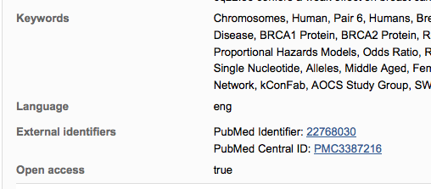
Collecting data locally: Automatic harvesting
Notes:
We want to keep direct user input to a minimum, though, since it’s hard to get people to put time into providing it, especially if those people are faculty.
Fortunately, in some cases we can get data on compliance without users having to input anything at all themselves. For instance, if a user has claimed a paper in Elements, and a copy of that paper eventually goes into PubMedCentral, the system should automatically pick up the PubMedCentral ID from sources that it regularly searches. And there we’ve got out evidence of open access compliance.

Slide 10
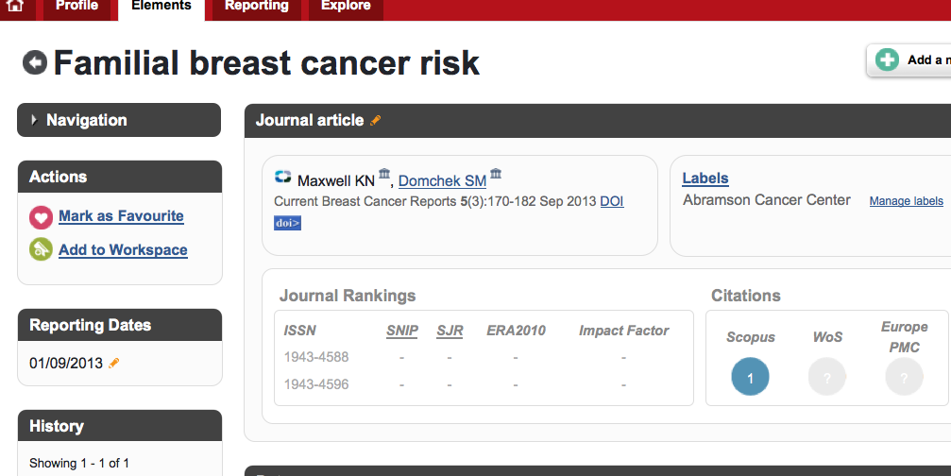
Collecting data locally: Labeling
Notes:
We also need to determine which papers are associated with which grants and programs, though, both so we know what’s required for that paper and so we can show our funders what they’re getting for their money. That does require some user input, but not too much. We took a fairly simple approach for our Abramson Cancer Center pilot, which basically involves one big grant program. Elements lets you create labeling schemas for publications, so we made one called “Associated Programs” with “Abramson Cancer Center” as one of the defined values. So our ACC folks can just tag any paper with that label from a pull-down menu. It’s pretty simple.

Slide 11
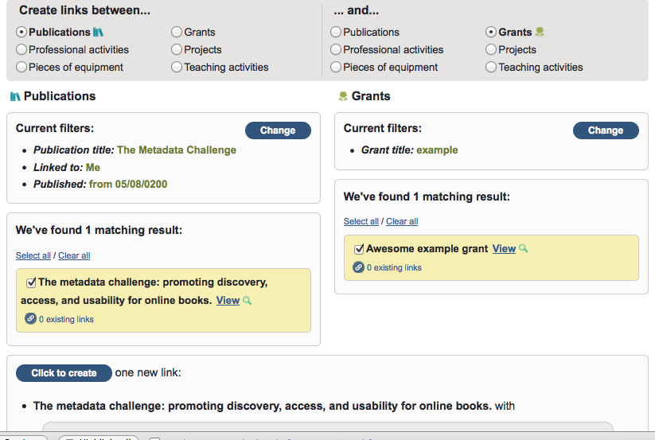
Collecting data locally: Relationships
Notes:
More generally, the Elements interface lets you establish relationships between items, like publications and grants. So if a user has entered information about a grant on their own, they can bring it up along with a publication they’ve claimed, and link the two together.
You can make other kinds of links as well…

Slide 12
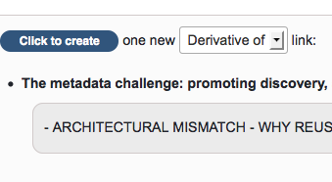
Collecting data: Relationship types
Notes:
…and in some cases you can specify that there’s a certain type of relationship. For instance, you can say that one publication is a derivative of another publication, or of a dataset.
Now, if you’re using a system where you’re entering data about your compliance with researcher policies, it’d be great if that system also helped you comply with them in the first place.

Slide 13
Help comply while collecting data
Show researchers what they should do
E.g. based on sponsors of linked grants, their policies
Show them what they can do
E.g. based on publication venues and their open access policies (from Sherpa/ROMEO et al)
Then help them do it
E.g. “Upload to repository” buttons
Notes:
For instance, if you’ve linked a paper to a grant with a known funder and a time period, wouldn’t it be great if the system reminded you: “Hey, this is a recent NIH grant, so you have to provide an open access version of this paper. Do you want help with that?” Now, Elements doesn’t actually do that at this point, but a system that recognized a repertoire of funders and could tap into public information about those policies, like the SHERPA Juliet database we mentioned earlier, could do it.
One thing Elements does do, though, is help you deposit a paper into a repository for open access. It only works with certain repositories at this point, and unfortunately not yet with the one we use. But I’m hoping that in the future there will be a general repository interface that anyone could code to.
But in any case, it makes use of public data– in this case data from SHERPA/ROMEO, to help researchers understand what they can do with their work. This can be important not only for compliance, but also for cost control For instance, a particular journal might charge a fee to make the official published version of an article open access. But it might also allow you to make a preprint available in a repository for no fee. Public data from sources like SHERPA/ROMEO lets researchers see what their options are.

Slide 14

Showing data publicly: Accessibility
(portion of a page on Scholars@Duke)
Notes:
Now, once you’ve collected data about your open access and data compliance, you should let the world know. And VIVO’s a great place to do that, especially since as an open source system with an extensible ontology, you can customize the interface to make your papers and data easy to find and reuse.
I want to give another shout-out here to Duke’s great Scholars interface, which I think I also showed last year.. Where when you bring up a publication list in their VIVO display, not only does it add links to publisher full text, but it also highlights links to open access copies anyone can freely read. We don’t yet provide this in Penn’s VIVO, but if you want to learn more about how Duke did it, they’ve got folks at this conference you can talk to. And we’re planning to implement something like it ourselves, if it doesn’t end up as a built-in feature of VVO first.

Slide 15
Showing data publicly: Relationships
Simple ones can just use properties
Grants-Publications: vivo:supportedInformationResource, vivo:isSupportedBy
Publications-Datasets (new as of VIVO 1.6) : cito:citesAsDataSource,
cito:isCitedAsDataSourceBy
More complex ones may require entities
FeePayment F: Sponsor S paid $M to R for article A
In theory, linked data allows versatile reuse…
Notes:
VIVO’s does already have bunch of things built-in, including an ample repertoire of properties you can use to express many of the relationships we’ve been talking about here. For instance, if you want to model a relationship between a grant and its publications in VIVO, you can use the “supportedInformationResource” property, and its inverse, “isSupportedBy”.
And if you’re on one of the newer releases of VIVO, you can also use relationships from CITO to link publications with the data sources they cite. “citesAsDataSource” and “isCitedAsDataSourceBy” came in with VIVO 1.6.
If you want to express more complex relationships, you might have to define some new entities. For example, one way you could describe payments for open access would be via a FeePayment entity, which relates a sponsor S , an amount paid M, a recipient R, and the article A that was paid for. This sort of relationship entity isn’t a novel sort of thing. VIVO already uses entities like Authorship to describe relationships between authors and papers, which can include a role and a position in an author list.
Now, expressing payments as linked data in VIVO lets you do interesting Semantic Web-style analyses and mashups, but it’s not always the most straightforward way to put this information out there.

Slide 16
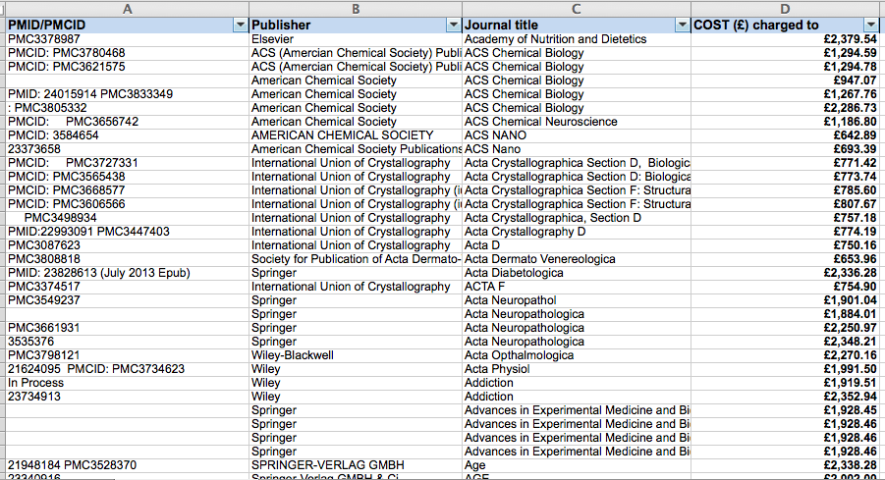
But don’t overlook spreadsheets
Notes:
It may be easier for many people just to provide a simple CSV spreadsheet. That’s what Wellcome Trust did with its publication of open access payment data that Manuel , mentioned. And open access advocates were able to do a lot with that spreadsheet. One nice thing about spreadsheets is you can share them lots of places; not just your own site, but places like figshare or Google drive. And we’ve found that our administrators really like them. Our Abramson administrator can generate a lot of relevant spreadsheet reports out of the box with Elements, and she can then manipulate them however she likes. It’s also possible to generate spreadsheets from VIVO. For instance, they have some built-in spreadsheets that summarize publication activity. And both Elements and VIVO support database query interfaces if you want to build your own spreadsheets.

Slide 17
Conclusions
Collect data on researcher compliance, relationships, and costs
Data of interest to many stakeholders: institutions, funders, public
Helps better manage research requirements, cost-effectiveness
Make it as easy as possible to collect data (& to comply!)
Publish data on compliance and spending
To help others find knowledge, minimize costs, monitor and promote reasonable publisher policies & fees
Can use linked data or spreadsheets
We’d love to talk more:
Manuel de la Cruz Gutierrez:
dmanuel@pobox.upenn.edu - @MDelaCG
John Mark Ockerbloom:
ockerblo@pobox.upenn.edu - @JMarkOckerbloom
Notes:
Whatever format or system you use, though, I hope we’ve shown you how you can use VIVO, Elements, and other systems to collect and disseminate data on researcher compliance, relationships, and costs. It’s also a good thing if you can use those systems to help make compliance and cost control easier. We’ve also shown you some general public sources like Sherpa’s knowledge base and data from places like Wellcome and JISC, that you can use to understand your compliance options and what they’re likely to cost you.
And if you publish the data you collect about your compliance, it can help other people find the open access research reports and data they’re looking for, and it could also help with transparency and fuel more comprehensive datasets on open access availability and costs along the lines of the reports of Wellcome and JISC. That will help the community ensure we’re actually getting the open access we intend at a reasonable cost.
Whether it’s VIVO-style linked data, spreadsheets, or some other convenient format, publishing data on your open access arrangements, and supporting global research intelligence efforts, helps you deliver more value to your funders and to the world.
We’d be happy to talk more about any of these issues. If you want to get in touch with us after this session, our email addresses and Twitter handles are on this slide, and we have very Googleable names. And we’re all here right now, so let’s hear your questions.

Slide 18
Local needs, public implications
(Note how info on public versions, related datasets, costs of compliance, etc., of interest to public as well as to us)

Slide 19
Some questions of local interest
Are researchers complying with mandates associated with grants?
Open access to papers
Providing (and safeguarding) associated data
If we’re depending on others (e.g. publishers) to provide these, are they following through?
What’s it cost to comply with the mandates?

Slide 20
Related questions of general personal interest
Can I find a free copy of a research article?
Where? PMC? Elsewhere?
Can I tell if it’s “legit”?
Can I find the data that goes with a particular article, freely?

Slide 21
Related questions of general institutional interest
What are the costs associated with providing open access articles and/or data?
Are we getting our money’s worth from those costs?
Are article fees in hybrid journals appropriately reducing subscription prices?

