Slide 1
VIVO and CRIS in Germany
Projects, trends and challenges
Lambert Heller, TIB Open Science Lab
VIVO 2014
Austin, TX, August 6-8, 2014

Slide 2
I have just five questions (plus all the answers!)
How decentralized can a country’s research system be?
Why VIVO?
How many does it take to introduce a VIVO system?
Why do we need many many more AgriVIVOs?
More web science, more data, even better VIVO?

Slide 3
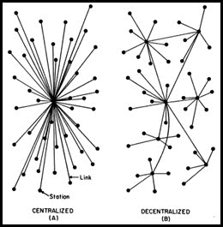
1. How decentralized can a country’s research be?
"Decentralization" by Adam Aladdin - Own work. Licensed under Creative Commons Attribution-Share Alike 3.0 via Wikimedia Commons - http://commons.wikimedia.org/wiki/File:Decentralization.jpg#mediaviewer/File:Decentralization.jpg

Slide 4
Enter the German research politics & funding system
Germany has a federal research system with many strong independent players (Helmholtz research centers, Fraunhofer, Max Planck, Leibniz, >400 state universities in 16 states...)
Centralized, nationwide research database (like in some Scandinavian and Eastern-European countries) seems unthinkable
Uptake of institutional CERIF-based research information systems (most commonly Elsevier Pure, Thomson Reuters Converis & QLEO FactScience) only since last 2-3 years

Slide 5

2. Why VIVO?
„AZ Why Ortsschild“ von Michael Fiegle - Eigenes Werk (Originaltext: „Eigene Fotografie“). Lizenziert unter Creative Commons Attribution-Share Alike 3.0 über Wikimedia Commons - https://commons.wikimedia.org/wiki/File:AZ_Why_Ortsschild.jpg#mediaviewer/Datei:AZ_Why_Ortsschild.jpg

Slide 6
Why VIVO?
Institutional level research data = invaluable
Don’t stop on that level: Discovery & connecting happens on community level
Use web (data, software, standards) as a tool!
Critical mass of potential VIVO users in EU
What to do about that?
We engage in CRIS standardization in GER
VIVO bootcamps in Hamburg (GER), Bath (UK)

Slide 7
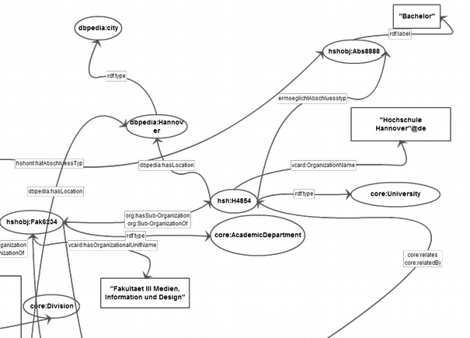
3. How many does it take to introduce a VIVO system?
Jakob Voss, RDF-Beschreibung der Fakultät III der Hochschule Hannover. https://github.com/hshdb/hsh-in-rdf/blob/master/images/rdf-beschreibung-der-hsh-fak-iii-updated.png

Slide 8
VIVO pilot at HsH (Univ of applied Sciences Hannover)
Next to Münster University: Second university in Germany aiming to go Linked Open Data
Aims to map all researchers, their publications and activities, partly including teaching (contents, time, locations)
Heavily involved with German localization of VIVO (ontologies & software)
Essentially the work of one librarian at HsH

Slide 9
VIVO pilot at HsH (Univ of applied Sciences Hannover)
Next to Münster University: Second university in Germany aiming to go Linked Open Data
Aims to map all researchers, their publications and activities, partly including teaching (contents, time, locations)
Heavily involved with German localization of VIVO (ontologies & software)
Essentially the work of one librarian at HsH*
*Who’s name is Christian Hauschke

Slide 10
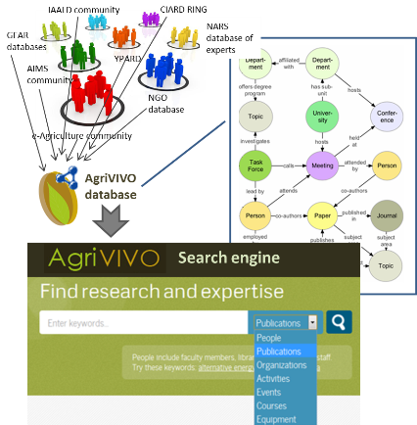
4. Why do we need many many more AgriVIVOs?
From: AgriVIVO. In: GFAR, The Global Forum for Agricultural Research (Website). http://www.egfar.org/information-gateway/ar4d-information-gateway/agrivivo

Slide 11
Prototype of an VIVO harvester in Germany
2013: We need something like AgriVIVO!
Mainly involved: Ina Blümel & Gabriel Birke (both TIB Open Science Lab)
Will go public by end of 2014
Mostly unstructured data scraped from Leibniz research association “Science 2.0” association
First lesson learned: Need to teach & help institutions to use simple semantic markup (like schema.org) and persistent IDs / links

Slide 12
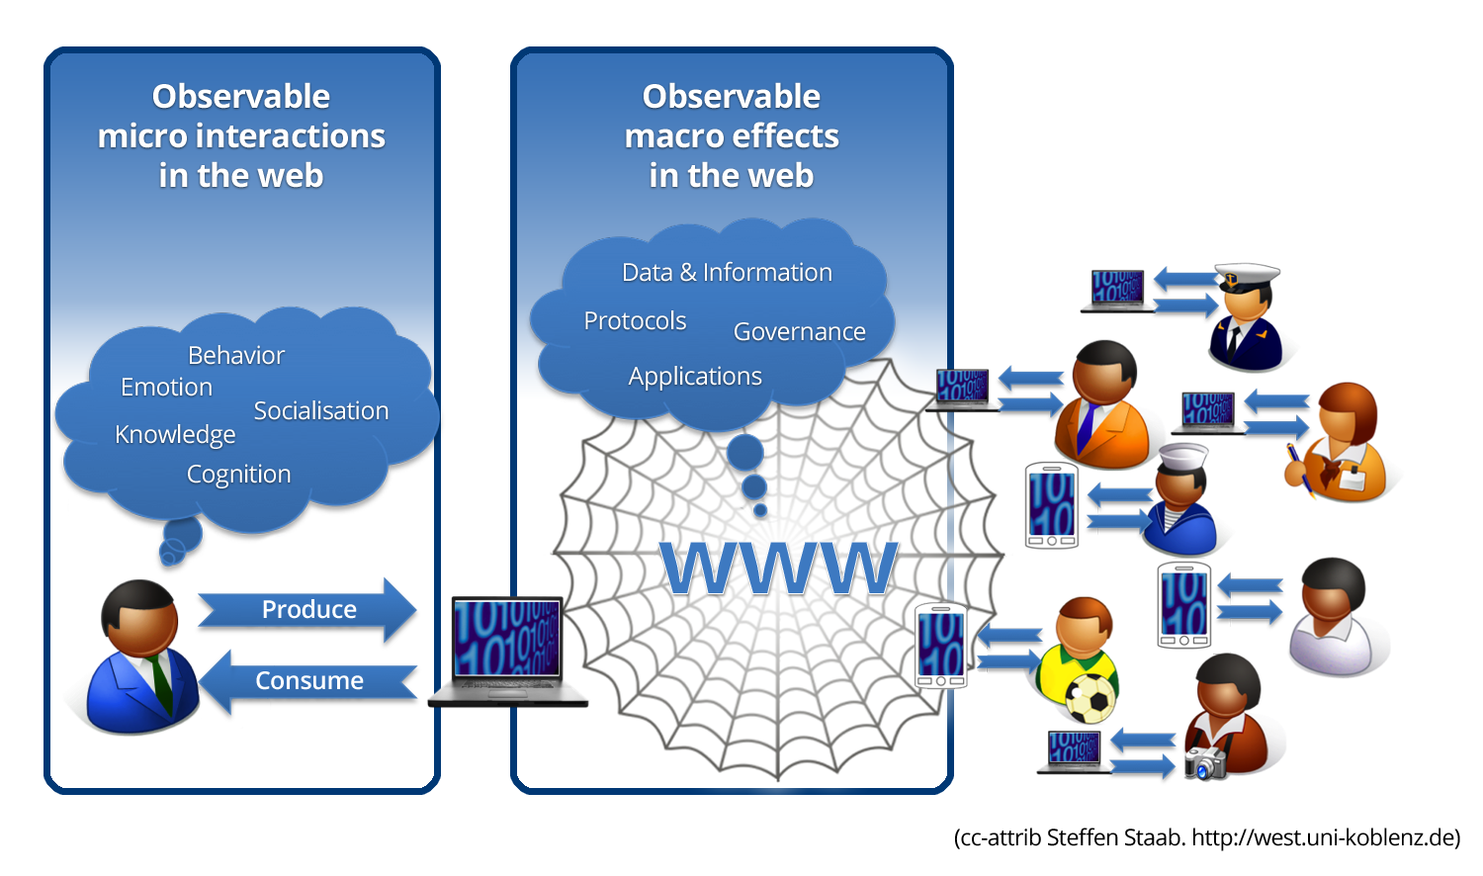
5. More web science, more data, even better VIVO?
"Human Behavior Co-constituting the Web" by SteffenStaab - I made the diagramme for my lecture "Introduction to Web Science"Previously published: It has not been published before today. Licensed under Creative Commons Attribution 3.0 via Wikimedia Commons - http://commons.wikimedia.org/wiki/File:Human_Behavior_Co-constituting_the_Web.png#mediaviewer/File:Human_Behavior_Co-constituting_the_Web.png

Slide 13
Our R&D projects together with Robert Jäschke (L3S)
DFG-proposal “German Academic Web”: Crawl of all german academic websites every month, pipeline to get (some) structured data out. Awaiting funding decision in September 2014.
Call for master-thesis “VIVO-CS”: Implement a VIVO based on researcher profiles from DBLP including data from their Twitter profiles.
…and (most probably) more to come. ☺

Slide 14


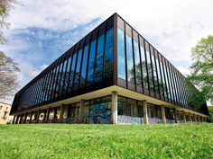



Thank you for your attention!

