Slide 1
Promoting ORCID Adoption in the Academic Institutional Ecosystem: A Progress Report Boston University
Christopher Shanahan MD MPH
Faculty Lead, Research Networking, BU CTSI
ORCID | 0000-0001-9067-5922

Slide 2
ORCID Integration Team
Peter Flynn II (ORCID Technical Lead)
Senior Application Developer, BUMC IT App Svcs / pflynn@bu.edu
Marco Basta
Senior Application Developer, BUMC IT App Svcs / bastam@bu.edu
Karim Kabbara
Senior Application Developer, BUMC IT App Svcs / kkabbara@bu.edu
Jim Vlachos
Application/Web Specialist, BUMC IT App Svcs / jvlachos@bu.edu
Christopher Shanahan MD MPH (Project leader)
Faculty Lead, Research Networking, CTSI, BUSM / cshanaha@bu.edu
Christopher Dorney (Project Co-leader)
Director, BUMC IT Application Services / dorney@bu.edu

Slide 3
Boston University
Medical (BUMC) campus
Schools of Medicine, Public Health & Dentistry
Boston Medical Center (BMC)
Charles River Campus (CRC)
Non-Medical Sciences, Humanities, etc.
Boston VA Healthcare System
West Roxbury, Jamaica Plain, Bedford

Slide 4
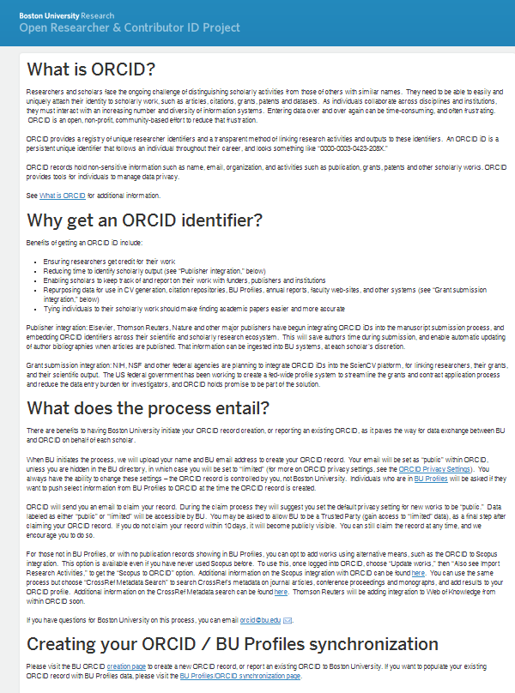
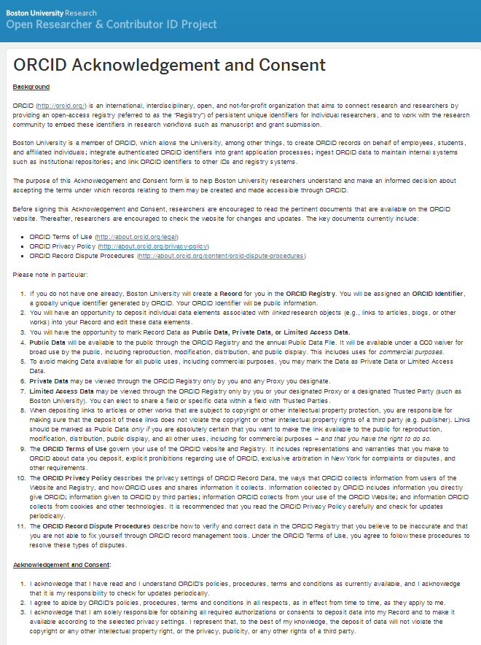
Informational / Gateway Web Pages
http:/sites.bu.edu/orcid/ http://sites.bu.edu/orcid/agreement/
Notes:
We integrated the ORCID API into BU Profiles to enable individuals to create own ORCiD using data from BU HR data or via BU Profiles (which additionally has employment and education hooks)
We provided Web pages to facilitate ORCID Registration & Signup

Slide 5
ORCID ↔ BU Profiles Integration
Through Profiles, users can create a new ORCID or report an existing ORCID
Can create or update ORCID from exiting Profiles data (e.g. works (publications), websites, bio (narrative), employment , education)
User’s ORCiD is associate with their unique university ID
An institution’s Profile roles are mapped to ORCID privacy levels.
ORCID hyperlink publicly displayed in BU Profiles
Bulk ORCID creation by admin (by school, dept., person-type, etc.).
Notes:
Users logged in to Profiles & editing their profile can:
Through Profiles, users can create a new ORCID or report an existing ORCID Can create or update ORCID from existing Profiles data § works (publications), websites, bio (narrative), employment , education o User’s ORCiD is associate with their unique university ID o An institution’s Profile roles are mapped to ORCID privacy levels. o Bulk ORCID creation by admin (by school, dept., person-type, etc.). o ORCID hyperlink publicly displayed in BU Profiles

Slide 6
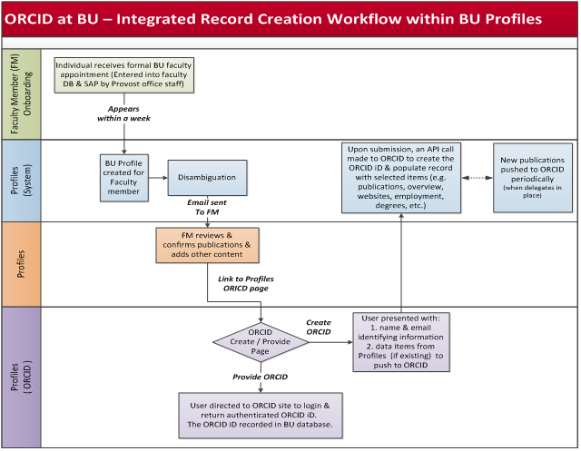
Notes:
Faculty Record Creation (Workflow)
Individual receives BU academic appointment
Appointment registered into faculty database & SAP by Provost office staff
BU Profile created for new faculty member within a week of academic appointment.
BU Profiles disambiguation engine
produces publication list for faculty profile.
Faculty receives email notice to:
login in to BU Profiles
review profile
confirm publications
add content (narrative, websites, awards, etc.)
Faculty review their pubs in Profiles (with disambiguation picking up new pubs since most come via PubMed)
give them time to validate
then push to ORCID

Slide 7
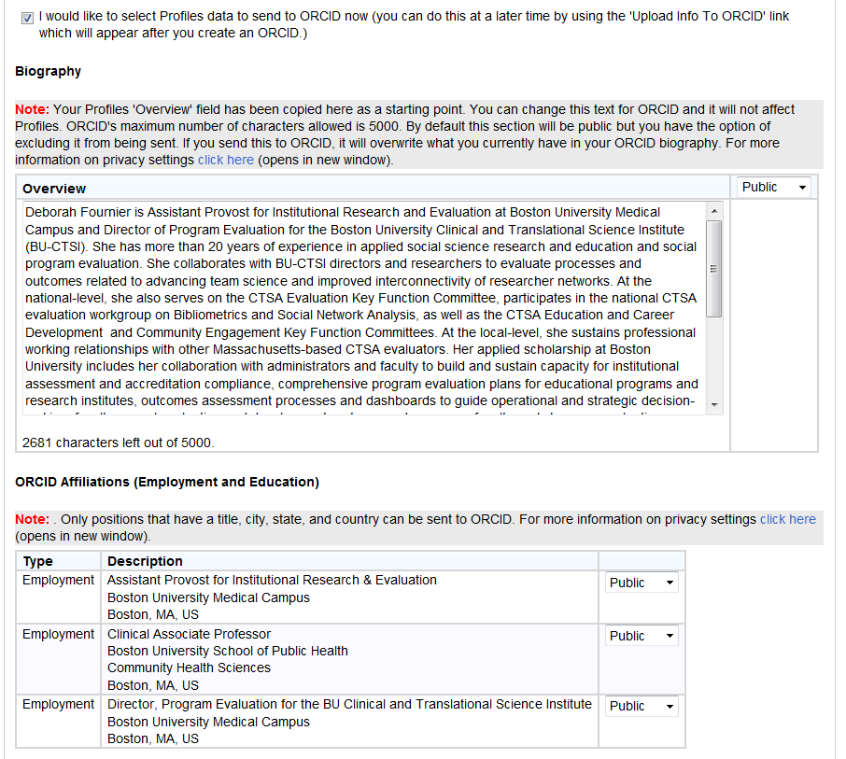
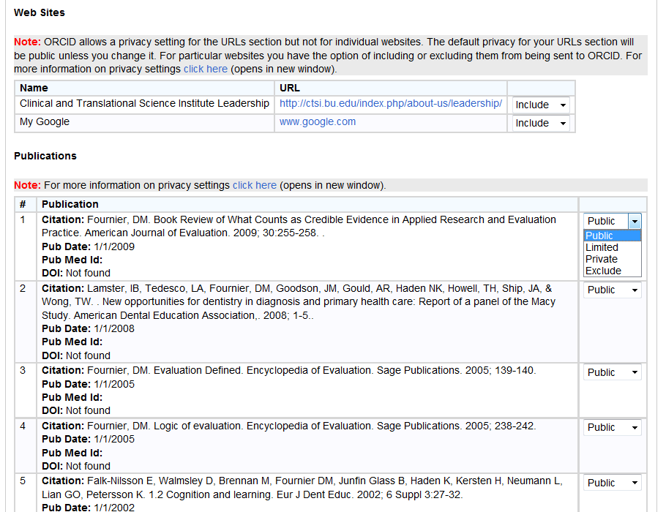
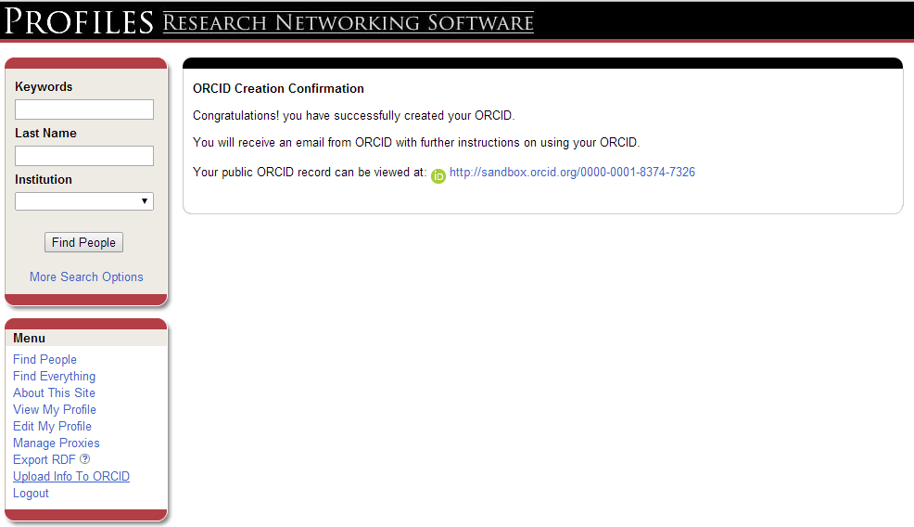
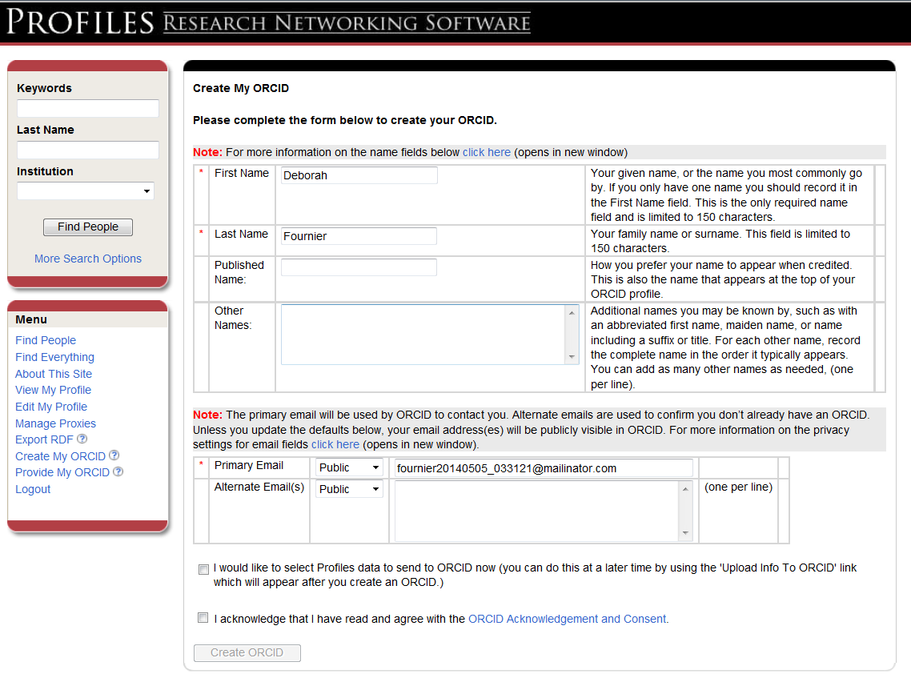
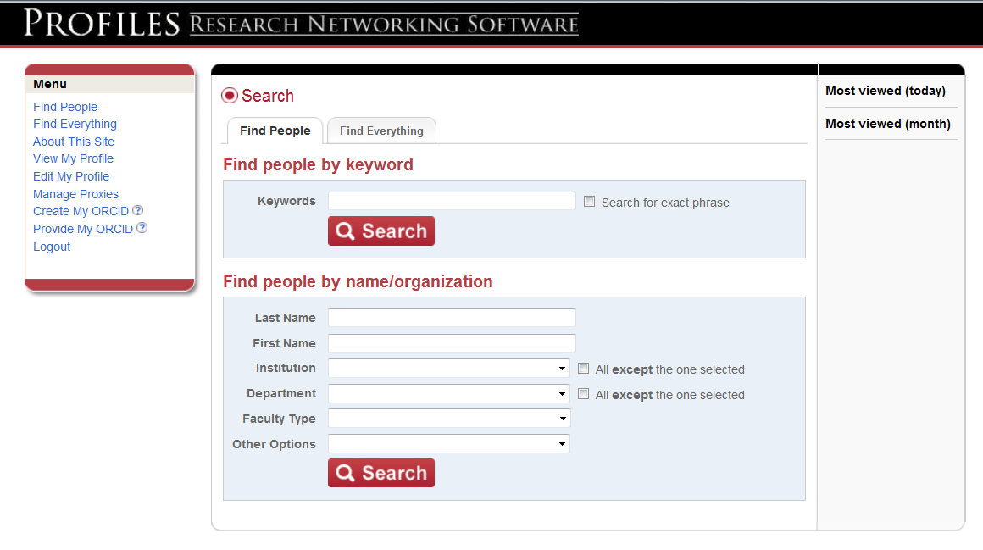
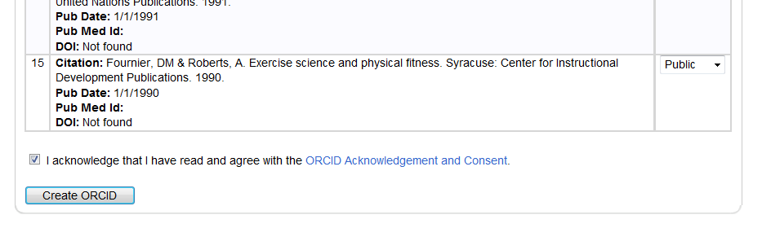
Notes:
From BU Profiles Menu can
Create My ORCID
Provide My ORCID

Slide 8
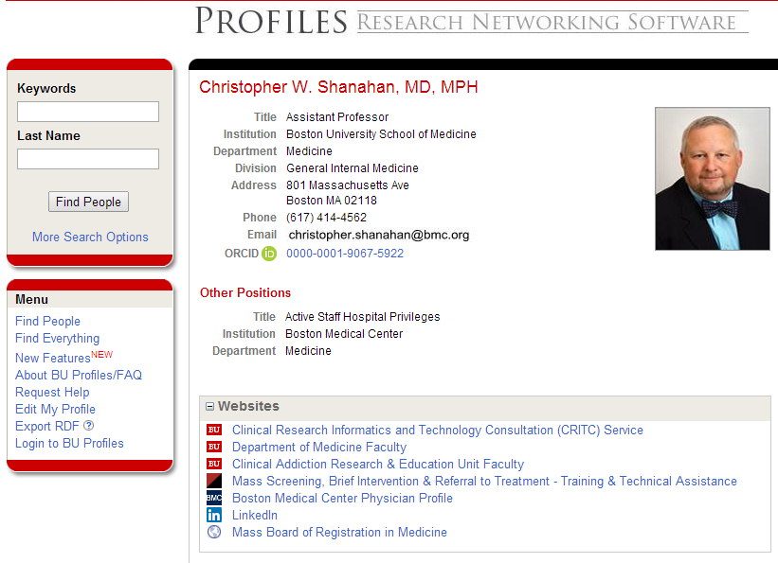
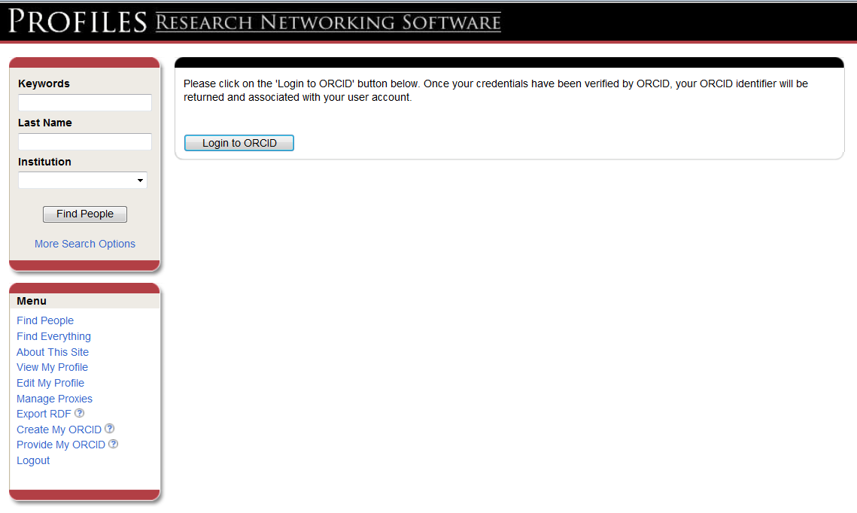

Slide 9
Workflows: New Faculty, Post-Docs, Graduate & Undergraduate Students
Records initially created for all BUMC faculty
On-boarding process identifies new faculty for ORCID creation.
Records eventually to be created for all BU faculty
To decrease # of faculty approvals, BU awaiting ORCID delegate information to be sent through the API before large scale creation of new ORCID records across BU.
BU will work to increase Faculty claim rate when widespread updates routine, claim workflow smooth & sustainable,.
Tracking & reporting of academic outcomes
Create/Track ORCID IDs for every researcher (faculty & students)
Target individuals at BU nearing departure (e.g. graduation).
For internal & external tracking/reporting (e.g. training grant proposals, etc.)
Notes:
If they are available in the GUI (not the API – that will take longer) we would consider doing larger #s of updates.
Bottom line: We will need to see more about how delegates will work within ORCID before we can do widespread updates.

Slide 10
Leadership Engagement & Policy
Engaged Medical Campus Provost Council members
Can make high-level decisions (e.g. Faculty opt-out; opt-in for others).
Reviewed ORCID policy & implementation plan
Established Universal Opt-out for FT Medical Campus Faculty
Endorsed recommendation to start at the medical campus
Easier to push pub data for faculty & postdocs in BU Profiles.
Enlisted BU General Counsel
Reviewed ORCID policy & implementation plan
Created the BU ORCID Acknowledge & Consent
Describes ORCID terms of use, privacy policy and, record dispute procedures, privacy levels, what to expect, & how data might be used.
Enrollment Approach:
Opt out:
FT & PT BUMC faculty may opt-out of ORCID.
For BUMC faculty not opting out, ORCiDs records created/prepopulated from BU Profiles
One (1) of 1616 eligible faculty opted out
55 eligible individuals had an existing ORCID.
Notes:
Talk through (no slide) what we did at BUMC to target faculty as opt out and postdocs AND don’t forget predocs upcoming as opt in.
Then talk about the ongoing efforts of CRC faculty, graduates and UROP. I don’t think you really need the UROP details in 19, unless you are going really fast. Maybe leave it in the deck and skip it if you are behind, in favor of slide 20, which is more valuable.

Slide 11
Researcher Participation / Outreach
Communications (eMail)
ORCID Opt-Out policy to FT Medical Campus Faculty via Provost ( ↑ likelihood read/acted on)
In-person Introductory Presentations:
Faculty
Graduate Students/Fellows & Post-Docs
Medical Students
Provosts
Deans
General Faculty Meetings
Faculty Development Conferences

Slide 12
Undergraduate Research Opportunities Program (UROP) – (In Development)
Three applications cycles (Sept., Dec., March)
Acceptance paperwork will require ORCID sign up.
1. Please supply your ORCID # http://sites.bu.edu/orcid/creation/
2. Don't know what ORCID http://sites.bu.edu/orcid/ )
3. Don't have an ORCID # Register & Claim one here. http://sites.bu.edu/orcid/creation/
Considering brief informational or enrollment events
"Establish your Scholarly / Professional Identity with ORCID" (a’la Texas A&M University)
Brief introduction to Research Networking at BU

Slide 13
Future Opportunities
BU Engineering
special test using ORCID to create BU Profiles
Grad students
Thesis submissions system
BU Library:
Discussing ORCID integration with Library citation/digital repository.
Dependent upon increase in ORCID functionality:
Grant, employment, & education data exchange

Slide 14
Thank you

