Slide 1
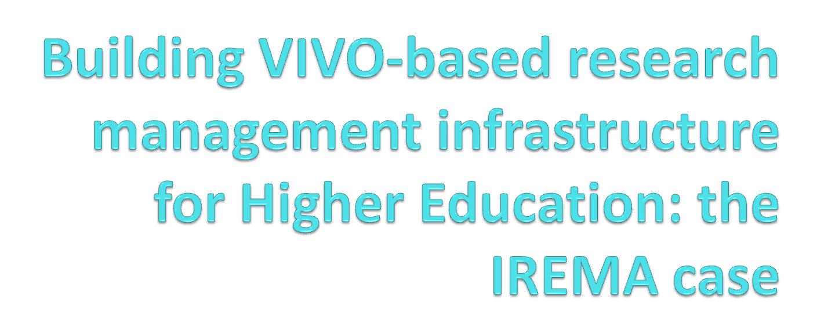
Anastasios Tsolakidis, Cleo Sgouropoulou, Evangelia Triperina, Panos Kakoulidis and Dimos Triantis

Slide 2
Overview
Introduction
Extension to VIVO ontology
IREMA system
Connecting VIVO & IREMA

Slide 3
Introduction
The aim of our system is
to offer a solution for the management and the
manipulation of academic information for evaluation
and quality assurance of academic institutions.
Notes:
Useful deductions can be derived by information about academic activities and collaborations
This information can be reused for quality assurance, strategic planning, dissemination of academic results, etc.

Slide 4
VIVO & AcademIS ontology
VIVO ontology:
  includes all the research information
  includes information about education in HEIs
AcademIS ontology:
  extension to the VIVO ontology
  includes all the educational information
  connections between research & education
  information about the quality management of academic setting

Slide 5
Extension to VIVO ontology – The AcademIS ontology
Several of the most important features of our extensions are the following:
Education:
Educational resource
Learning method
Evaluation process
Research:
Citations count
Outsourcer

Slide 6
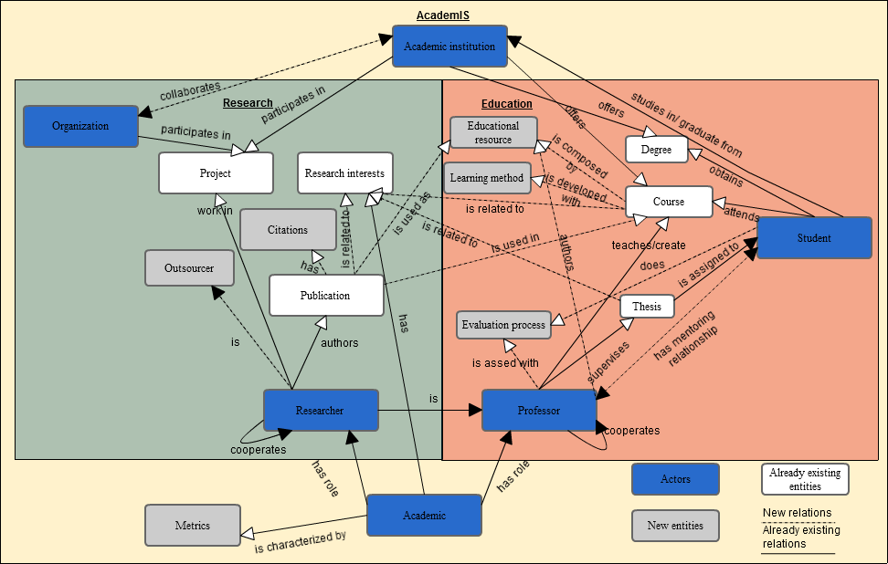
Extension to VIVO ontology – The AcademIS ontology

Slide 7
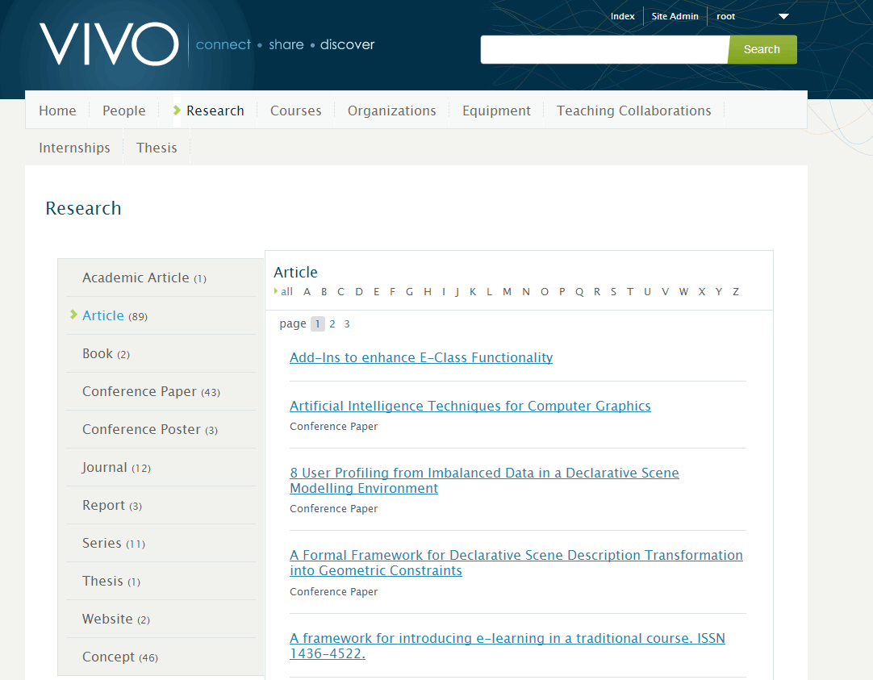
VIVO instance

Slide 8
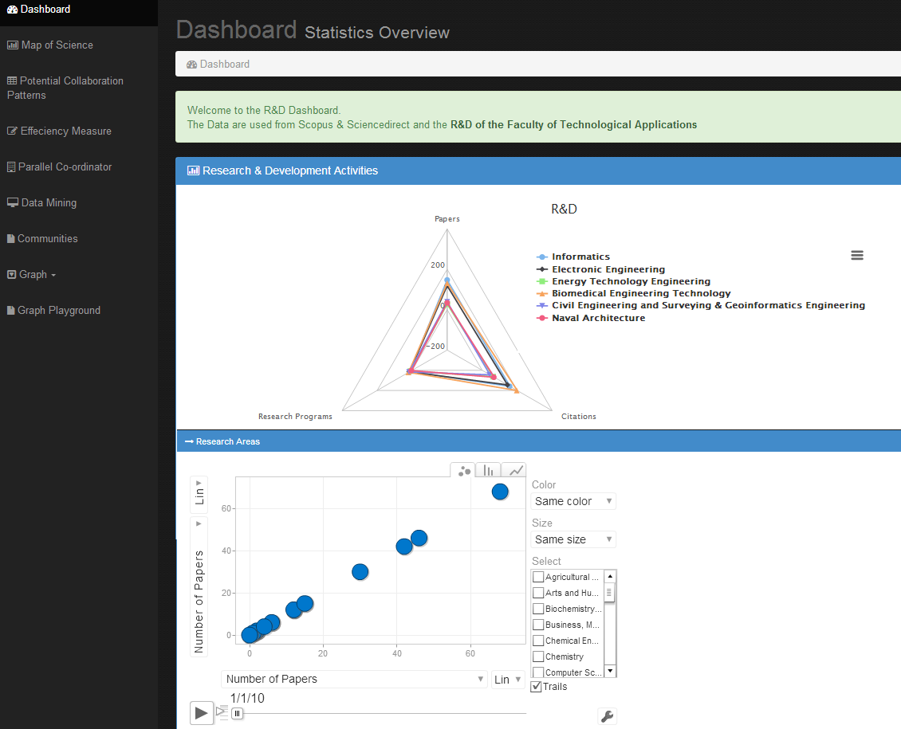
IREMA

Slide 9
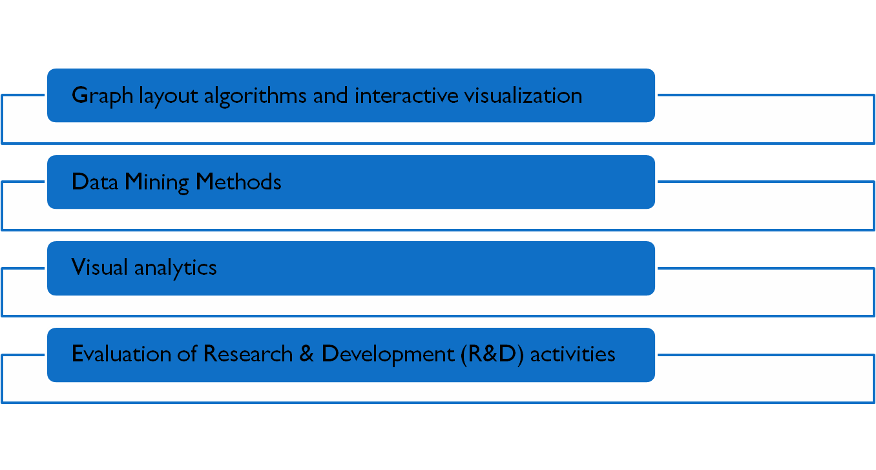
IREMA

Slide 10
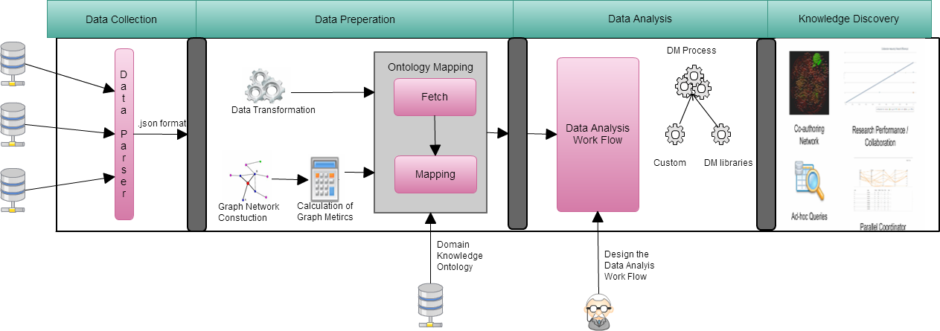
Ontology-centric decision support system
Notes:
Our system consists of 4 layers/each one of the layers communicate using web services.
Initially we have the data collection layer, where we have implement a parser in order to read data from different data sources as web services , xls,bib files or to establish a jdbc connection. and all of those data are transformed in .json format.
Then we have implanted the data preparation layer where data are praperated in order to be used to the analtysis layer. In this stage we calculate the graph metrics as the calculation of them is time consuming. Also in this stage the data are mapped on the ontology which specify a specific domain. When we have completed the mapping, our data are ready to be used fro the data analysis.
In this layer we have palced all the dm methods that our system include. Our system has a modular architecture so any dm method or nay dm linrary could be integrated in our system.
Also in this stage there exist a dm expert who set the workflow of our data analysis. Suppose for example that we want to examine the colaration among rd produvtivity and collaboration among the fm of an institute. In order to provide ansewer to such a question we have to design a work flow which consist of the calculation of the efficiency scores , the execution of the k-means clustering based on the graph metrics and finally the representation using a chart. All of those steps of the workflow have been modeled from an expert and implemnetd using aour systems.
So everyone how would like to observe the rcorrelation among those two indicators should have to use the wf that has previously designed from the expert.
So to come back in our architecture we have the data anaylsis layer which include work flows and data mining methods and the last layer which conssits of a variety of interactive representations

Slide 11
Institutional Research Management
Management functions | Key features | Types of network
Individual productivity assessment | Identify the collaborative roles an individual researcher plays in the collaboration network Analyze a researcher's collaboration patterns | Co-authorship network Parallel Coordinators
Collaboration group analysis | Identify the most active research topics/areas Identify the most cohesive collaboration research groups within the department/university | Co-authorship network Topic network Map of Science
Researcher-theme path analysis | Determine a core group of researchers to connect different research topics Discover new collaboration opportunities by connecting researchers with the same research theme and by recommending promising themes to key group of researchers | Author–topic network
Notes:
we will present our approach based on four key management functions as those described on Table 1.
Based on the r&d activities we use the authors‘ social network data as an example to demonstrate the
social network approach for research management.

Slide 12
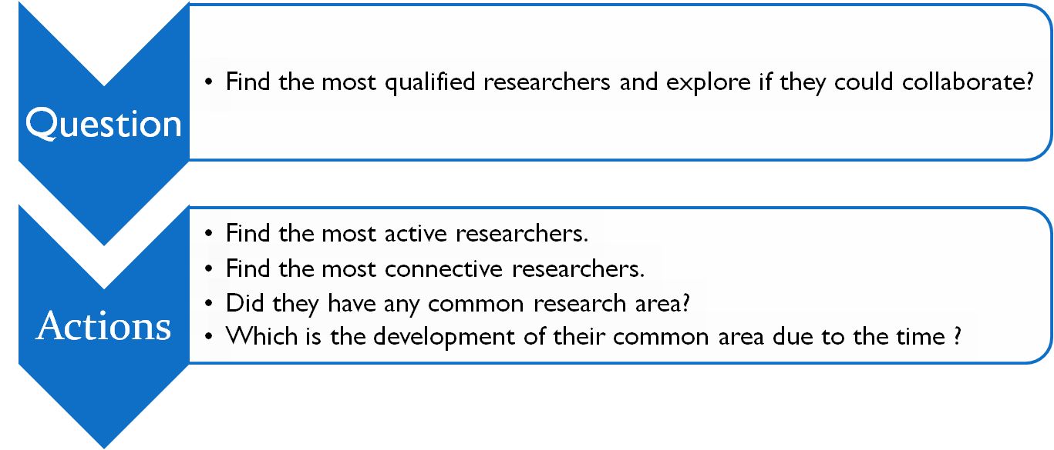
IREMA
Gives answers to meaningful questions

Slide 13

IREMA
Find the most active researchers.

Slide 14
IREMA
Find the most connective researchers.

Slide 15
IREMA
Did they have any common research area?

Slide 16
IREMA
Which is the development of their common area due to the time ?

Slide 17
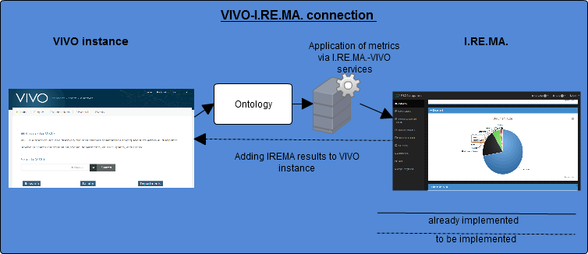
The role of the ontology in IREMA
IREMA uses the AcademIS ontology as the infrastructure for the institutional management.
AcademIS ontology (our extension to VIVO) is also utilized as a mean for the connection between VIVO and IREMA.

Slide 18
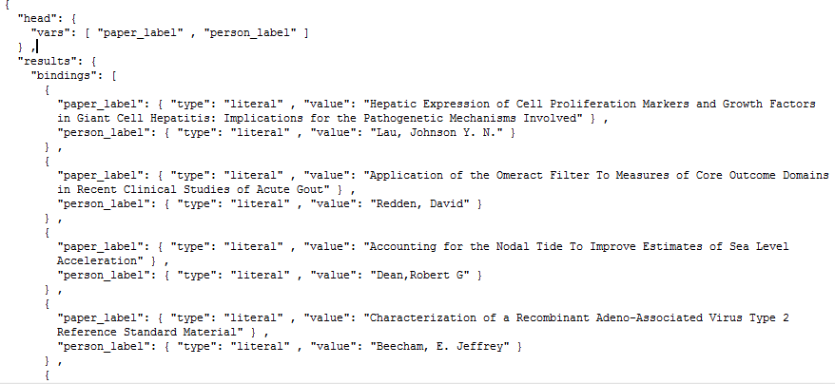
VIVO-IREMA in details
Step 1: Data Collection
Notes:
First, we collect data from public databases such as ISI's Web of Knowledge database and Elsevier's Scopus. We extracted information such as titles, authors and affiliations, abstracts, keywords, citation information etc. We next perform data cleaning to represent data in our standard format. This will avoid the data duplication problem due to different data storage formats used in different databases, which may lead to wrong article retrieval to authors' publications.

Slide 19
Institutional REsearch Management
Step 2: Data Preparation
Web Service Calls:
$.postJSON('/ViVo-Irema/rest/api/upload', ….)
  Construct the network (nodes-edges)
Notes:
First, we collect data from public databases such as ISI's Web of Knowledge database and Elsevier's Scopus. We extracted information such as titles, authors and affiliations, abstracts, keywords, citation information etc. We next perform data cleaning to represent data in our standard format. This will avoid the data duplication problem due to different data storage formats used in different databases, which may lead to wrong article retrieval to authors' publications.

Slide 20
Institutional REsearch Management
Step 3: Data Analysis
Web Service Calls:
$.postJSON('/ViVo-Irema/rest/api/creategraph', ….)
  Calculate the graph Metrics
  Create the .gexf file
Notes:
First, we collect data from public databases such as ISI's Web of Knowledge database and Elsevier's Scopus. We extracted information such as titles, authors and affiliations, abstracts, keywords, citation information etc. We next perform data cleaning to represent data in our standard format. This will avoid the data duplication problem due to different data storage formats used in different databases, which may lead to wrong article retrieval to authors' publications.

Slide 21
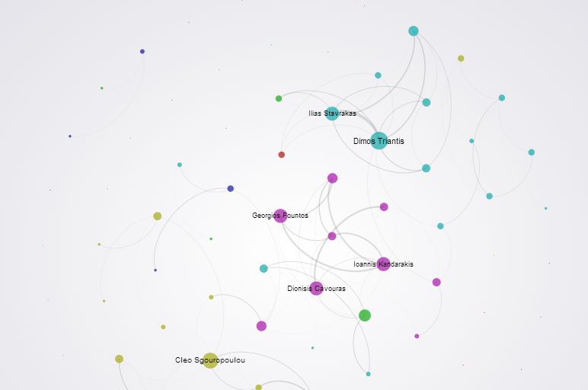
Institutional REsearch Management
Step 4: Data Visualization
Web Service Calls:
'/ViVo-Irema/graphview.html'
Notes:
First, we collect data from public databases such as ISI's Web of Knowledge database and Elsevier's Scopus. We extracted information such as titles, authors and affiliations, abstracts, keywords, citation information etc. We next perform data cleaning to represent data in our standard format. This will avoid the data duplication problem due to different data storage formats used in different databases, which may lead to wrong article retrieval to authors' publications.

Slide 22
Conclusion
Our system:
builds upon the renowned ontology VIVO-ISF & extends it,
uses the sharable and reusable linked data produced by the VIVO semantic web application, and
implements web services that are supplied by VIVO to meet the existing needs in the academic setting.

Slide 23
Future work
Addition of VIVO-I.RE.MA. metrics to VIVO instances
Visualization analysis for :
  educational activities & collaborations
  the connections between education & research
via VIVO-IREMA services
Data analysis endpoint (api) for VIVO instances

Slide 24


Any questions?

Slide 25

Anastasios Tsolakidis , atsolakid@teiath.gr
Cleo Sgouropoulou, csgouro@teiath.gr
Evangelia Triperina , evatrip@cs.teiath.gr
Panos Kakoulidis, pk88gr@hotmail.com

