Slide 1
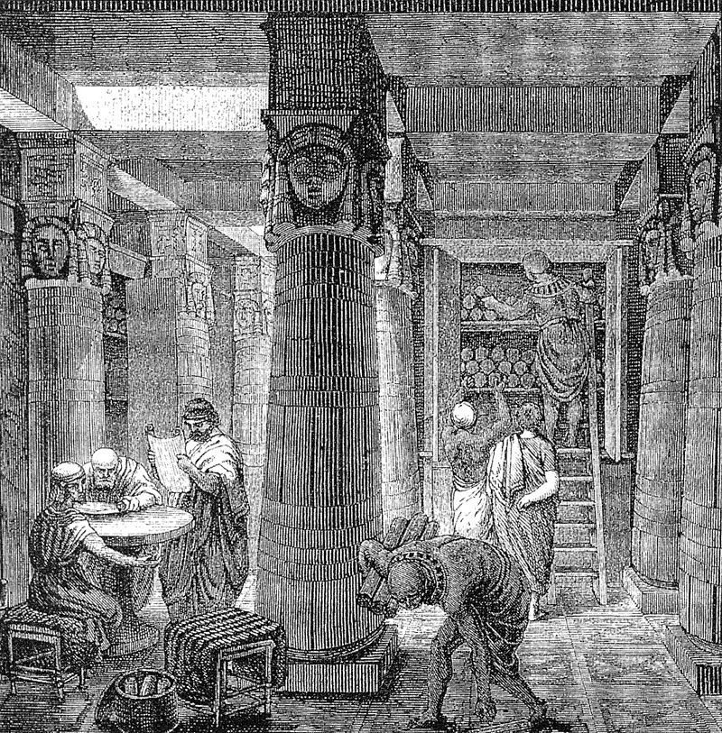
The stewardship challenges of long term open scholarship
An open access institutional repository perspective
Simone Sacchi
Amy Nurnberger
VIVO 2014: August 7, 2014
This work is licensed under a Creative Commons Attribution
4.0 International License.
Notes:
When I was looking for an image that said [title] I noticed an important oversight in our title, one that is instrumental in differentiating what we are here to talk about over these two days and, say, the Library of Alexandria

Slide 2
The stewardship challenges of long term open scholarship
digital
^
An open access institutional repository perspective
Simone Sacchi
Amy Nurnberger
VIVO 2014: August 7, 2014
This work is licensed under a Creative Commons Attribution
4.0 International License.
Notes:
That said, Knowing the broad variety that the phrase open access IRs indicates here’s a bit of perspective on who we are and our perspective:

Slide 3

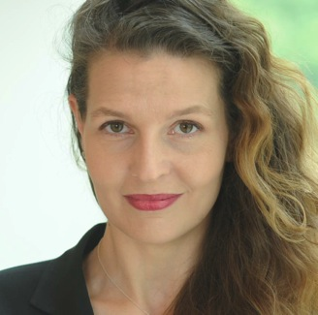
Context
Simone Sacchi, Research and Scholarship Initiatives Manager
@ScholComm @simosacchi
Amy Nurnberger, Research Data Manager
@DataAtCU @anurnberger
Notes:
Simone is unfortunately unable to be here today, and any misstatements or errors of communication are wholly mine.
----- Meeting Notes (8/6/14 10:44) -----
Simone & I are part of the Center for Digital Research and Scholarship

Slide 4



Context
Notes:
----- Meeting Notes (8/6/14 10:44) -----
Which is part of the Columbia University Libraries 7 Information Services

Slide 5


Context
Digital Programs & Technology Services
Collections & Services
Bibliographic Services & Collection Development
Notes:
----- Meeting Notes (8/6/14 10:44) -----
Which, as the name suggests is part of columbia university

Slide 6

Context
Digital Programs & Technology Services
Collections & Services
Bibliographic Services & Collection Development
Notes:
But not just columbia unviersity, because columbia university has a lot of affiliates

Slide 7




Context
Digital Programs & Technology Services
Collections & Services
Bibliographic Services & Collection Development
Notes:
Part of the center's work is hosting

Slide 8

Context
Digital Programs & Technology Services
Collections & Services
Bibliographic Services & Collection Development
Notes:
the institutional repository, Academic Commons, which serves all of these bodies
So, what is Academic Commons

Slide 9
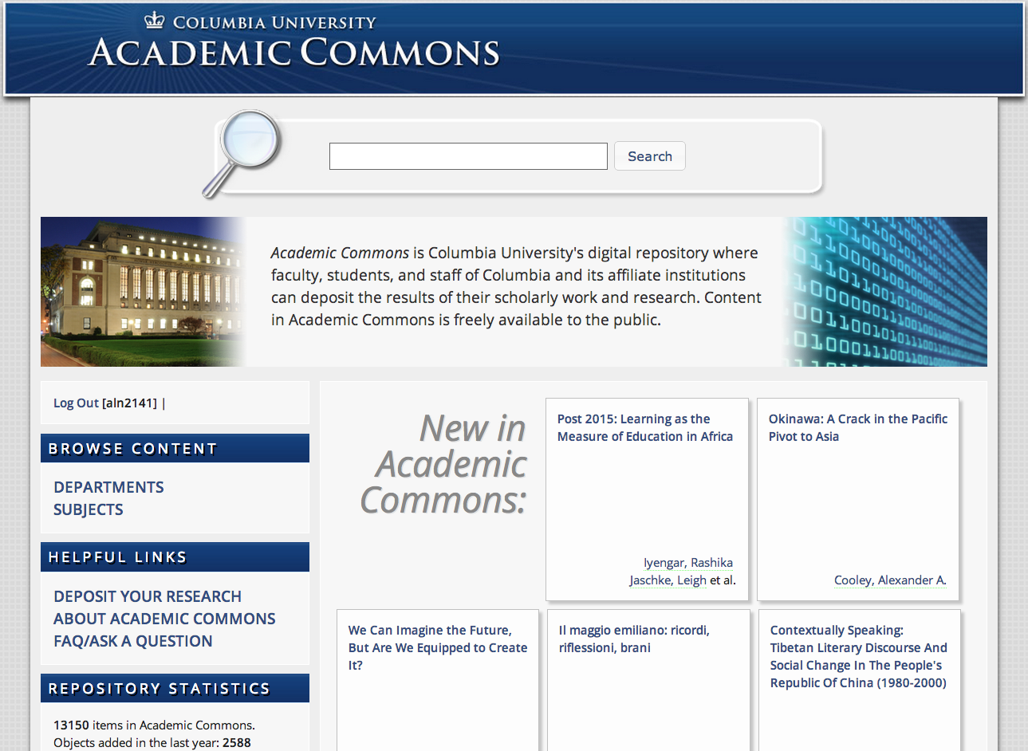
Context
An expression of Columbia’s research
A collection of digital research outputs
A place of preservation and access
The mission:
Academic Commons collects and stores the digital outputs of research and scholarship produced at Columbia University and its affiliates and presents them to the broadest possible audience.
Notes:
AC is a collection within the library of the digital research output of Columbia University & its affiliates
We have the mandate to preserve the research output of Columbia and affiliated institutions,
not only to provide access here and now, but to preserve CU’s research outputs for the long term &
Not just to preserve those outputs for CU, but for the future use of researchers throughout the world
To support CU’s mission of “to advance knowledge and learning at the highest level and to convey the products of its efforts to the world.”
So what AC engages in is long term open scholarship

Slide 10
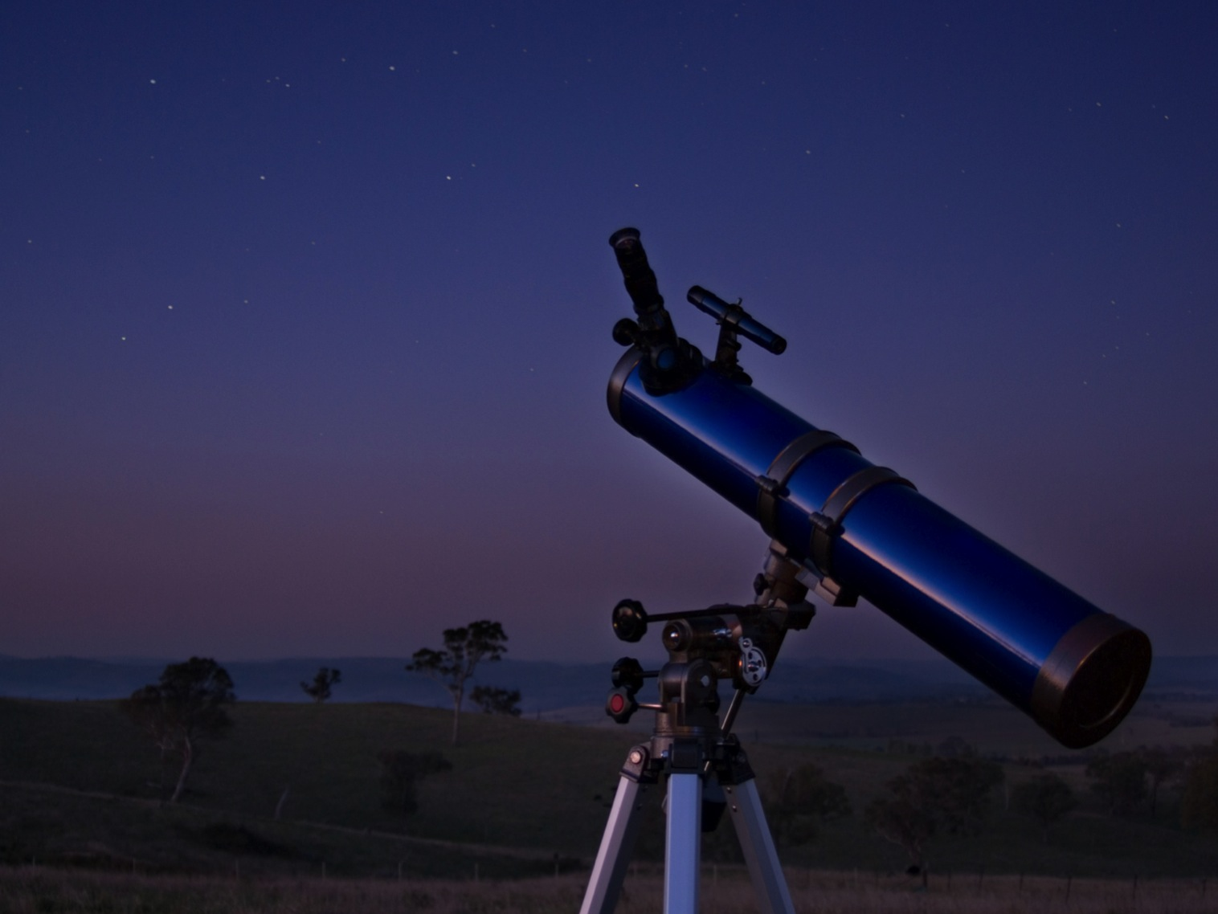
Opportunities
Scholarship advancement
Distribution
Access
Non-traditional digital scholarly works
Heterogeneity
Complexity
Metadata standardization
Federation
Lynch: http://dx.doi.org/10.1353/pla.2003.0039
Nelson: http://www.cs.odu.edu/~mln/ltrs-pdfs/NASA-2001-tm211426.pdf
Notes:
As with many other IRs, we face many of the opportunities picked out of the firmament in the early 2000s by Lynch, Nelson, and others
and of course with great opportunities

Slide 11
Opportunities
Scholarship advancement
Distribution
Access
Responsibilities
Long term preservation Stewardship
Non-traditional digital scholarly works
Heterogeneity
Complexity
Collection development and curation
Technological change management
Metadata standardization
Federation
Lynch: http://dx.doi.org/10.1353/pla.2003.0039
Nelson: http://www.cs.odu.edu/~mln/ltrs-pdfs/NASA-2001-tm211426.pdf
Notes:
Of course, with opportunities come great responsibilities
And over the years carrying out these responsibilities especially managing technological change,

Slide 12
Opportunities
Scholarship advancement
Distribution
Access
Interoperability
Responsibilities
Long term preservation Stewardship
Non-traditional digital scholarly works
Heterogeneity
Complexity
Collection development and curation
Technological change management
Metadata standardization
Federation
Relationship representation
Lynch: http://dx.doi.org/10.1353/pla.2003.0039
Nelson: http://www.cs.odu.edu/~mln/ltrs-pdfs/NASA-2001-tm211426.pdf
Notes:
has provided new responsibilities

Slide 13
Opportunities
Scholarship advancement
Distribution
Access
Interoperability
Responsibilities
Long term preservation Stewardship
Non-traditional digital scholarly works
Heterogeneity
Complexity
Collection development and curation
Technological change management
Metadata standardization
Federation
Relationship representation
Lynch: http://dx.doi.org/10.1353/pla.2003.0039
Nelson: http://www.cs.odu.edu/~mln/ltrs-pdfs/NASA-2001-tm211426.pdf
Notes:
And as we look at these opportunities through the lenses of our associated responsibilities as IRs, they become something different, something more, not just the simple points of light and possibility indicated by distribution or access, but something more complex

Slide 14
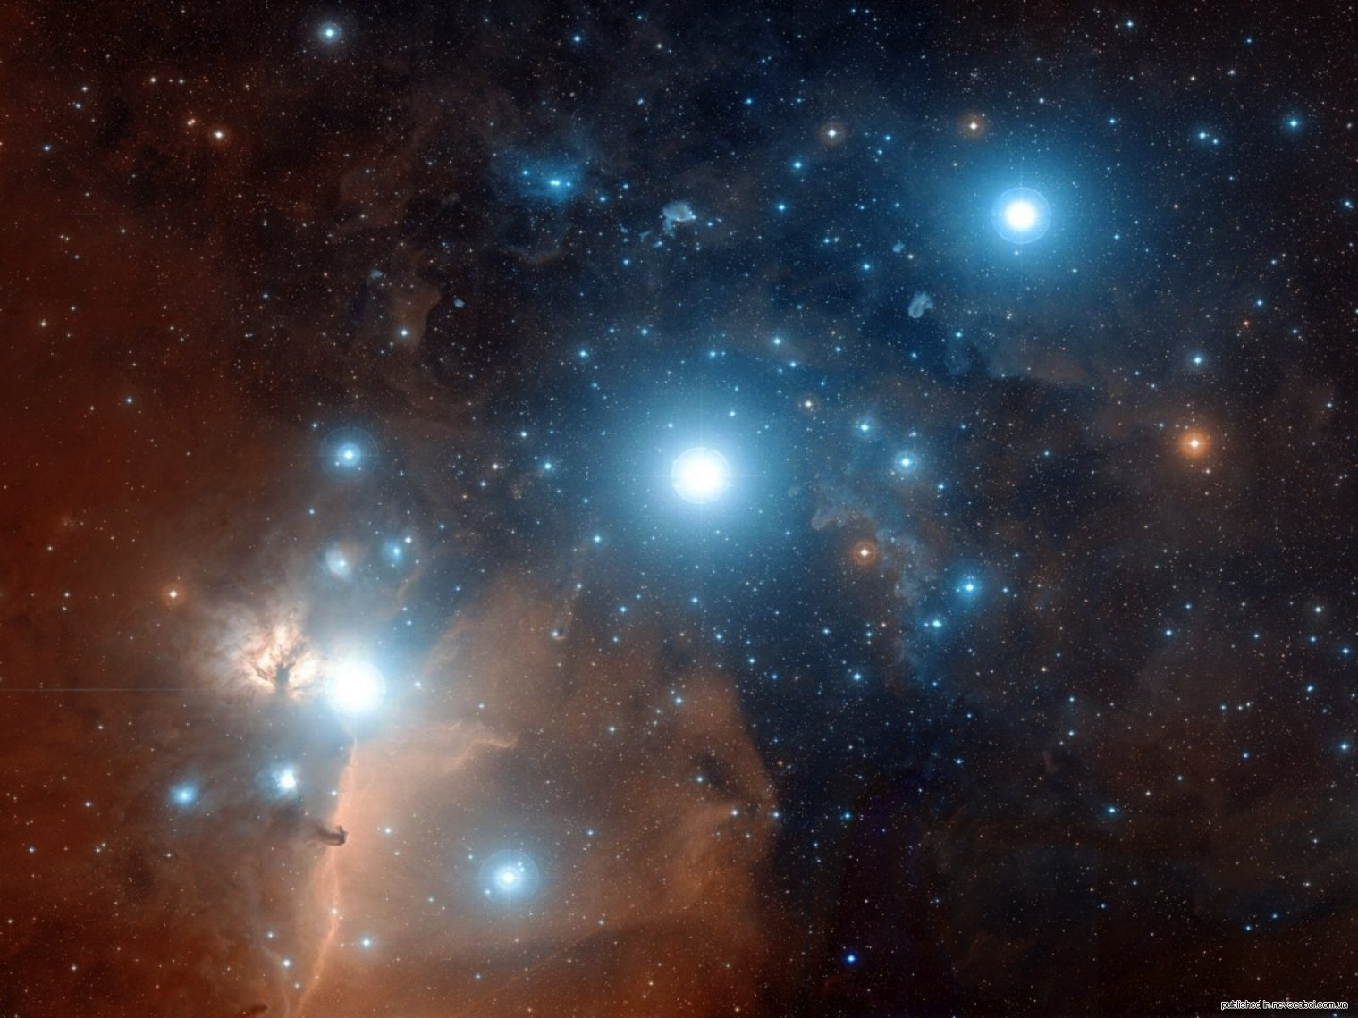
Use outside original context
Reuse with different technology
Evolving user expectations
Notes:
It’s not enough that objects are discoverable and accessible they need to be for the long term.
We have to expect material to be used outside of the original context of generation and development, to be adaptable to the the technological changes that make that possible and to be able to respond to changing user expectations who, even now our users are looking for in-repository capabilities of viewing and visualization in addition to being able to operate on data in a repository, and to have data be interoperable and semantically linked –
These are expectations for access where simple storage is not enough

Slide 15
Use outside original context
Reuse with different technology
Preservation length
De-accessioning
Migration candidacy
Evolving user expectations
Notes:
When we’re considering Collection, it’s not just grab everything produced at the university but, resolving issues of assessment.
how long something should be kept, should it be kept, should it be migrated?

Slide 16
Use outside original context
Increasing heterogeneity & complexity
Preserving context
Reuse with different technology
Preservation length
De-accessioning
Migration candidacy
Evolving user expectations
Notes:
And the non-traditional scholarly & research outputs? They are not showing any sign of regressing to some type of mean or common standard at this point - more like they are undergoing their own Cambrian explosion with no KT extinction event in sight. And of course this affects

Slide 17
Use outside original context
Increasing heterogeneity & complexity
Preserving context
Reuse with different technology
Preservation length
De-accessioning
Which metadata
standardization?
Migration candidacy
Evolving user expectations
Metadata remediation
Notes:
Metadata, while progress has been made to identify basic necessary elements, If you take a look at the DCCs wonderful collection of standards, it is obvious that further action is required to continue the useful description and characterization of evolving objects

Slide 18
Use outside original context
Increasing heterogeneity & complexity
Preserving context
Reuse with different technology
Preservation length
De-accessioning
Relationship mapping
Which metadata
standardization?
Migration candidacy
Evolving user expectations
Metadata remediation
Semantic linking
Notes:
Which is instrumental in implementing the relationship mapping & semantic linking that are really necessary for broadly envisioned federation & interoperability
So, how do IRs continue to make the most of these opportunities while fulfilling their responsibilities and commitments to long term open access? In a word…

Slide 19
Definition
Institutional Repository Infrastructure
Notes:
Infrastructure: the contextual physical and organizational structure an enterprise operates within which supports and sustains the mission of a repository

Slide 20
Definition
Institutional Repository Infrastructure
Technology
Policies
Notes:
As with most infrastructure, this includes technology & policy But technology & policies don’t just happen, by themselves (oh, for the repository fairies that grant wishes)

Slide 21
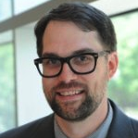

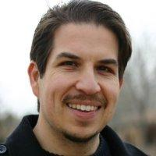


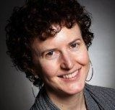
Definition
Institutional Repository Infrastructure
People
Technology
Policies
Notes:
– No, they are made possible by people with specific skills & understandings. And here is some representatives of the team that have helped Academic Commons deal with the challenges that those opportunities have presented. So, how have we dealt with the challenges of long term open scholarship?

Slide 22















Technology
The World (those with Internet access)
OAI-PMH
SEO:
Onsite Disk Array
Isilon storage
Offsite Tape Archive
➔MODS, RIOXX, DataCite
Ingest Services
Manual Metadata generation, sources:
Offsite Disk Array
Abstracts:
Authors OR Catalogers
Name & Funder authority:
Self deposit
CV Review
Outreach activities
SWORD from BMC
23665 Noun Project-Gubi Mann
Notes:
Let’s take the easy part first & talk technology.
Robust foundational storage
We have a Fedora-based repository which enables a great deal of content heterogeneity & complexity for the long term of unexpected developments
There is a selection of metadata schema we pull from to provide a standard of basic about the objects
Regarding access, we’ve done quite a bit with the Blacklight interface & and search optimization
There are a number of different collection modes
*just notes: shortfall: just storing the bits, not focusing on interoperability
Basic metadata doesn’t give as much for the facility of understanding context of production and enabling future reuse
and we’re working on developing linked open metadata w MODS-RDF & that project is being presented at IFLA in France, next week)

Slide 23
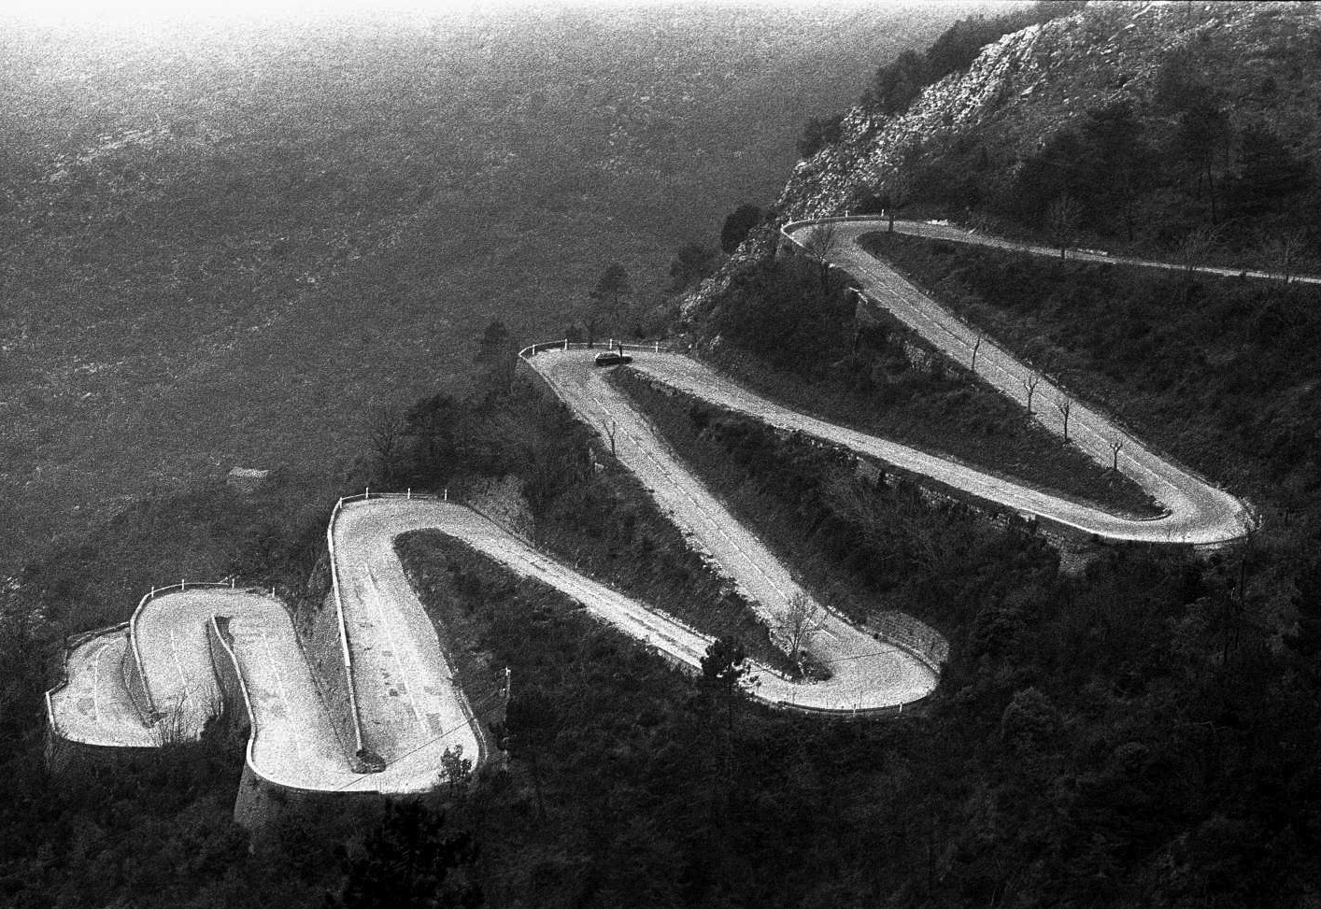
DSpace repository
Bepress repository
*not to time-scale
Notes:
So, here we are, we’ve rounded a few curves
Shared technology with the LDPD with a preservation-ready storage infrastructure
Separation of concerns between storage/preservation and access/discovery

Slide 24
Technology
Fedora
MODS, RIOXX, DataCite
Blacklight
Self-deposit & SWORD
Library IT
Heterogeneity
Standard metadata
Discovery & access
Collection active!
Long term storage and flexible tech
DSpace repository
Bepress repository
*not to time-scale
Notes:
And this is some of what out infrastructure has allowed us to accomplish
Shared technology with the LDPD with a preservation-ready storage infrastructure has really allowed us a large measure of flexibility by
Separating concerns between storage/preservation and access/discovery

Slide 25
Technology
Fedora
MODS, RIOXX, DataCite
Blacklight
Self-deposit & SWORD
Library IT
Heterogeneity
Standard metadata
Discovery & access
Collection active!
Long term storage and flexible tech
Policy
Depositor agreements
Re-use policy
Library publishing partner
Journal requirements
Funder mandates
DSpace repository
Bepress repository
*not to time-scale
Notes:
And here is part of our policy environment: , these occur at a variety of levels, moving from internal to external, with varying degrees of level and impact, and we are fortunate to have a fairly flexible local policy environment
Depositor agreements grant permissions,
Reuse policy places bounds on responsibility,
Library publishing partnership agreements support collections, a
nd Journal requirements & Funder mandates create expectations.

Slide 26
Paths not taken
*not to time-scale
Notes:
Of course, there’s always the conversation about the paths not taken, “Pat, if you had only turned left we wouldn’t have so much development work!” But really, that’s a different conversation, so let’s just move on to talk about how much further there is to go on this path.

Slide 27
*not to time-scale
Notes:
There are still a lot of areas that fall in the long-term stewardship area that are not addressed by our current implementations

Slide 28
Non-traditional digital scholarly works
Heterogeneity
Complexity
Federation
Scholarship advancement
Distribution
Access
Interoperability
Metadata standardization
Collection development and curation
Relationship representation
*not to time-scale
Notes:
So, to get to here, we’d really like to check off more of these boxes.

Slide 29
Policy
Robust policy statements
Depositor agreements
Institutional policy
Permit certification and listing
Address collection assessment
Define possible rights assertions
Explicitly permit migration & visualization
Enable data slices and transformation
Repository use as responsible research
Non-traditional digital scholarly works
Heterogeneity
Complexity
Federation
Scholarship advancement
Distribution
Access
Interoperability
Metadata standardization
✓
✓
✓
Collection development and curation
Relationship representation
✓
✓
*not to time-scale
Notes:
Policy
Robust– hits distribution, curation, access/interoperability
Depositor – that’s access and interoperability
Institutional – collection development

Slide 30
Technology
Display tools e.g. d3js
Multiple representations
Ingest APIs
Exposure APIs
Linked open data
MODS-RDF
Embedded displays and operations
Of metadata, of objects, of uses
Variety of incoming data, e.g. ELNs
For associated apps e.g. VIVO
For so many things…
Policy
Robust policy statements
Depositor agreements
Institutional policy
Permit certification and listing
Address collection assessment
Define possible rights assertions
Explicitly permit migration & visualization
Enable data slices and transformation
Repository use as responsible research
✓
Non-traditional digital scholarly works
Heterogeneity
Complexity
Federation
✓
✓
Scholarship advancement
Distribution
Access
Interoperability
Metadata standardization
✓
✓
✓
✓
✓
Collection development and curation
Relationship representation
✓
✓
*not to time-scale
Notes:
Technology
D3js and other tools – increase access through visualizations & interoperability
Multiple representations covers a lot of ground: from technical and rights metadata types to internal file structures of complex objects, like DH outputs, to different formats of the same resource, to employing IRs as publishing platforms
Linked Open Data for federation, metadata, characterization, and data itself - Barend Mons had a great presentation on this and its association with the concept of data that are FAIR: Findable, Accessible, Interoperable & Re-usable. But really, there is such power in semantically Linked data and the relationships it represents between objects, and especially between people.

Slide 31


People
Relationship representation
*not to time-scale
Notes:
These are the people that participate in the repository and are part of its infrastructure. This is where the greatest potential exists to push institutional repository development to the next level.
Shared development (??)

Slide 32
People
Relationship representation
*not to time-scale
Notes:
Increasing the strength

Slide 33
People
Relationship representation
*not to time-scale
Notes:
and variety of relationship representation provides both some of the strongest motivations to continue IRs as a locus of open long term scholarship, and some of the most powerful tools to realize these possibilities.
involvement of faculty, departments/schools and research administration who perceive the benefits of better relationship discovery tools, whether finding new collaborators or identifying new areas of possible research or developing new teaching endeavours, will push the bounds and transform the expectations of what IRs can and should do. And the Involvement of thoughtful and inventive people who can create solutions and implement them is necessary to make that happen
So just because we’ve checked off some boxes, doesn’t mean we’re done

Slide 34
Getting to the top of the mountain…
*not to time-scale
Notes:
this is a continuing conversation

Slide 35
Getting to the top of the mountain…
What are the technologies and policies IRs must put in place to successfully practice open-access-oriented long term digital stewardship?
How should IR infrastructure evolve to support effective representation of complex research outputs and their relationships for preservation and meaningful use and reuse in the long term?
Which technologies and policies found in domain repositories can IRs leverage?
*not to time-scale
Notes:
And, I’d like to continue the conversation with you now with these questions.
What are your thoughts?

Slide 36
Please respect the licenses
"The Great Library of Alexandria” by O. Von Corven https://commons.wikimedia.org/wiki/File:Ancientlibraryalex.jpg Public Domain
Lynch, C. A. (2003). Institutional repositories: Essential infrastructure for scholarship in the digital age. Portal : Libraries and the Academy, 3(2), 327-336. Retrieved from http://ezproxy.cul.columbia.edu/login?url=http://search.proquest.com/docview/216182966?accountid=10226
Nelson, M.L., Argue, B., Efron,M., Denn, S., Pattuelli, & M. C. et al (2001). A Survey of Complex Object Technologies for Digital Libraries. NASA/TM-2001-211426. http://www.cs.odu.edu/~mln/ltrs-pdfs/NASA-2001-tm211426.pdf
“Telescope” by Ryan Wick https://secure.flickr.com/photos/ryanwick/3461850112/ - flipped horizontally, CC-BY 2.0
“Orion Belt” by Davide De Martin (http://www.skyfactory.org ); Credit: Digitized Sky Survey, ESA/ESO/NASA FITS Liberator http://apod.gsfc.nasa.gov/apod/ap051013.html Public Domain
“Route du Col de Braus” by Ericd GFDL
"Gray - replace this image female" by Dove - File:Red - replace this image female.svg. Licensed under Creative Commons Zero, Public Domain Dedication via Wikimedia Commons - _replace_this_image_female.svg
https://commons.wikimedia.org/wiki/File:Gray_-_replace_this_image_female.svg#mediaviewer/File:Gray_-
"Gray - replace this image male" by Yvwv - Own work. Licensed under Creative Commons Attribution-Share Alike 3.0 via Wikimedia Commons - https://commons.wikimedia.org/wiki/File:Gray_-_replace_this_image_male.svg#mediaviewer/File:Gray_-_replace_this_image_male.svg

