Slide 1

VIVO Success Factors:
On the Path to Sustainability
Layne Johnson - VIVO Project Director
Jonathan Markow – DuraSpace CSO

Slide 2

Pop Quiz!!

Slide 3
Pop Quiz
Question #1: Who owns VIVO?
  DuraSpace
  Cornell University
  Cornell and University of Florida
  NIH
  None of the above

Slide 4
Answer Key
#1. E. You own VIVO
Notes:
Talk about what this means re community participation

Slide 5
Pop Quiz
Question #2: Which of the following is an important role for the VIVO project?
  Project Director
  Technical Lead
  Release Manager
  Ontology Lead
  All of these and more

Slide 6
Answer Key
#2: Critical roles: project director, technical lead, release manager, ontology lead, committers, contributors, marketing and communications manager, steering and leadership teams, working group leads, documentation contributors, strategic planners, infrastructure managers, community development lead, fund-raising coordinator, services manager, webinar producer, wait, there’s more…!!
Notes:
Critical roles most be filled

Slide 7
Pop Quiz
Question #3: How are decisions made on the VIVO project?
  Jon Corson-Rikert tells everybody what to do
  A bunch of managers make it all up as they go along
  VIVO developers make an educated guess about what we all need
  None of the above

Slide 8
Answer Key
#3: None of the above:
It’s a community-driven project!
A governance model is in place to ensure that representative decision making is our style
Committers have autonomy over day to day technical decisions
Your input is vital to project success!
Notes:
Must have effective governance

Slide 9
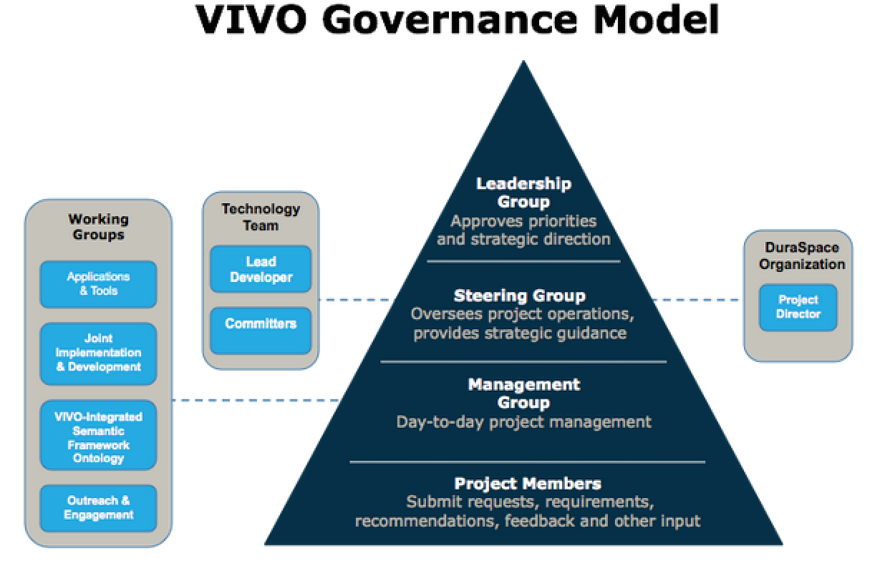

Slide 10
Pop Quiz
Question #4: Which of the following is not important project infrastructure:
  Wiki
  Issue tracker
  VIVO BBQ Ribs Cookbook
  Mailing lists
  Code repository

Slide 11
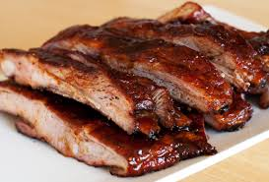
Answer Key
#4:
Notes:
Need a solid technical and communications infrastructure

Slide 12
Pop Quiz
Question #5: What is the ideal number of institutions contributing code to VIVO:
  One (Keep it simple!)
  Two (Two’s company, right?)
  Three (Nothing like a crowd of developers!)
  1024
  None of the above

Slide 13
Answer Key
#5: We don’t know either, but we think it’s somewhere between 3 and 1024.
A diverse group of committers is important for the health and longevity of the project!
Notes:
Diverse group of committers

Slide 14
Pop Quiz
Question #6: Which of the following services do VIVO Registered Service Providers not offer:
  VIVO Installs
  Full Implementation
  Customization
  Clean and Fold Laundry
  Integrations

Slide 15
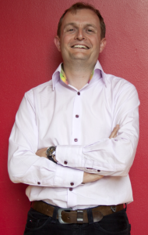
Answer Key
#6: Introducing Jonathan Breeze, CEO, Symplectic, who will answer this question.
Notes:
Service providers are important for project success

Slide 16
Pop Quiz
Question #7: Which of the following is not a VIVO expense:
Travel
Marketing Material
Payroll
Project Director
Legal fees
F. Fund raising
G. VIVO T-shirts
H. VIVO Light
Sabers
I. Bookkeeping
J. Web Site

Slide 17

Answer Key
#7: H. VIVO Light Sabers
(VIVO developers are Jedi but they are not yet licensed for light saber use.)

Slide 18
Pop Quiz
Question #8: Which of the following is not part of the business plan for VIVO revenue sources:
  VIVO Casino Nights
  Private & Government Grants
  Membership Fees
  Hosted services
  Managed Projects

Slide 19

Answer Key
#8: A. (And no bake sales either!)
Notes:
Projects need diverse revenue sources

Slide 20
On the subject of membership…
DuraSpace membership is new this year
DuraSpace members get organizational benefits plus VIVO governance rights
Institutions contributing > 0.5 FTE in-kind staff resources get governance rights too!
DuraSpace members can allocate their fees to the project of their choice.
Join us and support VIVO!!!

Slide 21
Pop Quiz
Question #9: Which of the following does VIVO not partner with:
  ORCID
  CASRAI
  Fedora Repository
  EuroCRIS
  ASPCA

Slide 22

Answer Key
#9: E. ASPCA (But never say never!)
Notes:
Partnerships and outreach are critical

Slide 23
Summary of VIVO Success Factors
Community ownership
Critical project roles are filled
Strategic direction
Representative governance
Diverse base of committers and contributors
Technology infrastructure
Registered Service Providers
Diverse revenue sources and in-kind contributions
Productive partnerships

Slide 24

Congratulations!

