Slide 1


Linked Data for Libraries
Jon Corson-Rikert and Dean B. Krafft
2014 VIVO Conference
August 7-8, 2013

Slide 2
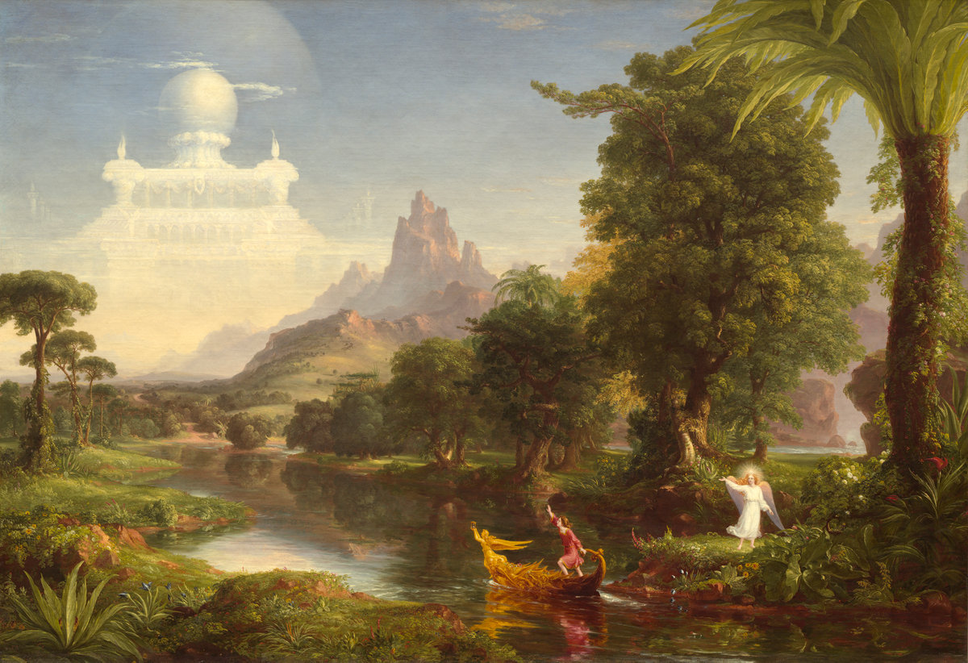
Vision: Create a LOD standard to exchange all that libraries know about their resources
Courtesy National Gallery of Art, Washington

Slide 3
Linked Data for Libraries (LD4L)
On December 5, 2013, the Andrew W. Mellon Foundation made a two-year $999K grant to Cornell, Harvard, and Stanford starting Jan ‘14
Partners will work together to develop an ontology and linked data sources that provide relationships, metadata, and broad context for Scholarly Information Resources
Leverages existing work by both the VIVO project and the Hydra Partnership

Slide 4
“The goal is to create a Scholarly Resource Semantic Information Store model that works both within individual institutions and through a coordinated, extensible network of Linked Open Data to capture the intellectual value that librarians and other domain experts add to information resources when they describe, annotate, organize, select, and use those resources, together with the social value evident from patterns of usage.”

Slide 5
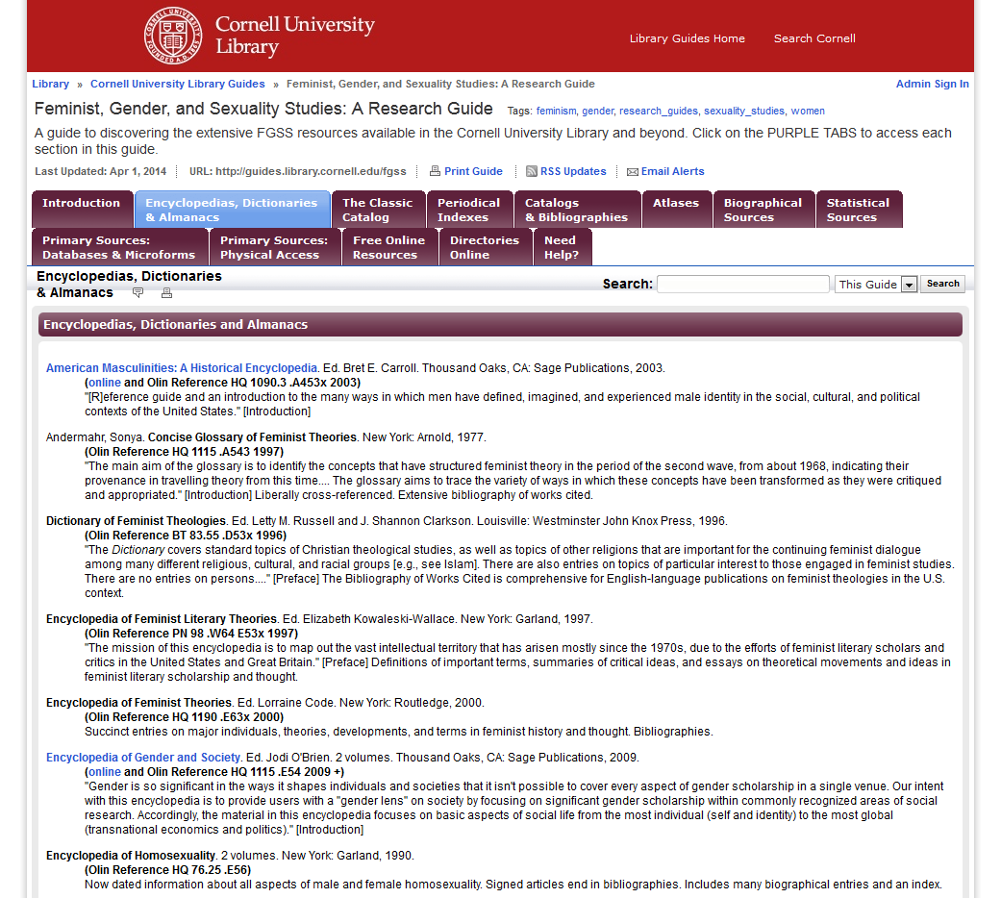
Notes:
This is an example of the type of librarian curated information we want to be able to capture, and to use to improve discovery within all the search and browse tools that the Library provides.

Slide 6
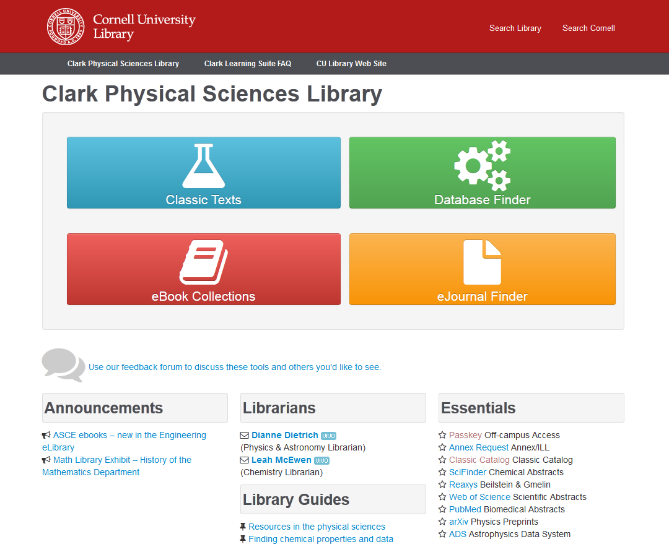
Notes:
We also want to be able to build hand-curated virtual collections for specialized disciplinary audiences

Slide 7
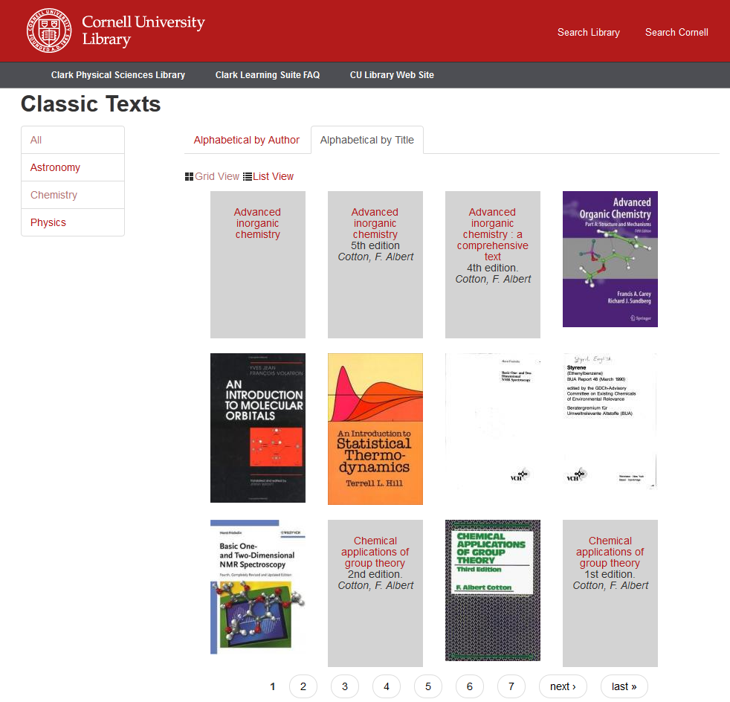

Slide 8
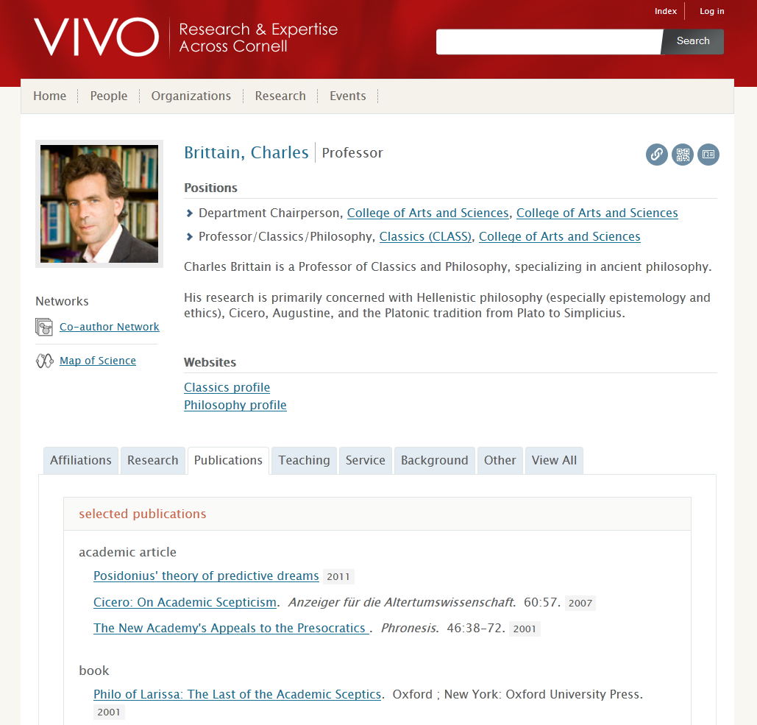
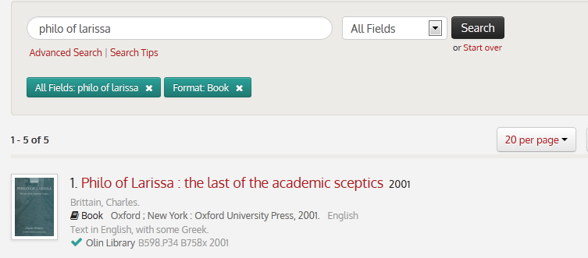

Slide 9
How LD4L builds on VIVO
The LD4L ontology will use components of the VIVO-ISF ontology
LD4L will use VIVO ontology design patterns
Vitro plus LD4L ontology will provide a basis for annotation tools and review of entity resolution and external resources identified through linked data
The multi-institution LD4L demonstration search will be an adaptation of VIVOsearch.org
LD4L will link to existing VIVO data

Slide 10

http://projecthydra.org
Hydra slides courtesy of Tom Cramer

Slide 11
What Is Hydra?
A robust repository fronted by feature-rich, tailored applications and workflows (“heads”)
One body, many heads
Collaboratively built “solution bundles” that can be adapted and modified to suit local needs.
A community of developers and adopters extending and enhancing the core
If you want to go fast, go alone. If you want to go far, go together.
Notes:
The only way to build a rich & robust solution is to engage a large community of developers. The only way to build a sustainable solution is to spur adoption by a community of institutions w/ vested interest in shared success.

Slide 12
A wide range of applications
ETD Deposit System
General Purpose Institutional Repository
Digitization Workflow System
Simple
Complex
Generally a single PDF
Simple, prescribed workflow
Streamlined UI for depositors, reviewers & readers
Heterogeneous file types
Simple to complex objects
One- or two-step workflow
General purpose user interfaces
Potentially hundreds of files type per object
Complex, branching workflow
Sophisticated operator (back office) interfaces
Notes:
A single application could not effectively cope with these three use cases; however any institution would want to safeguard the outputs of all these disparate systems in a digital repository for management and preservation. HYDRA gives a framework where ONE BODY (the repo) can support MULTIPLE HEADS (tailored applications)

Slide 13
Hydra Philosophy -- Technical
Tailored applications and workflows for different content types, contexts and user interactions
A common repository infrastructure
Flexible, atomistic data models
Modular, “Lego brick” services
Library of user interaction widgets
Easily skinned UI
One body, many heads

Slide 14
Technical Framework - Components
Fedora provides a durable repository layer to support object management and persistence
Solr, provides fast access to indexed information
Blacklight, a Ruby on Rails plugin that sits atop solr and provides faceted search & tailored views on objects
Hydra Head, a Ruby on Rails plugin that provides create, update and delete actions against Fedora objects

Slide 15
Major Hydra Components

Slide 16
How LD4L builds on Hydra
We will create an ActiveTriples Hydra component to mimic ActiveFedora
We will make it possible to use a TripleStore as a Hydra repository as well as Fedora
The new Cornell Blacklight/Solr-based search will index from Cornell’s triple-based LD4L store
We will explore using Hydra-based collections as data sources for LD4L data about resources

Slide 17

Provides model for access to library data
Includes access to ShelfRank for Harvard Library resources
Provides concrete example for creating an ontology for usage
Source data for Harvard LD4L instance

Slide 18
LD4L Use Cases
Currently have draft set of 12 use cases in 6 clusters on LD4L public wiki (https://wiki.duraspace.org/display/ld4l/)
Users include: faculty, student, dean, researcher, librarian, bibliographer, and cataloger
Use cases are driving the ontology development, MARC to BIBFRAME conversion, data source selection, and engineering work

Slide 19
Use Case Clusters
Bibliographic + curation data, e.g. create virtual collection, tag resources
Bibliographic + person data, e.g. see works authored by faculty who have taught a given course
Leveraging external data including authorities, e.g. search with geographic data
Leveraging the deeper graph (via queries or patterns), e.g. identify related works
Leveraging usage data, e.g. discovery guided by community usage
Three-site services, e.g. cross-site search

Slide 20
Identifying Data Sources
Bibliographic data: CUL/Harvard/SUL catalogs
Person data: VIVO, Stanford CAP, Profiles
Usage data: LibraryCloud, Cornell/Stanford circulation, BorrowDirect circulation
Collections: Archival EAD, IRs, SharedShelf, Olivia, arbitrary OAI-PMH
Annotations: Cornell CuLLR, Stanford DMS, Bloglinks, DBpedia, LibGuides
Subjects & Authorities

Slide 21
BIBFRAME
The Library of Congress (LoC) has developed the BIBFRAME ontology as an (eventual) replacement for MARC, the current cataloging standard for library resources
Both LoC and Zepheira, a contractor, have developed converters that produce BIBFRAME RDF from MARC XML
http://bibframe.org/

Slide 22
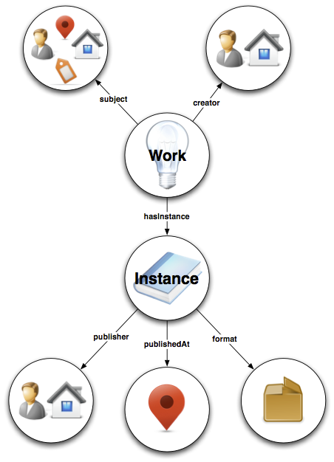
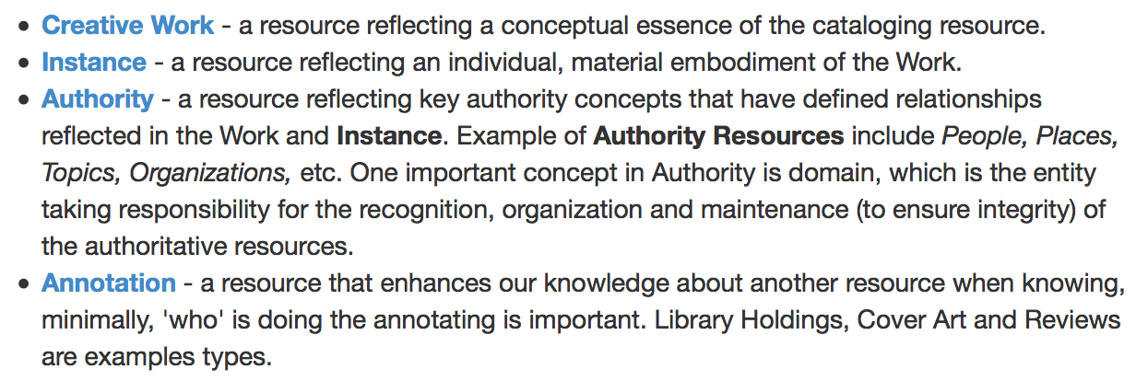
BIBFRAME basic entities and relationships
http://bibframe.org/vocab-model/

Slide 23
BIBFRAME Issues
LoC focus on capturing and representing MARC, not on connecting to LOD cloud
LoC converter is de-facto spec for MARC-> BIBFRAME, but requires pre/post-processing for full LOD interoperability
Zepheira converter does not do as complete a capture of MARC
LoC and Zepheira both still open to feedback on BIBFRAME; Stanford group providing a lot

Slide 24
Assembling the Ontology
Goal: connect library resources with other data on the Web
By using ontologies commonly found in linked data
By connecting with VIVO/CAP/Profiles information
By using persistent, stable local identifiers (URIs)
By linking stable local identifiers to global identifiers
By supporting annotations with provenance
By adding information on usage

Slide 25
Likely components of the LD4L Ontology
Library resources: BIBFRAME
Additional bibliographic types and partonomy relationships: FaBiO
People/Organizations: VIVO-ISF (includes FOAF)
Annotations: OpenAnnotation
Provenance: PROV-O, PAV
Licensing: Creative Commons; Dublin Core Terms; Software Ontology
Concepts: SKOS (or vocabularies such as Getty with stable URIs)
Many identifiers: VIAF, ORCID, ISNI

Slide 26
Connecting with the Schema.org world
The Schema.org community is gaining traction as a way to add lightweight structure to web pages
OCLC as a large library vendor has elected to represent their data as linked data using Schema.org (with some extensions)
LD4L will use BIBFRAME along with other ontologies internally and as linked data, but may embed Schema.org tags in web pages to facilitate interpretation by standard search engines

Slide 27
Adding identifiers
Translating MARC records into RDF will not in and of itself make useful linked data
Identifiers are essential
Local identifiers for statements made by an institution, both local authority information and annotation
Global identifiers for people, organizations, and places where they can be reliably determined
VIAF, ORCID for people
Evaluating Dbpedia for place linkages

Slide 28
Common identifiers for catalog records
OCLC functions as a union catalog using identifiers shared across institutions
In most cases the catalog records should be identical across libraries, with some local additions
Goal is to assign common URIs to bibliographic resources from Cornell, Harvard, and Stanford to support common search discover and interlinking
Annotations and usage information can then be compared across 3 institutions
If it can work for 3, it can work for many

Slide 29
OCLC linked data efforts
OCLC is also assigning unique URIs to the original works that bibliographic identifiers refer to
These URIs would enable much more powerful and deeper linking across multiple editions and derivatives
OCLC is also assigning stable URIs to LCSH subject headings
Typically multiple headings are used in combination to indicate genre, geography, and/or time period in addition to primary subject
Subject headings are also linked to stable URIs for FAST subject headings, a derivation of LCSH designed to support faceting
http://www.oclc.org/research/activities/fast.html?urlm=159754
Notes:
Of millions of possible combinations, OCLC mints URIs for the combinations observed in use

Slide 30
Fully functional linked data
Ideally all library catalog records will (eventually) refer to identified works, authors, organizations, places, and subject headings
Ideally all library catalog records will be joined with VIVO/CAP/Profiles data as a coherent, richer local authority picture
Ideally library catalog records will be interoperable with each other as linked data
Ideally library linked data will interoperate with any other linked data via common, global identifiers and shared ontologies

Slide 31
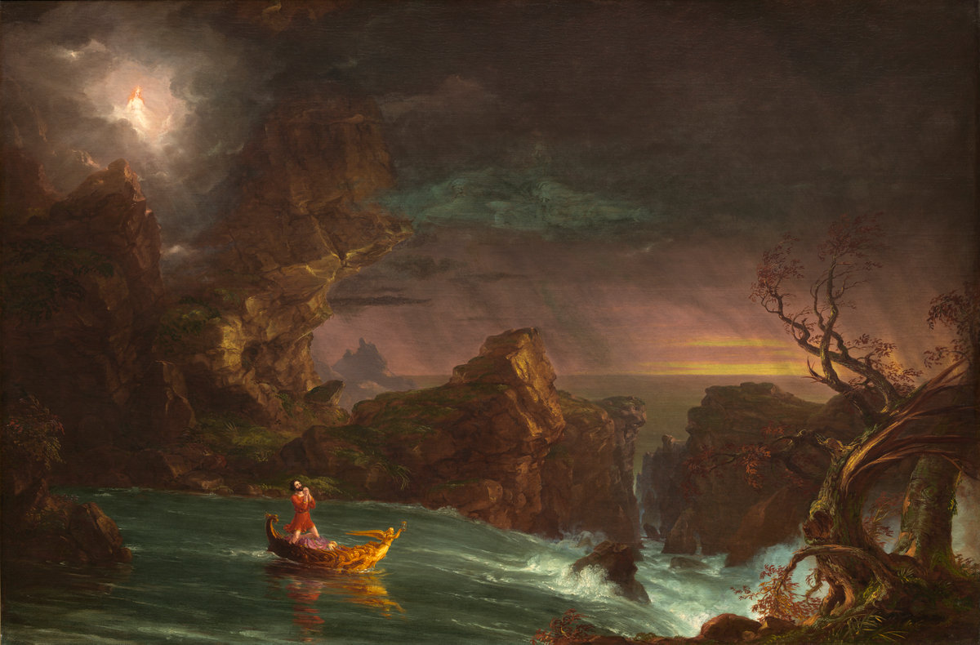
Current state of the LD4L project
Courtesy National Gallery of Art, Washington

Slide 32
Project timeline 2014
Jan-June 2014: Initial ontology design; identify data sources; identify external vocabularies; begin LD4L and Hydra ActiveTriples development
July-Dec 2014: Complete initial ontology; complete initial ActiveTriples development; pilot initial data ingests into Vitro-based LD4L instance at Cornell

Slide 33
Workshop – January 2015
Hold a two-day workshop for 25 attendees from 10-12 interested library, archive, and cultural memory institutions
Demonstrate initial prototypes of LD4L and ontology
Obtain feedback on initial ontology design
Obtain feedback on overall design and approach
Make connections to support participants in piloting this approach at their institutions
Understand how institutions see this approach fitting in with their own multi-institutional collaborations and existing cross-institutional efforts such as the Digital Public Library of America, VIVO, and SHARE

Slide 34
Project timeline Jan-June 2015
Pilot LD4L instances at Harvard and Stanford
Populate Cornell LD4L instance from multiple data sources including MARC catalog records, EAD finding aids, VIVO data, CuLLR, and local digital collections
Develop a test instance of the LD4L Search application harvesting RDF across the three partner institutions
Integrate LD4L with ActiveTriples

Slide 35
Project timeline July-Dec 2015
Implement fully functional LD4L instances at Cornell, Harvard, and Stanford
Public release of open source LD4L code and ontology
Public release of open source ActiveTriples Hydra Component
Create public demonstration of LD4L Search-based discovery and access system across the three LD4L instances

Slide 36
Project Outcomes
Open source extensible LD4L ontology compatible with VIVO ontology, BIBFRAME, and other existing library LOD efforts
Open source LD4L semantic editing, display, and discovery system
Project Hydra compatible interface to LD4L, using ActiveTriples to support Blacklight search across multiple LD4L instances

Slide 37
Questions?

