Slide 1
“Flavors” of Python

Slide 2
There are two main ways of writing Python code:
Interactive python
Instant results
Script
Type out instructions (code) then run it

Slide 3
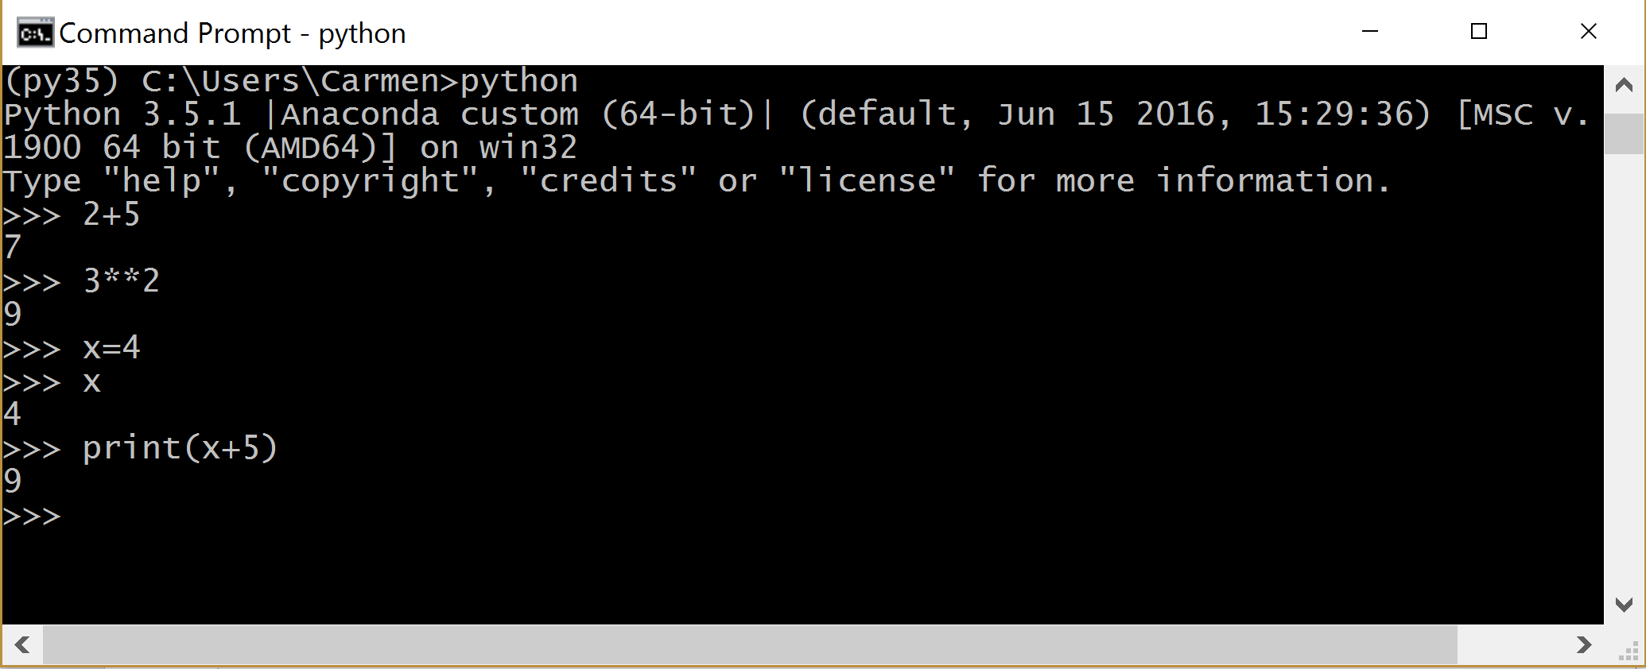
Running “python”

Slide 4
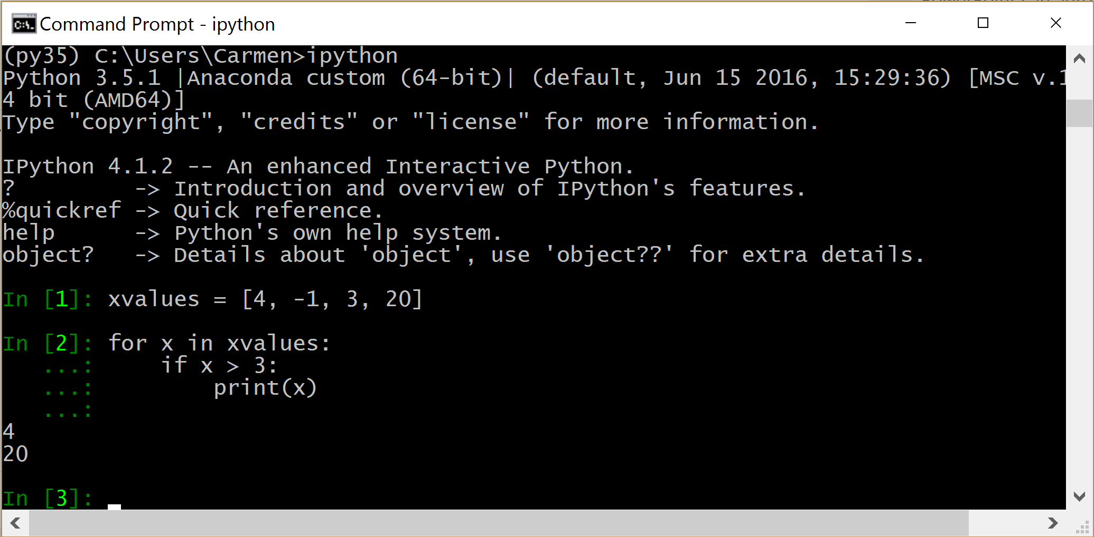
Running “ipython”

Slide 5
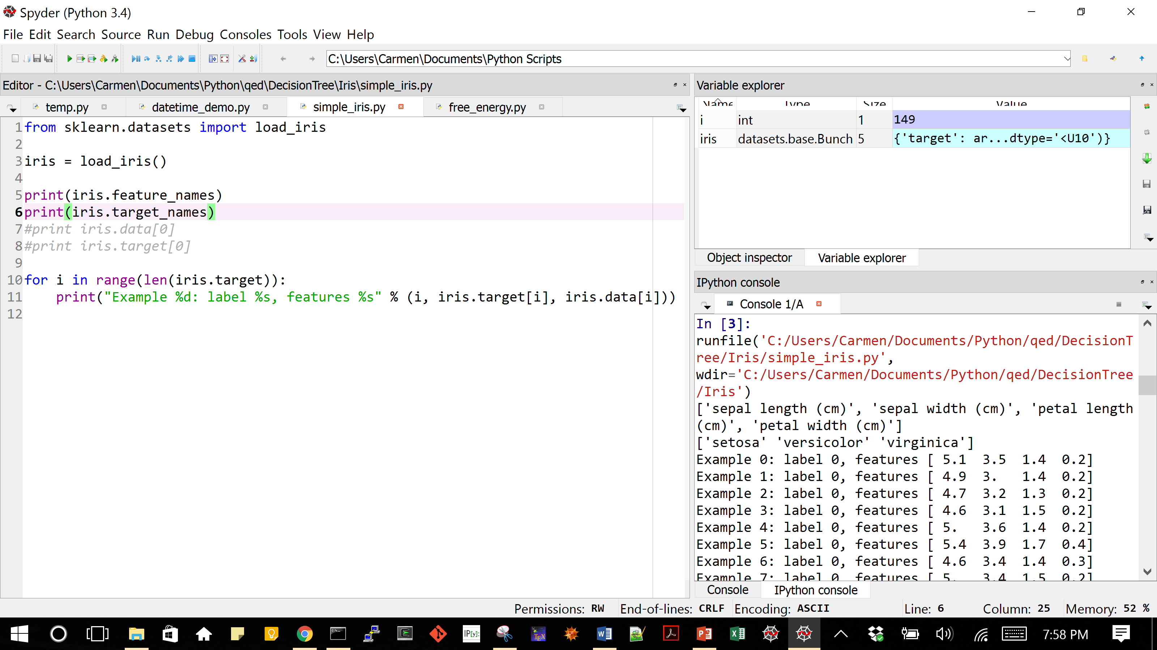
Spyder

Slide 6
Jupyter Notebook
Excellent for playing around
You can view code and its output together
Excellent for documentation
Can be saved in different formats

Slide 7
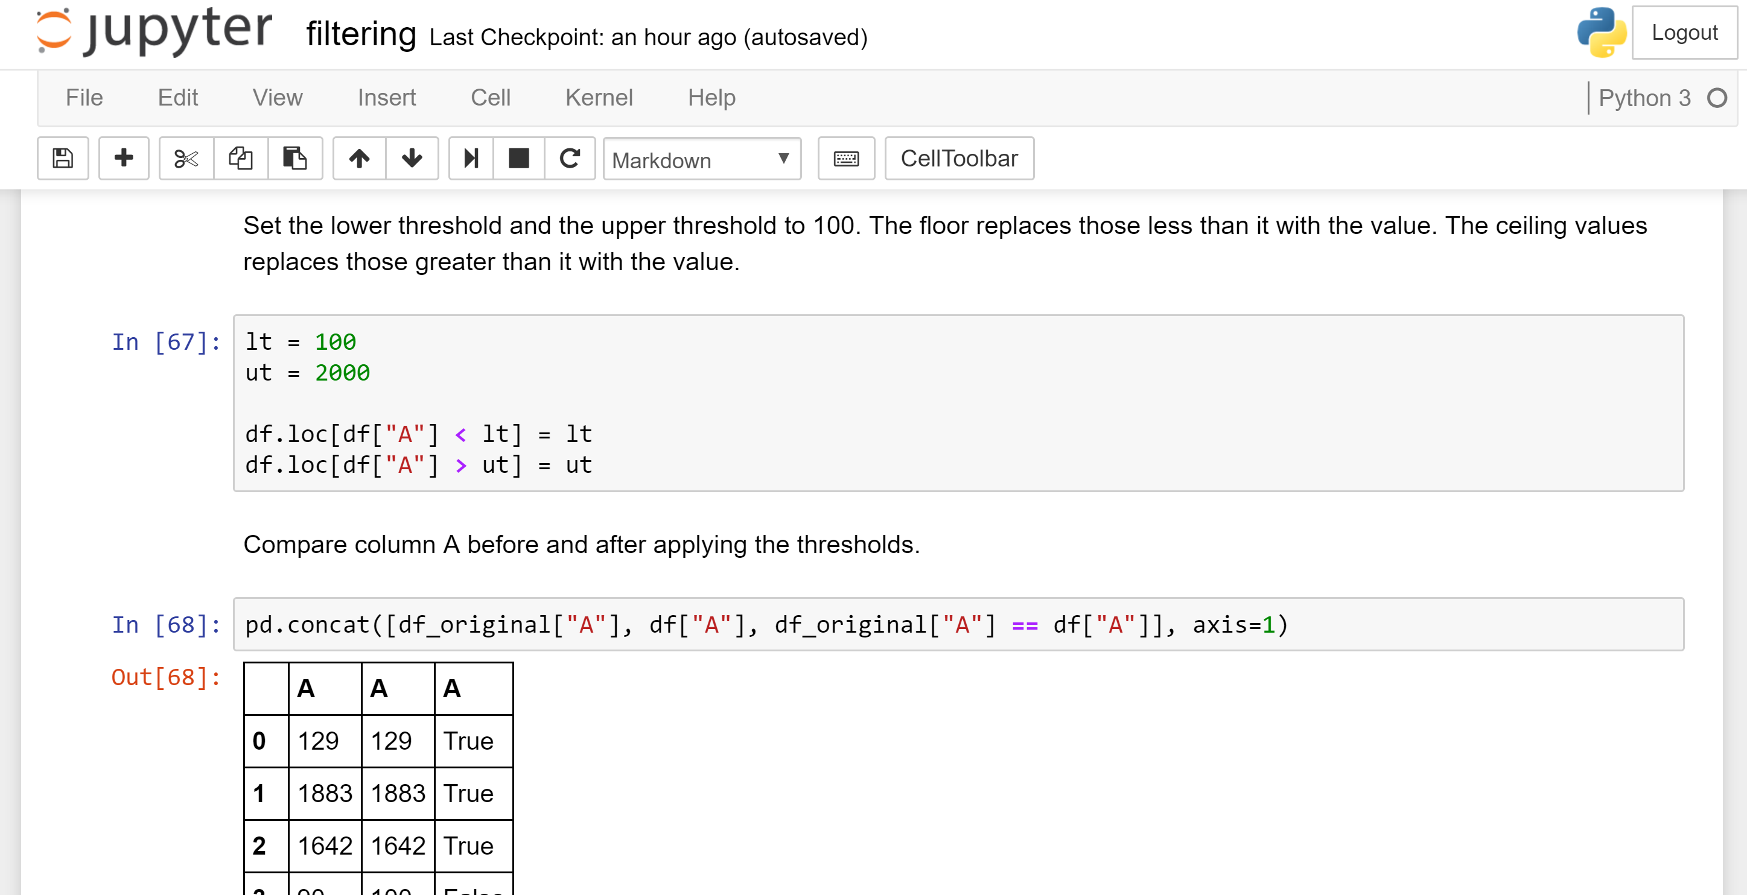

Slide 8
More on running a notebook
https://sites.google.com/a/jsums.edu/cwrightjsu/python/run-notebook

