Slide 1
FlexTensor: An Automatic Schedule Exploration and Optimization Framework for Tensor Computation on Heterogeneous System
Transformer计算优化组第4次汇报
报告人：陈宇童
小组成员：陈兴焱 陈宇童 侯皓文

Slide 2
目录
论文信息
论文内容
拓展
综合分析
小组进展汇报

Slide 3
论文信息

Slide 4
论文信息
1. 标题 ：FlexTensor: An Automatic Schedule Exploration and Optimization Framework for Tensor Computation on Heterogeneous System
2. 作者 ：Size Zheng, Yun Liang, Shuo Wang, Renze Chen, Carlos Guestrin, Arvind Krishnamurthy
3. 刊物/会议：ASPLOS
4. 时间：2020年
5. 单位：北京大学

Slide 5
论文内容

Slide 6
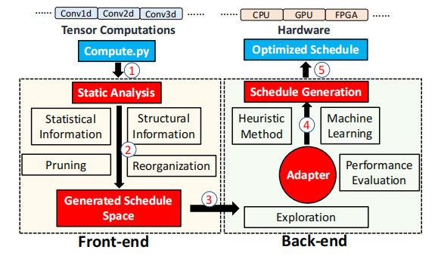
论文内容-Overview
What is FlexTensor
A schedule exploration and optimization framework for tensor computation on heterogeneous
systems
The Front-end & The Back-end
a template-free, fully-automatic
framework without human interference

Slide 7
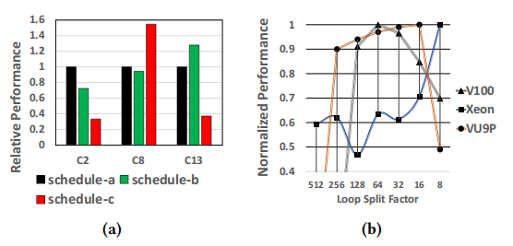
论文内容-Overview
What is FlexTensor for
different combinations of schedule primitives lead to
different performance
the hardware heterogeneity further adds
complexity
Traditional implementation of these
tensor computations is very difficult to program and takes a long time to develop

Slide 8
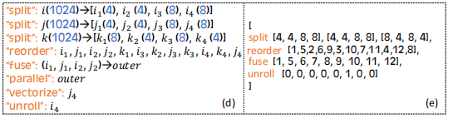
论文内容- Front-end Analysis and Schedule Space
Schedule Space Generation
Each point in the schedule space is encoded using a vector, and each value in the vector represents a specific choice of primitive or parameter.

Slide 9
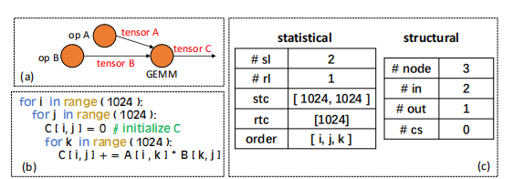
论文内容- Front-end Analysis and Schedule Space
Static Analysis
Statistical information
#sl #rl stc rtc order
Structural information
#node #in #out #cs

Slide 10
论文内容- Front-end Analysis and Schedule Space
Schedule Space Generation
Prune
limit the depth of primitives combination;
prune the parameter space
pre-determine certain decisions for different hardware
After pruning，rearrange the schedule space for the subsequent exploration

Slide 11
论文内容-Back-end Exploration and Optimization
Exploration with Heuristics and Machine learning
Heuristic Method - simulated annealing - schedule space
Machine Learning Method - Q-Learning - find the best

Slide 12
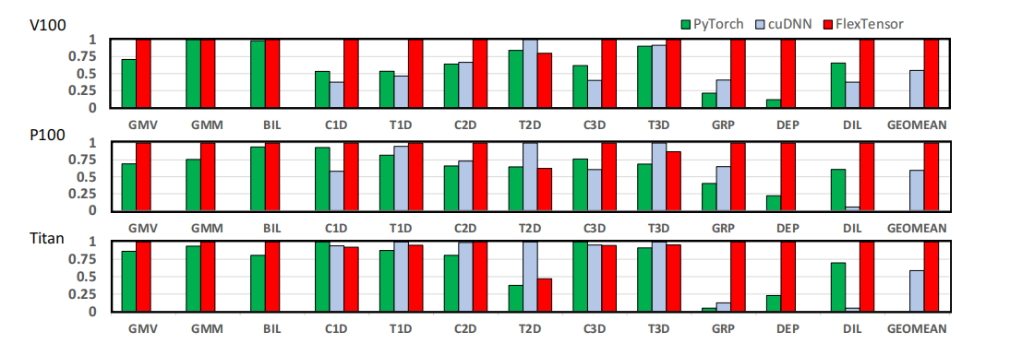
论文内容-Evaluation
the Winograd algorithm

Slide 13
论文内容-Evaluation
the Winograd algorithm

Slide 14
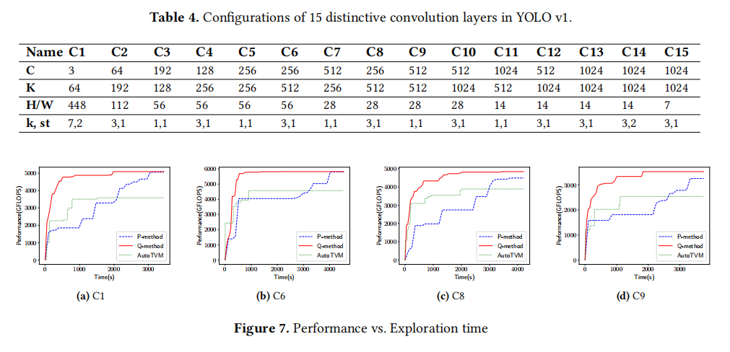
论文内容-Evaluation

Slide 15
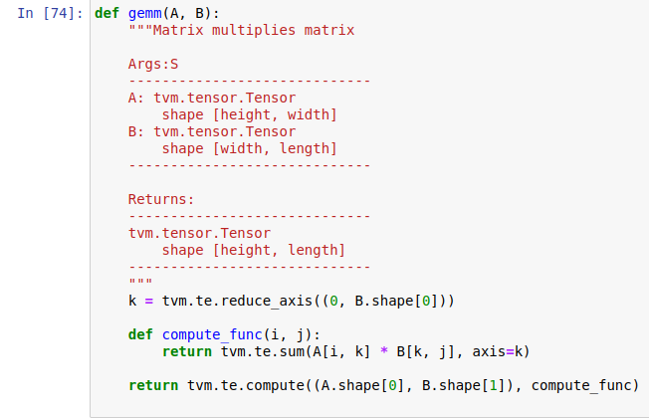

拓展-Example

Slide 16
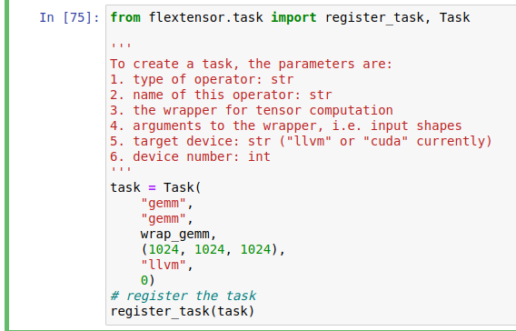
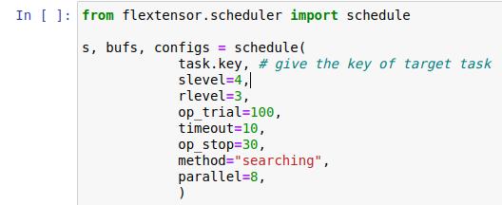
拓展-Example

Slide 17
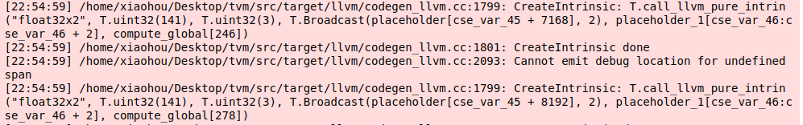
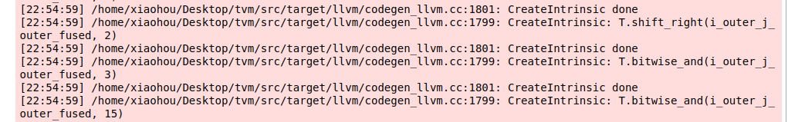
拓展-Example

Slide 18
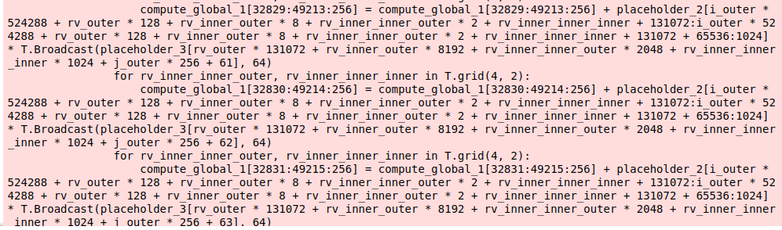
拓展-Example

Slide 19
拓展-AutoTVM
@autotvm.template("tutorial/matmul_v1") # 1. use a decorator
def matmul_v1(N, L, M, dtype):
A = te.placeholder((N, L), name='A', dtype=dtype)
B = te.placeholder((L, M), name='B', dtype=dtype)
k = te.reduce_axis((0, L), name='k')
C = te.compute((N, M), lambda i, j: te.sum(A[i, k] * B[k, j], axis=k), name='C')
s = te.create_schedule(C.op)
# schedule
y, x = s[C].op.axis
k = s[C].op.reduce_axis[0]
# 2. get the config object
cfg = autotvm.get_config()
# 3. define search space
cfg.define_knob("tile_y", [1, 2, 4, 8, 16])
cfg.define_knob("tile_x", [1, 2, 4, 8, 16])
# 4. schedule according to config
yo, yi = s[C].split(y, cfg['tile_y'].val)
xo, xi = s[C].split(x, cfg['tile_x'].val)
s[C].reorder(yo, xo, k, yi, xi)
return s, [A, B, C]
Define the search space
def matmul_v0(N, L, M, dtype):
A = te.placeholder((N, L), name='A', dtype=dtype)
B = te.placeholder((L, M), name='B', dtype=dtype)
k = te.reduce_axis((0, L), name='k')
C = te.compute((N, M), lambda i, j: te.sum(A[i, k] * B[k, j], axis=k), name='C')
s = te.create_schedule(C.op)
# schedule
y, x = s[C].op.axis
k = s[C].op.reduce_axis[0]
yo, yi = s[C].split(y, 8)
xo, xi = s[C].split(x, 8)
s[C].reorder(yo, xo, k, yi, xi)
return s, [A, B, C]
cfg = autotvm.get_config()
cfg.define_split("tile_y", y, num_outputs=2)
cfg.define_split("tile_x", x, num_outputs=2)

Slide 20
拓展-AutoTVM
@autotvm.template("tutorial/matmul_v1") # 1. use a decorator
def matmul_v1(N, L, M, dtype):
A = te.placeholder((N, L), name='A', dtype=dtype)
B = te.placeholder((L, M), name='B', dtype=dtype)
k = te.reduce_axis((0, L), name='k')
C = te.compute((N, M), lambda i, j: te.sum(A[i, k] * B[k, j], axis=k), name='C')
s = te.create_schedule(C.op)
# schedule
y, x = s[C].op.axis
k = s[C].op.reduce_axis[0]
# 2. get the config object
cfg = autotvm.get_config()
# 3. define search space
cfg.define_knob("tile_y", [1, 2, 4, 8, 16])
cfg.define_knob("tile_x", [1, 2, 4, 8, 16])
# 4. schedule according to config
yo, yi = s[C].split(y, cfg['tile_y'].val)
xo, xi = s[C].split(x, cfg['tile_x'].val)
s[C].reorder(yo, xo, k, yi, xi)
return s, [A, B, C]
Define the search space
def matmul_v0(N, L, M, dtype):
A = te.placeholder((N, L), name='A', dtype=dtype)
B = te.placeholder((L, M), name='B', dtype=dtype)
k = te.reduce_axis((0, L), name='k')
C = te.compute((N, M), lambda i, j: te.sum(A[i, k] * B[k, j], axis=k), name='C')
s = te.create_schedule(C.op)
# schedule
y, x = s[C].op.axis
k = s[C].op.reduce_axis[0]
yo, yi = s[C].split(y, 8)
xo, xi = s[C].split(x, 8)
s[C].reorder(yo, xo, k, yi, xi)
return s, [A, B, C]
cfg = autotvm.get_config()
cfg.define_split("tile_y", y, num_outputs=2)
cfg.define_split("tile_x", x, num_outputs=2)

Slide 21
拓展-AutoTVM
# logging config (for printing tuning log to the screen)
logging.getLogger('autotvm').setLevel(logging.DEBUG)
logging.getLogger('autotvm').addHandler(logging.StreamHandler(sys.stdout))
# There are two steps for measuring a config: build and run.
# By default, we use all CPU cores to compile program. Then measure them sequentially.
# We measure 5 times and take average to reduce variance.
measure_option = autotvm.measure_option(
builder='local',
runner=autotvm.LocalRunner(number=5))
# Begin tuning with RandomTuner, log records to file `matmul.log`
# You can use alternatives like XGBTuner.
tuner = autotvm.tuner.RandomTuner(task)
tuner.tune(n_trial=10,
measure_option=measure_option,
callbacks=[autotvm.callback.log_to_file('matmul.log')])
Define the search space
RandomTuner 随机顺序枚举
GridSearchTuner 网格搜索（<1000)
GATuner 遗传算法搜索
XGBTuner 训练一个XGBoost模型来预测，并根据结果选下一批(10^9，CUDA GPU上一个conv2d算子的空间大小)

Slide 22
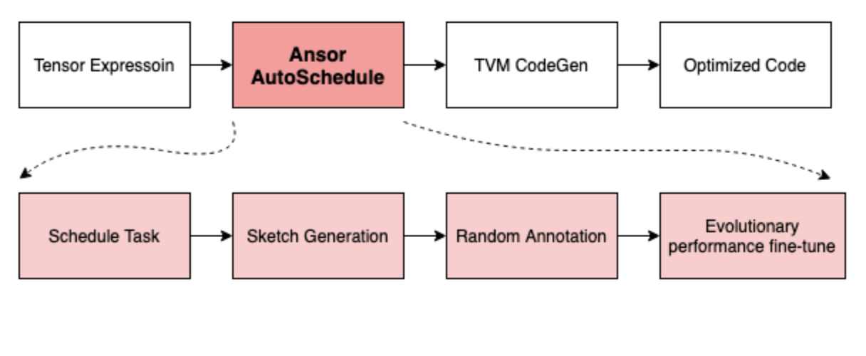
拓展-Ansor

Slide 23
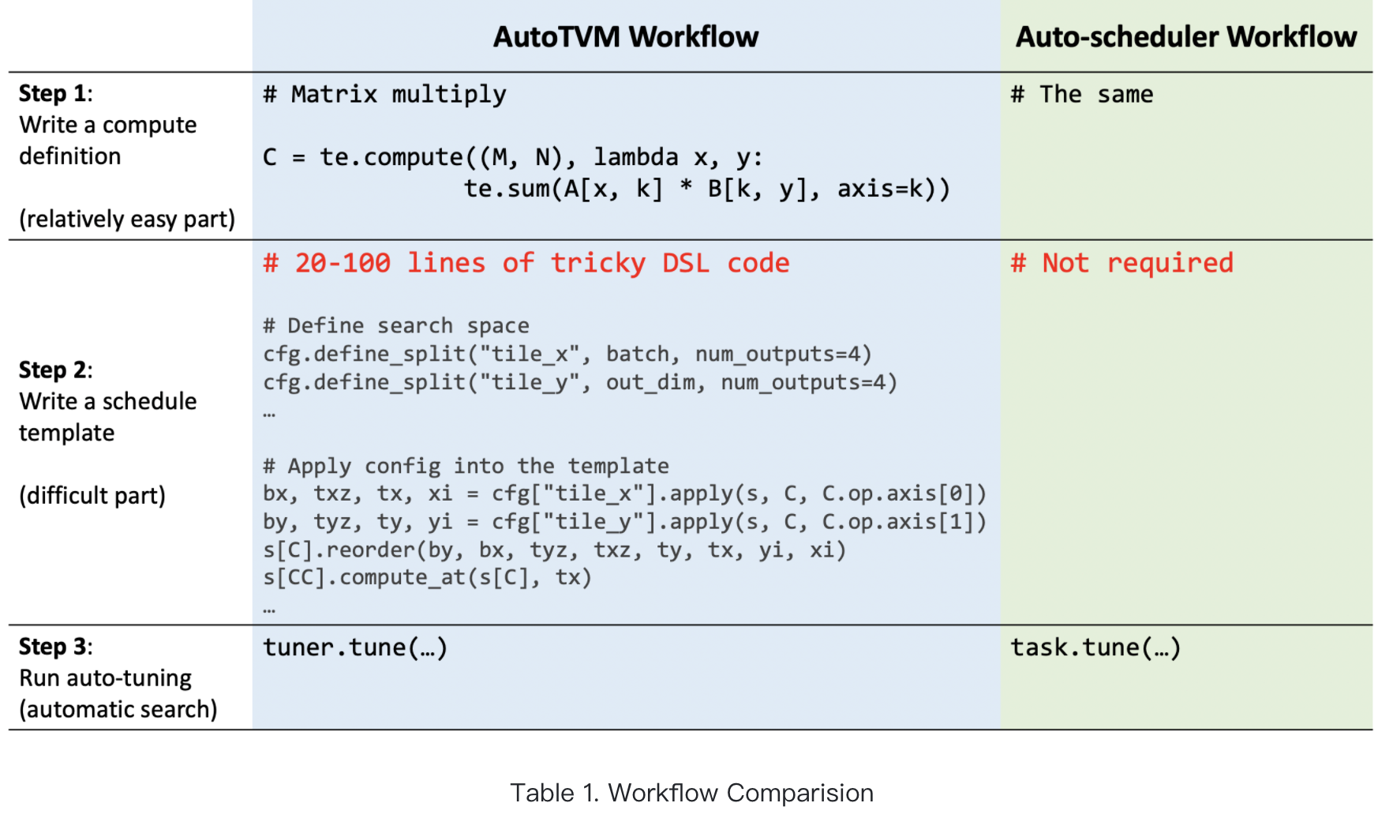
扩展-Ansor

Slide 24
组内进展

Slide 25
组内进展
陈兴焱：
阅读tvm源代码：
- 理解tvm中C++与python代码互相调用的ffi机制，修改tvm C++源代码，成功反映到python端调用
- 理解tvm中的类间关系，理解各种operation类，初步理解schedule类
阅读 FlexTensor、AMOS
陈宇童：
完成FlexTensor环境配置，完成相关实验
阅读autotvm、Ansor等论文进行对比
完成MLC tutorial
侯皓文：
写作业做实验考试
读论文amos flextensor tanent等

Slide 26
后续工作安排
TVM源代码阅读以及调用路线分析
开始阶段性任务——尝试实现部分transformer算子

Slide 27
感谢观看
创寰宇学府 育天下英才
报告人 陈宇童

