Slide 1

Final Project: Uber/Lyft Dataset
DS160 – Introduction to Data Science
December 10, 2025
Chris Myhre

Slide 2
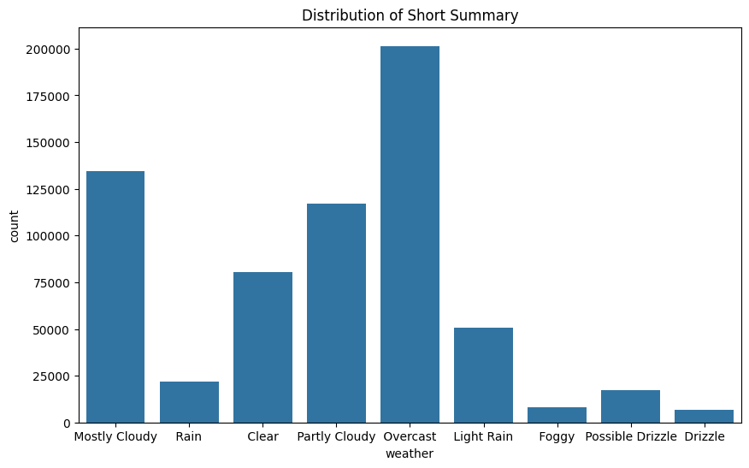
Dataset Summary
Source: Kaggle
Dimensions: 57 columns, 693,071 rows
Dropped unnecessary columns
Dropped NA rows (8% of data)

Slide 3



Research Question
Is price influenced by weather?
Is their any correlation between demand and weather?

Slide 4
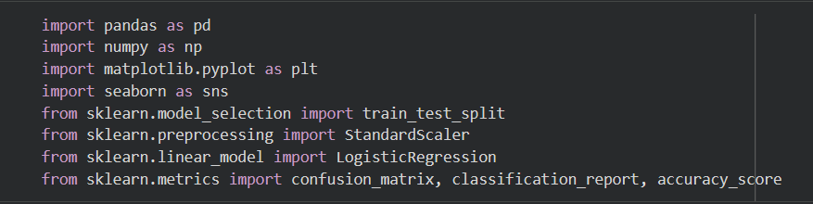

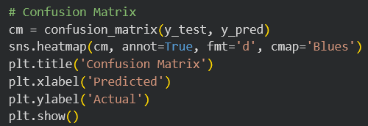
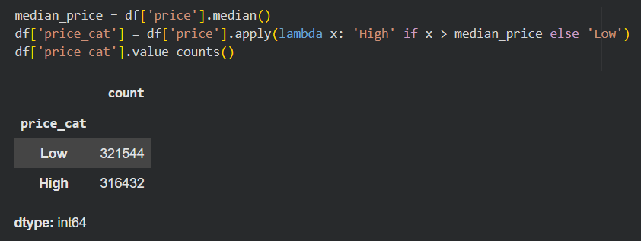


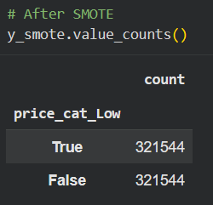
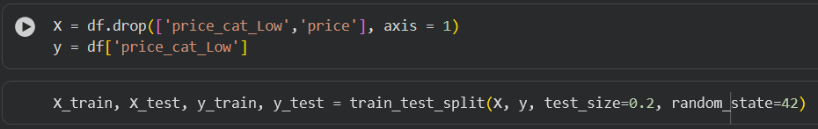
Python EDA

Slide 5
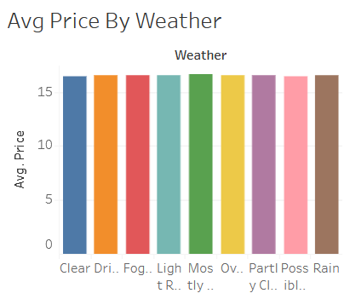
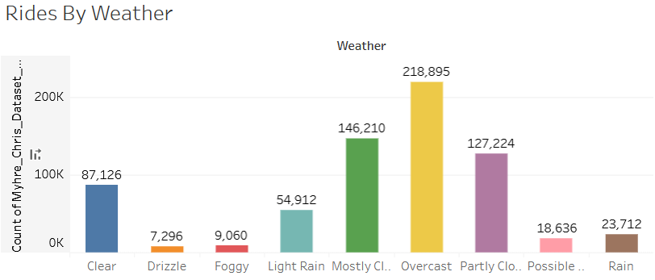
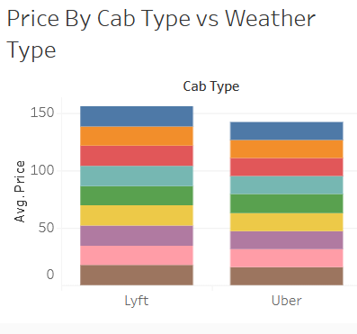
Tableau Worksheets

Slide 6
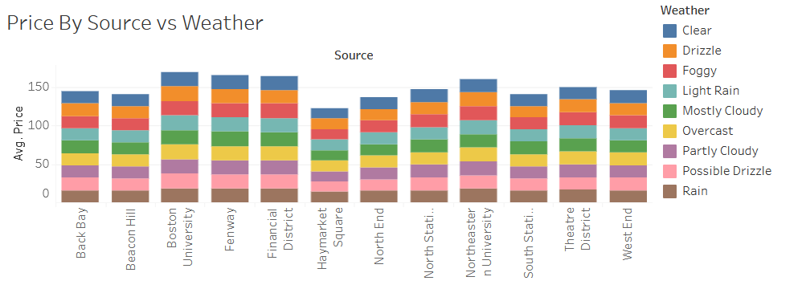
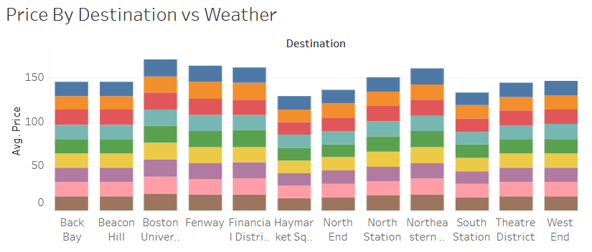
Tableau Worksheets

Slide 7
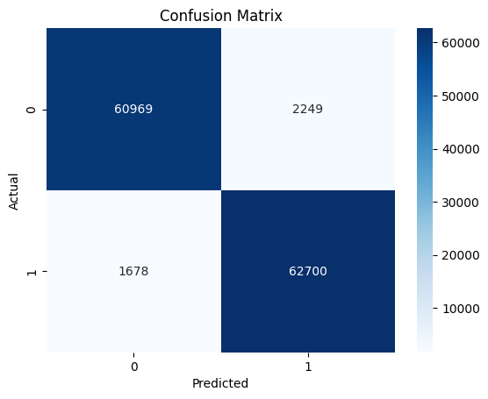
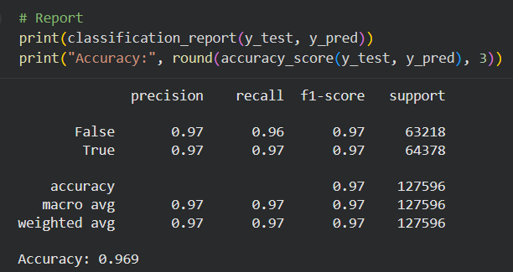
Confusion Matric and Metrics

Slide 8
Key Insights
Weather has not influence on demand
Weather has no influence on Uber/Lyft prices
Only a minority of rides were ordered on rainy days

Slide 9


Conclusion
Overall Accuracy: 96.92%
Improvements:
Different Dataset
Train Model Locally

