Slide 1

Coursera Capstone
The Battle of Neighborhoods Final Assignment
Conor Zimmerman

Slide 2
Business Problem
To the stakeholders of a national grocery store chain.
Which neighborhoods in and around Pittsburgh, PA could be considered suitable locations to host a new grocery store?
To solve this, we will focus on the variety of existing venues within Pittsburgh’s neighborhoods, their respective locations in the area, and how these neighborhoods compare.

Slide 3
Data
Allegheny Zip Codes Mapping Data
Sourced from Pennsylvania Spatial Data Access (PASDA)
ZIP, Neighborhood, Longitude, Latitude
FourSquare Places API
Most common venues found within a 500m radius of each neighborhood.

Slide 4
Clustering
K-means Clustering
96 clustered Pittsburgh neighborhoods
7 distinct clusters
Based on Top 10 Most Common venue types within each neighborhood.

Slide 5
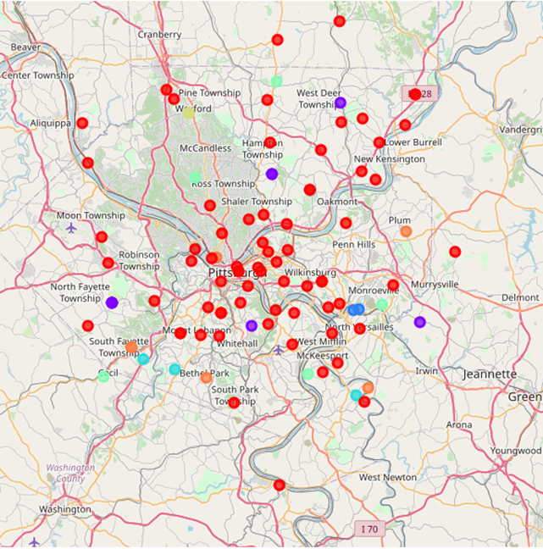
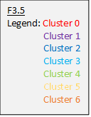
Mapping

Slide 6
Cluster 1
Construction and Landscaping (Most Common)
Flower Shops, Farms, Farmer’s Markets
15276 | PITTSBURGH
15126 | IMPERIAL
15075 | RURAL RIDGE
15116 | GLENSHAW
15231 | PITTSBURGH
15071 | OAKDALE
15085 | TRAFFORD
15227 | PITTSBURGH

Slide 7
Cluster 4
Restaurants (Most Common)
Farms, Farmer’s Markets
15140 | PITCAIRN
15045 | GLASSPORT
15237 | PITTSBURGH
15007 | BAKERSTOWN
15321 | CECIL

Slide 8
Cluster 6
Baseball Fields (Most Common)
Parks, Event Spaces, Restaurants
15057 | MC DONALD
15239 | PITTSBURGH
15064 | MORGAN
15290 | PITTSBURGH
15047 | GREENOCK
15102 | BETHEL PARK

Slide 9
Suggestions
Cluster 1
Ongoing development, Centralization of pre-existing services
Cluster 4
Opportunity to provide new service to area
Cluster 6
Family-based population, High activity

Slide 10
Conclusion
Results
Reduction of initial dataset by 80%
19 suitable neighborhoods
Additional data for further study
Pittsburgh Townships and Boroughs
Pittsburgh Economics and Demographics
Pre-existing Grocery locations

