Slide 1
Caffeine
in Theory Driven Approaches to Cognitive Enhancement (book download: shorturl.at/vOW56)
Presented by Can Sozuer

Slide 2
After this talk…
How much caffeine should I take (on a daily basis)?
“I can’t start my day without a cup of coffee”
I don’t use caffeine regularly, can I take it to enhance my performance during finals season?
I use caffeine regularly, does that make me smarter?
Should I tell my caffeine-addicted aunt to stop drinking coffee?

Slide 3
Caffeine Trivia
Caffeine Metabolism is a function of…
Absorbed <~45min after oral administration
Peak blood levels in 15-120min
European Food Safety Authority recommends max 400mg/day
Works by blocking adenosine receptors (aka. is an antagonist)
Metabolism rate
Age
Previous caffeine use
Umbrella terms → caffeine naivety, caffeine sensitivity

Slide 4
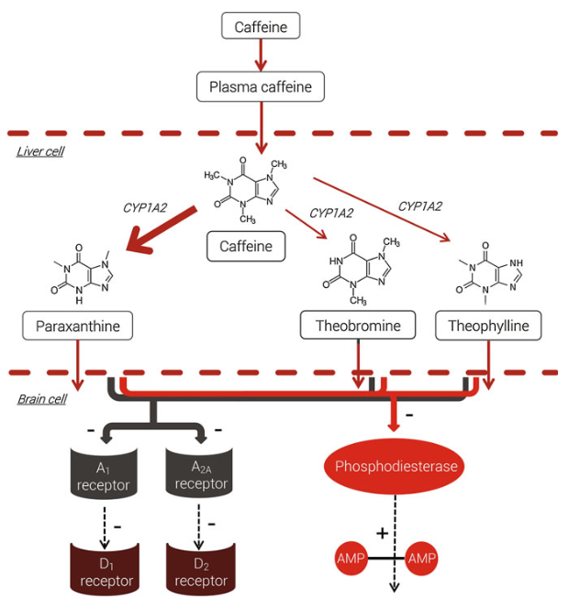
Mechanism*
Caffeine doesn’t bind to membrane receptors
A_2A and D_1 and D_2 receptors are both high in dopamine rich areas.
At >500mg doses intracellular calcium are mobilized and phosphodiesterases are inhibited
cAMP levels increase

Slide 5
Mechanism*
Caffeine doesn’t bind to membrane receptors
A_2A and D_1 and D_2 receptors are both high in dopamine rich areas.
At >500mg doses intracellular calcium are mobilized and phosphodiesterases are inhibited
cAMP levels increase

Slide 6
Mechanism*
Caffeine doesn’t bind to membrane receptors
A_2A and D_1 and D_2 receptors are both high in dopamine rich areas.
At >500mg doses intracellular calcium are mobilized and phosphodiesterases are inhibited
cAMP levels increase

Slide 7
Acetylcholine
Adenosine receptor activation blocks
Dopamine
Norepinephrine
Serotonin

Slide 8
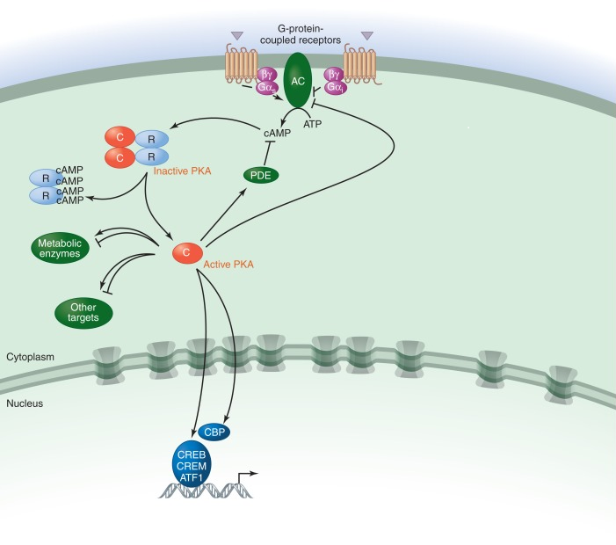
cAMP Pathway
Mixed results of caffeine on memory
Unintentional learning benefits more in humans
Memory retention but not acquisition benefits in rodents
Sassone-Corsi, P. (2012). The cyclic AMP pathway. Cold Spring Harbor Perspectives in Biology, 4(12). https://doi.org/10.1101/cshperspect.a011148

Slide 9
Short Term Effects
Withdrawal reversal hypothesis of caffeine
Withdrawal symptoms:
  Headache
  Fatigue
  decreased energy and alertness
  depressed mood
“there are no net benefits of caffeine consumption, but rather that caffeine consumption after overnight abstention brings regular users back to their performance and energy baseline”
Conflicting results?

Slide 10
Short Term Effects
Richardson et al. 1995
Haskell et al. 2005
>200mg/day = regular users
<15mg/day = non-users
Max use = 1000mg/day
70 or 250mg doses
Finds negative effect of withdrawal reversal
>50mg/day = regular users (mean = 217mg/day)
<50mg/day = non-users (mean = 20mg/day)
Regular users: 60-800mg/day
Max use = 800mg/day
75 or 150 mg doses
Does not find effect of withdrawal reversal

Slide 11
Short Term Effects 2
Smit and Rogers, 2020
Haskell et al. 2005
>200mg/day = high consumers
<100mg/day = low consumers
12.5, 25, 50 and 100 mg caffeine
Finds POSITIVE effect of withdrawal reversal
>50mg/day = regular users (mean = 217mg/day)
<50mg/day = non-users (mean = 20mg/day)
Regular users: 60-800mg/day
Max use = 800mg/day
75 or 150 mg doses
Does not find effect of withdrawal reversal

Slide 12
Short Term Effects 3
Smit and Rogers, 2020
Questions to ask
>200mg/day = high consumers
<100mg/day = low consumers
12.5, 25, 50 and 100 mg caffeine
Finds POSITIVE effect of withdrawal reversal
Is there a monotonic correlation between caffeine and some measure?
Can we assume it for all values of some independent variable?
Can we assume it for all values of some third variable?
Can we assume a constant rate of increase?

Slide 13
Regular Users
Possible confounds:
  Mood
  Expectancy in the morning
"it is difﬁcult to determine whether improved performance is a consequence of changes in expectancy, alertness, and mood, reversal of withdrawal symptoms, or the caffeine"
Stronger effects at low alertness, low expectancy

Slide 14
Non-Users (<300mg/week = <43mg/day)
A term with less variation, I hope
Large increases on (Childs and De Wit, 2006)
Physiological:
  Blood pressure
  Feelings of arousal
And psychological measures:
  Positive mood
  Attention
Doses ? 0, 50, 150, 450mg

Slide 15
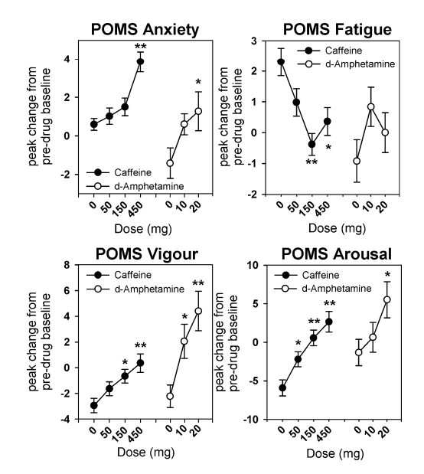
<43mg/day (Childs and De Wit, 2006)
Mostly monotonic changes
Somewhat logarithmic changes
Increased:
Anxiety
Fatigue
POMS Vigor
POMS Arousal

Slide 16
<43mg/day (Childs and De Wit, 2006)
Mostly monotonic changes
Somewhat logarithmic changes
Increased:
Anxiety
Fatigue
POMS Vigor
POMS Arousal

Slide 17
<43mg/day (Childs and De Wit, 2006)
Mostly monotonic changes
Somewhat logarithmic changes
Increased:
Anxiety
Fatigue
POMS Vigor
POMS Arousal

Slide 18
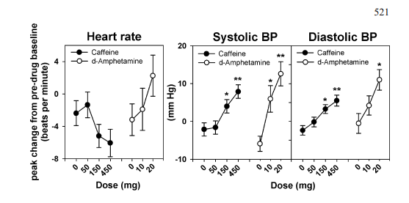
<43mg/day (Childs and De Wit, 2006)
Mostly monotonic changes
Somewhat logarithmic changes
Increasing blood pressure
Decreasing heart rate

Slide 19
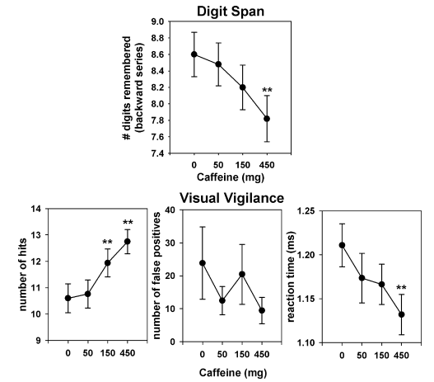
<43mg/day (Childs and De Wit, 2006)
Mostly monotonic changes
Somewhat logarithmic changes
Increasing visual vigilance
Decreasing WM capacity

Slide 20
Non-Users (?) (Haskell et al. 2005)
>50mg/day = regular users (mean = 217mg/day)
<50mg/day = non-users (mean = 20mg/day)
Regular users: 60-800mg/day
Max use = 800mg/day
75 or 150 mg doses
Does not find effect of withdrawal reversal
Finds cognitive improvements
  performance on digit vigilance accuracy and reaction time
  Working memory reaction time
  sentence veriﬁcation accuracy
Finds physiological changes
  Reduced mental fatigue

Slide 21
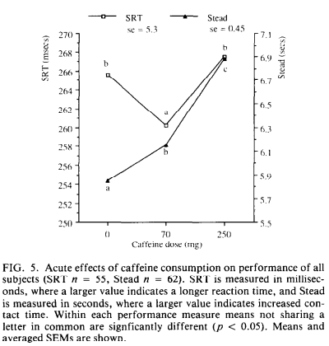
Non-Users (Richardson et al. 1995)
The chapter does not mention this paper in 'non-users'
Did not differentiate between <15mg/day and >200mg/day users in their analysis of their performance measures.

Slide 22
Short Term Effects
Richardson et al. 1995
Haskell et al. 2005
>200mg/day = regular users
<15mg/day = non-users
Max use = 1000mg/day
70 or 250mg doses
Finds negative effect of withdrawal reversal
>50mg/day = regular users (mean = 217mg/day)
<50mg/day = non-users (mean = 20mg/day)
Regular users: 60-800mg/day
Max use = 800mg/day
75 or 150 mg doses
Does not find effect of withdrawal reversal

Slide 23
Non-Users (Richardson et al. 1995)
The chapter does not mention this paper in 'non-users'
Did not differentiate between <15mg/day and >200mg/day users in their analysis of their performance measures.

Slide 24
Long Term Effects of Caffeine
Moderate long-term intake can reduce the risk of cognitive decline, dementia, and Alzheimer's disease
Caffeine use reduces late life cognitive decline for women only
This disappears when adjusted for:
  Age
  intelligent quotient score
  social class
Vague evidence for reducing cognitive decline, too much noise in the form of ^ and lifestyle and gender

Slide 25
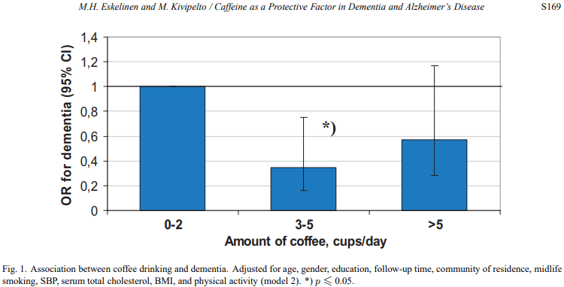
Long Term Effects
Eskelinen and Kivipelto, 2010
Longitudinal
Correlational

Slide 26
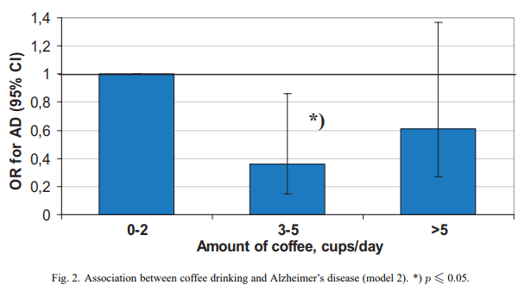
Long Term Effects
Eskelinen and Kivipelto, 2010
Longitudinal
Correlational

Slide 27
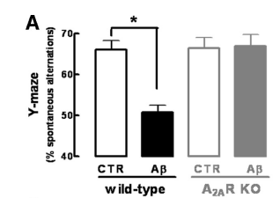
Long Term Effects (Canas et al. 2009)
Why would caffeine protect against Alzheimer's disease?
A few reasons:
  Adenosine receptor blockade protects against AD in mice
  protects synaptic transmission
  prevents neuron death

Slide 28
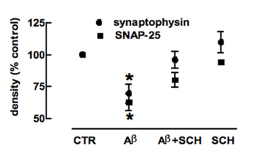
Long Term Effects (Canas et al. 2009)
Why would caffeine protect against Alzheimer's disease?
A few reasons:
  Adenosine receptor blockade protects against AD in mice
  protects synaptic transmission
  prevents neuron death

Slide 29
Caffeine
in Theory Driven Approaches to Cognitive Enhancement (book download: shorturl.at/vOW56)
Presented by Can Sozuer

